Slide 1

Example
Mapping and Challenges
Tanzania stakeholder meeting
Nov 2016

Slide 2
ART DELIVERY

Slide 3
1. Desk review

Slide 4
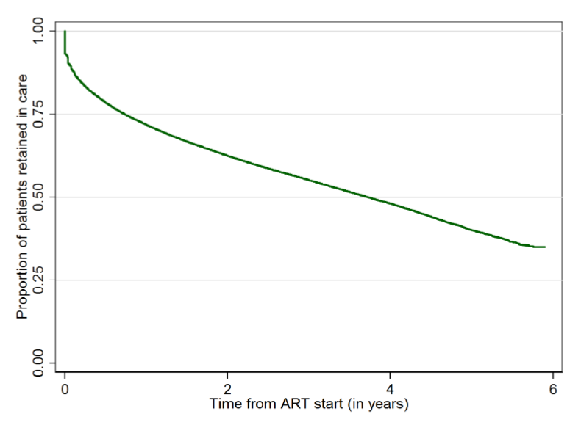
Retention on ART 2009-2014
Data from
6 regions
41 countries
304,000 patients
Retention worse for
Men
Children & adolescents
By 6 years only 1/3 remain on treatment
Source: IeDEA-WHO 2015

Slide 5
Retention in East Africa (1)
Geng et al Clin Infect Dis. 2016 Apr Retention in Care and Patient-Reported Reasons for Undocumented Transfer or Stopping Care Among HIV-Infected Patients on Antiretroviral Therapy in Eastern Africa: Application of a Sampling-Based Approach
18 081 patients, 3150 (18%) were lost to follow-up
2 years after ART,
  69% were in care at their original clinic,
  14% transferred (4% official and 10% unofficial),
  6% were alive but out of care,
  6% died in care (<60 days after last visit), and
  6% died out of care (≥ 60 days after last visit).
Silent Transfers

Slide 6
Retention in East Africa (2)
Among lost patients found in care elsewhere,
  structural barriers (e.g., transportation) were most prevalent (65%),
  followed by clinic-based (e.g., waiting times) (33%)
  psychosocial (e.g., stigma) (27%).
Among patients not in care elsewhere,
  psychosocial barriers were most prevalent (76%),
  followed by structural (51%) and
  clinic based (15%).

Slide 7
Evidence of Barriers to retention Tanzania
Tomori et al AIDS Care. Barriers and facilitators of retention in HIV care and treatment services in Iringa, Tanzania: the importance of socioeconomic and sociocultural factors.
lack of knowledge and misperceptions of treatment,
access problems that included difficulties in reaching distant clinics
pervasive poverty that left PLHIV unable to cope with out-of-pocket costs associated with their care,
persistent stigmatization of PLHIV and
frequent reliance on alternative healing systems instead of biomedical treatment.

Slide 8
2. Feedback from field visits and implementing partner interviews

Slide 9


Slide 10
PLWHIV :
Waiting time and frequency of visit
Q: How long, on average, do you wait for services in your health facility?
  1 to 2 hours (15)
  5+ hours (11)
  2 to 3 hours (7)
Q: How often do you receive your ART, and would you prefer a longer period?
  1 time per month and prefer longer (2-3 months) (16)
  I receive every 2 months (5)
  1 time per month and do not prefer longer (4) "I prefer to see my doctors every month because they help me"

Slide 11
Field Visit Data: ART Delivery
Facility Level Services: WHEN
  57% (12) of facilities reported offering block appointments at CTC
  40% (8) facilities reported offering non-office hour ART access
  48%-62% of facilities reported offering specific appointment times for children of different ages
  8% (2) of facilities reported offering specific appointment times for Key Populations ( FSW MSM PWID)
  14% (3) of facilities reported offering specific appointment times for Vulnerable Populations
  81% (17/21) of facilities offered long ART prescription; often for mobile clients, students studying abroad and during rainy season (16 of those were for 2 month prescriptions)
  8% (2/21) of facilities offered fast track refills for ART
Notes:
VPs= (prisoners, mobile populations, migrant workers, fishermen, farmers, clients and partners of FSW, adolescents)
KPs = FSW, MSM, PWID

Slide 12
Field Visit Data:
PLWHIV Distance to clinic
Q to PLWHIV (22) : How long do you travel to reach your health facility for ART and other HIV services?
  30 minutes walking (9 responses)
  1 hour walking (4 responses)
  + 2 hours walking (5 responses)
  4 hours walking (4 responses)
“Some people traveling very long distances to get services because of stigma in their community"

Slide 13


Slide 14
PLWHIV: Where to collect ART
Q to PHWHIV ( 30) : Would you prefer to get ART in your community? If yes, what place would that be?
  Yes, at nearby dispensary (11)
  Yes, at nearby duka-la-dawa/pharmacy (3)
  No, because of stigma in my community (9)
  No, I want to see my doctor at CTC (7)
"It is a good idea to get ART at the community for people on ART for a long period, but it will be difficult because of stigma in the community, especially for new clients"

Slide 15
ART delivery Facilities: Where?
  90% (19/21) of facilities offered ART refill
  0% of facilities reported offering community based ART by CHWs
  0% of facilities reported offering community based ART by trained expert clients
  0% of facilities reported offering private outlets for ART only

Slide 16


Slide 17
Field Visit Data: Integration
Facility Level Services
  81% (17) of facilities reported offering integrated HIV/TB care
  8% (2) of facilities reported offering integrated HIV/STI care
  76% (16) of facilities reported offering integrated HIV/RCH care
  86% (18) of facilities reported offering integrated HIV/PMTCT care

Slide 18



Challenges for retention and adherence
Facility Staff Interviews
CBO Staff Interviews
PLHIV Interviews
  Refusal of clients to take ART when they feel well
  LTFU due to stigma in the community
  Frequent movement of clients to another CTC due to stigma
  Religious reasons against using ART, so use traditional meds
  Long distance to access services
  Drug stock outs
  Staff shortage resulting in long waiting times for clients
  Stigma towards PHLIV makes it difficult to collect drugs close to home
  “I’m afraid to disclose to my family, I cannot receive drugs at a nearby facility”
  High travel costs to reach CTC facility
  Long waiting times to see clinicians
  Stock out of ARVs causing changes to drugs
  Accessing CTC during normal working hours if you’re employed
  Lack of money to pay for transport to CTC
  PLHIV don’t like going to government facilities because of unfriendly staff ( esp for KPs)
  PLHIV don’t like going to government facilities because of long waiting times
  Stigma against PLHIV forces them to seek CTC services in distant facilities

Slide 19
Best Practice to support retention and adherence
Facility Staff Interviews
CBO Staff Interviews
PLHIV Interviews
  Reminder calls for appointments
  Mobile tracking of lost to follow up
  Long prescription programs
  Decentralization of services to be closer to the community
  Use of block appointments
  Decentralize ART services to be closer to communities
  Increase HIV education in the community to reduce stigma
  Long prescription programs (especially for stable clients)
  Increase the number of HCWs who can provide ART
  Home based adherence and retention counselling
  PLHIV support groups
  Income generating activities for PLHIV

Slide 20
Suggested innovations to support retention and adherence
Facility Staff Interviews
CBO Staff Interviews
PLHIV Interviews
Open dispensaries closer to the community for ART
  “It is a good idea to get ART at the community level for people on ART for a long period, but it will be difficult because of stigma in the community, especially for new clients”
Provide more education in the community to reduce stigma
Long prescription programs (2-3 months)
Increase the number of HCWs who can prescribe ART
Block appointments to reduce cues
  “Block appointments make it very fast and efficient to get services, there are no cues”
  Long prescription programs
  Decentralizing services to be closer to communities
  Use of block appointments to reduce waiting time
  Train more HCWs on administering ART
  Outreach programs to deliver ART to rural communities
  Use expert clients to provide adherence counselling
  Integrate HIV services into other facility health services
  Use expert clients to track LTFU clients
  Use PLHIV peer experts in provision of HIV services
  Decentralize services so they are closer to communities
  Use existing support groups for ART distribution
  Make it mandatory for health insurance to cover HIV and AIDS costs, including transport to facilities

Slide 21
Interventions to support retention and Adherence from Implementing partners
Multi month prescribing (outcomes LTFU and mortality lower in MMP groups)
    Decentralisation of refill to health centres not accredited as ART sites - bi-monthly outreach. Longitudinal study found improvement in mean weight, CD4 count, and retention (from 69% to 83%) for participating clients
    Follow up visit where clients choose a date for their next visit, and the clients receive a reminder phone call the day before the visit: Program has reduced percentage of patients missing appointments from 46% to 14% in 1 year

Slide 22
Interventions to support retention and Adherence from Implementing partners
    Lay Community Health Work refill ART every 3 months at community ART distribution points for stable patients on ART Outcome: 89% retention in care (of 2,162 clients taking part) after 12 months
    PLHIV adherence group rotates picking up ART for fellow group members (3 per group) and delivers to their homes

Slide 23
3. Policy assessment against WHO recommendations

Slide 24

Frequency of clinical and refill visits
WHO
Tanzania
Less frequent clinical consultation visits (3-6 months) (strong, moderate)
Less frequent medication pick up visits (3-6 months) (strong, low)
Monthly
Some exceptions for mobile clients, mobile, students studying abroad, during rainfall and people living very far from CTC (case by case)

Slide 25

Location of clinical review and ART refills
WHO
Tanzania
Initiation and maintenance in peripheral facilities
Initiation of ART at peripheral facilities with maintenance at the community level
Decentralisation to primary care clinic
Decentralise for B+ to dispensaries

Slide 26

Service provider
WHO
Tanzania
Trained and supervised non physician clinicians can initiate and maintain ART
Trained and supervised CHW can dispense ART between clinical visits
Trained and supervised lay providers can distribute ARV in community settings for children, adolescents and adults living with HIV
Non physician clinicians can initiate and maintain clients on ART

Slide 27


