Slide 1






2017 Key Considerations for
Differentiated ART delivery for Specific Populations:
Pregnant and breastfeeding women,
adolescents and children
&
Key populations

Slide 2
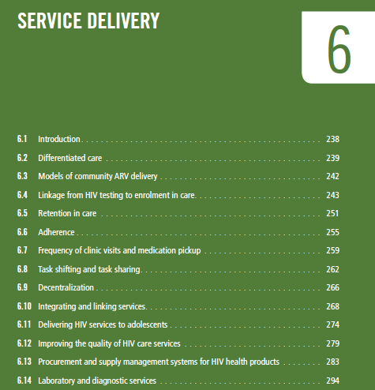
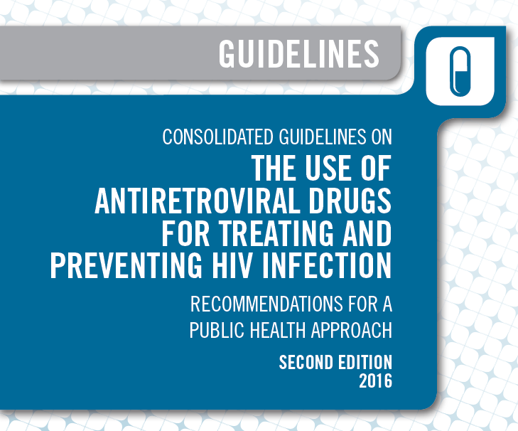
Not just what and when to start BUT HOW

Slide 3
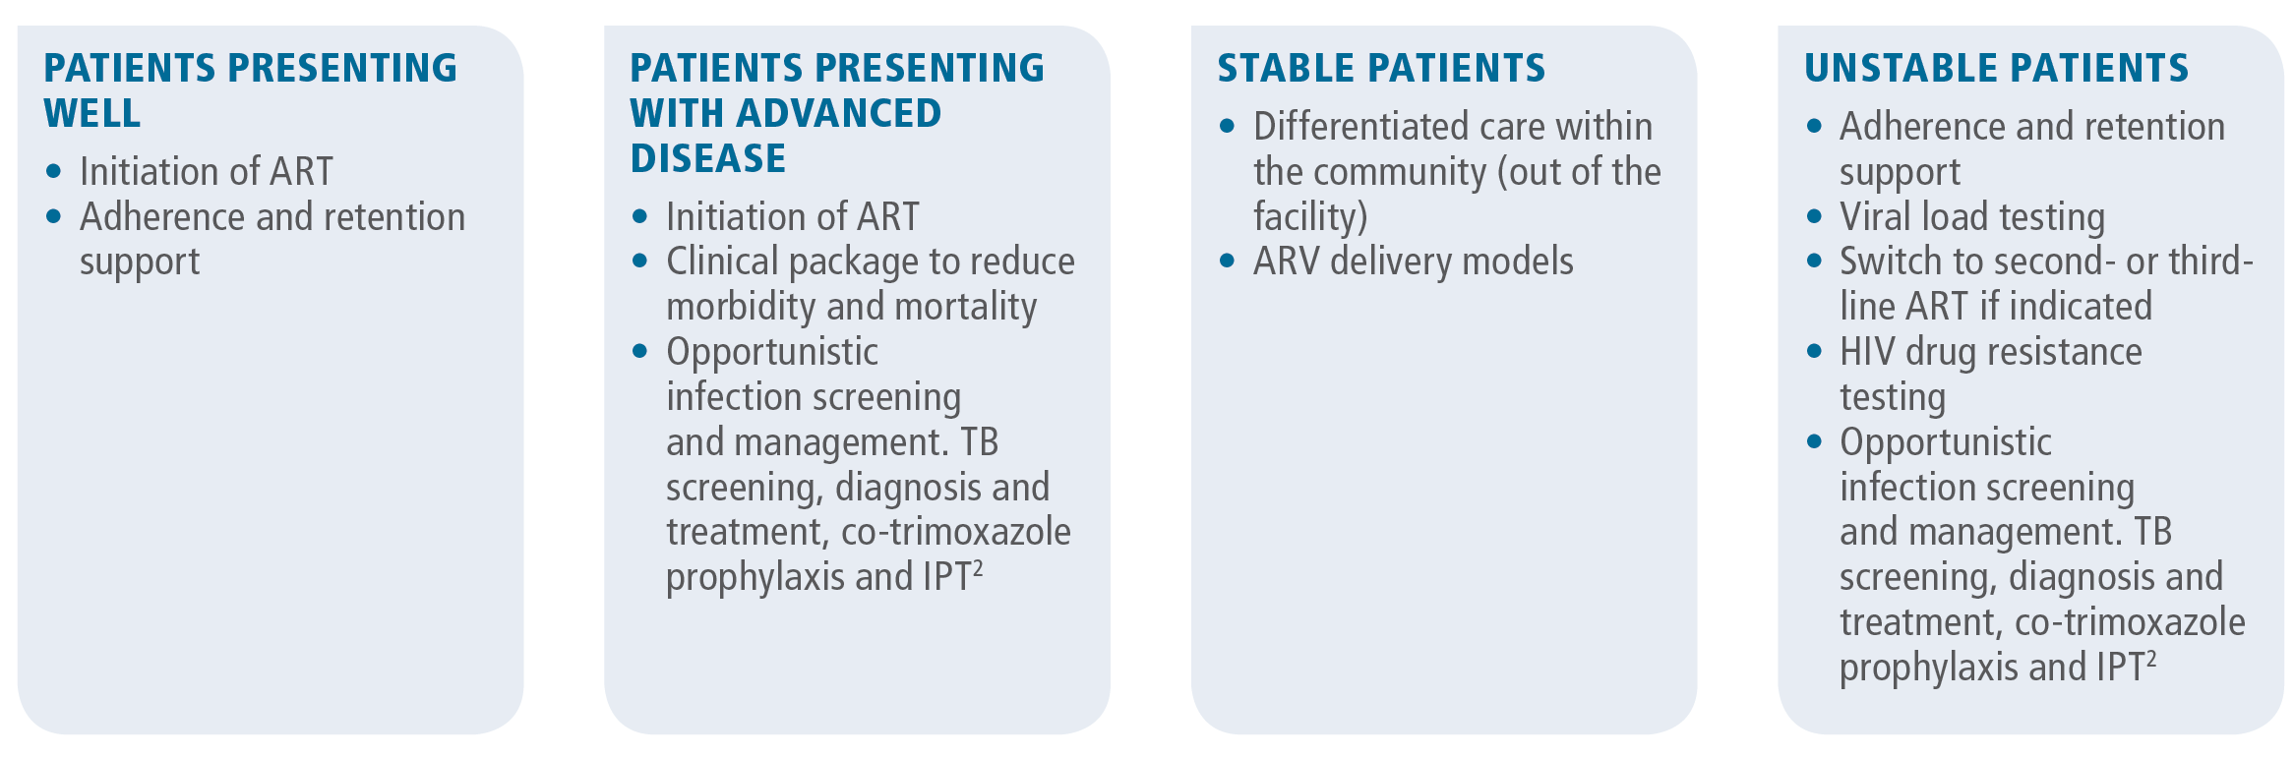
2016 Guidelines
Identified diversity of care needs for PLHIV
Focused on adult clients
Notes:
Signals a big shift away from one-size fits all approach

Slide 4
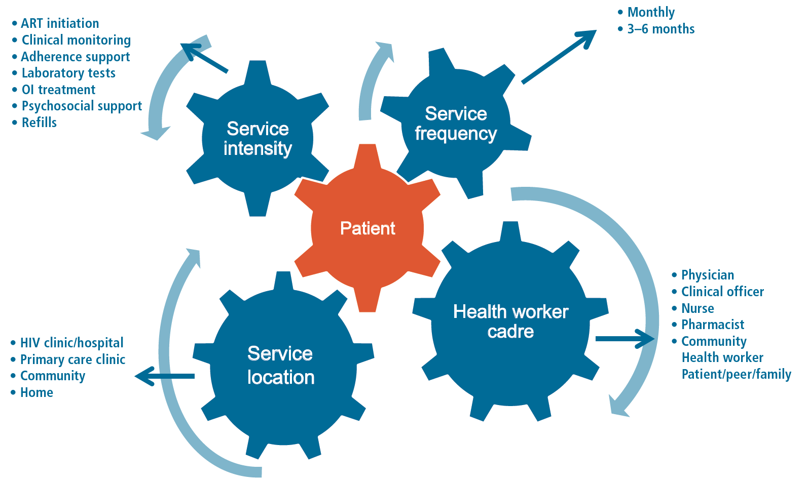
“Key factors in differentiated approaches to HIV care”

Slide 5
2017 Key Considerations
Supports differentiated ART delivery for:
  Pregnant and breastfeeding women, adolescents and children
  Key populations
    including (1) people who inject drugs, (2) sex workers, (3) men who have sex with men, (4) transgender people and (5) people in prisons and closed settings.
  Considers for each of these populations:
    Criteria for clinically stable clients
    Building blocks for ART refill, clinical consultation & psychosocial support visits
    Referral for intensified care

Slide 6
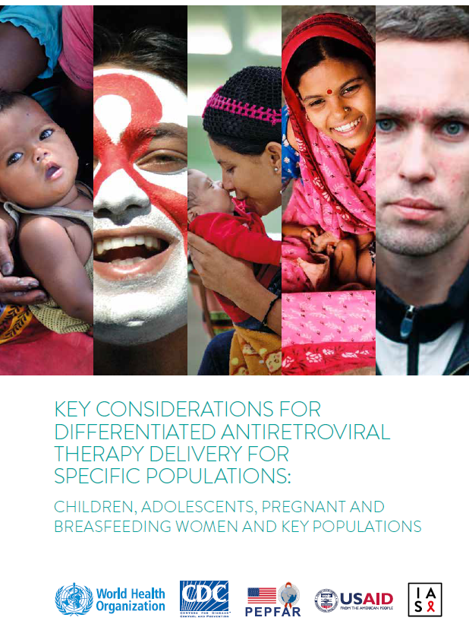

Slide 7
Definition of ‘stable’ client
Same as adult
+
Children: Older than two years + same regimen for >3 months + disclosure process orientation with caregivers.
Adolescents: Access to psychosocial support established
Women clinically stable on ART when conceiving: Already accessing differentiated ART delivery model + one viral load test of <1000 copies/mL in past three months + accessing antenatal care.
Women initiating ART during pregnancy: Only eligible for differentiated ART in the postpartum period + HIV-negative PCR result for six-week-old infants + evidence accessing infant follow-up care.
Drug use or drug dependence, including alcohol: Clinician assessment of safety of reduced clinical care and support.
Notes:
Adult =
> 1 year on ART
no adverse drug reactions
no current illnesses incl. malnutrition in children or mental health conditions
a good understanding of lifelong adherence
evidence of treatment success
- 2 consecutive VL measurements of <1 000 copies/ml OR
- CD4> 200 or rising CD4.

Slide 8
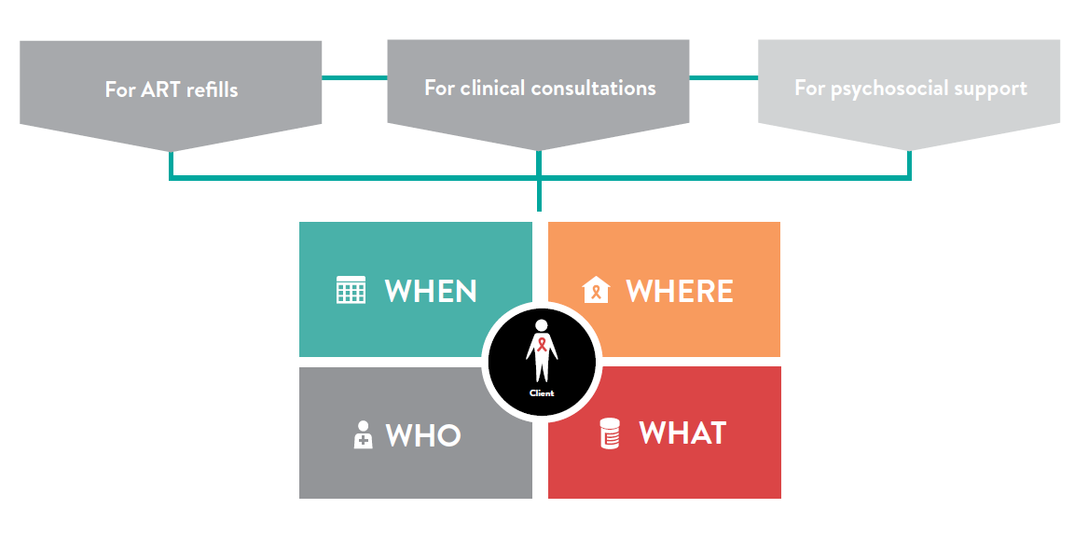

Slide 9

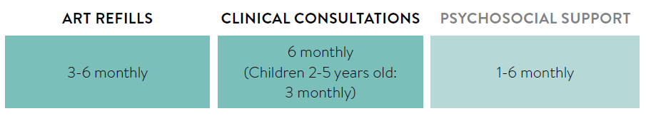
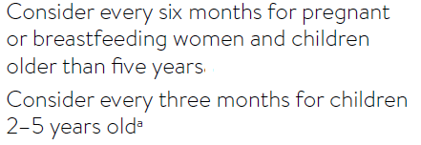

Slide 10

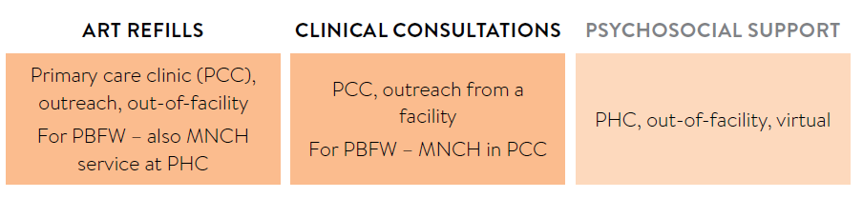

Slide 11

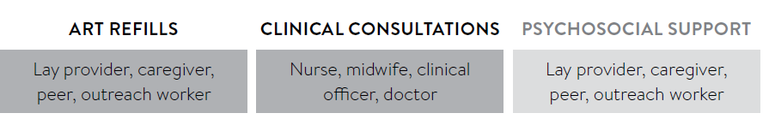
Mid-level health workers can undertake routine clinical consultations with doctors engaged in complicated cases

Slide 12

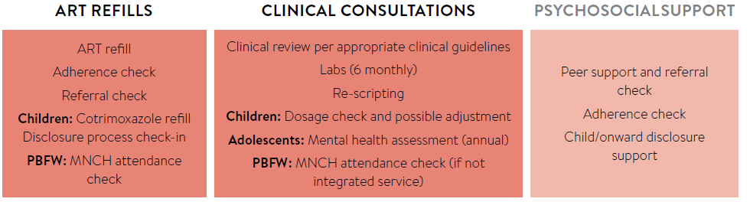
For children, adolescents and pregnant & breastfeeding women:
For key populations:
ART refills | Clinical consultations | Psychosocial support
HIV prevention and harm reduction | Mental health assessment Drug and alcohol screening HIV prevention, including harm reduction, sexually transmitted infections, viral hepatitis and TB services either on site or through referral | Check need for legal advice Addressing violence and provide HIV prevention, including harm reduction Support after release from prisons

Slide 13
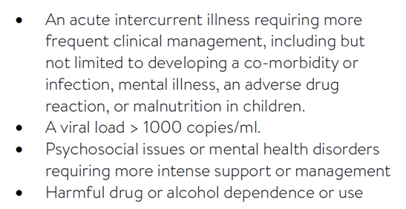
Referral criteria for intensified care
Notes:
In the same way that criteria are required for accessing differentiated ART delivery for stable clients, criteria are needed for referring a client from the differentiated ART delivery model for intensified care. The Key Considerations recommend the same referral criteria for all family populations. When differentiated ART delivery models started, it was common to refer the clients with poor adherence back to routine facility-based, clinician-led care. As adolescents, clients who experience “instability” (such as viral rebound) may be able to remain in their differentiated ART delivery model but have additional clinical consultations and/or one-on-one adherence counselling added for a specified period to support re-suppression.

Slide 14


