Slide 1

Country policies to enable Differentiated Care:
Four country examples

Slide 2




Zimbabwe
South Africa
Swaziland
Kenya

Slide 3

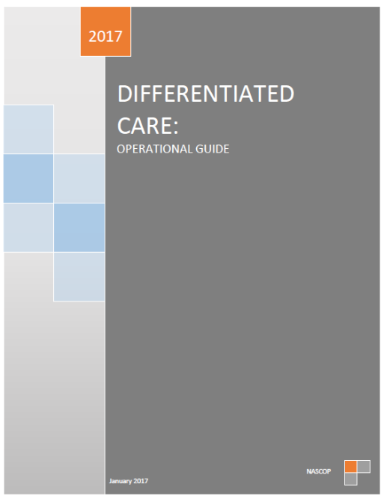


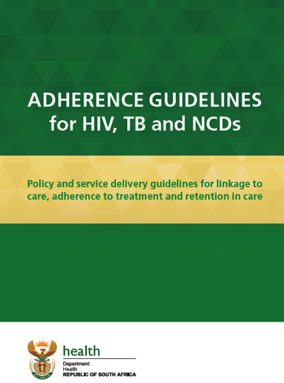
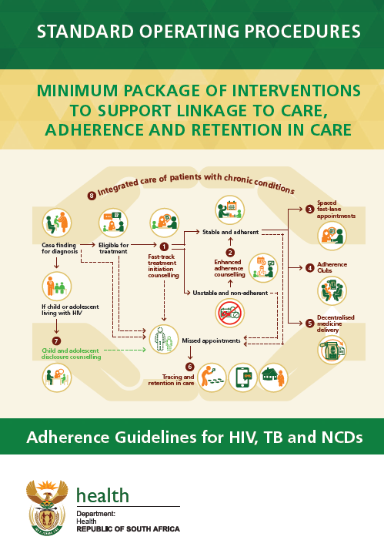
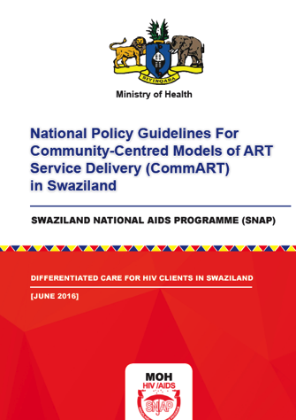
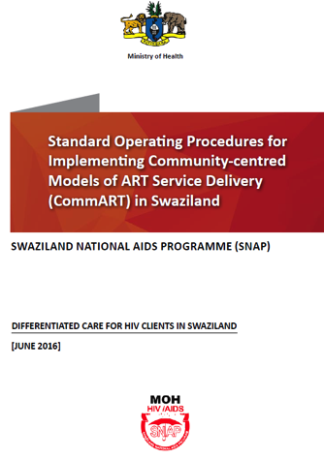
Notes:
Countries have commonly taken the approach of developing both a policy and either job aides or SOPs to support implementation.
Some countries policies address differentiated service delivery throughout the cascade while others have started with differentiated ART delivery.
Some countries have integrated differentiated care within their HIV management guidelines while others have kept separate.

Slide 4

Zimbabwe
Integrates HIV management with service delivery models
Differentiated across the continuum of care from HIV testing to ART delivery
Covers all populations
Supported by job aides

Slide 5
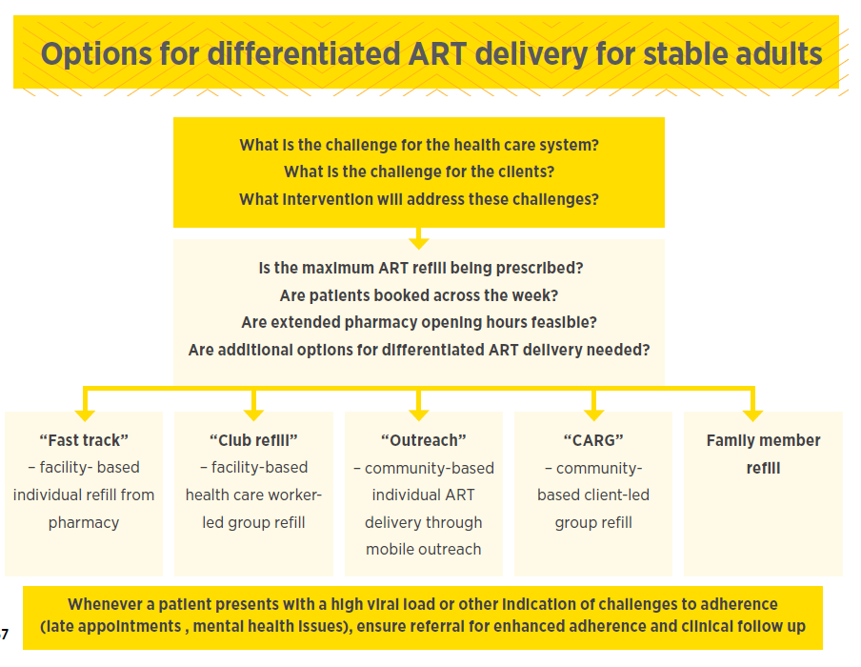
Stable client
ART delivery models
Notes:
These are 5 ART delivery models which can be adopted by facilities.

Slide 6
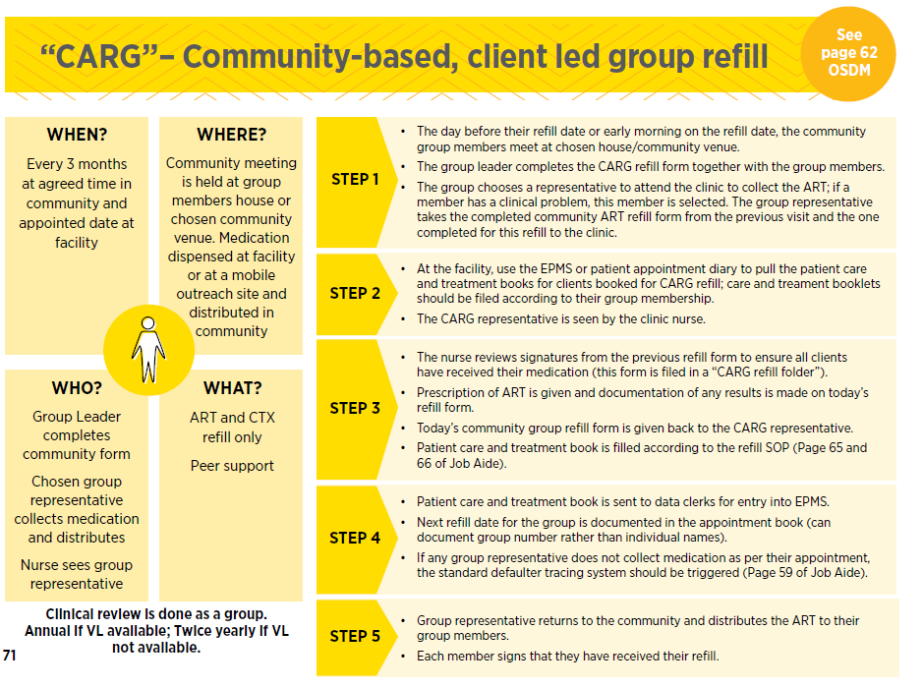
Combined building blocks + SOP
Notes:
These are 5 ART delivery models which can be adopted by facilities.

Slide 7
Kenya
Integrates HIV management guidelines and differentiated service delivery
Follows WHO approach by differentiating at ART initiation (well or advanced HIV) & once on treatment (stable or unstable)
Prescriptive ito building blocks but not service delivery models
Accompanied operational guide
Model SOPs including in operational guide

Slide 8
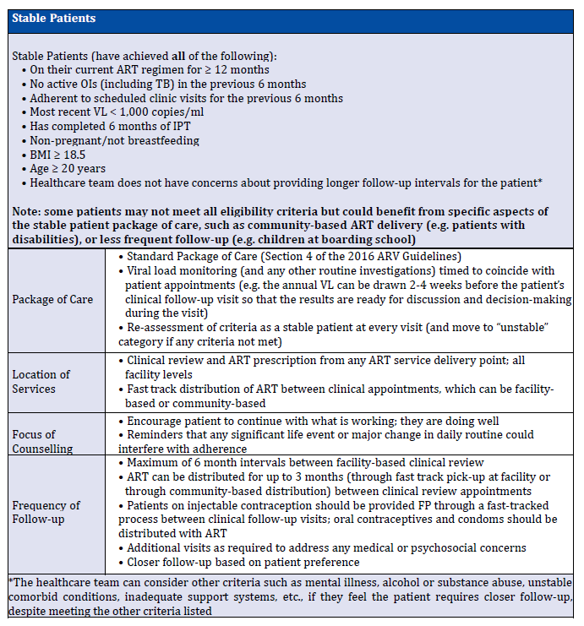
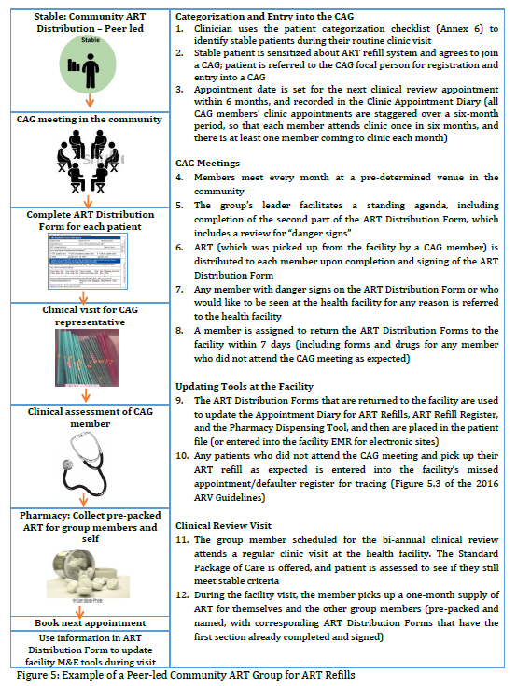
Stable client building blocks
Notes:
For each of the WHO buckets:
Well or advanced HIV at ART start and stable or unstable once on ART, there is table setting out the building blocks. The guide then provides examples of models of ART delivery and includes SOPs for these to support implementation.

Slide 9
South Africa
Not limited to HIV
Accompanies HIV management guidelines
Across the continuum but focused on ART delivery models for stable clients
Mostly adult with some reference to other populations
Accompanied by SOPS

Slide 10
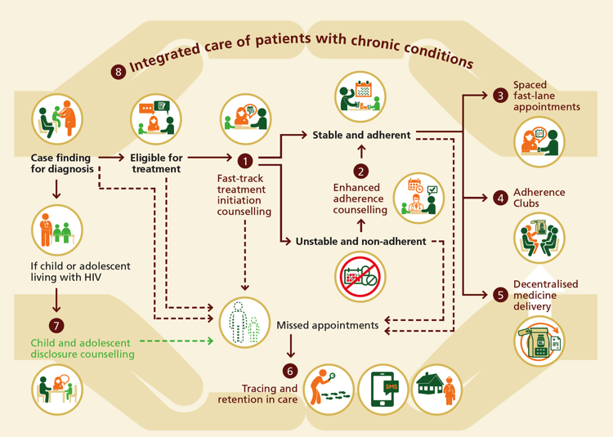
Stable client ART delivery models
Notes:
3 options provided for chronic medication delivery – spaced fast lane appointments, adherence clubs, decentralised medicine delivery i.e. community pick-up points.

Slide 11
Swaziland
Separate from HIV management guidelines
Focuses on differentiated ART delivery models
Covers adult and adolescent populations
Accompanied by SOPS

Slide 12

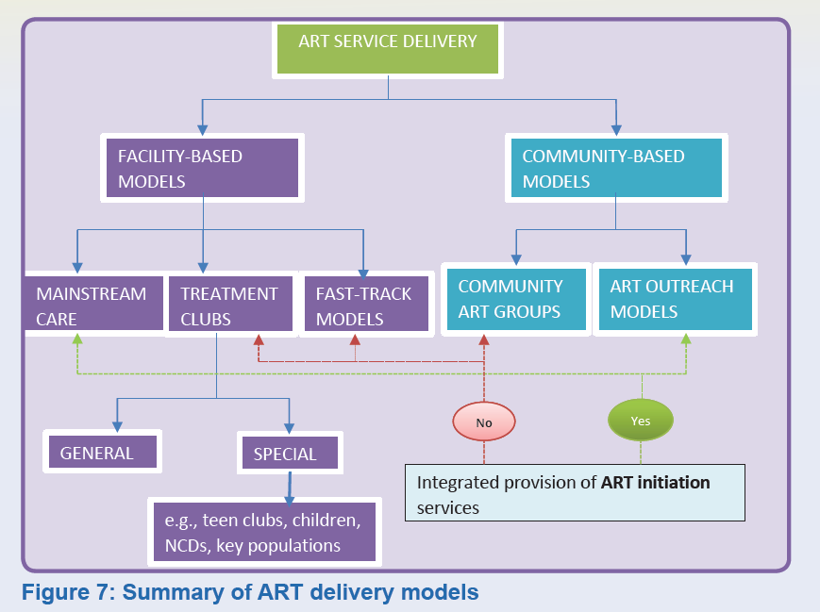
Stable client ART delivery models
Notes:
Diagram in guidelines sets out service delivery model options in facility and out of facility.

Slide 13

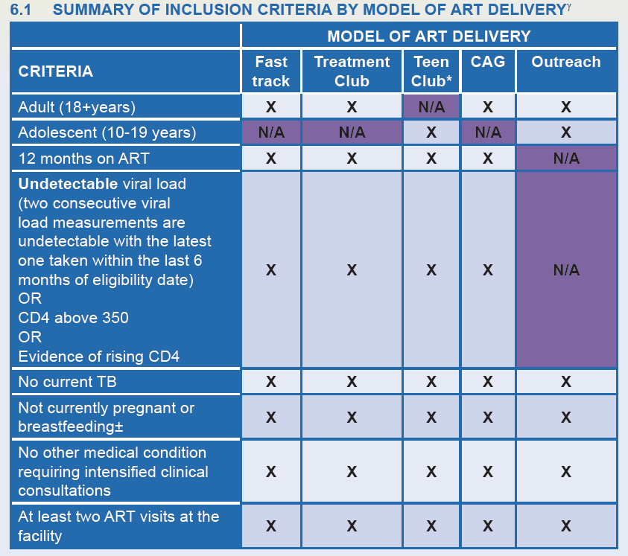
Eligibility for each model
Notes:
Guidelines set out who is eligible for each model.

Slide 14

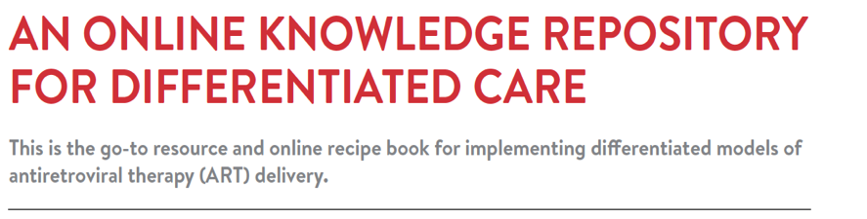

Country specific guidelines
Global guidance
ART delivery model examples
Implementation tools & resources
FAQs
Published evidence
Notes:
For more examples both country guidance and operational differentiated ART delivery models IAS has put together an online repository of global guidance, country specific guidance, comparable descriptions of implemented models in different contexts together with their tools. It also include all published and conference abstract evidence on differentiated ART delivery to date.

Slide 15


