Slide 1


Recommendations from the 2016 WHO Guidelines on differentiated ART delivery

Slide 2
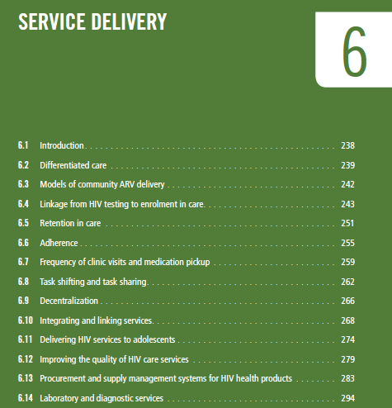
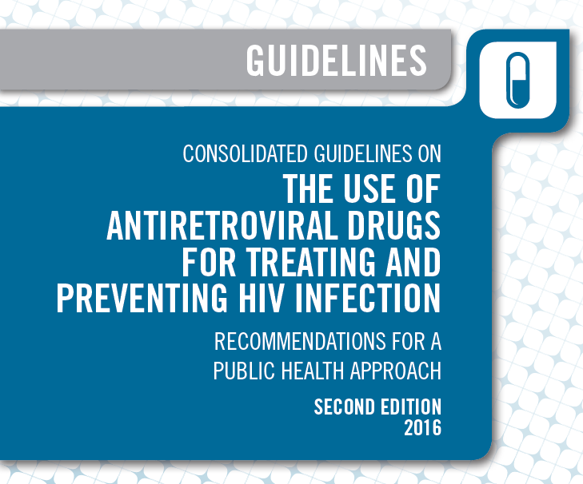
Not just what and when to start BUT HOW

Slide 3
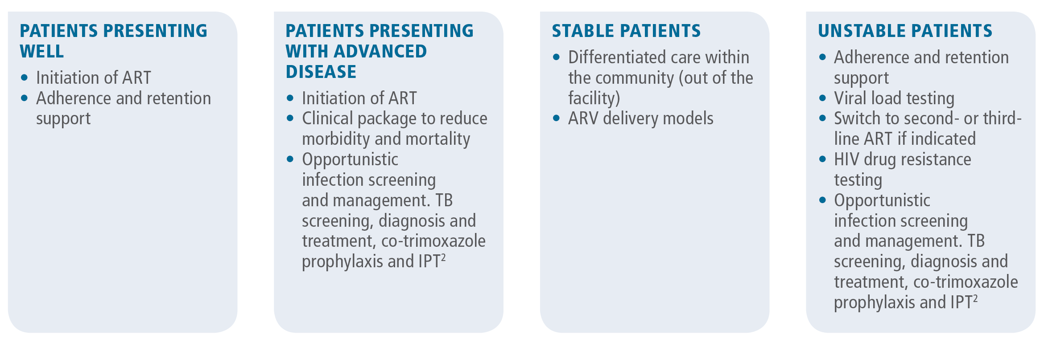
Diversity of care needs for PLHIV
Notes:
Signals a big shift away from one-size fits all approach

Slide 4
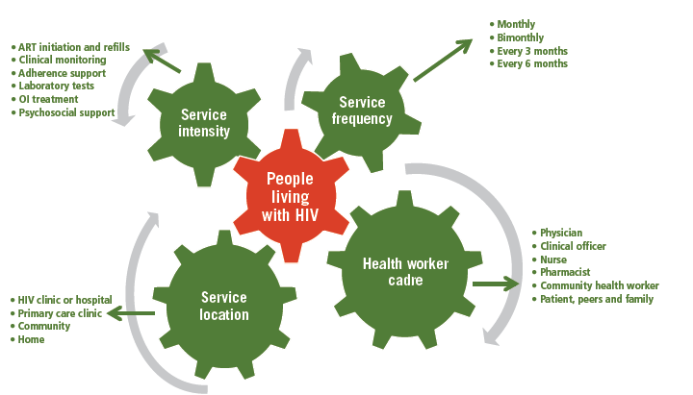
“Key factors in differentiated approaches to HIV care”

Slide 5
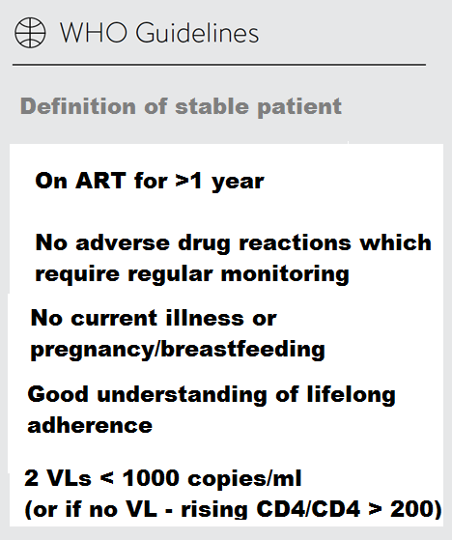
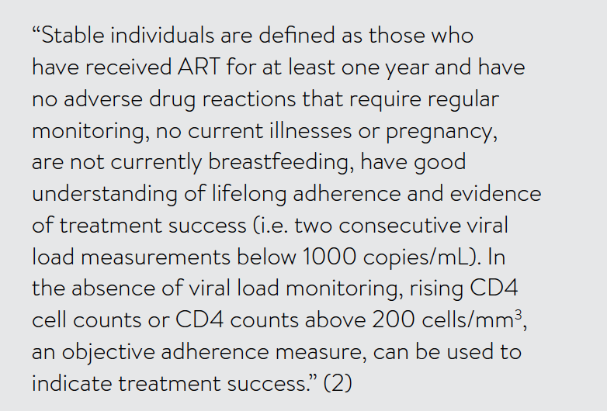
Definition of stable patient
Notes:
On the left – key point and on the right exact narrative from guidelines.
In 2017 WHO considerations for differentiated ART delivery for family populations (which includes pregnant and breastfeeding women) removed exclusion from stable client.

Slide 6

Building block recommendations

Slide 7

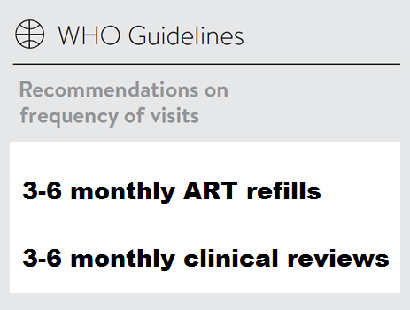
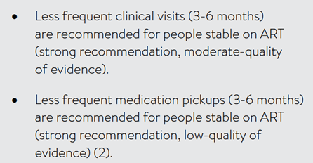
Notes:
On the left – key point and on the right exact narrative from guidelines.

Slide 8

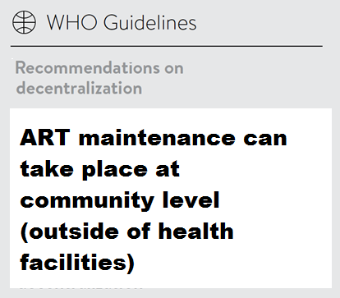
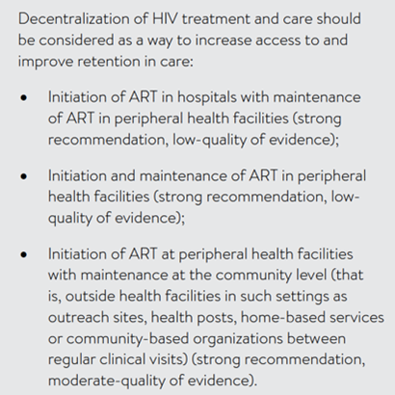
Notes:
On the left – key point and on the right exact narrative from guidelines.

Slide 9

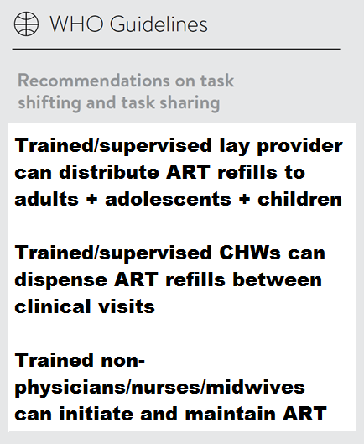
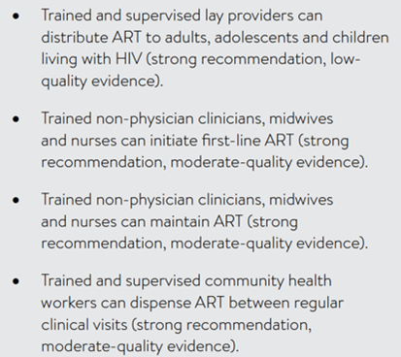
Notes:
On the left – key point and on the right exact narrative from guidelines.

Slide 10

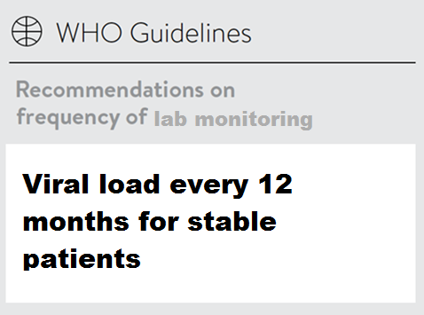
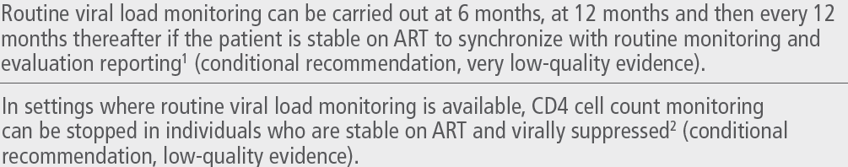
Notes:
On the left – key point and on the right exact narrative from guidelines.

Slide 11


