Slide 1

Brief introduction to differentiated care
An approach to service delivery

Slide 2
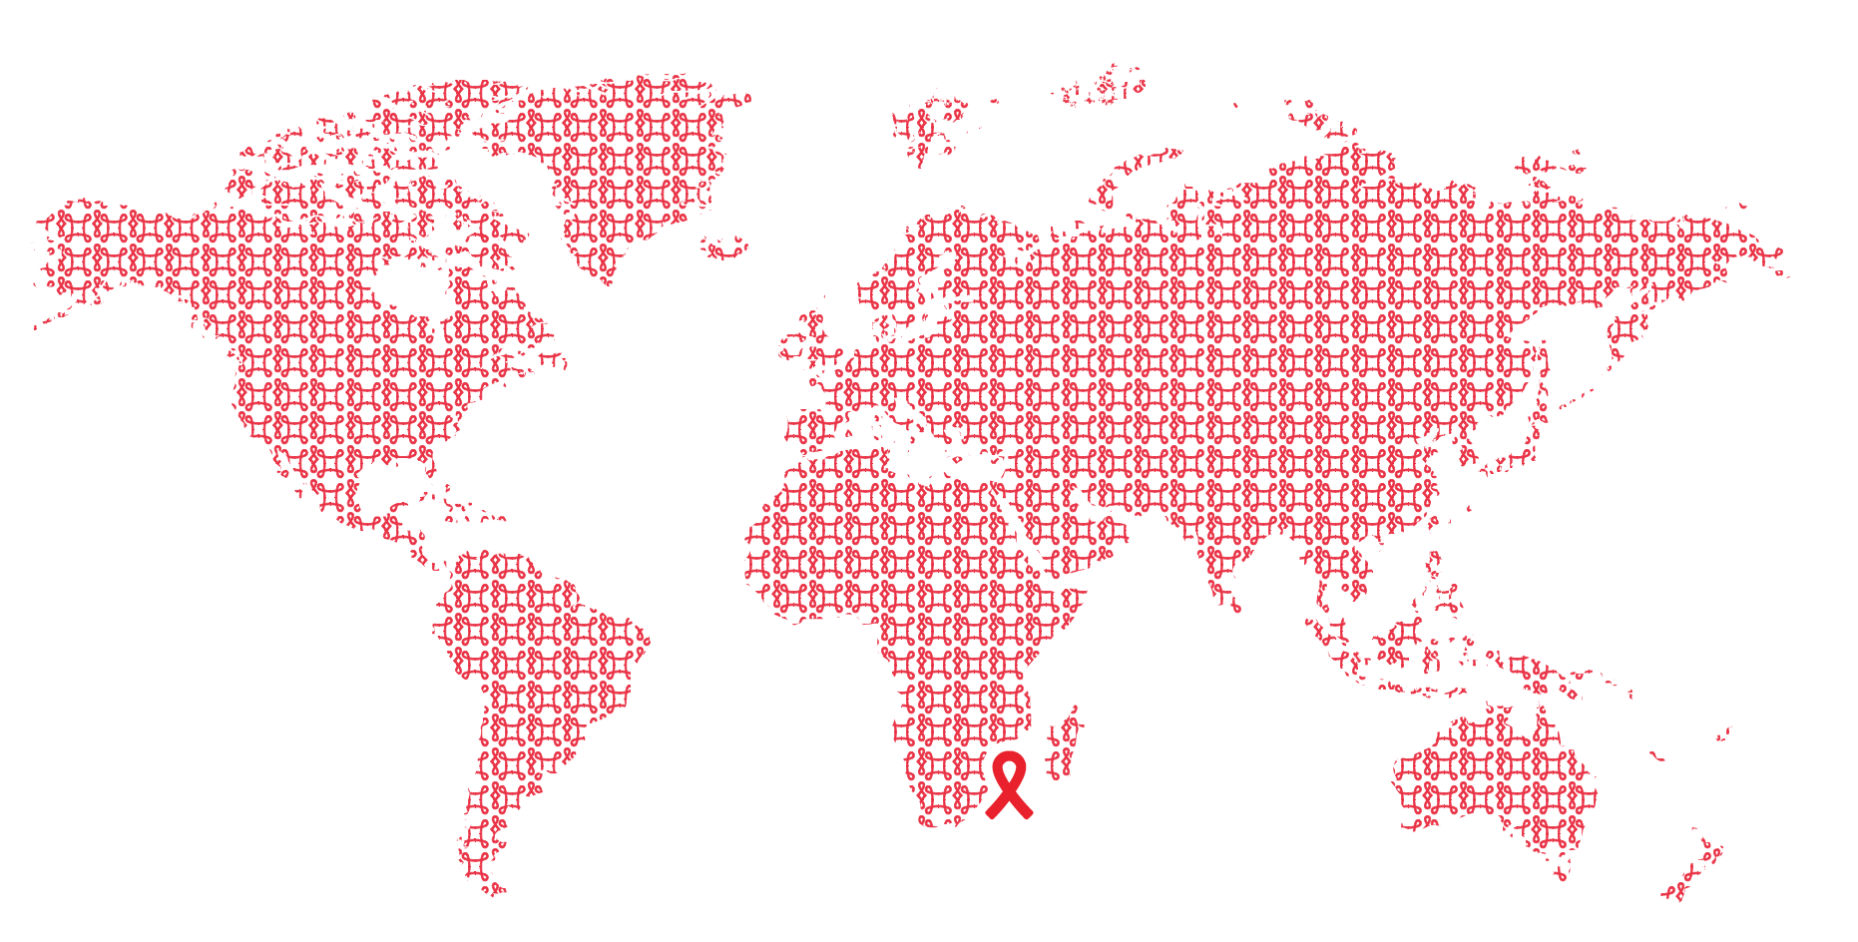
What is differentiated care?

Slide 3

Differentiated care
is a client-centred approach that
simplifies and adapts HIV services across the cascade to reflect the preferences and expectations of various groups of people living with HIV (PLHIV) while reducing unnecessary burdens on the health system.
Notes:
This means changing our thinking about how to provide HIV services – different groups of patients are best suited to different models of service delivery at different points along their HIV treatment pathway. Our approach to HIV management has historically provided only one standard service delivery model - where patients are expected to come to our facilities to get an HIV test, if tested positive a patient is expected to report to our HIV services at our facilities to start on ART. Once on ART, patients were required to come back to the facility to see a clinician and receive the ART refill usually monthly for the rest of their lives. This approach treats all patients the same despite their differing needs and does not leverage our scarce health resources towards those most in need.

Slide 4
Core principles of differentiated care
Client-centred care
Health system efficiency
Notes:
The core principle for differentiating care is to provide ART delivery in a way that acknowledges specific barriers identified by clients and empowers them to manage their disease with the support of the health system. WHO highlights the need for client-centred care to improve the quality of HIV care services
With the population of PLHIV having increasingly diverse needs, it is acknowledged that health systems will have
to adapt away from a “one-size-fits-all” approach. Differentiated care supports shifting resources to clients who are the most in need by supporting stable clients
to have fewer and less intense interactions with the health system.

Slide 5
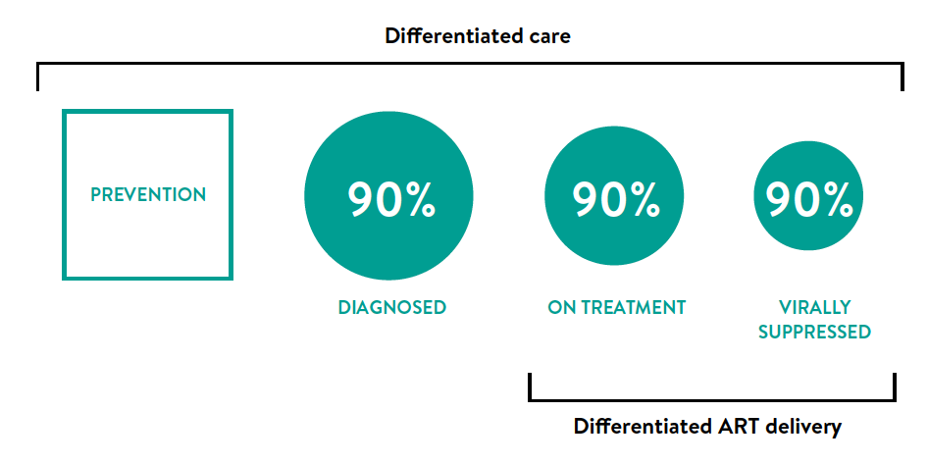
Differentiated care is applicable across the HIV care continuum

Slide 6

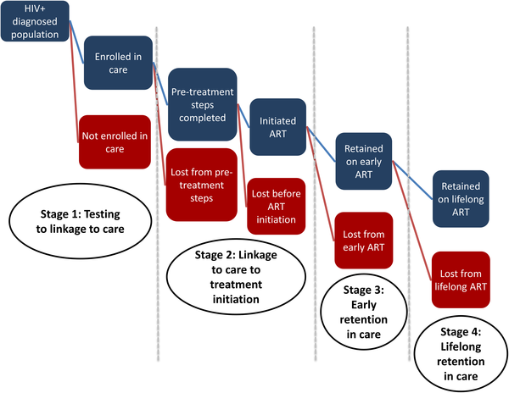

Fox MP, Rosen S (2017) A new cascade of HIV care for the era of “treat all”. PLOS Medicine 14(4): e1002268. https://doi.org/10.1371/journal.pmed.1002268
http://journals.plos.org/plosmedicine/article?id=10.1371/journal.pmed.1002268
Notes:
Differentiating care applies to each step of the HIV cascade. The focus has been on differentiating ART delivery services for those clients in the last stage of the cascade. This presentation will explain how to approach differentiating service delivery for those clients who have been on ART for some time. A similar approach can be taken to differentiate HIV testing and linkage to care services.

Slide 7
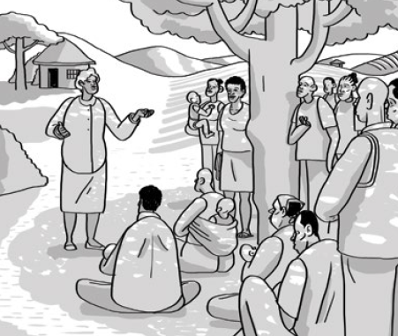
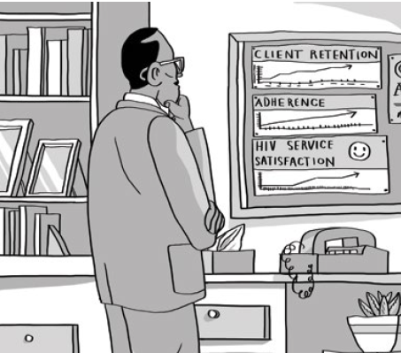
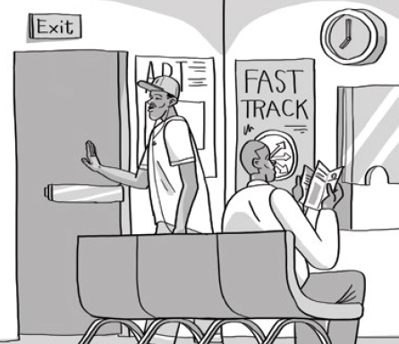
Why differentiate ART delivery
To improve client experience
To improve health outcomes
Leverage resources to ‘treat all” and achieve 90-90-90

Slide 8
How to approach differentiating ART delivery
Identify client and health system challenges
Define for whom you are differentiating care
Determine the appropriate building blocks for differentiated ART delivery for your identified population
Notes:
I will now provide you with an abbreviated process approach to differentiating ART delivery services…

Slide 9
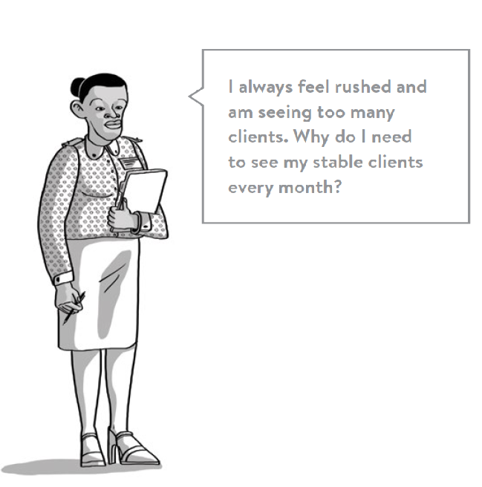
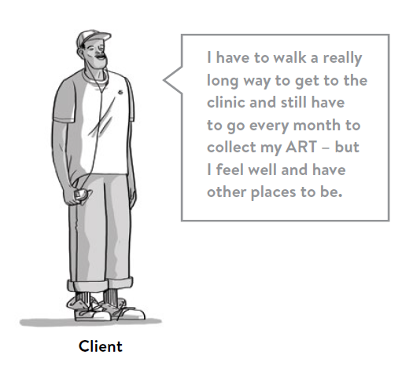


1. Identify the challenges
Notes:
We need to ask ourselves 1) what are our clients challenges – what makes it difficult for them to stay on ART long term? 2) what are our health system challenges – what makes it difficult to provide quality health services?

Slide 10
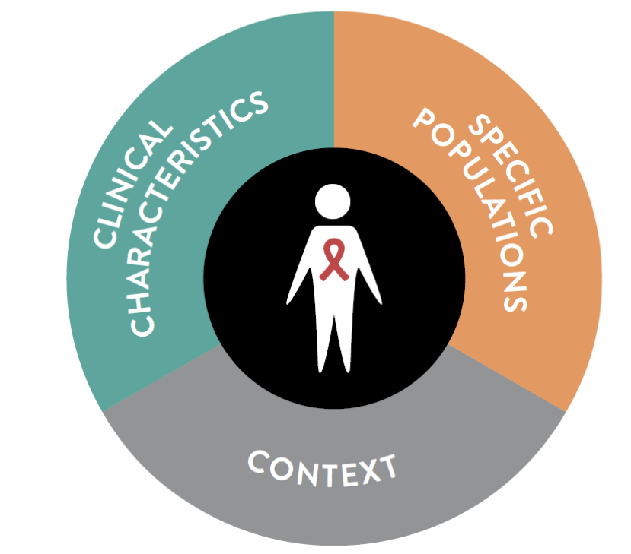
2. Define for whom we are differentiating ART delivery
Notes:
Based on these challenges – we need to decide who we are differentiating ART delivery for? Which client population, which clinical characteristics and in which context?

Slide 11
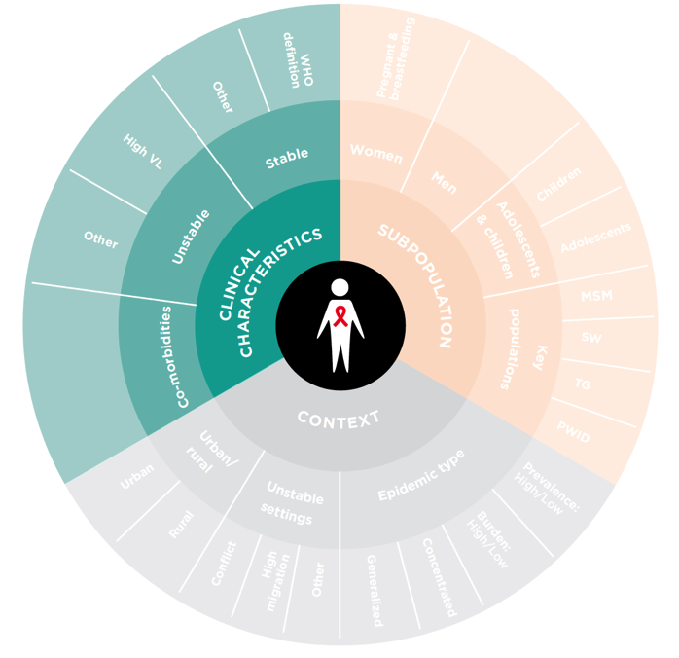
Notes:
We need to start by asking ourselves what our client’s clinical needs are a particular time point in their treatment pathway. A client who is stable on ART with a suppressed viral load will have different clinical needs – focusing on simplified access to ongoing ART refills with limited need for clinical support compared with a client who has started ART with advanced HIV, is unwell or has a high viral load – where intensified clinical support is needed.
WHO 2016 guidance service delivery chapter recommended at ART start differentiating approach for those presenting well and those presenting with advanced disease and after first viral load assessment – those stable on ART and those who are not.

Slide 12
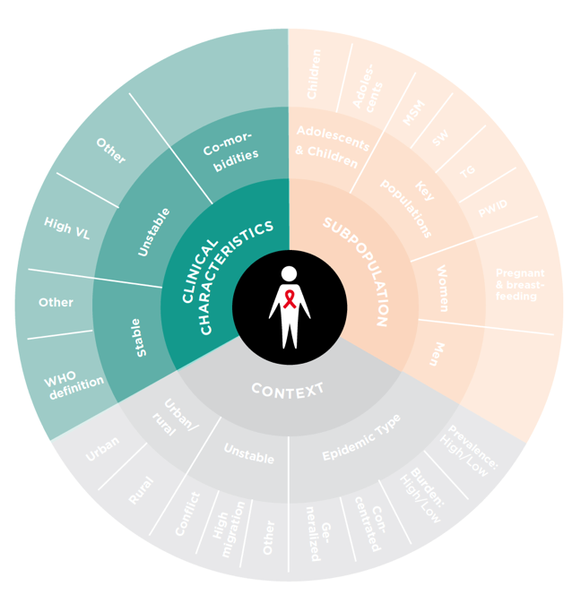
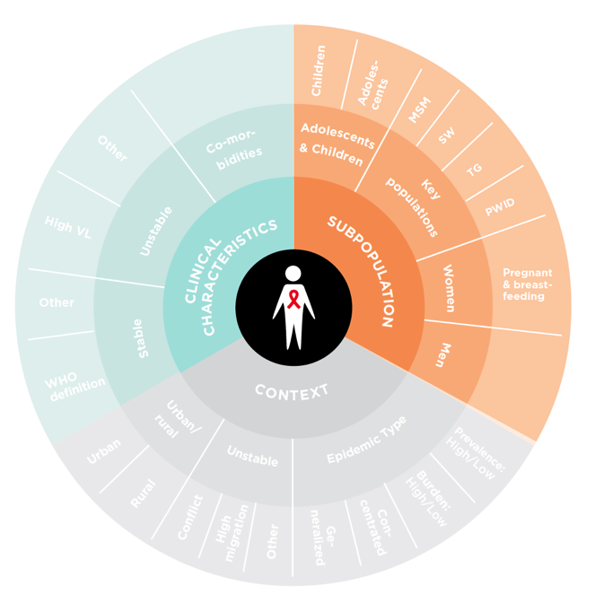
Notes:
We then need to decide which client population we are wanting to provide services too. Most differentiated ART delivery models to date have focused on adults but there is now a move to also differentiating service delivery for stable children, adolescents, PBFW and key populations. Both WHO and IAS will release guidance at the IAS conference in Paris.

Slide 13
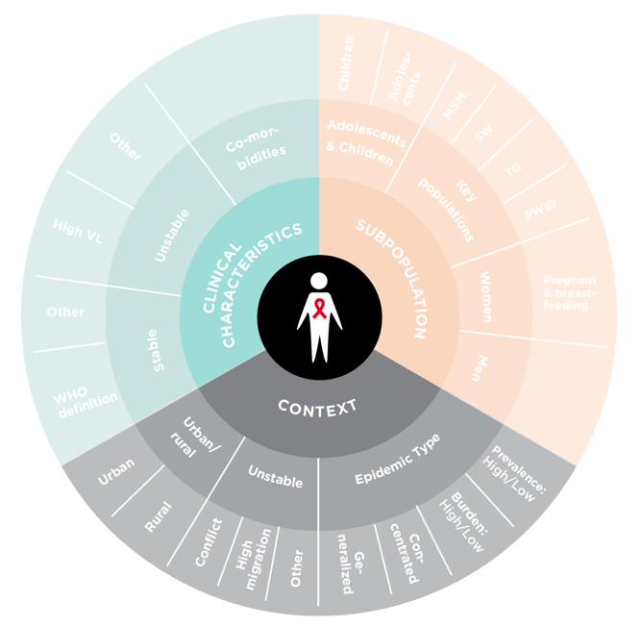
Notes:
Lastly we need to identify the context – different service delivery models are feasible in different contexts. For instance, in a rural area it may be difficult to have enough numbers to form a group (especially an adolescent group) or it may not be feasible to get ART refills to all rural areas. At national level, it is important to ensure policy supports a range of models so that facilities in rural/urban or low/high burden areas can choose to implement those appropriate to their context.

Slide 14
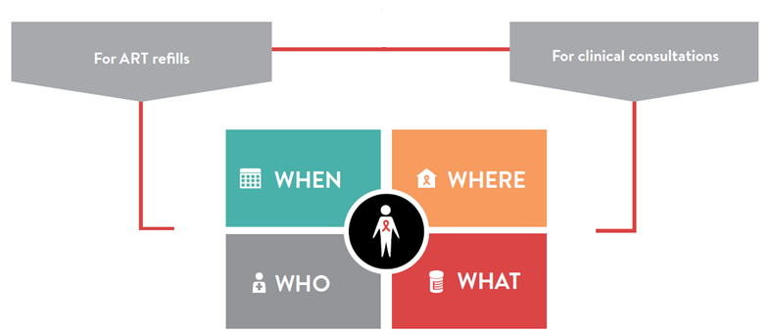
3. Determine the building blocks
Notes:
Once you have defined whom you are differentiating care for – for instance stable adults across a range of contexts. It is necessary to determine the building blocks of ART delivery models for stable adults – how frequently should services be provided, where can services be provided, who can provide these services and what package of services should be provided. This needs to be assessed separately for both ART refills and clinical consultations as these may have different frequency, location and service providers.

Slide 15
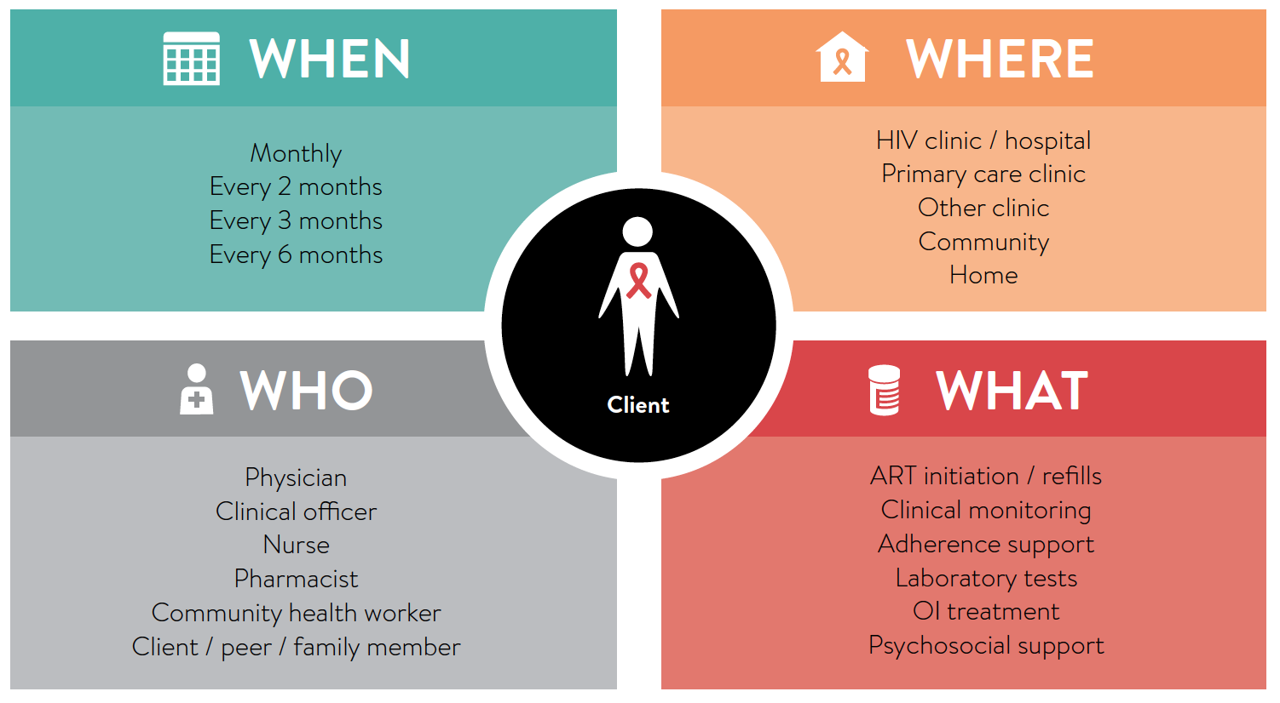
Notes:
How often do stable adults need to collect ART refills? How often do they need to see a clinician?
Where can they collect their ART refills? Where can they have their clinical consultation?
Who can distribute ART refills and who can conduct their clinical consultations?
What services should be provided at an ART refill visit and what services should be provided at a clinical consultation?

Slide 16
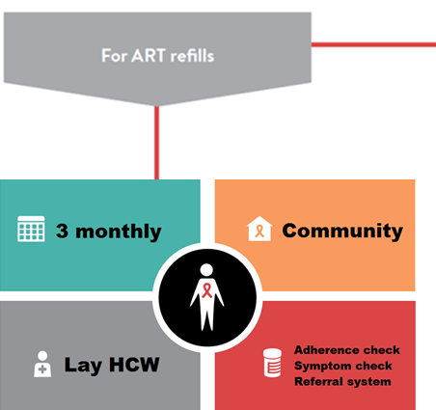
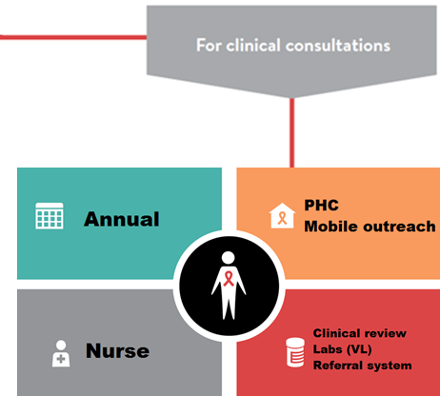
Example outcome
Stable adults = >18 years + >12m on ART, 1 VL <1000copies/ml no current illness or adverse event requiring regular clinical follow-up
Notes:
To illustrate this undertaken process, we have put together an example outcome. After considering our client and health system challenges, we have determined it appropriate to differentiate service delivery for stable adults on ART. We have defined who is a ‘stable’ client. After considering WHO guidance, we decided that our stable adult clients could receive 3 month supply of ART which could be distributed at a community level by a lay provider provided a brief adherence and symptom check are done with an effective referral pathway in place to refer those client with problems to the facility. These clients will only need to be seen annually (going beyond WHO guidance following the examples of other countries in the region – Zimbabwe and South Africa). This clinical consultations can be done at a PHC or by mobile outreach from a PHC by a nurse ito national clinical guidelines who would also require an effective referral system should she need to refer a client to more skilled clinician.

Slide 17

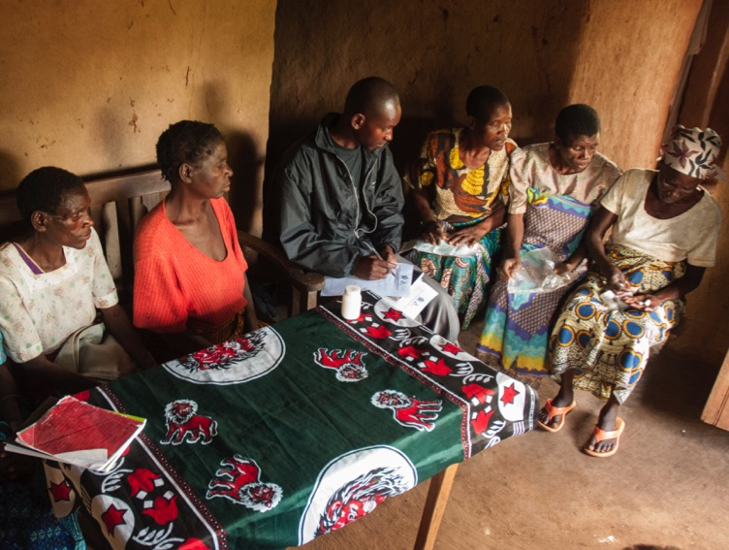
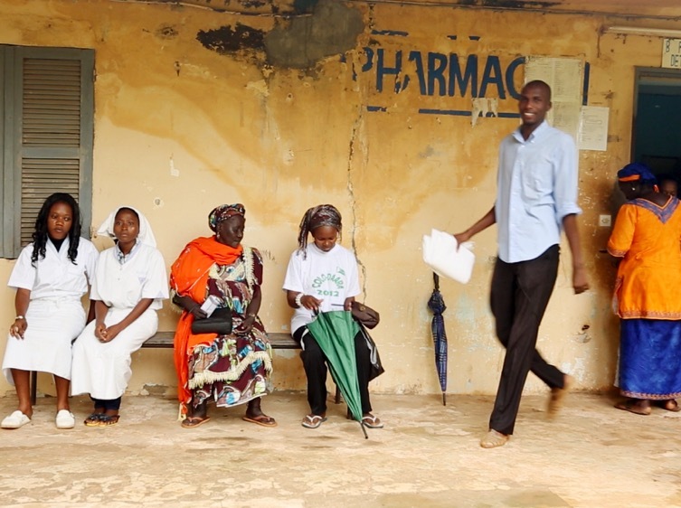

ART adherence clubs
Community ART groups (CAGs)
Health care worker-managed group
Client-managed group
Fast track ART refill collection at facility
Mobile outreach
Fixed community ART refill distribution
Home ART delivery
Facility-based individual
Out-of-facility individual
Notes:
Once the building blocks have been determined, it is possible to build differentiated ART delivery models using these build blocks – what the model looks like and how it works should be determined at facility level with participation from clients regarding their preferences. To date ART delivery models for stable clients have fallen into 4 main categories – group models have taken the form of those managed directly by HCWs such as the ART adherence clubs or managed by clients themselves such as the community ART groups. Individual models have either been facility based which mostly ensure fast tracked ART refill collection or out-of facility models such as mobile outreach, fixed ART refill distribution points in communities or in low burden settings home ART delivery. Countries adopting differentiated ART delivery for stable clients have mostly provided for a range of these models to provide facilities with choice of which
h ones are appropriate to implement in their setting.

Slide 18
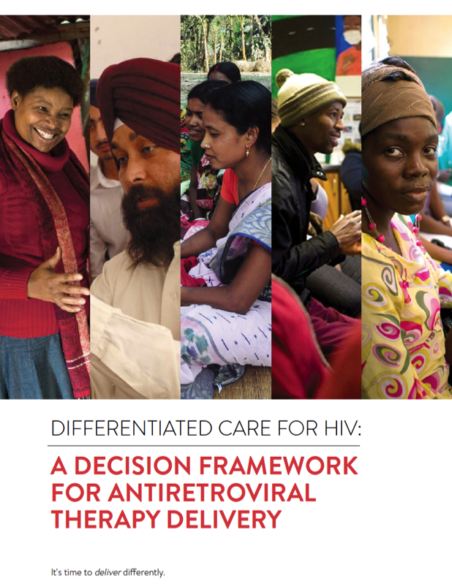
Notes:
For further detail on how to differentiate ART delivery – IAS has developed a detailed decision framework to guide countries at national, district and facility level.

Slide 19

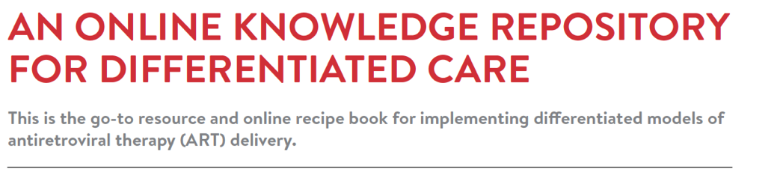

Notes:
In addition, IAS has put together an online repository of global guidance, country specific guidance, comparable descriptions of implemented models in different contexts together with their tools. It also include all published and conference abstract evidence on differentiated ART delivery to date.

Slide 20
Image : “Interaction Institute for Social Change | Artist: Angus Maguire.”
Notes:
In closing – differentiated care is about moving away from everyone getting the same thing towards clients getting what they need to make it easier to achieve long term viral suppression.

Slide 21


