Slide 1
TITLE
Differentiated Care for People who inject Drugs, Men who have sex with men, Sex workers, Transgender people, Prisoners and other people living in closed settings
(select one or more)
Presenter name
Country

Slide 2
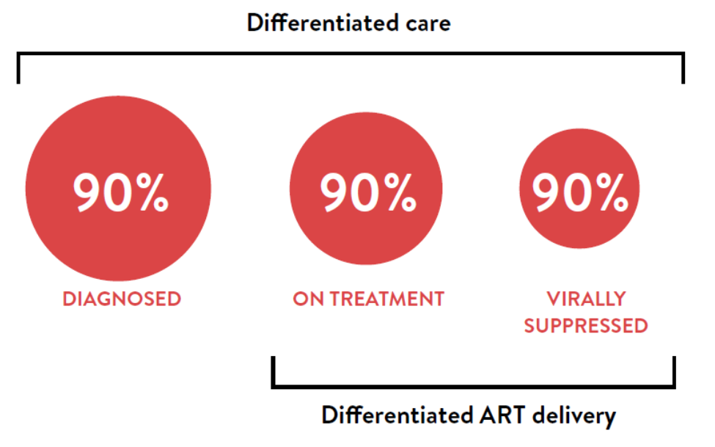
Differentiated care applies across the HIV care continuum

Slide 3
Challenges/Rationale
PLEASE DESCRIBE THE SITUATION IN YOUR COUNTRY, REGION, CITY. IDENTIFY CHALLENGES IN REACHING, TESTING, TREATING AND RETAINING KP
Health system challenges
E.g. Reaching more people
Identify more HIV positive people
Improve HIV positive patient outcomes
Reduce barriers to access
Improve management of sick clients, clients with comorbidities etc.
Increase retention of KP on ART if they are feeling well and are challenged by frequent visits
Patient challenges
E.g. Travel and wait times
Lack of treatment literacy
Stigma and discrimination
Comorbidities
Complicated care
Adherence support to remain on ART if feeling well and clinic visits are a hardship or unfriendly

Slide 4
Who was care for? Define the clinical characteristics, population and context
Clinical characteristics
Stable/Unstable/Co-morbid
Specific population
Context
Urban/rural, unstable context, epidemic type

Slide 5
An Overview of the intervention
Describe the intervention
What kind of model?
Health care worker-managed group, client-managed group, facility-based individual model or out-of-facility individual model?
Type of service
For example government/NGO, community based or Community lead, Health facility satellite, DIC, outreach, involving/employing peers
Describe the key elements of the intervention
Describe the building blocks
WHEN – at what frequency are clients seen
WHERE – where is care provided
WHO – what cadre of staff facilitates the model
WHAT – services are provided
Is ART delivery already part of the model?

Slide 6
Implementing the intervention
Describe what it took to get this into place
Was this a pilot project
Has it been taken to scale
Did you have to train staff? What materials did you use
Was there a lot of supervision required
How did you track progress? What M&E elements did you build into the model
Do you know how much this cost?
Overall was this feasible?
Is there evidence of success? (including client outcomes, client satisfaction, HCW perspectives, waiting times, etc.

Slide 7
CHALLENGES AND SUCCESSES
CHALLENGES
SUCCESSSES

Slide 8
LESSONS LEARNED/RECOMMENDATIONS

Slide 9
Summary of “standard of care” vs. Differentiated service delivery model
 | Facility based/traditional model | Differentiated service delivery model
BUILDING BLOCKS WHEN
WHERE
WHO
WHAT
OUTCOMES*
Training requirements
Cost effectiveness of model
Evidence of success
*Report relevant outcomes depending on the intervention – e.g. HIV-Positive yield/% linkage to care/% initiated / % retention / % virally suppressed
This is a summary table to compare existing services or the standard of care to the intervention/differentiated service delivery model

