Slide 1
TITLE
Differentiated Care for children, adolescents, pregnant women, breastfeeding women (select one or more)
Presenter name
Country

Slide 2
Challenges/Rationale
PLEASE DESCRIBE THE SITUATION IN YOUR COUNTRY, REGION, CITY. IDENTIFY CHALLENGES IN TREATING AND RETAINING SPECIFIC POPULATIONS
Health system challenges
  Reaching more people
  identify more clients (first 90),
  Improve client outcomes (second and third 90s)
  reduce staff workload
  Reduce barriers to access
  Improve management of sick clients, clients with comorbidities, etc.
Patient challenges
  Travel and wait times
  Lack of treatment literacy
  Stigma and discrimination
  Improve/expand access
  Simplify care
  Reduce wait time

Slide 3
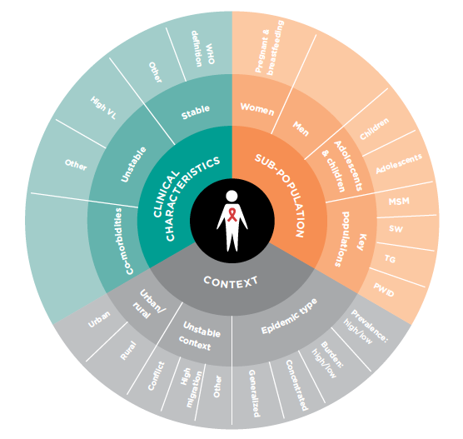
Who was care for?
Define the clinical characteristics, population and context
Clinical characteristics
  Stable/Unstable/Co-morbid
Specific population
Context
  Urban/rural, unstable context, epidemic type

Slide 4
An Overview of the intervention
Describe the intervention
  What kind of model?
    Health care worker-managed group, client-managed group, facility-based individual model or out-of-facility individual model?
  Type of service
    For example government/NGO, community based or Community lead, Health facility satellite, DIC, outreach, involving/employing peers
  Eligibility
    Who is eligible to access the model? E.g. “stable” clients (how is the defined), what ages, etc.
Describe the key elements of the intervention
  Describe the building blocks
    WHEN – at what frequency are clients seen
    WHERE – where is care provided
    WHO – what cadre of staff facilitates the model
    WHAT – services are provided
  Is ART delivery already part of the model?
  How are clients “up-referred” if they are no longer eligible/require more frequent/intense clinical support?

Slide 5
Implementing the intervention
Describe what it took to get this into place
Was this a pilot project
  Has it been taken to scale
Did you have to train staff? What materials did you use
  Was there a lot of supervision required
How did you track progress? What M&E elements did you build into the model
Do you know how much this cost?
Overall was this feasible?
Is there evidence of success? (including client outcomes, client satisfaction, HCW perspectives, waiting times, etc.

Slide 6
CHALLENGES AND SUCCESSES
CHALLENGES
SUCCESSSES

Slide 7
LESSONS LEARNED/RECOMMENDATIONS

Slide 8
Summary of “standard of care” vs. Differentiated service delivery model
 | Facility based/traditional model | Differentiated service delivery model
BUILDING BLOCKS WHEN
WHERE
WHO
WHAT
OUTCOMES*
Training requirements
Cost effectiveness of model
Evidence of success
*Report relevant outcomes depending on the intervention – e.g. HIV-Positive yield/% linkage to care/% initiated / % retention / % virally suppressed
This is a summary table to compare existing services or the standard of care to the intervention/differentiated service delivery model

