Slide 1
Prioritization of Low-cost and effective Differentiated HIV Testing Services
AFROCAB Webinar
28 May 2026
Busi Msimang & Celine Lastrucci
HIV, TB, Hepatitis and STI Department
WHO/HQ

Slide 2

Presentation Outline
Prioritization, WHO recommended Testing strategies - DSD
Quality of HIV testing
HIV self-testing and blood-based tests
Cost-efficient and effective approaches
Discussion -

Slide 3
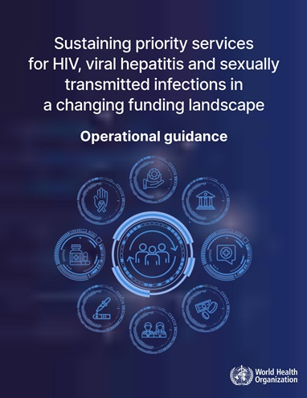

Prioritization to sustain priority services
Tier 1
Tier 2
Facility based testing HIV and syphilis (symptomatic and priority populations)
Targeted community-based testing
Flexible self-testing
AHD & VL monitoring
Syndromic management of STIs
More routine facility-based HIV testing – including for hepatitis
New multiplex (more guidance and evidence pending)
Hepatitis treatment monitoring
CaCx screening
Case-finding & prevention focused testing
Range of cadres – include lay providers, community workers
Facility-based HTS remains a priority - identify key entry points: malnutrition clinics, ANC, TB, STI, family planning

Slide 4




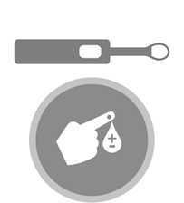
WHO recommends a strategic mix of differentiated HTS approaches
Facility-based HTS
remains a priority and should be routinely offered to all clients of unknown or HIV-negative status
Identify key entry points for both in-patient and out-patients, malnutrition clinics, ANC, TB, STI, family planning services
Focused community-based
In addition to routine offering of facility-based testing
e.g. outreach, CBOs, workplace, clubs, bars.
Network-based testing
A range of approaches (partner services, social network testing, family and household testing services)
Extends testing to partner/family members/social networks. ​
Include distribution of self-tests
HIV Self-testing:
Offering self-test kits for individual, and/or their partner,
Collect their sample (oral or blood), perform tests, and interpret results privately. All reactive results need confirmation.
Testing services
Facility-based
Community-based
Self-testing
Network-based testing
Differentiate and target locations and populations with greatest need

Slide 5
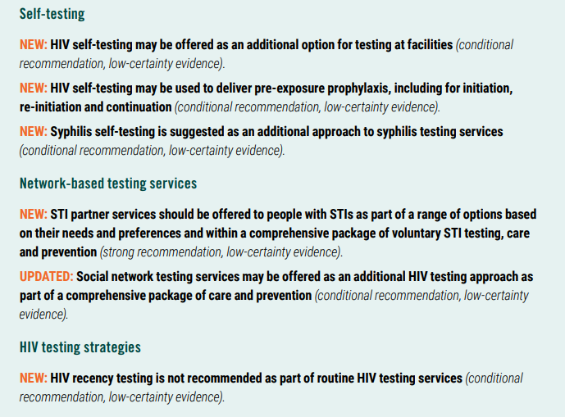
Summary of HIV testing updated recommendations
(2024)

Slide 6
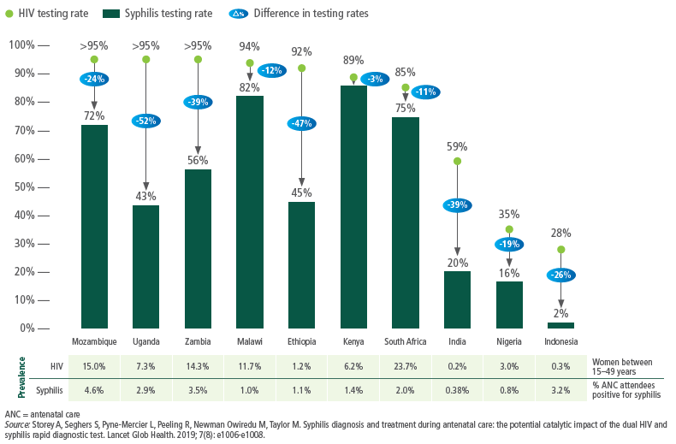
Differences in coverage of testing for HIV and syphilis in pregnant women visiting ANC in 10 countries, 2016–2018
Syphilis testing rates in ANC suboptimal and lagging behind
Introducing dual HIV/syphilis rapid tests as the first test in ANC is a cost-saving approach to reducing mother-to-child-transmission in all settings
Dual HIV/syphilis RDs can help close the gap!
Triple Elimination critical

Slide 7
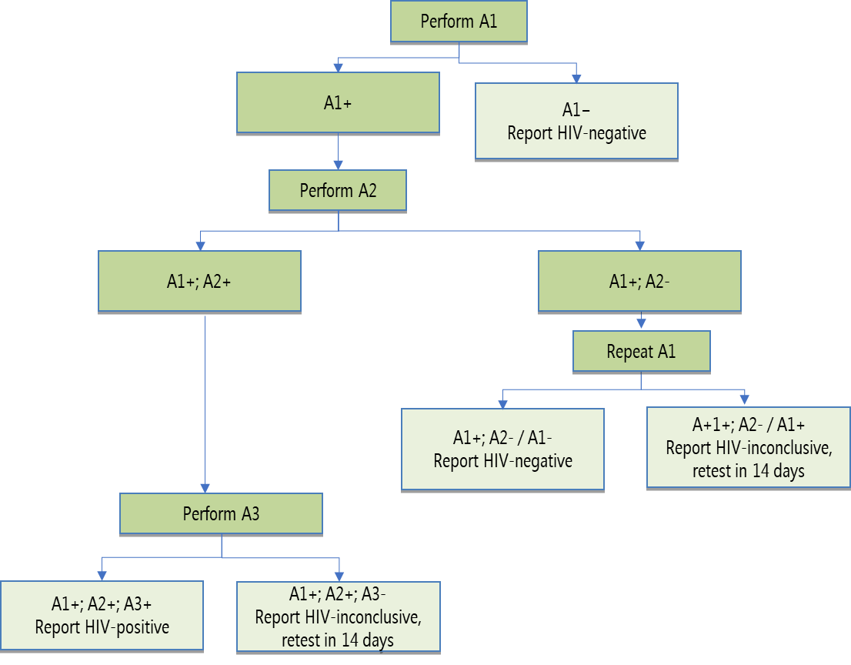

WHO recommended 3-test algorithm for accuracy (>18months)
To prevent misdiagnosis
WHO recommends that an HIV-positive diagnosis be made based on three consecutive HIV-reactive results.
In all settings
Use quality assured tests
Performance characteristics
Highest sensitivity (to rule in all positives [true +false]) | A1
Highest specificity (>A1) (to rule out all false positives) | A2 and A3
The WHO three-test strategy should not be confused with a tiebreaker strategy:

Slide 8

Principles for the selection of HIV products
–Verification study–
Performance characteristics
Highest sensitivity (to rule in all positives [true + false]) | A1
Highest specificity (to rule out all false positives) | A2 and A3
Correctness of the final HIV status is dependent on:
  Specificity of the individual products used (for A1, A2, A3), and
  Probability that any specimen that is falsely-reactive on the first assay (A1) is not also falsely-reactive on the second assay (A2) and third assay (A3)
It is suggested to conduct a verification study of the new testing algorithms in order to:
Identify the combination of products which have minimum possible common cross-reactivity to reduce the risk of false HIV-positive diagnosis. (Note: Products from the same manufacturer should not be used as part of the testing algorithm to minimize common cross-reactivity)
Not intended to reevaluate sensitivity and specificity of individual products!

Slide 9
QMS tool kit adapted to non-laboratory settings development
A significant proportion of HIV testing is performed outside laboratories
There is a need to ensure quality in those settings
A generic, multi-disease toolkit (qualitative serological RDTs - no quantitative nor semi-quantitative methods) adapted to non-laboratory settings in ressources contraint contexts
Tool Kit ≠ guidelines: A simplified approach to operationalize our guidance
Set of tools from different partners and developed specifically: short (short text + links) and practical.

Slide 10
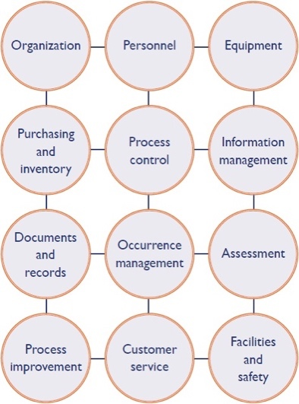






Adaptation of existing tools to non-laboratory testing sites in resource-constrained settings
Laboratories
Non-laboratory testing sites
Simplification
Organization, governance and planning
Workforce development
Procurement, supply chain and inventory management
Process control assessment and continuous quality improvement
Documents, records and information management
Post Market Surveillance
The QMS tool kit does NOT replace existing tools but provide set of crucial activities to implement in case not all can be done

Slide 11
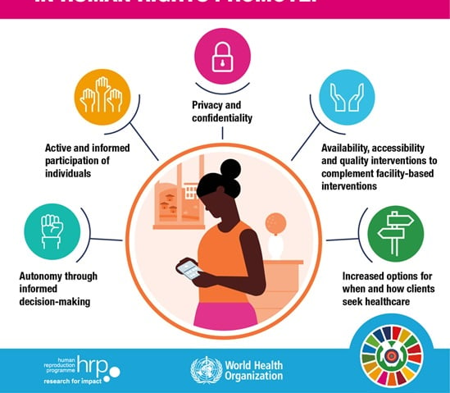
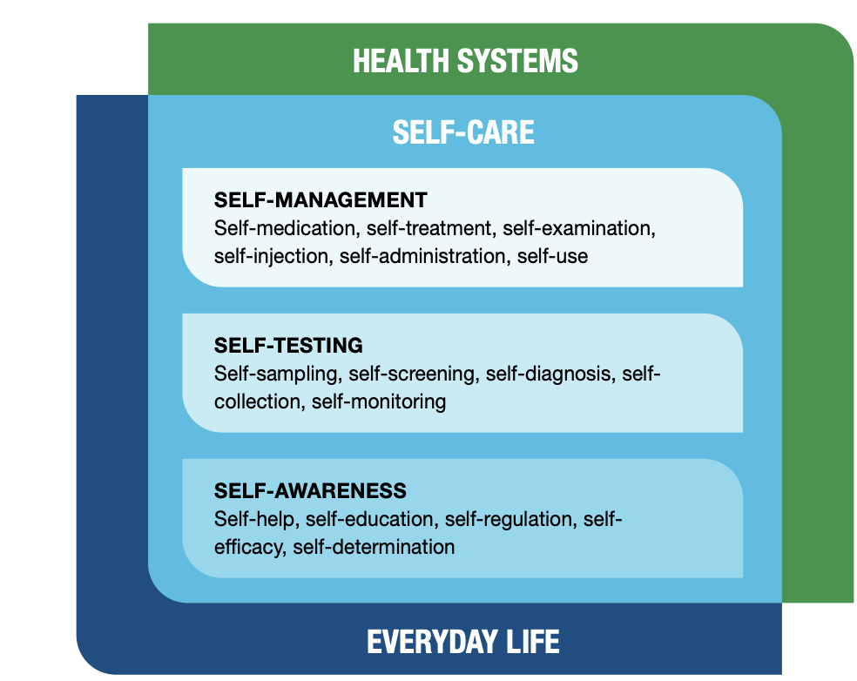

The self-care revolution: Why self-care?
Self-care is the ability of individuals, families and communities to promote health, prevent disease, maintain health and cope with illness and disability with or without the support of a health worker.
Self-testing is a process in which an individual collects their specimen using a simple RDT, performs the test, and interprets their result, when and where they want.
Recommended across all three diseases
There are WHO prequalified blood, oral and urine sample HIVST (WHO supports all three)
All accurate and acceptable

Slide 12

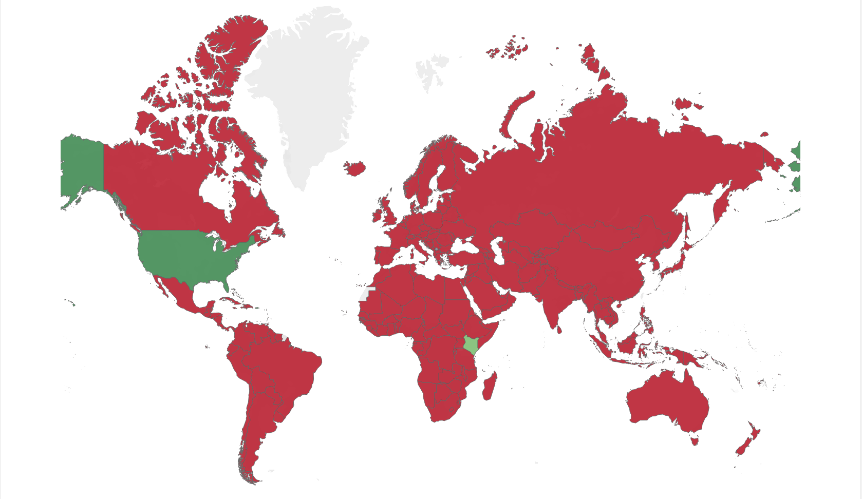
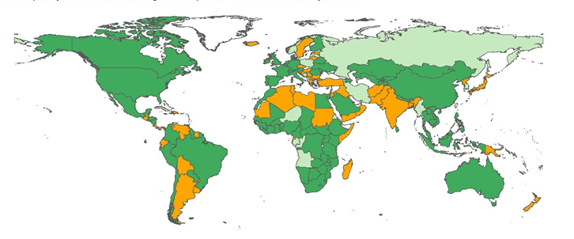
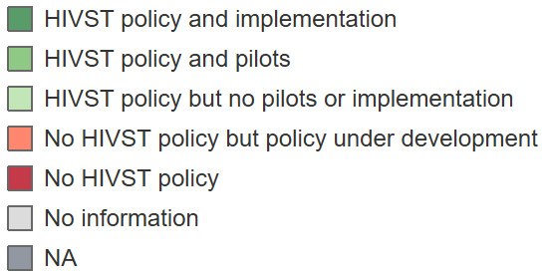
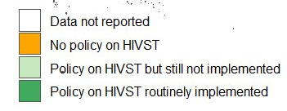
HIVST progress over a decade
2012-2025 - 5000% increase in HIVST policy over 13 years
2012
2025
Policy: 2 countries
Implementation: 1 country, only private sector
Quality-assured products: 1, no WHO PQ
Procurement: ~1 million HIVST kits annually (high-income and research only)
Cost: High cost, wide variability ($5-40)
Policies: 109 countries
Implementation: +100 countries, range of models
Quality-assured products: 10 (8 PQ, 2 ERPD)
Procurement: > 30 million HIVST kits annually (domestic, donor and private sector)
Cost: Moderate to low in LMICs ($1-3), wide variability, high costs remain in some settings
Source: WHO/Unitaid landscape, Global AIDS Monitoring and ARV Survey, AMDS report

Slide 13
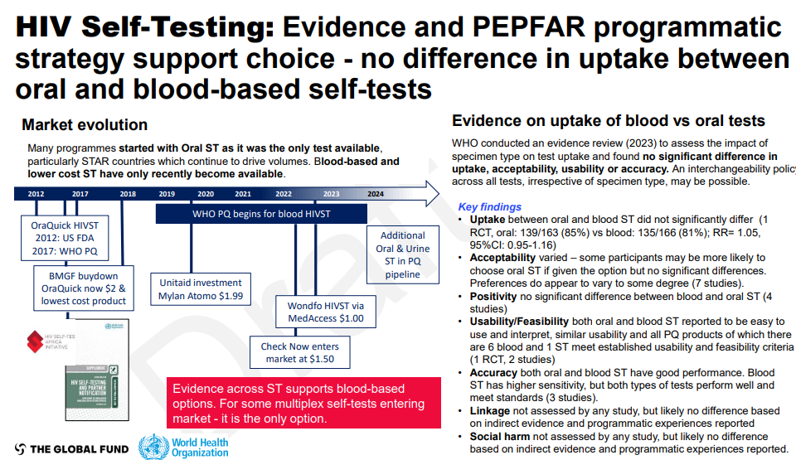
HIVST data shows no difference in uptake between blood and oral options
WHO guidance supports all three
Beijing Wantaï urine ST WHO PQ in April 2025

Slide 14
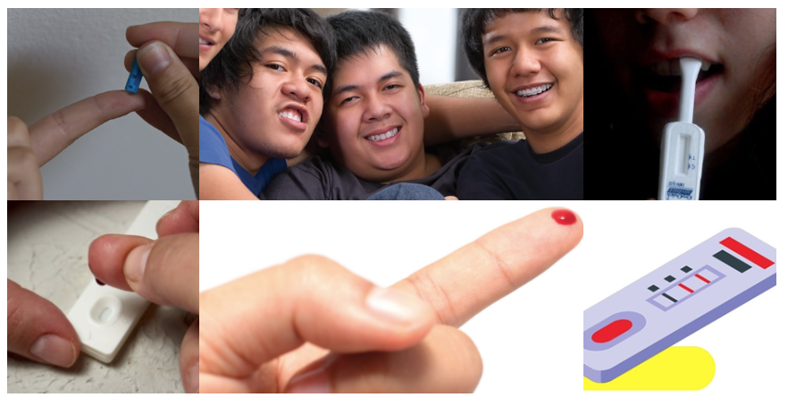
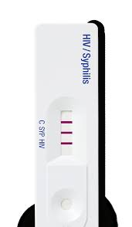
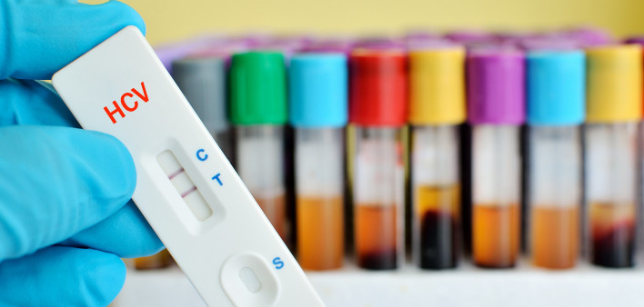
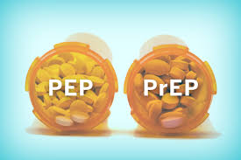
SELF-TESTING
Self-testing recommended across conditions and diseases
No difference in blood, oral and urine self-tests
  All accurate and acceptable - no difference in uptake
  Consider cost-efficiencies
HIVST recommended in health facilities
  Complimenting existing provider-administered HIV testing
  Replacing risk-based screening tools
HIVST recommended for PEP and PrEP (oral & DVR)
  Covers PrEP initiation, re-initiation and continuation
  No need for further testing to confirm negative results
  Ongoing research for long-acting injectable PrEP is needed
Syphilis ST, including dual HIV/syphilis ST, recommended
  More multiplex ST likely in the future, Critical opportunity for integration

Slide 15
HIV self-testing for PrEP and PEP
HIV self-testing may be used to deliver pre-exposure prophylaxis, including for initiation, re-initiation and continuation (conditional recommendation, low-certainty evidence).
HIVST may be considered for use in post-exposure prophylaxis (PEP)
HIVST can be used for initiation, continuation, and re-initiation of PrEP (Oral and DVR)
Could simplify PrEP delivery by reducing the need for frequent clinic visits
Should be driven by client needs and preferences
HIVST in PrEP helps streamline HTS requirements for oral PrEP (daily and on-demand) and the dapivirine ring (DVR)
No need for further testing to confirm negative results
Ongoing research on the role of HIVST in the use of long-acting injectable PrEP (CAB-LA)
https://www.who.int/publications/i/item/9789240095137
https://www.who.int/tools/prep-implementation-tool

Slide 16

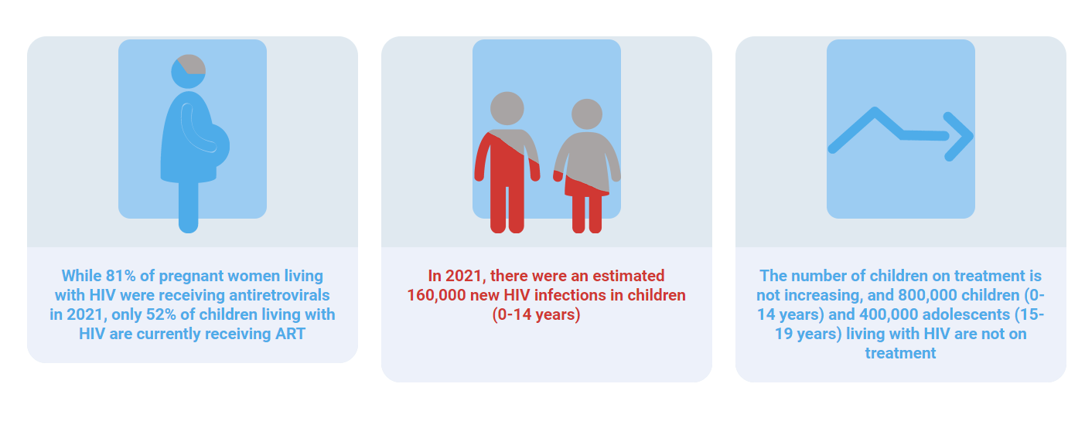
Case finding and equity priorities for HTS
Vision to end paedatric AIDS by 2030 focuses on addressing key gaps:
Missed opportunities for testing and late testing;
Ineffective linkage and lack of support on re-engagement in care where needed; transmission;
Suboptimal testing frequency and offer of prevention
Lack of low-barrier service delivery and restrictive policies (e.g. age of consent for testing)
Children and adolescents being left behind and need focused effort
https://www.childrenandaids.org/global-alliance

Slide 17

Strategic opportunity for cost-savings
Shifting to low-cost HIV test kits and commodities​

Slide 18
Understanding HIV testing costs - costefficiency
+1 billion HIV RDTs were procured in 101 LMICs 2015-2023.
18% increase in HIV RDTs procured from 2021 to 2023*.
Main HIV testing costs are personnel (testers) and commodities (test kits)
Focusing on these two areas is a strategic way to cut costs
*This represents much of large procurers and donor resources not direct procurement figures from EIC/WHO report 2024.
Graph is illustrative and adapted from Vyas et al 2020 https://bmchealthservres.biomedcentral.com/articles/10.1186/s12913-020-05446-5

Slide 19
Prequalified HIV RDTs
22 HIV RDTs for professional use
  17 different manufacturers
8 HIV RDTs for self-testing
  7 different manufacturers
All PQ-ed IVDs meet PQ requirements
ALL IVDs accepted for PQ assessment meet minimal performance characteristics defined by WHO

Slide 20
WHO catalogue prices, Feb 2026
No. | Product name | Manufacturer | Clinical Sensitivity (%) | Clinical Specificity (%) | Price per test
1
2 | STANDARD Q HIV 1/2 Ab 3-Line Test | SD Biosensor, Inc | 100 | 99.3 | US$ 0.72
3 | First Response HIV 1-2.O Card test (Version 2.0) | Premier Medical Corporation Private Limited | 100 | 100 | US$ 0,75
4 | ONE STEP Anti‐HIV (1&2) Test | InTec PRODUCTS, INC | 100 | 100 | US$ 0.55
5 | One Step HIV1/2 Whole Blood/Serum/Plasma Test | Guangzhou Wondfo Biotech Co., Ltd | 100 | 100 | US$ 0.68
6 | Genie Fast HIV 1/2 | Bio-Rad | 100 | 98.5 | EUR 1.2
7 | Diagnostic kit for HIV (1+2) antibody (colloidal gold) V2 | Shanghai Kehua Bio-engineering Co., Ltd | 100 | 100 | US$ 0.70
8 | Determine HIV Early Detect | Abbott Diagnositcs Medical Co. Ltd. | 100 | 99.4 | US$ 0.9
9 | DPP HIV 1/2 Assay | Chembio Diagnostic Systems Inc. | 100 | 99.9 | US$ 2.75
10 | OraQuick HIV 1/2 Rapid Antibody Test | OraSure Technologies, Inc. | 99.1 | 99.8 | US$ 3.0
11 | Rapid Test for Antibody to HIV (Colloidal Gold Device) | Beijing Wantai Biological Pharmacy Enterprise Co. | 100 | 98.5 | US$ 0,53
12 | SURE CHECK HIV 1/2 Assay | Chembio Diagnostic Systems Inc. | 99.8 | 99.9 | US$ 2.1
13 | ABON HIV 1/2/O Tri-Line HIV Rapid Test Device | ABON Biopharm (Hangzhou) Co. Ltd. | 100 | 99.7 | US$ 0.71
14 | INSTI HIV-1/HIV-2 Antibody Test | BioLytical Laboratories, Inc. | 100 | 99.7 | US$ 2,79
15 | Bioline HIV-1/2 3.0 | Abbott Diagnostics Korea Inc | 100 | 99.7 | US$ 0.82
16 | Uni-Gold HIV | Trinity Biotech Manufacturing Ltd. | 99.8 | 99.9 | EUR 0.71
17 | HIV 1/2 STAT-PAK | Chembio Diagnostic Systems Inc. | 99.5 | 100 | US$ 1.2
18 | Determine HIV-1/2 | Abbott Diagnositcs Medical Co. Ltd. | 100 | 98.9 | USD$ 0.90
19 | Geenius HIV 1/2 Confirmatory Assay | Bio-Rad | 100 | 97.3 | EUR 17.5
20 | TrinScreen HIV | Trinity Biotech Manufacturing Ltd. | 100 | 100 | USD$ 0.75
21 | Panbio HIV | Abbott Rapid Diagnostics Jena GmbH | 100 | 99,7 | US$ 1,2
  Source: WHO catalogue 2025; WHO tool kit 2021
Notes:
HIVRDT, 4 supplier are <70 including 2 suppliers around 0,5$
don't forget to include cost of accessories if not part of the packaging
Depending on the accessories, prices can vary (eg: 1,6$ with safety lancet versus 0,9$ with sterile lancet),

Slide 21
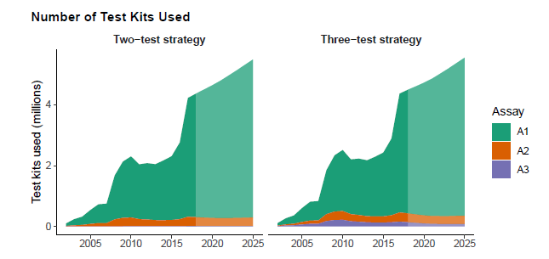
Greatest impact:
Focus on adopting a low-cost first test (A1)
The first test drives HIV testing programme costs
Source: WHO GL 2019; WHO/UNAIDS/Malawi Department of HIV/AIDS, 2019 derived from Maheu-Giroux M et al AIDS 2019. DOI: 10.1097/QAD.0000000000002386.

Slide 22
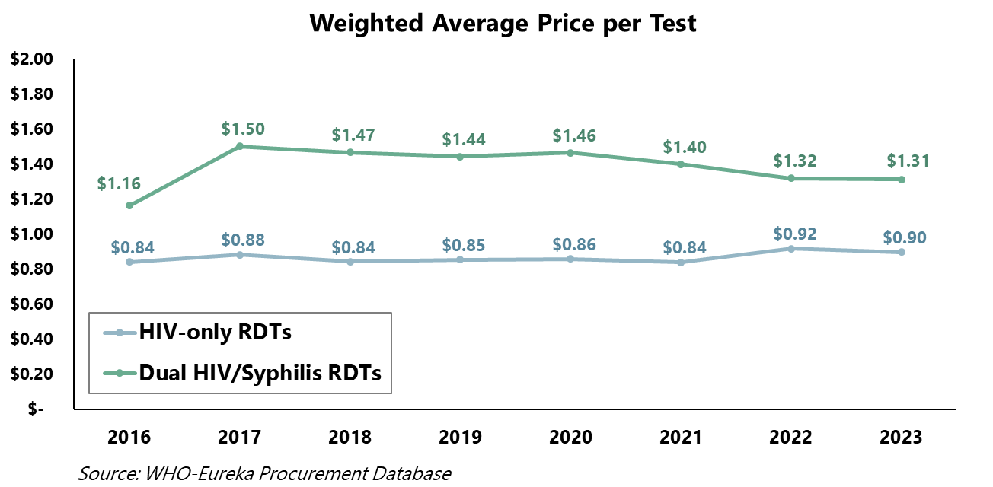
Average weighted price of HIV tests remains high, yet low-cost quality-assured options are available
Average weighted price of HIV tests:
HIV RDT: $0,90
HIV/syphilis RDT: $1,31
HIVST: $2,00
Yet, lower cost quality-assured tests exist
*Note price information includes cost of accessories per WHO sources and catalogue as of 5 May 2025
Reference information: EIC/WHO 2024, WHO catalogue 2025; WHO tool kit 2021; Global Fund 2025
**Abon – owned by Abbott
** SD Bioline – subsidiary of Abbott

Slide 23
Average weighted price of HIV tests remains high, yet low-cost quality-assured options are available
Current opportunities in the WHO catalogue
HIV RDT: +22 PQ’ed ($0,53-$2,79)
  4 manufacturers have tests costing less than $0,70
  5 manufacturers have tests costing $0,70 to $0,75
  All can be used as the first test
Dual HIV/Syph RDT: 3 PQ’ed costing $0,90 to 0,95
HIVST: 8 PQ’ed ($1-$3,29)
  2 manufacturers have tests costing less than $1,50
Average weighted price of HIV tests:
HIV RDT: $0,90
HIV/syphilis RDT: $1,31
HIVST: $2,00
Yet, lower cost quality-assured tests exist
*Note price information includes cost of accessories per WHO sources and catalogue as of 5 May 2025
Reference information: EIC/WHO 2024, WHO catalogue 2025; WHO tool kit 2021; Global Fund 2025
**Abon – owned by Abbott
** SD Bioline – subsidiary of Abbott

Slide 24
Example of savings:
HIV testing for 5 million people annually
Status quo A1 HIV RDT
  $0.90 costs US$4,5 million
Low-cost A1 HIV RDT
  $0.53* costs US$2.65 million
Savings gained
  US$1.85 million savings
  41% instant decrease in annual costs
Could be used to maintain testing coverage and reinvest in lifesaving services
*: lowest cost RDTs with accessories as per May 2025 WHO catalogue
Note this is a simplified and illustrative example based on costs in previous slides
Notes:
This is not a formal costing

Slide 25
Common misconceptions
Lower cost means lower quality
WHO encourages countries to use quality-assured HIV tests to maintain quality and accurate testing
Quality-assured products (e.g. WHO pre-qualified) have undergone a stringent performance and quality assessment
Oral-based HIVST are better than Blood-based HIVST or vice-versa
There are pre-qualified blood, oral and urine-based HIV self-tests that are safe and accurate
WHO supports all three
The urine-based HIVST has been recently pre-qualified

Slide 26

Differentiate testing, strategic mix and target locations and populations with greatest need
Use 3-test strategy to maintain quality and prevent misdiagnosis
Include blood-based HIVST in the pool of HIV self tests
Switching to lower-cost tests can result in cost savings
Cost-efficiency in HIV testing services is critical in sustaining essential HIV services
Lower-cost tests do not imply lower-quality tests
Cut costs without cutting quality – use quality assured products
Countries should focus on adopting lower-cost tests:
  HIV RDTs: ≤ $0.70,
  Dual HIV/syphilis RDTs: ≤ $0.95,
  HIV self-tests (HIVST): ≤ $1.50
Focus on switching out the first test for the greatest and most immediate savings
Countries must push manufacturers to fund training and quality assurance activities in new agreements and tenders.

Slide 27
ACKNOWLEDGEMENTS
HIV Testing team
HIV, TB, Hepatitis, STI Department

