Slide 1

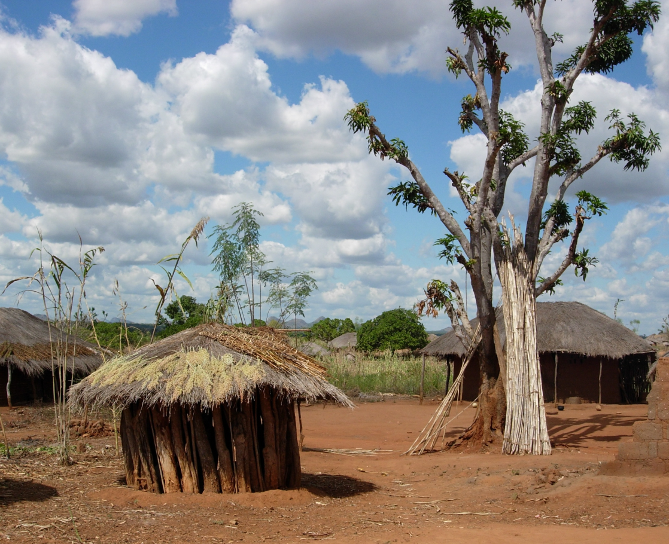
The value of Community ART Groups (CAG) for HIV patients on ART in rural northern Mozambique
L.F. Jefferys¹, J. Hector¹, M.A. Hobbins², J. Ehmer², N. Anderegg³
¹SolidarMed, Pemba, Mozambique, ²SolidarMed, Lucerne, Switzerland, ³University of Bern, Institute of Social and Preventive Medicine, Bern, Switzerland

Slide 2
Background
Mozambique has 1.5 million people living with HIV*
HIV prevalence 11.5%*
Anual deaths due to HIV: 45,000*
60% coverage of ART ^{ɸ}
In 2013, MOH recommended the implementation of CAG in Mozambique as a strategy to improve retention of patients in HIV treatment and care
*UNAIDS 2014
ɸ Global AIDS response programme report 2014

Slide 3
Community ART Groups (CAG)
  Rotate monthly clinic visits among members
  Receive medication for all group members
  Reduce time and money spent on attending consultations
  Form a social network within a community to reduce stigma and increase available support and empowerment
Up to 6 people can join a CAG
Voluntary partication
Eligibility criteria: Age>15 years, CD4 >200, Non-pregnant, clinical status

Slide 4
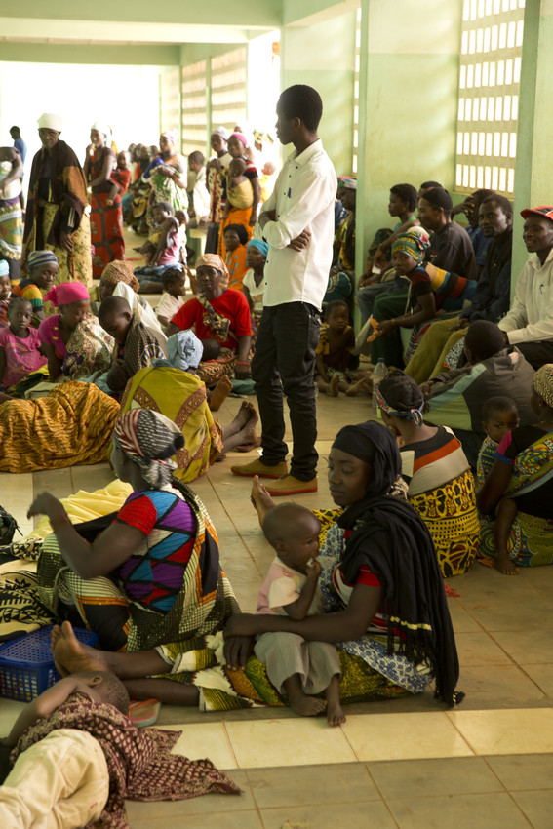
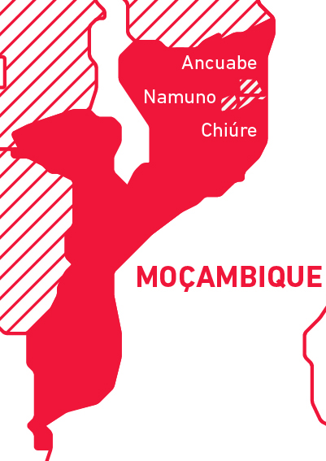
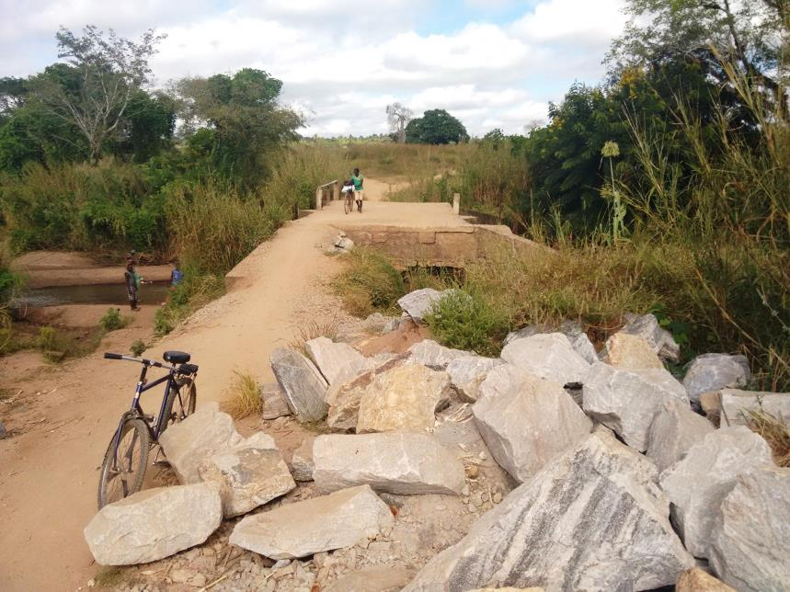
District of Ancuabe, Mozambique
Retention of patients in ART: 6 months 76%, 1 year: 69%
Notes:
Why

Slide 5
Implementation of CAG in Ancuabe
Lay counsellors provide information whilst patients are waiting for their clinic appointment
Interested people from the same village can group together, after eligibilty screening by counsellor
Followed up by counsellor in the community
A medical officer supervises the work of the lay counsellors

Slide 6
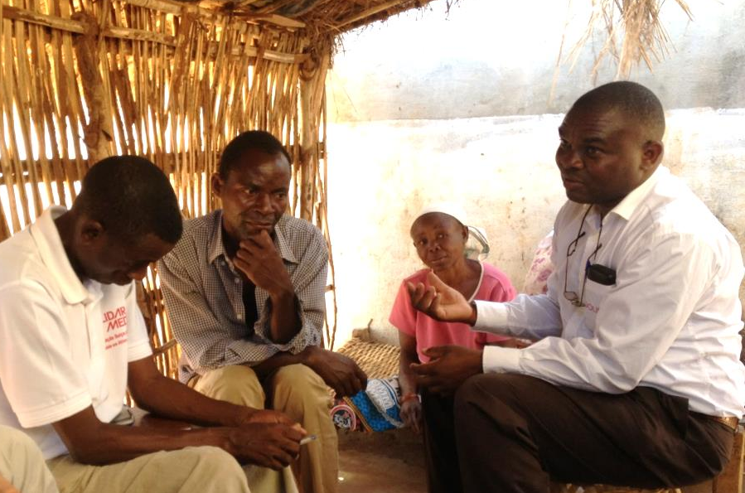
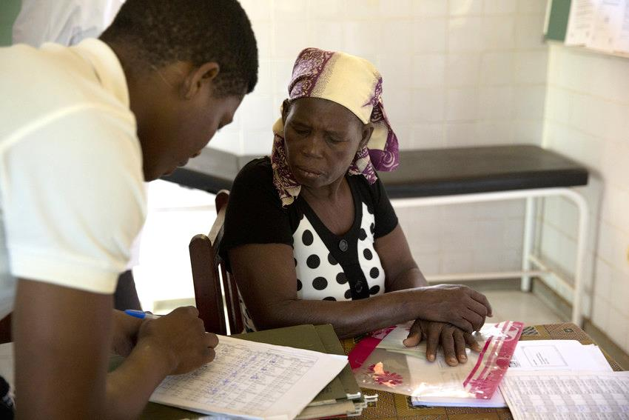
Study Objectives
Who are joining the CAG ? Comparison between CAG and non-CAG.
Is there an association of being in CAG with improved health outcomes?

Slide 7
Selection of eligible patients
3082 patients starting ART 2010-2015 in Ancuabe
1624 patients meeting eligibility critera
(age, non-pregnant, follow up >6 months)
1306 patients with values for variables
180 – joined a CAG
1126 – did not join a CAG
Notes:
Time ART – CAG median: 581 days (308-938)
< 6 months: 26 patients, 6 months-1 year: 27 patients, 1 year – 2 years: 53 patients, 2 years – 3 years: 43 patients, >3 years: 28 patients.

Slide 8
Baseline characteristics
 | All (N=1306) | CAG (N=180) | Non CAG (N=1126)
Sex [N(%)] male female | 484 (37%) 822 (63%) | 53 (29%) 127 (71%) | 431 (38%) 695 (62%)
Median age (IQR) [years] | 33.1 (26.2-41.3) | 35.2 (28.4-45.2) | 32.9 (26.0-40.9)
Median CD4 cell count at ART initiation (IQR) [cells/µL] | 257 (149-352) | 261 (175-362) | 256 (146-351)
WHO stage at initiation [N(%)] 1 2 3 4 | 313 (24%) 298 (23%) 535 (41%) 160 (12%) | 33 (18%) 41 (23%) 78 (43%) 28 (16%) | 280 (25%) 257 (23%) 457 (41%) 132 (12%)
Median days late in the 1st 6 months of treatment (IQR) | 23 (6-49) | 21 (8-41) | 24 (6-49)
Notes:
Total follow up time (mean): 2.2 years, CAG 3.1 years, non-CAG 2 years

Slide 9
Associations with CAG participation
 | OR | 95%-CI | p-value
Sex [N(%)] male female | 1 1.72 | (1.22-2.48) | 0.021
Age (per 1-year increase) | 1.02 | (1.01-1.03) | 0.005
CD4 cell count at ART initiation (per 100 cells/increase) | 0.99 | (0.91-1.07) | 0.681
WHO stage at initiation [N(%)] 1 2 3 4 | 1 1.32 1.49 1.72 | (0.81-2.12) (0.97-2.34) (0.99-2.99) | 0.105
Days late in the 1st 6 months (per 10 day increase) | 0.96 | (0.91-1.01) | 0.160
Statistical method: Multivariable logistic regression

Slide 10
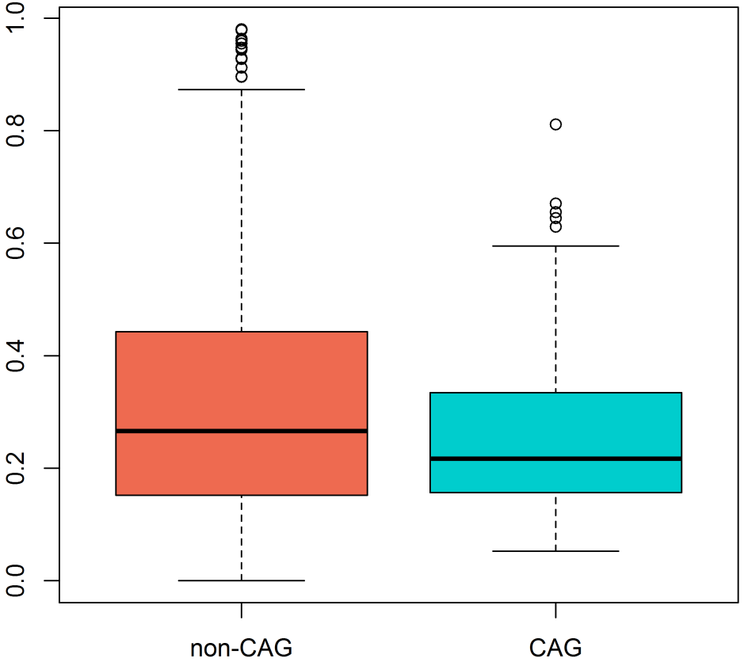
Outcomes: Medication refills
Percentage of time without medication
P=0.01
Notes:
Total follow up time (mean): 2.2 years, CAG 3.1 years, non-CAG 2 years

Slide 11
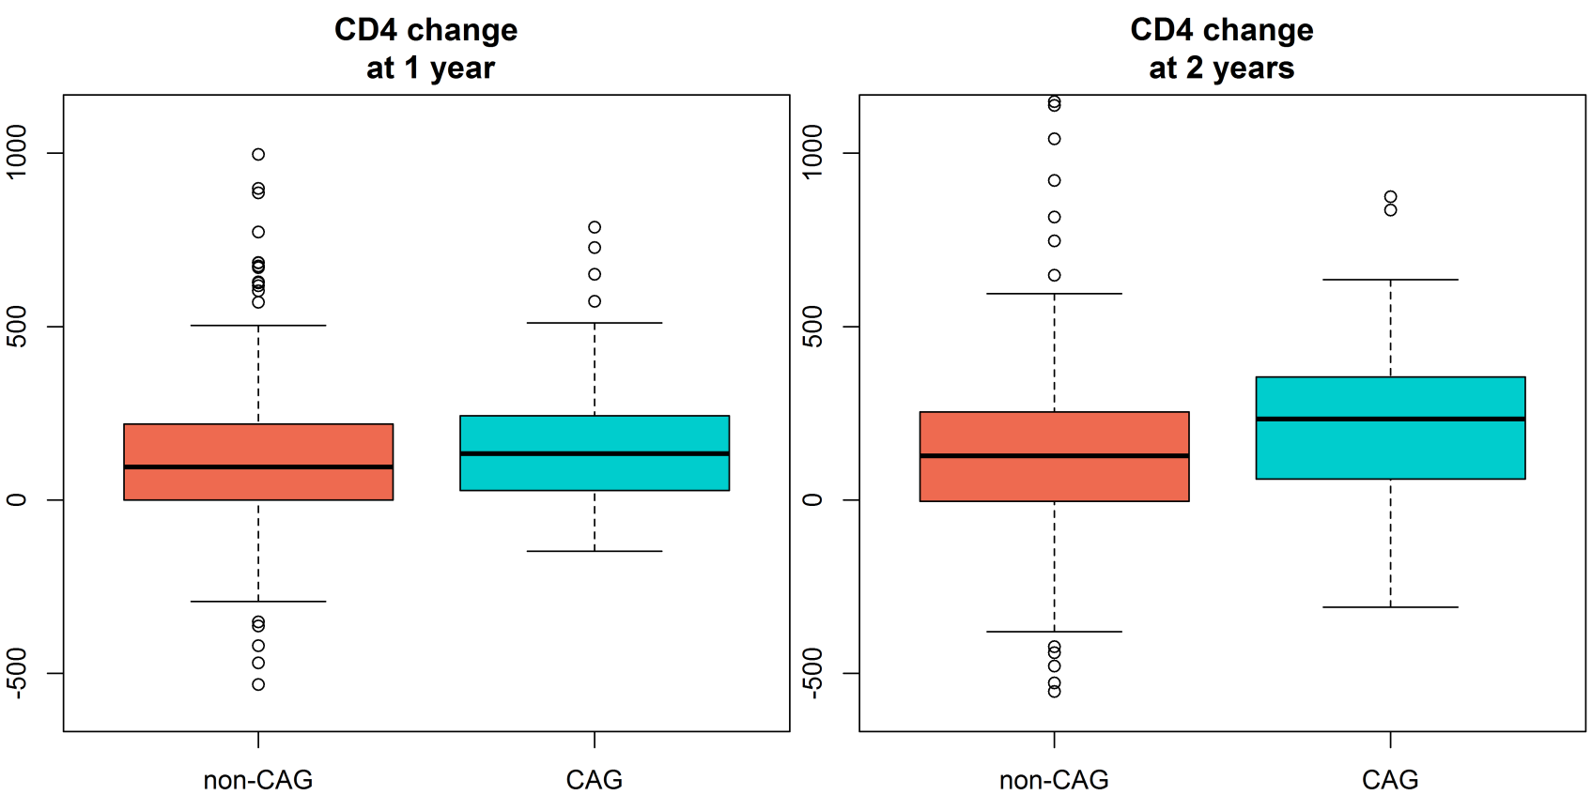
Outcomes: Response to ART
P= 0.07
P=0.01
234
95
134
128

Slide 12
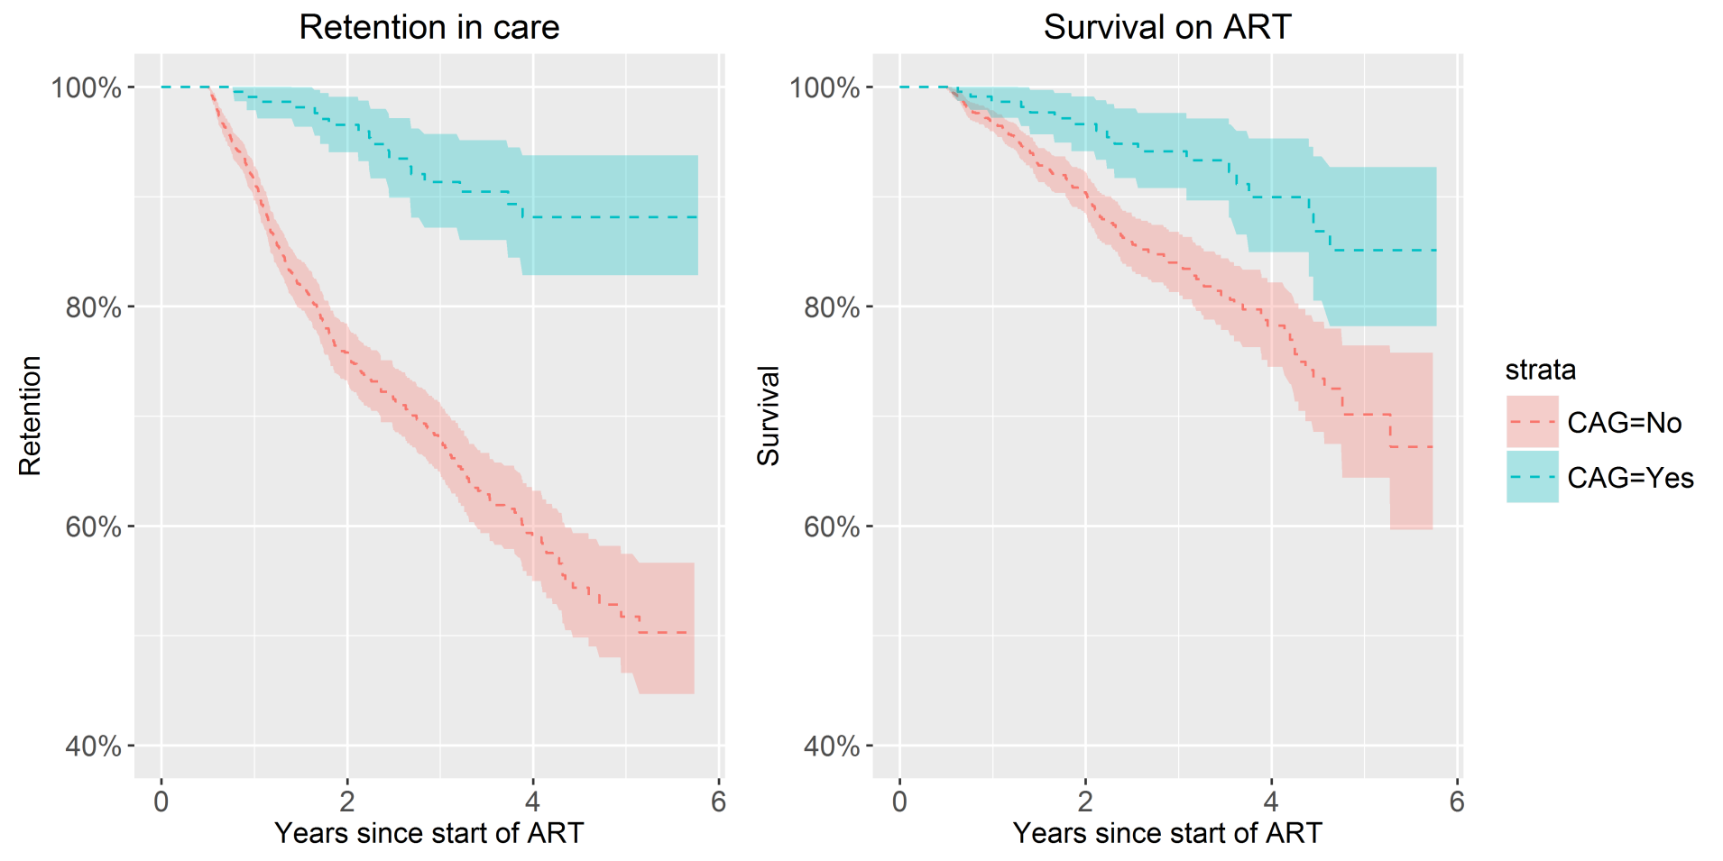
Survival and Retention in Care
*LTFU was defined as having no visit >6 months prior to database closure
*During 3035 person years of follow up
Notes:
10.5% of patients died (8.9% in CAG, 10.7% in non-CAG), 22.6% were LTFU (6.1% in CAG, 25.2% in non-CAG)

Slide 13
Survival and Retention in Care
CAG-participation was associated with a 55.1% reduction of the risk of mortality (adjusted hazard ratio [aHR] 0.449, 95%CI 0.264-0.762)
CAG-participation was associated with a 84.3% reduction of the risk of LTFU (aHR 0.157, 95%CI 0.086-0.288)
Cox proportional hazards models Adjusted for sex, age, CD4 and WHO stage at baseline, and adherence during 1st 6 months of treatment

Slide 14
Conclusion
Patients who joined a CAG were better attenders and had better health outcomes
We should focus on attracting more men into CAG
These findings support the use of CAG to improve retention in care and health outcomes in rural settings
We still need strategies to improve retention in care for pregnant, lactating women and children

Slide 15
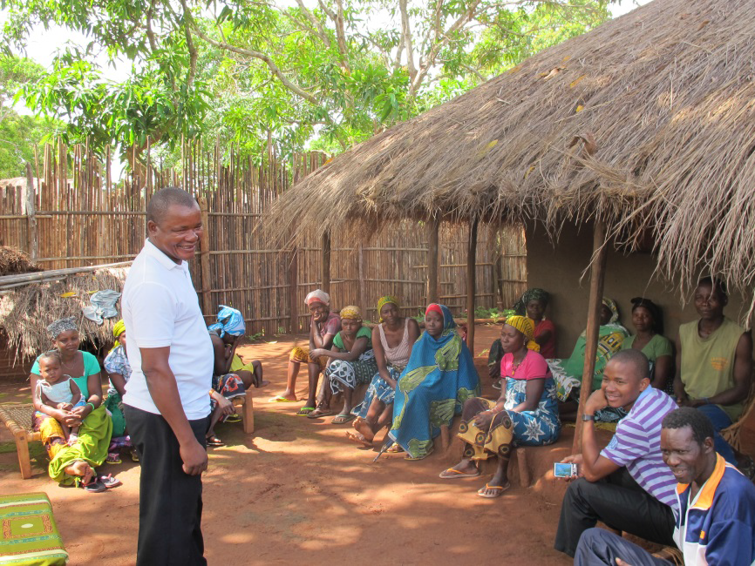
Thank you

