Slide 1


Differentiated ART delivery for specific populations in action:
What is happening in Zimbabwe?
Dr. Tsitsi Apollo
Ministry of Health and Child Care, Zimbabwe

Slide 2
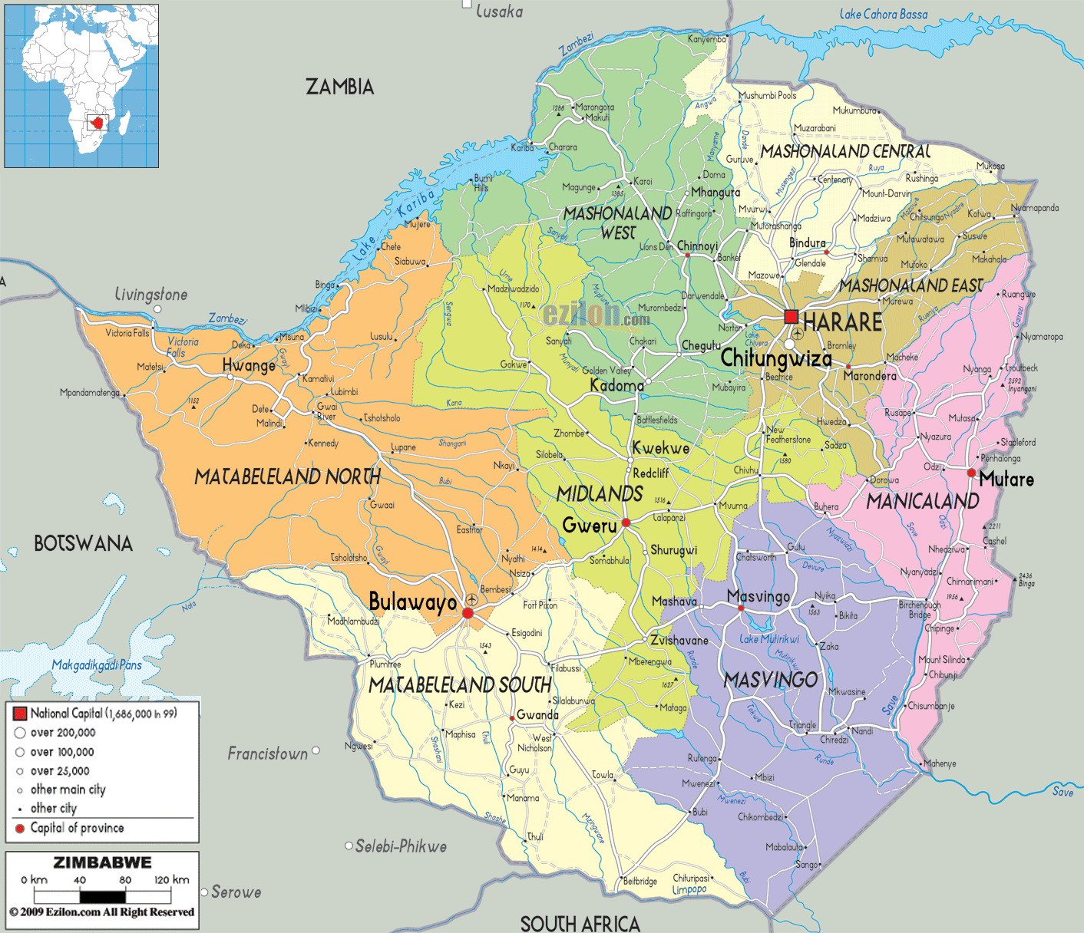
Introduction
Zimbabwe has a population of 13m people (Census, 2012)
  An estimated 1,3 m PLHIV (7% are children)
  HIV Prevalence: 13.8% among 15-49 yr. age group
    Female 16.7%
    Male 10.5%
  HIV Incidence: 0.48 in 2016 (down from 1.42 in 2011, 0.98 in 2013)
  Need for PMTCT 65 158
  MTCT rate 5,2%
  TB/HIV co-infectivity rate 70%
Notes:
Zimbabwe has a projected population of 13m people and is among the countries in Sub-Saharan
Africa worst affected by the HIV

Slide 3
Background
Zimbabwe initially decided to differentiate service delivery to improve:
Quality of HIV services
Client satisfaction
Health system efficiencies
2015 OSDM endorsed differentiated ART delivery approach for stable adults

Slide 4
2017 updated Operational & Service Delivery Manual (OSDM)
2017 OSDM included further differentiation:
Across the continuum from testing to long term retention
To other populations including families and key populations
Updated the job aides

Slide 5
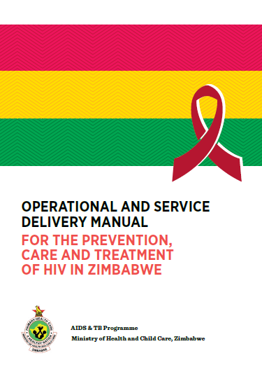
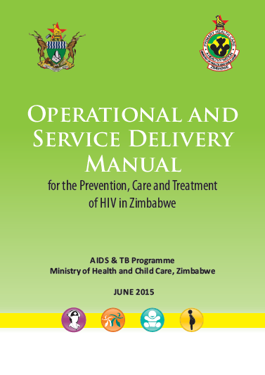

February 2017

Slide 6
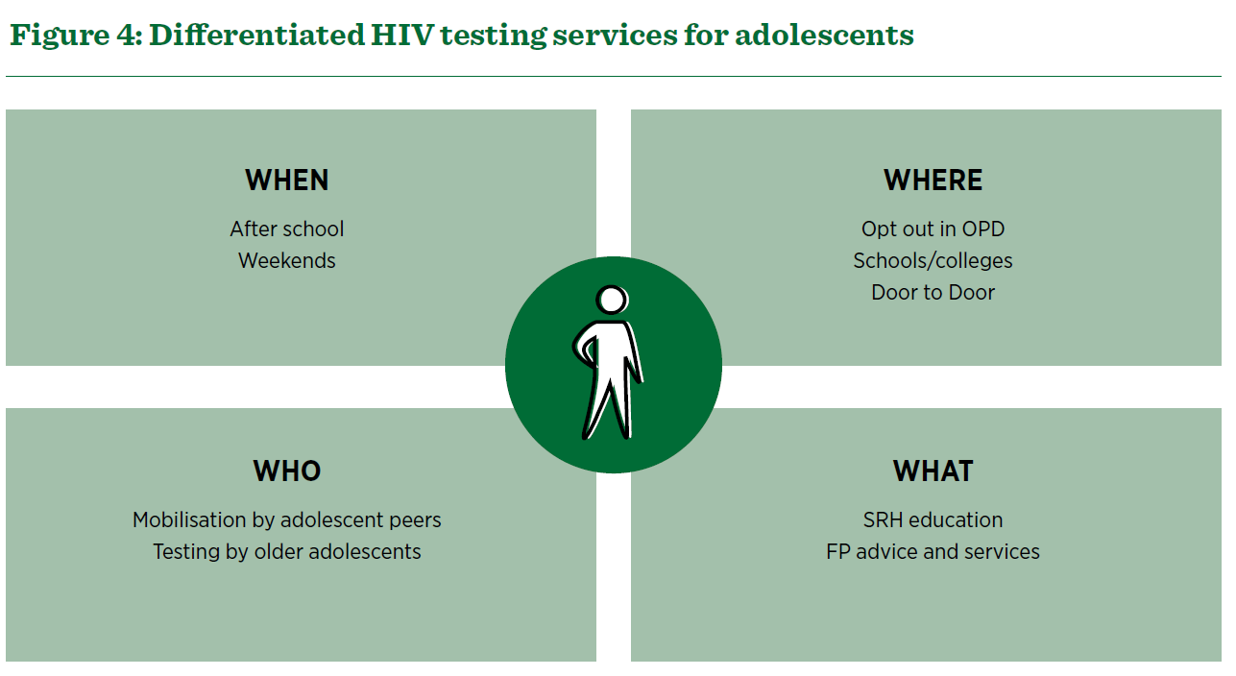

Slide 7
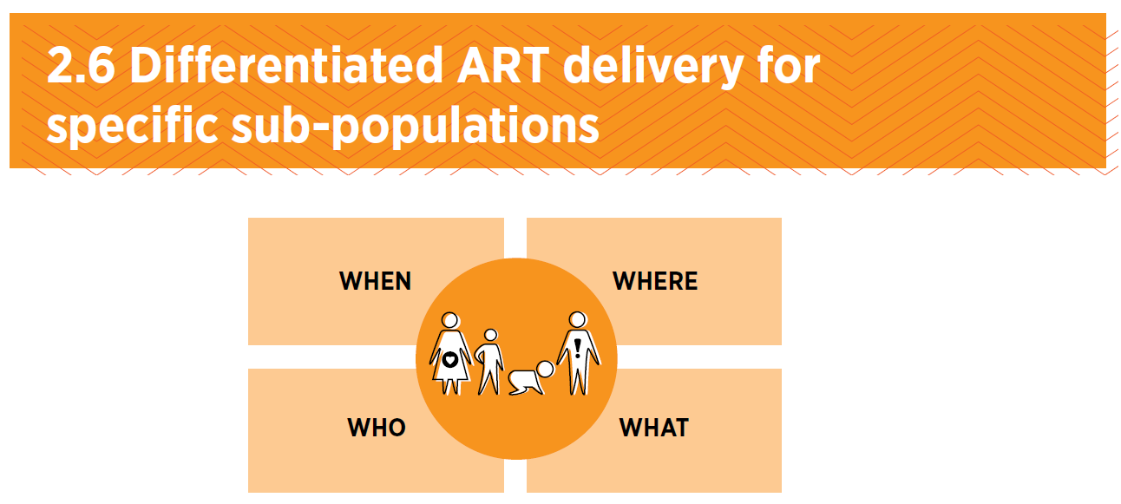

Slide 8
How we differentiated ART delivery for stable adults
Eligibility criteria – who is a stable adult
Setting out the building blocks for ART refill and clinical consultation visits
  Frequency (WHEN)
  Location (WHERE)
  Service provider (WHO)
  Service package (WHAT)
Endorsed 5 models to choose from at facility level

Slide 9
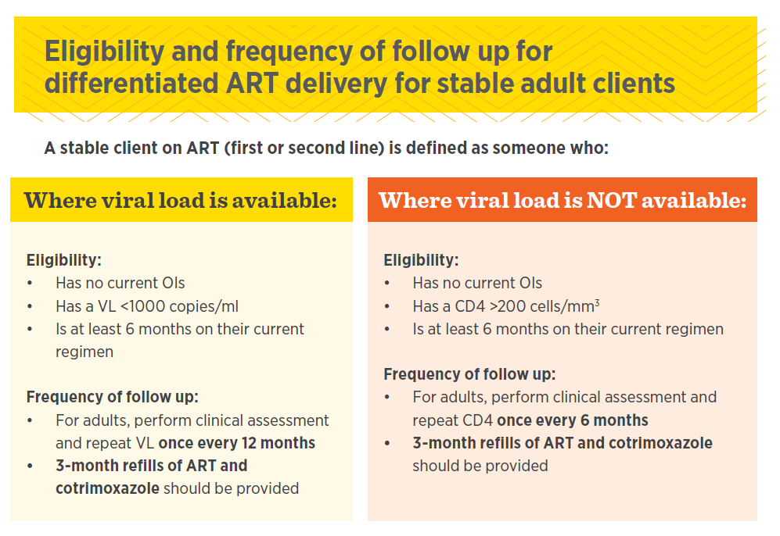

Slide 10
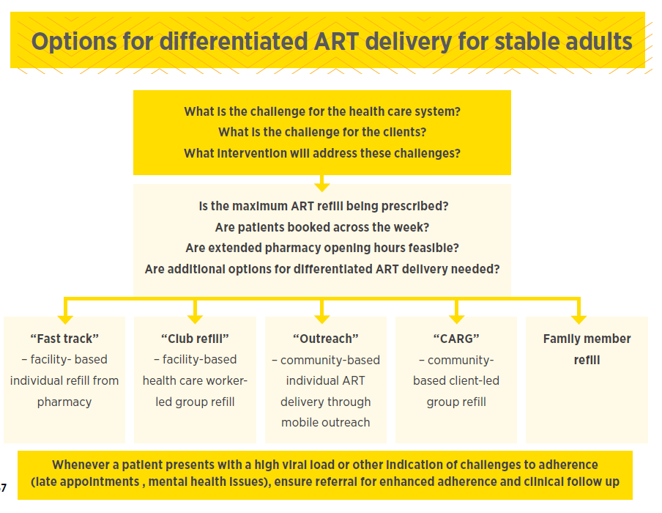
1.
2.
3.
4.
5.
Notes:
These are 5 ART delivery models which can be adopted by facilities.

Slide 11
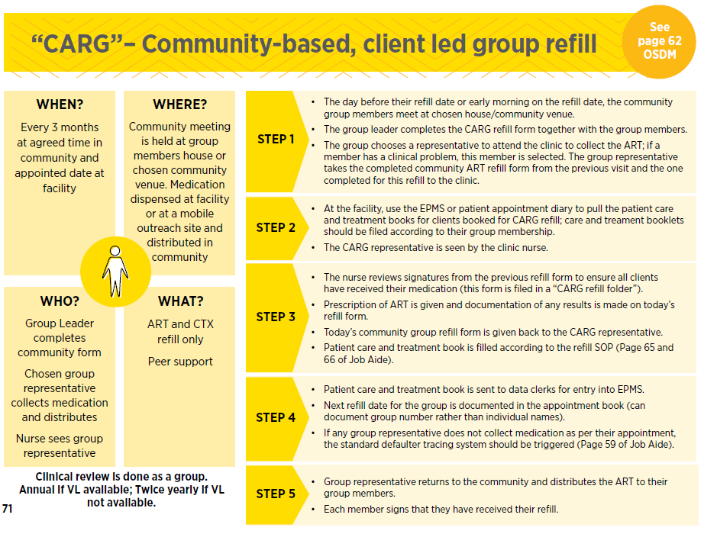
Job Aide each model:
Combined building blocks + SOP
Building blocks
SOP
Notes:
These are 5 ART delivery models which can be adopted by facilities.

Slide 12
How we have approached differentiated ART delivery for family and key populations
Determined eligibility criteria
Determined ART delivery building blocks for each family and key population
Assessed where stable adult models could be adapted and used for family and key populations
Set out SOPs for any new models or added clarifications for existing models

Slide 13
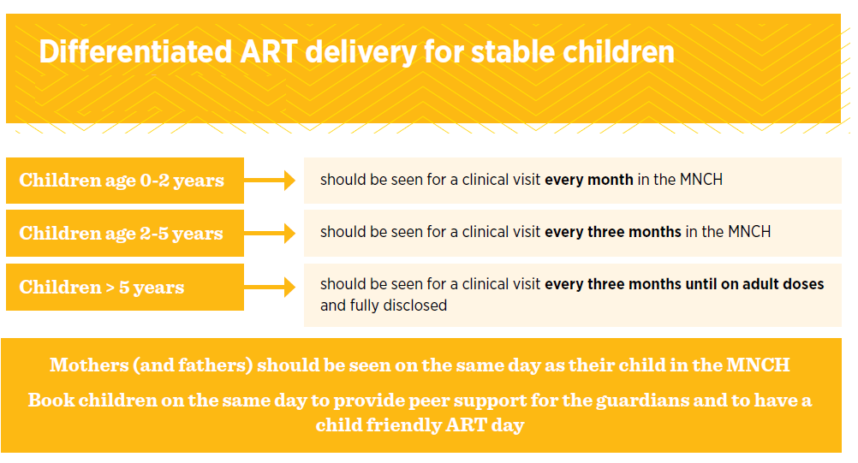
Stable Children

Slide 14
Differentiated ART delivery models for children
Which models allow access for stable children or have been adjusted for children?
  Family member ART refill
  Club refill

Slide 15
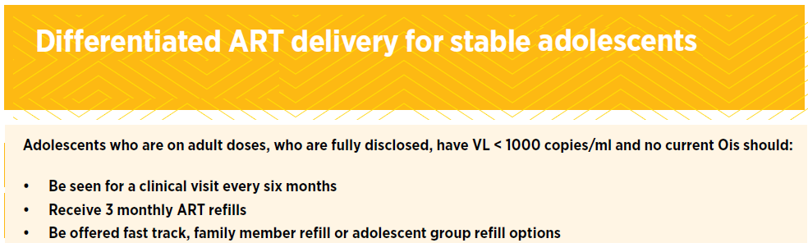
Stable Adolescents

Slide 16
Differentiated ART delivery models for adolescents
Which models allow inclusion of stable adolescents or have been adjusted for adolescents?
  Family member ART refill
  Facility-based adolescent group refill
  Fast track

Slide 17
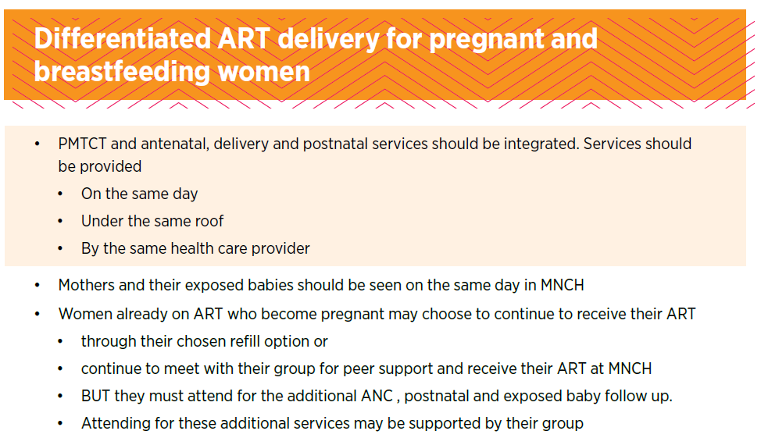
Stable Pregnant and Breastfeeding women (PBFW)
Differentiates btw women stable on ART before pregnancy and diagnosed during pregnancy

Slide 18
Differentiated ART delivery models for PBFW
Which models allow access for women who become stable in breastfeeding period?
  Club refill integrated with baby follow-up
  Which models allow access for women who become already stable when conceive?
  Can continue in any of 5 adults models provided attend MNCH care OR
  Can attend for peer support but get ART refill from MNCH service

Slide 19
Stable Key and Vulnerable Populations
Same eligibility criteria as adults
Same when/where/who and what except:
  Prisoners: 1m refills with clinical review 3 monthly
  Mobile populations: Can provide 6m refills/family member can collect refills
  All KPs: considers stand alone services where feasible and can use peer expert client for refills
  PWID: add needle exchange and methadone replacement therapy to package of services

Slide 20
Differentiated ART delivery models for key populations
Which models allow inclusion of stable KP or have been adjusted for KP?
  All 5 adult models
  Consider group type models with same KP

Slide 21
Conclusion/Way Forward
Progress with implementation in 2017
Extending differentiated ART delivery to family and key populations is possible
National sensitisation on the OSDM, Job Aide and guidelines – all provinces, partners, mentors
Cascade training to sub-national levels through mentorship programme
Nurse tutors trained; updating pre – service training package to include DSDs
Revision of the Integrated HIV Training (HIT) curriculum for in – service training

Slide 22
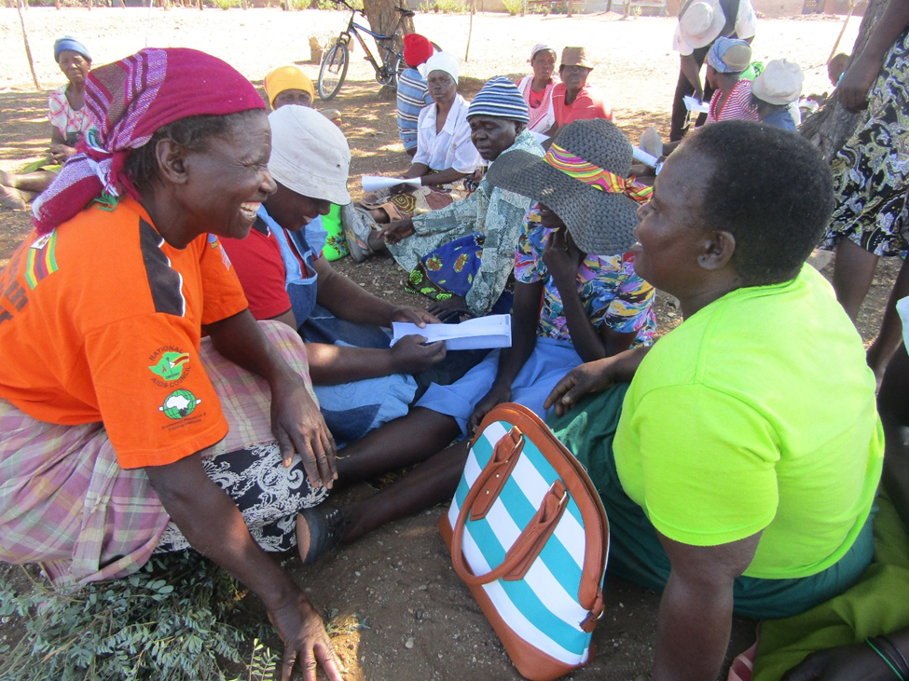
I Thank You

