Slide 1
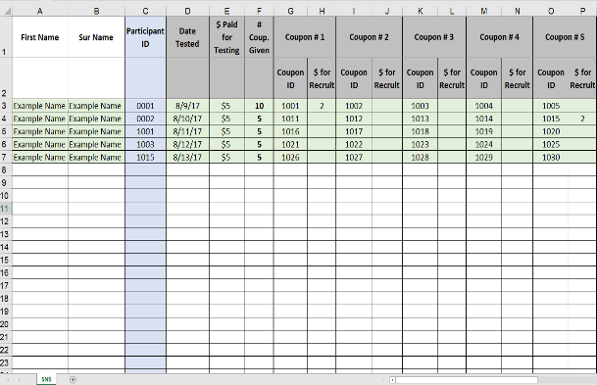
Social Network Strategy - HTS
Start by finding recruiters
Recruiter Instructions (SNS-Form A)
Step 1
Step 4
Step 5
Step 6
Step 2
Identify people in your network (friends, acquaintances, sexual partners, or relative) who may be at risk of HIV infection.
Consider if these network members may be interested in receiving an HIV test if they can receive a small incentive when they get tested.
Tell your network member that the results of his/her HIV test will never be shared with you.
A friendly professional can be reached by the phone number for any questions about HIV testing location or about their test results.
Contact the HIV testing location to inquire about any referral incentives owed to you.
Step 3
You will receive referral coupons to give to them to direct them to a friendly and confidential HIV testing location.
Step 7
Refer to the SNS Coaching Guide for detailed coaching techniques to improve recruitment.
Trained staff may ask HIV+ clients to consider recruiting social or sexual network members who may be at risk for HIV
Peer recruiters may be trained and incentivized to initiate social network testing
Referral Coupon (SNS-Form B)
Recruiters (HIV+ and high-risk negative clients) are instructed on referring network members for HTS
Friend code:________
00055
Referral Coupon
FRIENDS PROJECT
[Insert logo or symbol to identify project]
Recruiters are given referral coupons to give to their “high-risk” network members for HTS (SNS-Form B)
The person presenting this coupon is eligible to receive a free test and an incentive by presenting at a participating site.
Participating sites:
Site A
Insert address and directions or a small map
Hours: 10am – 6pm, M-F
Site B
Insert address and directions or a small map
Hours: 2pm – 8pm, M-F
Recruitment of network members takes place
For questions about the Friends Project, please call XXX-XXX-XXXX.
Recruiters receive a modest incentive (e.g., ~2-3 USD, airtime, other) for each network member who completes HTS
Coupon Tracking (SNS-Form C)
Network members who test for HIV (HIV+ and high-risk HIV- associates) are offered the opportunity to recruit their network members for HTS
Recruitment of network members and incentive distribution should be tracked using SNS-Form C

Slide 2
Recruiter Instructions (SNS-Form A)
Step 1
Step 4
Step 5
Step 6
Step 2
Identify people in your network (friends, acquaintances, sexual partners or relative) who may be at risk of HIV infection.
Consider if these network members may be interested in receiving an HIV test if they can receive a small incentive when they get tested.
Tell your network member that the results of his/her HIV test will never be shared with you.
A friendly professional can be reached by the phone number for any questions about HIV testing location or about their test results.
Contact the HIV testing location to inquire about any referral incentives owed to you.
Step 3
You will receive referral coupons to give to them to direct them to a friendly and confidential HIV testing location.
Step 7
Refer to the SNS Coaching Guide for detailed coaching techniques to improve recruitment.

Slide 3
SNS Coaching Guide (1)
Coach’s Name:
Date of Coaching Session:
Name of Recruiter:
Contact Information for Recruiter:
Purpose: These questions can be used as a guide to help the recruiter identify high-risk members of their network and strategize how to effectively recruit them. In the United States context, this coaching has helped improve HIV test yield.
Introduce the Coaching Session
What is your understanding of what I am asking you to do?
Let’s talk about confidentiality. None of the information you have told me will be shared with any other person. The notes I have taken will be kept in a locked file cabinet and will be used only as a reminder on what the plan was for each person.
Identify Network Members
Next I’d like for us to talk about someone you know who you think should test for HIV and who you’d be willing to have a conversation with.
What would you like to call this person? You don’t have to say their name.
How would you describe your relationship to this person?
Please describe this person. (If necessary to assist with coaching, probe to get information on age, gender, etc.)
Why do you think this person could be at risk for HIV?
Do you believe this person has ever tested for HIV before?
Coach – Develop a Plan
When and where would you bring up the subject of HIV testing?
How would you bring up the subject of testing for HIV with this person? What will you say about it?
How do you think this person would react to you bringing up the subject of testing for HIV?
How would you respond to those reactions?
Do you think there is any possibility this person would react in a violent way?
Do you think the person will ask you about your HIV status? If so, how would you respond?
Centers for Disease Control and Prevention, October 22, 2016
Social Network Strategies to Increase HIV+ testing yield

Slide 4
Coach’s Name:
Date of Coaching Session:
Name of Recruiter:
Contact Information for Recruiter:
SNS Coaching Guide (2)
Coach – Develop a Plan
How would you disclose your HIV status? How comfortable are you with disclosing your status and your decision to test? (Discuss approaches for disclosing their own HIV status their network members, should they choose to do so.)
If you are not comfortable disclosing your status, how can you discuss (the importance of) testing without revealing your HIV test results/status? (Discuss approaches to raising the topic of HIV counseling, testing, and referral to network members without revealing their own status.)
We can provide the following types of testing: [X or Y]. Which of these do you think this person is most likely to accept?
Here are the locations where we can provide testing: [A, B, C]. Where do you think this person is most likely to test?
Do you prefer to refer this person to testing (refer), come in with him/her (escort), or meet in an agreed upon location where testing can be provided (coordinate)?
Let’s talk a minute about how the incentive program works. What questions do you have about it? How will you explain it to your friends?
Let’s talk about how to respond to any additional questions from network members about HIV transmission risks, available support services, confidentiality or privacy, or any other issues/questions your friends may have.
Summarize and Close your plan with the Recruiter
Let me summarize your plan for your network members.
Does anything about this plan make you uncomfortable?
How confident do you feel that you can carry out this plan with your friend/relative/associate?
I will want to follow up with you to see how things went. Let’s talk about our plan for that follow up.
26. What final questions or concerns do you have?
Centers for Disease Control and Prevention, October 22, 2016
Social Network Strategies to Increase HIV+ testing yield

