Slide 1
STEPS TO INDEX TESTING

Slide 2
What are the 10 Steps of Index Testing?
Step 1. Introduce the concept of Index Testing during pre-test session or
Step 2. Offer Index Testing as a voluntary service to all clients testing HIV-positive or
Step 3. If client accepts participation, obtain consent to inquire about their partner(s)
Step 4. Obtain a list of sex and needle-sharing partners and biological children <19 with
Step 5. Conduct an intimate partner violence (IPV) risk assessment for each
Step 6. Determine the preferred method of partner notification or child testing for each
Step 7. Contact all named partners and biological children <19 with unknown status
Step 8. Record outcomes of partner notification and family
Step 9. Provide appropriate services for children and partner(s) based
Step 10. Follow-up with client to assess for any adverse events associated

Slide 3
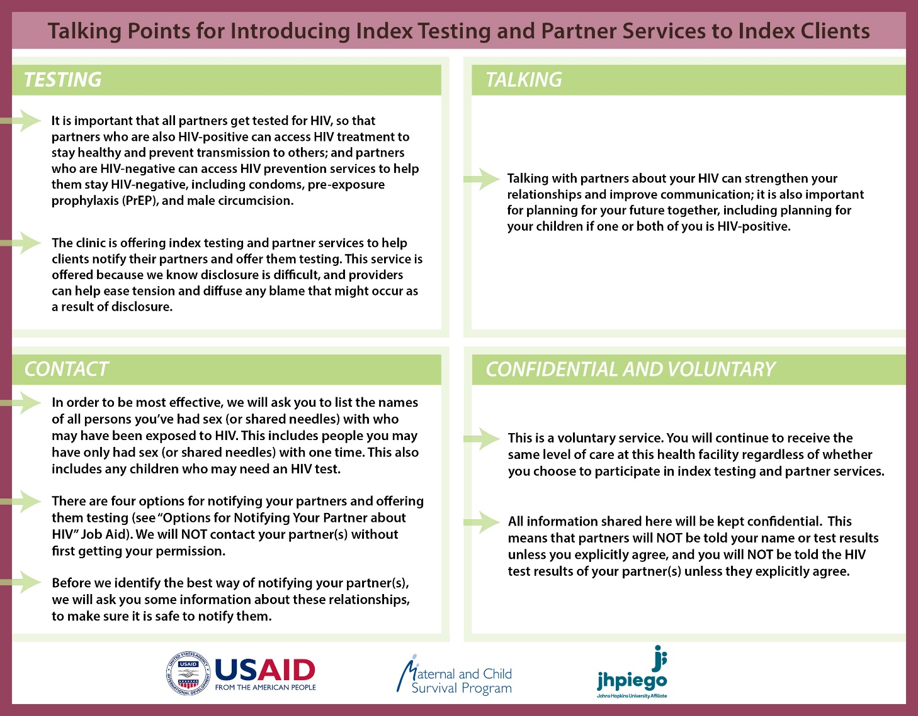
7a. Tools
Notes:
Point out that theses tools can be found in the learner’s workbook..

Slide 4
NOTIFYING PARTNERS
Step 7.Provide PNS
Step 8: Record outcomes of partner notification and family testing
Record outcomes of partner notification and family testing
Complete all data recording and reporting requirements for Index Testing.
Step 9: Provide appropriate support services for partners/couples based on their results
Step 10: Follow up with client to assess for any adverse events associated with index testing

