Slide 1
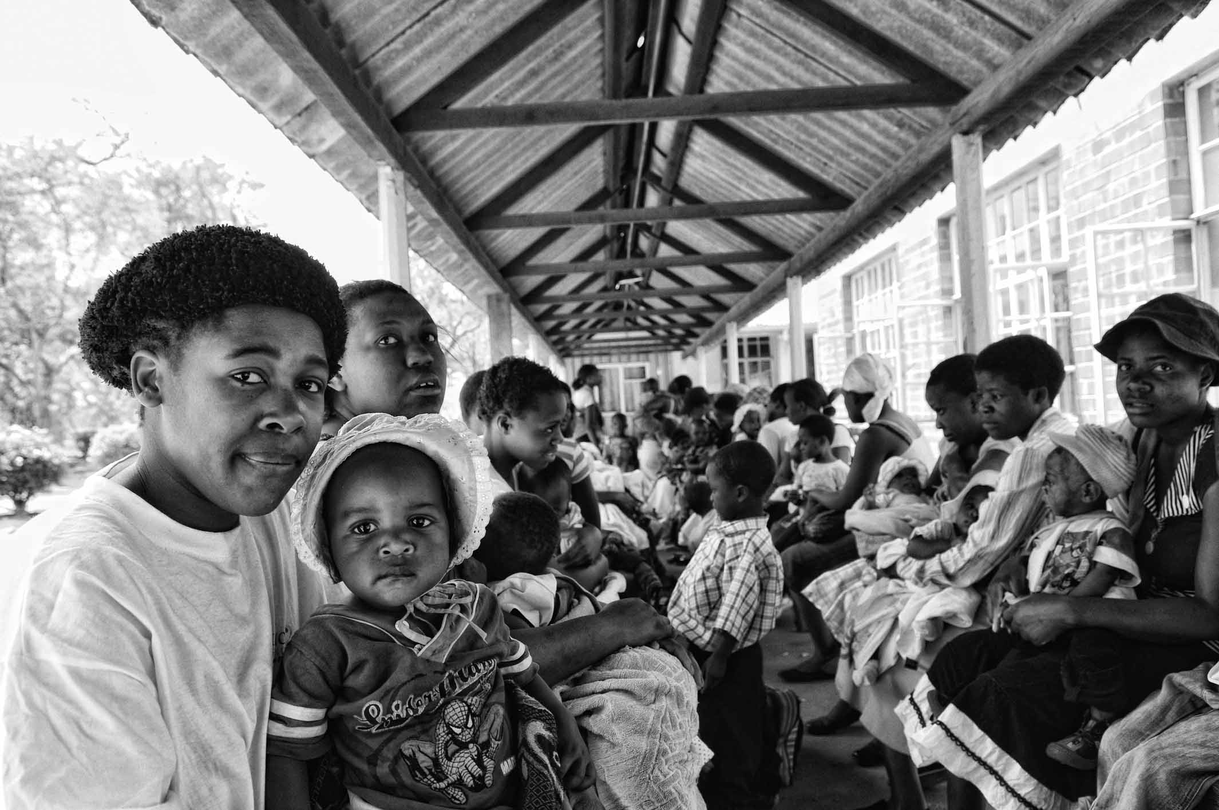
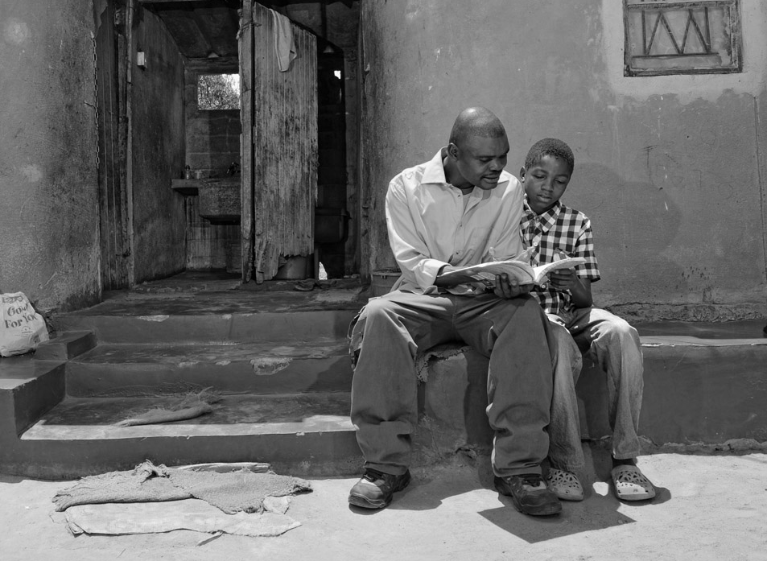
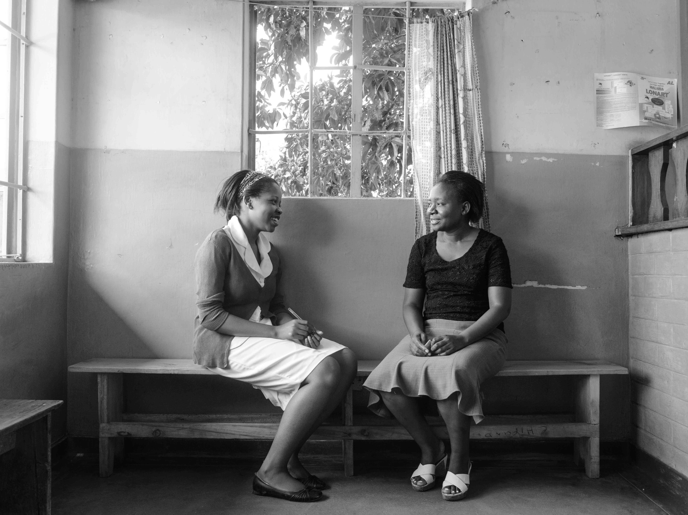
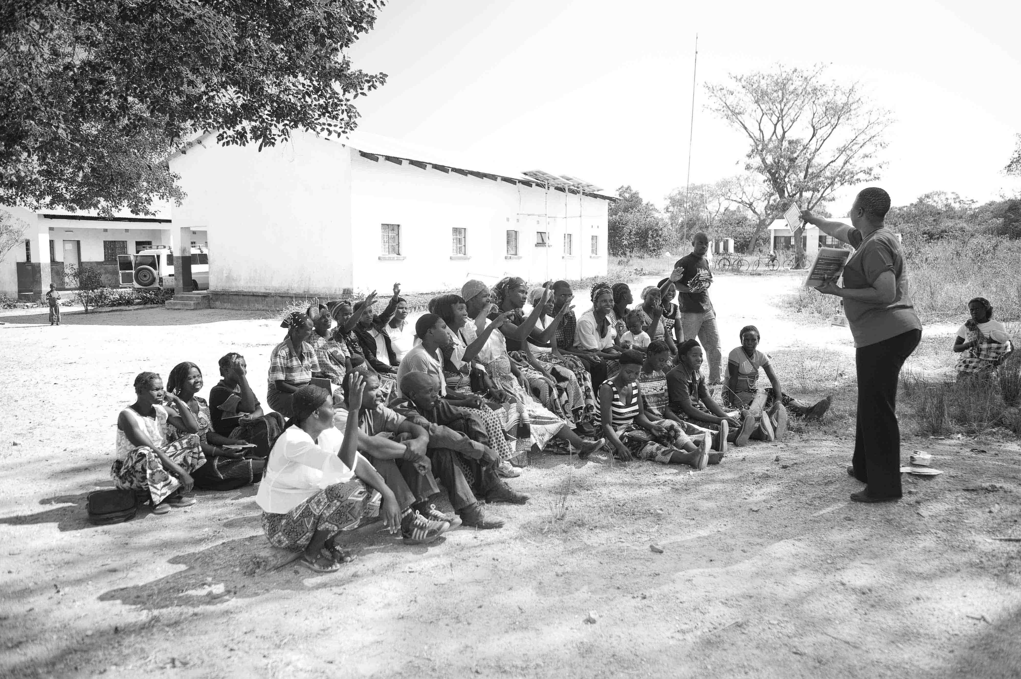



UNITAID PSI
HIV SELF-TESTING AFRICA
Improving linkage to treatment and prevention after (self)-testing among male partners of antenatal care attendees: a multi-arm adaptive cluster randomised trial in Malawi

Slide 2
Research Question
What are the most promising candidate interventions for increasing HIV testing, care and prevention in partners of pregnant women?

Slide 3
Background
Conventional testing failing to reach men
Post-test linkage
  Drives health impact and cost-effectiveness
Some highly effective prevention options are under-utilized
  Voluntary medical male circumcision (VMMC)
  Couples testing
Pregnancy an opportunity to use HIV self-testing for prevention
  High incidence with risk to child
  Well established services to identify HIV+ve women
Malawi population-based HIV impact assessment (MPHIA) 2015–2016; Sharma et al., PLoS Med (2017)

Slide 4
Multi-arm multi-stage (MAMS) cluster randomised trial design (Phase 2)
Methods development
Formative qualitative study
  Intervention development
Unit of randomisation: ANC day (cluster)
One interim analysis (end of first stage) drop for
  Futility
  Safety

Slide 5
Objective and trial outcomes
    Objectives:
      estimate of effect size of intervention(s) for subsequent Phase 3 trial
      acceptability, safety, cost-effectiveness at scale
Primary outcome
  % male partners of antenatal clinic attendees (ANC)
    test for HIV and link into care or prevention within 28 days
    Including initiating ART or being circumcised within 28 days
Secondary outcomes
      % male partners who test for HIV within 28 days (woman reported)
      % women who participate by arm (acceptability)
      Risk of social harms including intimate partner violence (IPV)
      Total cost of providing the service per trial arm

Slide 6
Recruitment, participation & follow-up interview by trial stage
Stage 1 (n = 36 clusters)
6 arms
Stage 2 (n = 35 clusters)
5 arms; lottery dropped
Enrolment
Women present in ANC (1404)
Ineligible (n = 320, 23%)
Discontinued (n = 77, 7%)
Women present in ANC (1733)
Ineligible (n = 468, 27%)
Discontinued (n = 39, 3%)
Randomisation (n = 36 clusters)
Randomisation (n = 35 clusters)
Allocation
Reasons for ineligibility
<18y old
Absent partner
Partner on ART
Not 1st ANC visit
Already recruited
Lost to follow-up (n = 0 clusters)
Interviewed @ 4 weeks
(n = 745; 69%)
Lost to follow-up (n = 0 clusters)
Interviewed @ 4 weeks
(n = 1120; 89%)
Follow-up
# eligible (n=1084)
Mean cluster size: 26
Range: 11 to 60
# eligible (n=1265)
Mean cluster size: 29
Range: 9 to 67
Analysis

Slide 7
Selected baseline characteristics of men
(as reported by women at baseline)
Characteristic | SOC N = 408 | ST only N = 442 | ST + $3 N = 380 | ST + $10 N = 512 | ST + lottery N = 155* | ST+reminder N = 452
Age (years) Mean (SD) | 30.0 (9.8) | 29.1 (5.8) | 30.1 (5.9) | 29.2 (6.9) | 30.3 (10.9) | 29.5 (6.0)
Never tested for HIV before | 66% | 46% | 54% | 52% | 46% | 40%
Tested >12m ago† | 52% | 54% | 57% | 56% | 64% | 54%
Unable to read and write | 3% | 3% | 2% | 0% | 1% | 2%
Paid employee | 61% | 68% | 67% | 69% | 61% | 58%
SD: standard deviation; SOC: standard of care; ST: self-test kits; Reminder: phone call to man on the same day and after 5 days of enrolment of woman
* Dropped at interim analysis (end of stage 1)
† Denominator of men who have previously tested

Slide 8
Primary outcome results (adjusted analysis)
% of male partners tested + linked to care or prevention within 28d
100% -
RR 2.57 (2.04, 3.10)
Across both stages of study
676 (29%) men attended clinic
  44% HIV testing for first time
630 (93%) confirmed HIV-ve:
  408 already circumcised
  222 booked for VMMC
46 (7%) confirmed HIV +ve;
  42 (91.3%) started ART
  3 adverse events
  none serious (all Grade 2)
  Lottery arm dropped for futility after interim analysis
RR 1.97 (1.53, 2.41)
RR 1.13 (0.90, 1.35)
80% -
60% -
RR 1.21 (0.96, 1.45)
RR 1.17 (0.86, 1.60)
40% -
20% -
0% -
P=0.075
P<0.001
P<0.001
P=0.240
P=0.159
SOC
ST only
ST+$3
ST+$10
Lottery
Reminder

Slide 9
% all* male partners starting ART or booked for circumcision within 28 days
P<0.001
P=0.001
P=0.066
P=0.066
* Intention to treat analysis including all eligible women: assumes 1:1 ♂:♀
Notes:
“booked for circumcision” --- relates to

Slide 10
Proportion of male partners tested within 28d by arm & stage – as reported by the woman
% of all* male partners testing for HIV
Day 28 follow-up (ACASI)
  91% ♀ interviewed
* Intention to treat analysis including all eligible women: assumes 1:1 ♂:♀

Slide 11
Conclusions
Woman-delivered HIVST highly acceptable to both partners
  >87% partner testing through a low cost add-on to strong national program
  No serious safety issues reported by 2,349 pregnant women
Answering a major concern about HIVST and linkage
  Demand for follow-on HIV services by male partner higher than SOC in all HIVST arms
    Significantly so for $3 and $10 dollar incentive arms
  Linkage to prevention not well defined, but prime driver of cost-effectiveness
  Incremental costs per man tested /linked to ART or VMMC lowest in incentive arms
Major new route for VMMC demand creation in “older” men
  First trial to investigate HIVST + VMMC
Nested within PSI-UNITAID STAR
  Informing design of large scale studies
  Informing mathematical modelling & economics

Slide 12






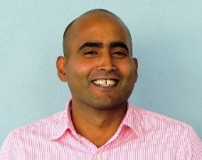
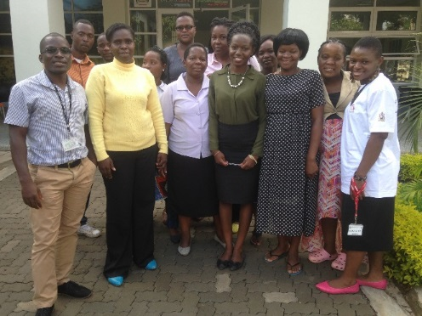
Acknowledgements
Supervisors
Collaborators
LSHTM
Aurelia Lepine
LSTM / MLW
Nicola Desmond
University of Warwick
Nigel Stallard
Hendy Maheswaran
MLW
Moses Kumwenda
Funders
Katherine Fielding
Liz Corbett
PASTAL team
Clinic in-charges
Maureen: Zingwangwa
Mgungwe: Bangwe
Modester: Ndirande

Slide 13
Preliminary economic findings
2016 US Dollars
Providing ANC attendees a leaflet for their male partner about the MFC least costly
In comparison to providing only an information leaflet, providing HIVST kit and a financial incentive:
US$35-40 per additional male partner tested for HIV and linked to MFC
US$135-155 per additional male partner started ART or linked to VMMC
Higher financial incentive may offer better value for money
 | Information leaflet only | HIVST kit only | HIVST kit + US$3 incentive | HIVST kit + US$10 incentive | HIVST + Lottery | HIVST kit + Phone reminder
Total ANC cost | 54.24 | 4201.30 | 3964.46 | 7358.44 | 1474.19 | 4401.72
Total MFC cost | 314.83 | 193.33 | 310.49 | 510.19 | 68.78 | 154.51
Total Intervention cost** | 369.08 | 4, 394.64 | 4,274.95 | 7,868.63 | 1,542.97 | 4,556.23
Male tested for HIV | 56 | 85 | 155 | 266 | 30 | 84
HIV+ve male identified | 3 | 11 | 11 | 14 | 4 | 3
HIV+ve male started ART | 3 | 10 | 10 | 13 | 4 | 2
HIV+ve male linked for VMMC | 11 | 17 | 29 | 55 | 3 | 20
Cost per male partner tested for HIV | 6.59 | 25.85 | 13.79 | 14.79 | 25.72 | 27.12
Cost per male HIV+ve identified | 123.03 | 399.51 | 388.63 | 562.04 | 385.74 | 1,518.74
Cost per male started ART or linked to VMMC** | 26.36 | 162.76 | 109.61 | 115.72 | 220.42 | 207.10
Incremental cost per additional Male HIV tested* | REF | 138.81 | 39.45 | 35.71 | More costly Less effective | 149.54
Incremental cost per additional Male started ART or linked to VMMC* | REF | 309.66 | 156.23 | 138.88 | More costly Less effective | 523.39
*Incremental to “Information leaflet only arm” **Does not include cost of circumcision
ANC: Antenatal Clinic MFC: Male friendly Clinic
Notes:
For each intervention in the trial we estimated the costs of providing the intervention at the ante-natal clinic --- and the costs of receiving confirmatory HIV testing at a Male friendly clinic
We found that providing ANC attendees a leaflet was the least costly strategy : approximately US$7 per male partner tested for HIV
We found providing a financial incentives: approximately US$14 per male partner tested for HIV
In comparison to just providing a leaflet --- the incremental cost-effectiveness of financial incentive arms was:
→approximately US$40 per additional male partner tested for HIV
→approximately US$150 per additional male partner started onto ART or linked to VMMC service
Interestingly it looks like the higher incentive arm was more cost-effective
The economic findings support dropping the Lottery arm

