Slide 1
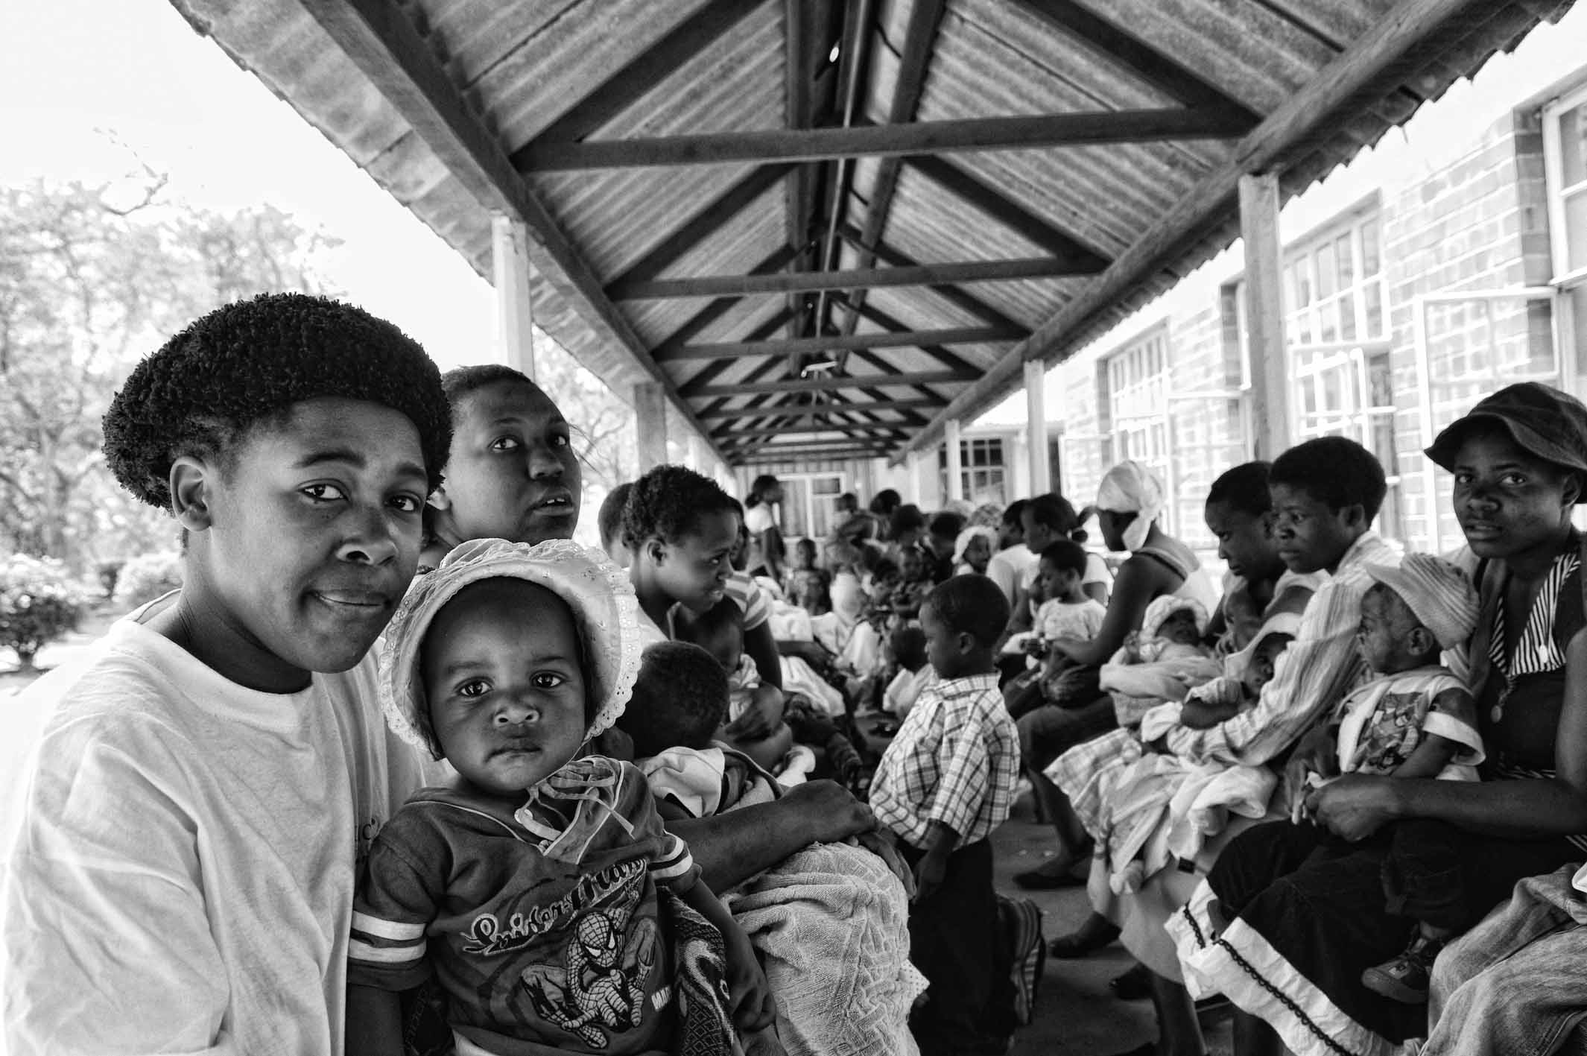
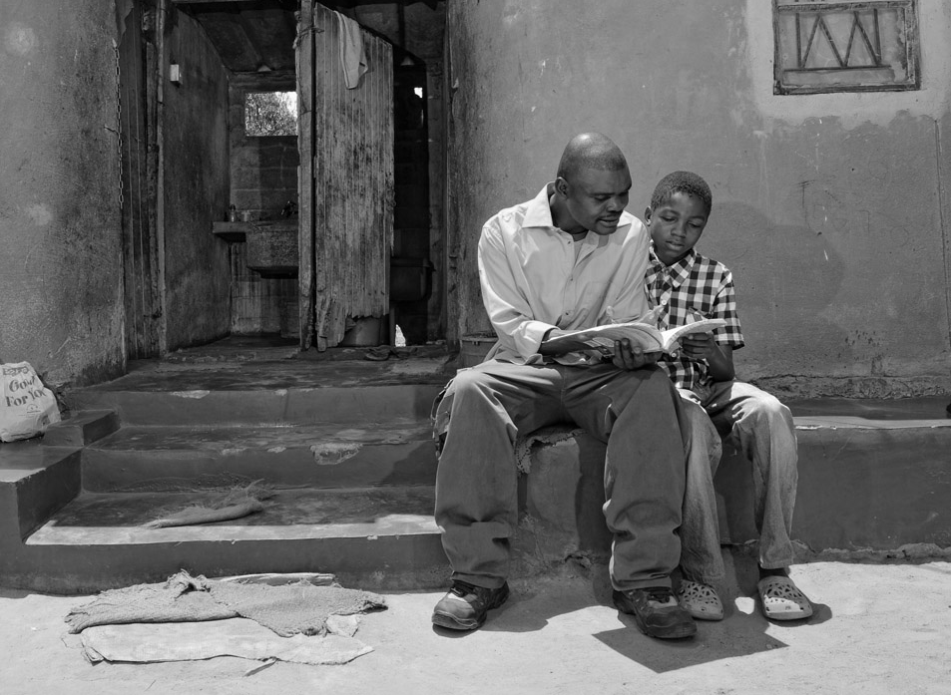
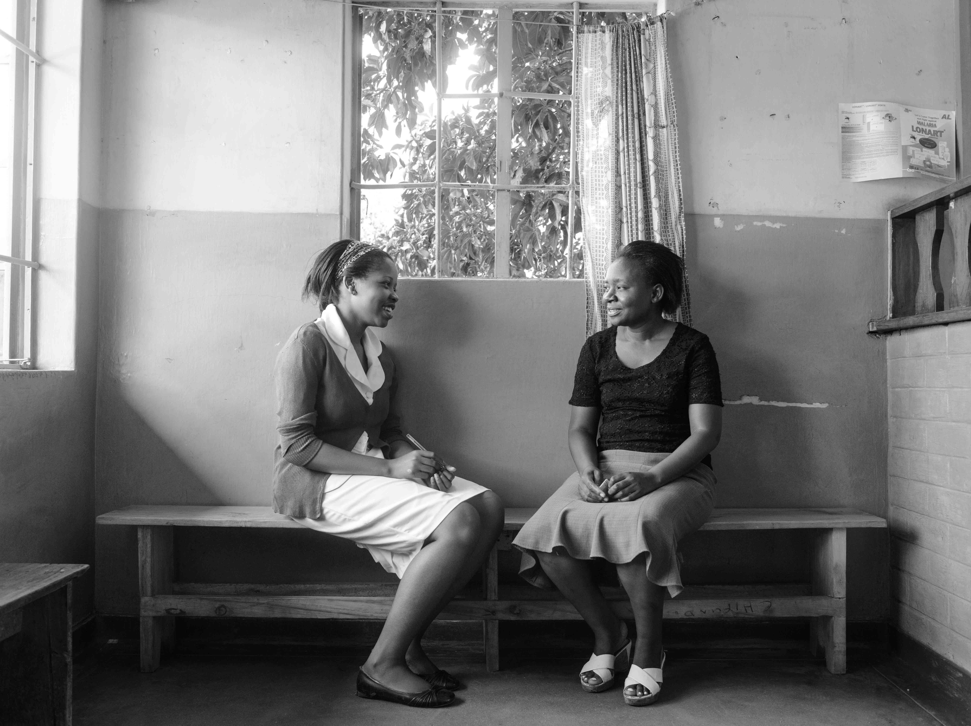
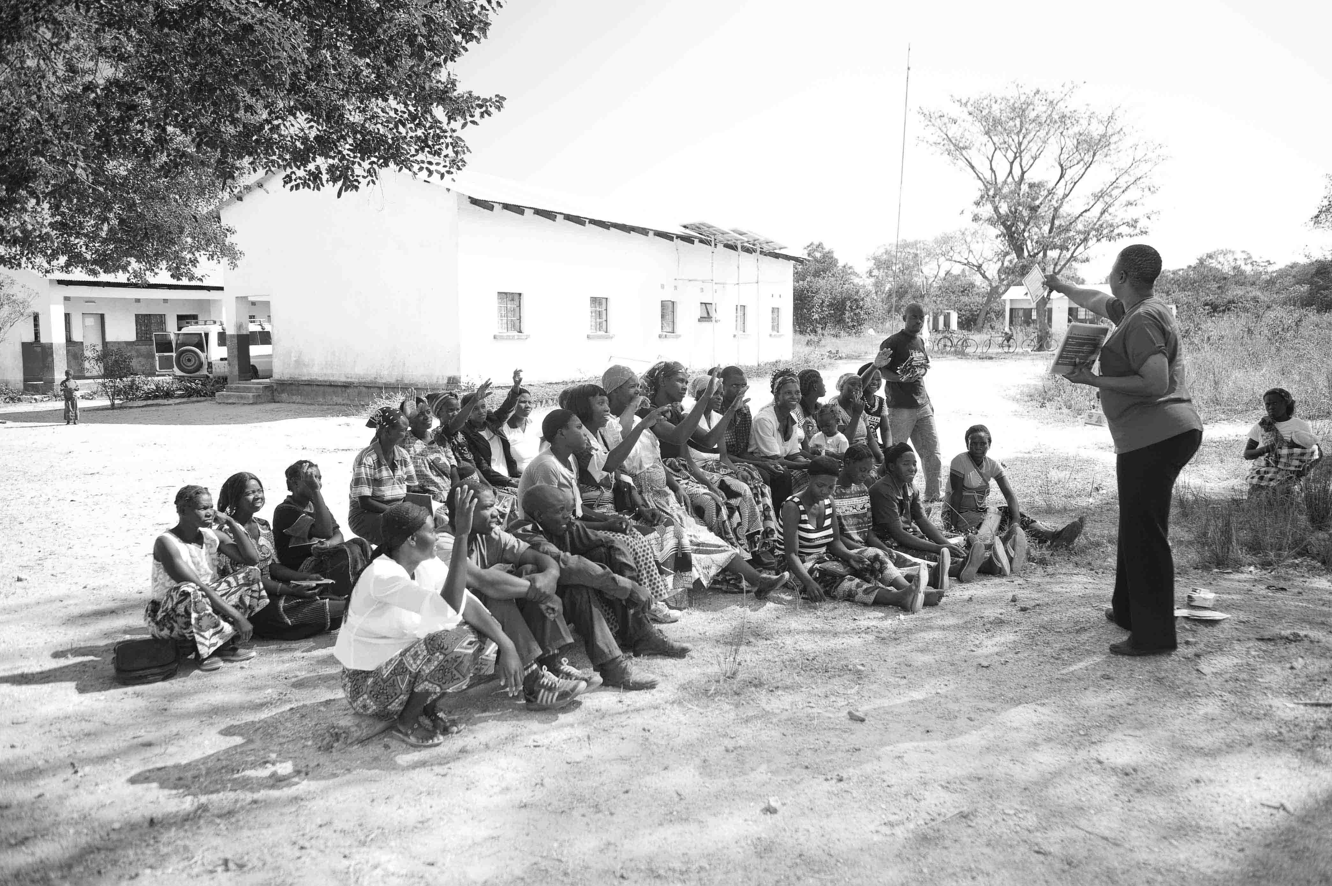


UNITAID PSI
HIV SELF-TESTING AFRICA
STAR, the world largest evaluation of HIV Self-Testing
9th IAS Conference, Paris 2017
Dr Karin Hatzold, Population Services International
Notes:
Mesdames et Monsieurs Bon Jour.
The HIV Self Africa Project is the world largest evaluation of HIVST..

Slide 2
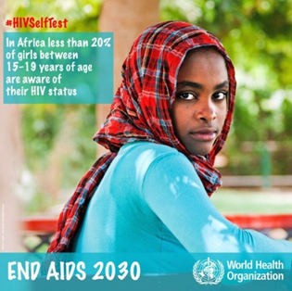
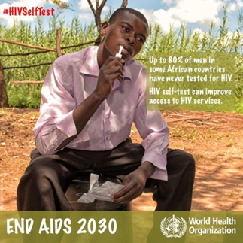
Progress toward the first 90 by region, 2016
Asia & the Pacific
Eastern &
southern Africa
Eastern Europe & central Asia
Latin America & the Caribbean
Source: UNAIDS, Global AIDS Update 2017
Notes:
The global community is working toward achievement of the 90s. There remains a significant gap in achievement of the first 90, ensuring the 90% of PLHIV know their status. Globally, only 70% of individuals living with HIV are aware of their status. Achieving the subsequent 90s is dependent on achievement of the first 90, making improvements in HIV testing coverage the backbone for achievement of this global goal. Uptake of HIV testing and knowledge of status is particularly low among men, adolescents and young people and key populations.

Slide 3


Using HIVST to Address Market Failures and Achieve Public Health Impact
+
DIRECT ACTION
DIRECT
IMPACT
ADDITIONAL IMPACT
Link to Treatment
Health for PLHIV: Reduced Morbidity & Mortality
Population Productivity & Growth
Social Benefit
Social Harm
Reduced HIV Transmission & Infections Averted
Link to Prevention
-
Efficiency
Increased uptake among populations not current reached by existing channels.
Increased testing frequency among populations with high ongoing risk of HIV infection.
Triaged out of HIV negatives of Health System
Cost and Time Savings (Health System & Users)
Expanded Coverage
Equity of Health
*Adapted framework based on BMGF & UNITAID HIVST Meeting
Notes:
HIVST may be a crucial opportunity to address this current failure of the testing market. We know, based on existing evidence that HIVST can increase uptake among certain populations not currently reached by existing channels and that testing frequency can also be increased among certain populations with high ongoing risk of HIV infections. This can address the current gap in testing and achieve significant health impact.
First, by identifying PLHIV earlier in the course of infections (or identifying individuals who would not otherwise test), and linking them to care, HIVST, decreases morbidity and mortality for PLHIV, reduces HIV transmission and averting new HIV infections.
Second, by identifying PHLIV who are negative, and linking them to prevention services, HIVST reduces HIV transmission and averts HIV infections. In addition, by testing them rapidly with this screening test, negatives are pulled out of the health system, providing potential cost and time savings to the health system overall. (They don’t require testing in facilities with more person time, etc.)
There may be additional impacts—including social and economic benefits, as well as health system benefits.
The STAR Project, which I’ll discuss today, is building the evidence of this public health impact (where it does not yet exist) which is critical to encouraging investment from large global buyers, including country governments, Global Fund and PEPFAR.

Slide 4

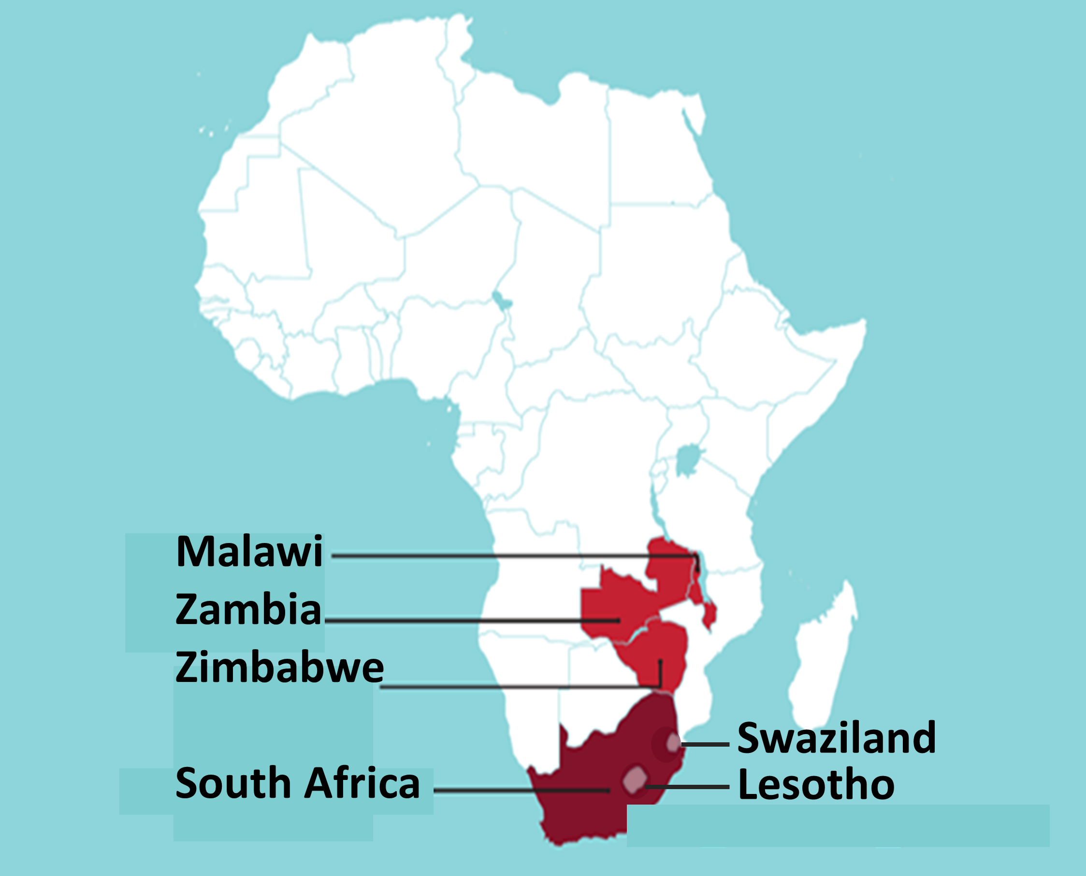



STAR Project Outcomes
  Increase access to HIVST
  Optimise distribution models for the safe scale-up of HIVST, including effective linkage into care & prevention for both general and key populations
  Increase Informed Demand
  Define the best marketing and demand creation strategies for HIVST
  Reduce Policy and Regulatory Barriers
  Support the full integration of HIVST into national policy & algorithms; establish WHO normative guidance; include HIVST in global HIV planning and projection tools
  Remove structural barriers
  Establish market landscape (including market size) to encourage market entry and competition; support establishment of a harmonised regional regulatory approval framework
Notes:
The UNITAID/PSI STAR Project is PSI’s flagship project in HIV self-testing. This is a $23M project implemented in three countries – Malawi, Zambia and Zimbabwe. The project is designed to support HIVST development by:
Increasing access to HIVST by determining how best to deliver HIVST to meet consumer demand and achieve health impact.
Increasing demand among consumers, using marketing strategies informed by consumer insights and learnings about the consumer’s path to purchase.
Reducing barriers in the enabling environment by establishing policy supportive of HIVST at global and local levels, and by providing the information required to global donors to catalyze demand at a global level.
Removing structural barriers to market entry, including clarification of the regulatory environment at global and local level and encouraging market entry by making information about the market more readily available.
Across these four outputs, the project seeks to strengthen HIVST supply, demand and enabiling environment to facilitate a healthy HIVST market. Today, I’ll summarize some of our key learnings from STAR, as well as other HIVST investments, all of which inform current and future efforts to develop a healthy HIVST market.

Slide 5
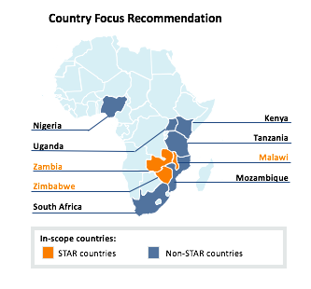
Potential HIVST Market Size
 | CONSERVATIVE | MODERATE
Refined market size for 2020 | 3.3 – 5.5M | 11.3 – 15.3M
Community-based channels | 2.4 – 3.5M | 4.6 – 7.0M
Pharmacies | - | 3.3 – 4.3M
Facility-based channels (excl ANC) | - | 1.2 – 1.7M
Secondary Distribution at ANC | - | 0.7 – 0.8M
Secondary Distribution at PICT | - | 0.07 – 0.1M
Key Populations | 0.8 – 2.0M | 0.8 – 2.1M
Notes:
If there is so much potential for the HIVST to address current gaps in the HIV testing market, it begs the questions– how large is the HIVST market.
In 2016, PSI estimated the HIVST market size in 9 sub-Saharan African countries. I won’t present details here, but would be happy to discuss the model further and you can read about it more in our report. Critically, we present two scenarios dependent on relative investment in HIVST across different distribution models. At the conservative end, we estimate the market in these nine countries would stand at 3.3-5.5 million in 2020. In a scenario of moderate investment, we estimate this market size may be as large as 11.3-15.3.
Critically, private sector scenarios are limited; if this channel shows potential and receives investment the growth could be significant. In addition, the model assumes limited HIVST in facility-based models. If efficiencies are proven and are cost-effectives, we could see a drastic change in the market size

Slide 6
Demand Increases with Improved Public Health Evidence
Increased uptake of HIVST in the target population
Increased coverage of HTS in the target population
Increased ART and VMMC coverage
Improved design of HIVST models for target populations
Level of accuracy ?
How can we anticipate and report on social harms?
What are delivery costs?
What are user preferences? Can demand be maximized?
What is the market size?
Is there equitable access among men, young people, key populations?
What is impact of HIVST on the frequency and coverage of HIV testing ?
How effective do self-testers link to VMMC and ART services ?
What is the cost/cost-effectiveness of HIVST linkage ?
What are user preferences for post-test services? How can demand for post-test services be increased?
What is the cost-effectiveness of HIVST?
Formative Research
  Definitive multi country evaluation
Notes:
These are the research questions of STAR. I’ll go over this at high level, emphasizing that the first two colums are where the greatest evidence currently lies, with work ongoing.

Slide 7
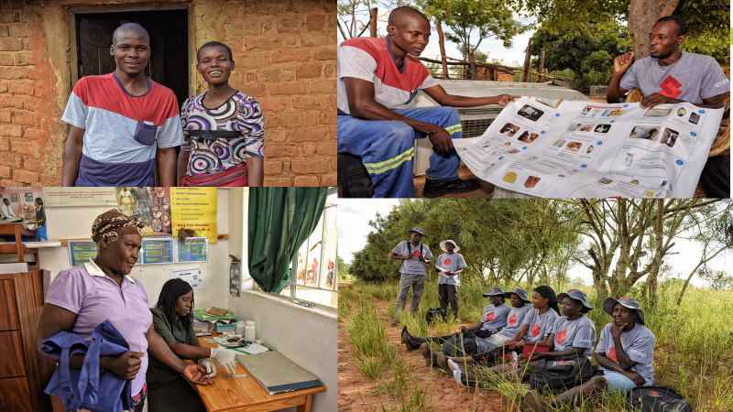
Contact
DR. KARIN HATZOLD
Director UNITAID/PSI HIV Self-Testing Africa (STAR) Project
khatzold@psi.org

