Slide 1
Sexual network testing Documentation

Slide 2
Sexual network testing tool.
This is also called INDEX NETWORK TESTING form.
It helps to identify a network of potentially positive clients from already identified positive clients.
It is also important for advocacy and planning of targeted HTS in the facility and community
It helps in providing information on the prevalence of sexual transmission of HIV.

Slide 3
Index network testing tool.
Objective of the Tool | To elicit PLHIV linked to an index who may not have had HTS. Documents the network of PLHIV traceable to an index client. The form is used for all adult and adolescent ( males and females) including pregnant women enrolled in the HIV program at their first clinical encounter
Who fills the tool | The SNT focal person or trained counselor tester on index network testing.
When to fill the tool | The form is filled real time as positive client is identified and s
Where to keep the tool | The form is kept by the SNT focal person or the trained counselor tester, at various service delivery points where HTS are done.
Source of Information | Patient responses.

Slide 4
Sexual network testing form (header)
This section requires identification of the category of index client.
It also requires documentation on visit date, date confirmed HIV, patients name, client code, hospital number, sex, LGA and facility name.

Slide 5
Sexual network testing form(body)
This section requires documentation on enrolment date, demographic features and educational background, and partner notification counselling.

Slide 6
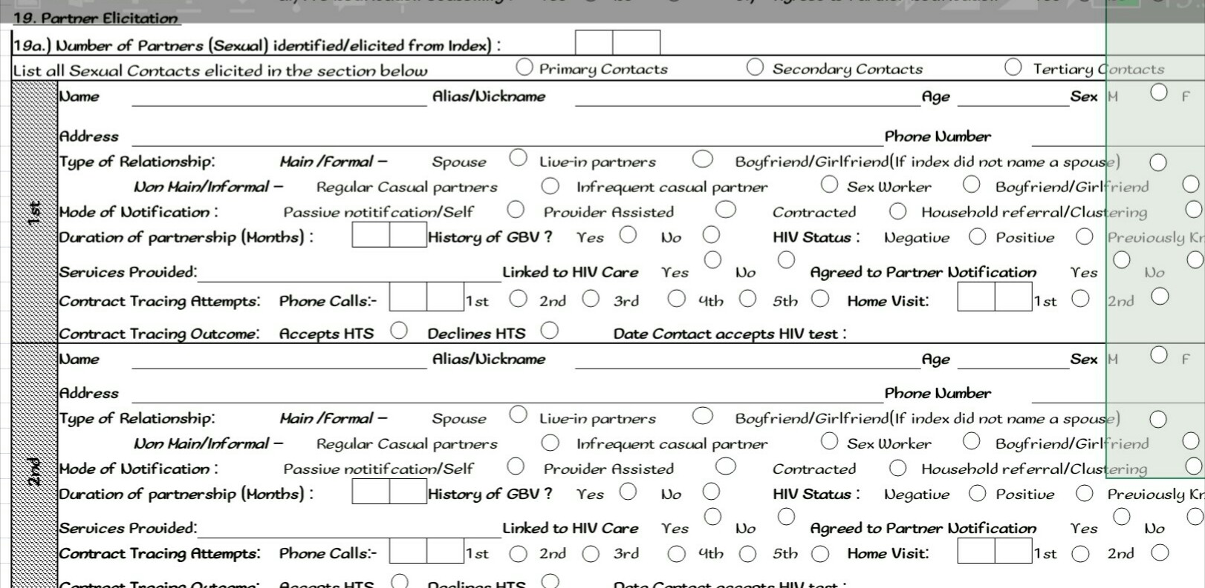
Elicited partners information.

Slide 7
Sexual network testing form(tail).
The section is the tail-end of the form that requires the name and signature of SNT focal person or trained counselor tester.

Slide 8
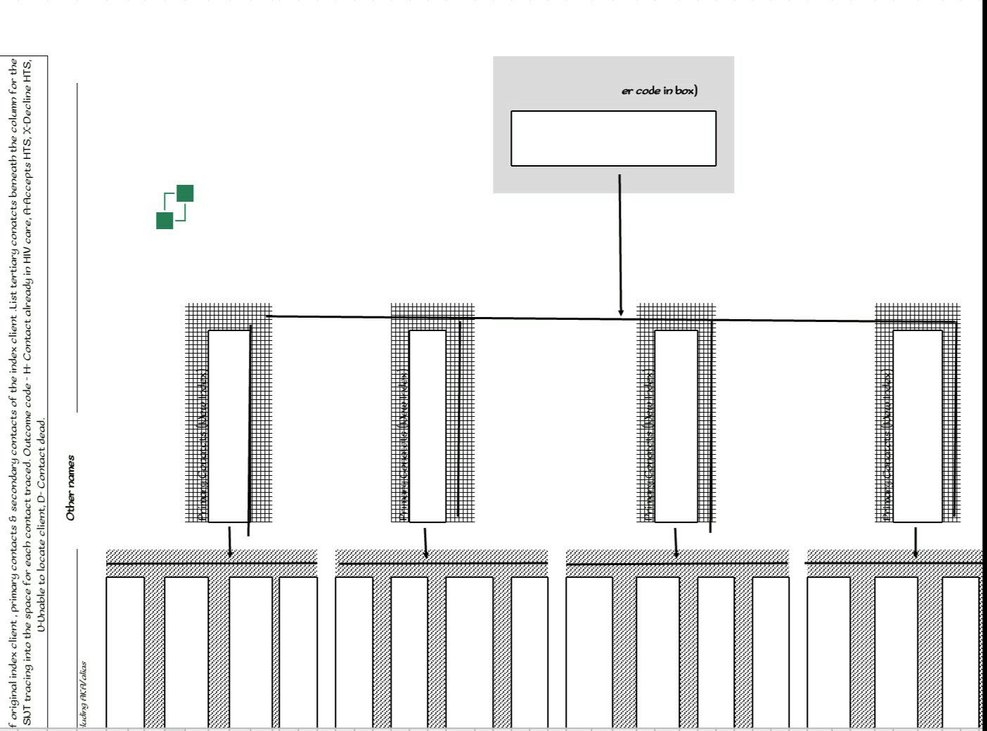
Sexual network tree
This section is similar to the adult ICE except for the inclusion of paediatric specific variables like head circumference and surface area, general appearance of cardiovascular, glands and genitalia. The additional physical findings is also required

Slide 9
Index network testing Register.
This section requires documentation of state, LGA, facility name, month and year.

Slide 10
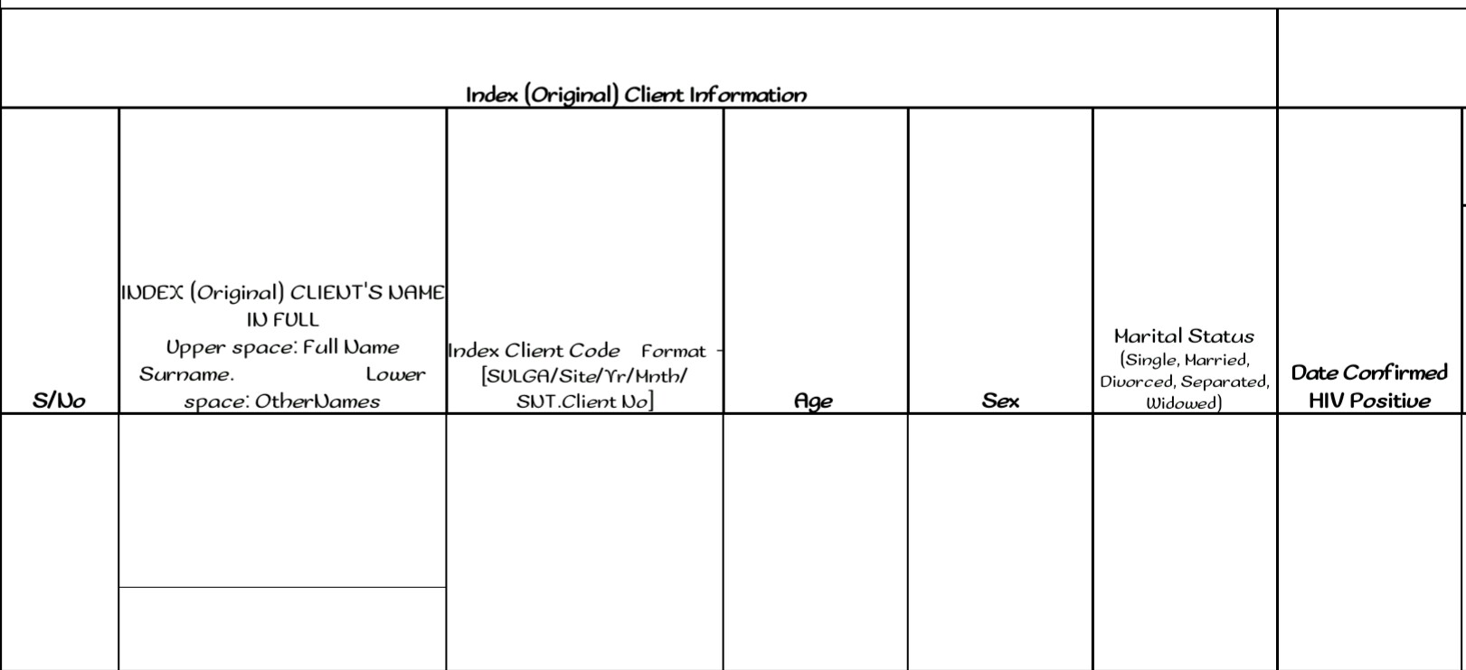
Index network testing Register.
This section requires documentation of Client’s full name, index client code, age, sex, marital status and date confirmed HIV.

Slide 11
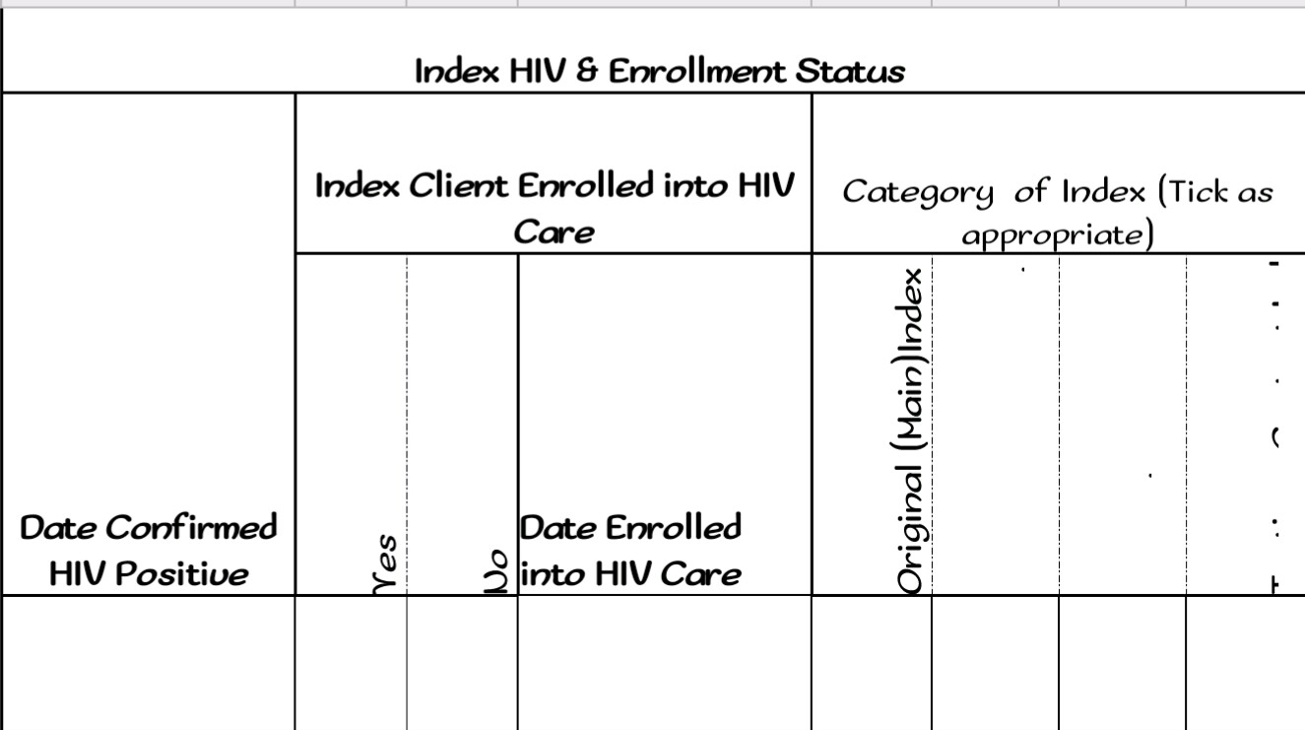
Index network testing Register.
This section requires documentation of confirmation of HIV, date enrolled into care and the category of index.

Slide 12
Index testing register contd.
This section requires documentation of partner notification, counselling and number of partners elicited.

Slide 13
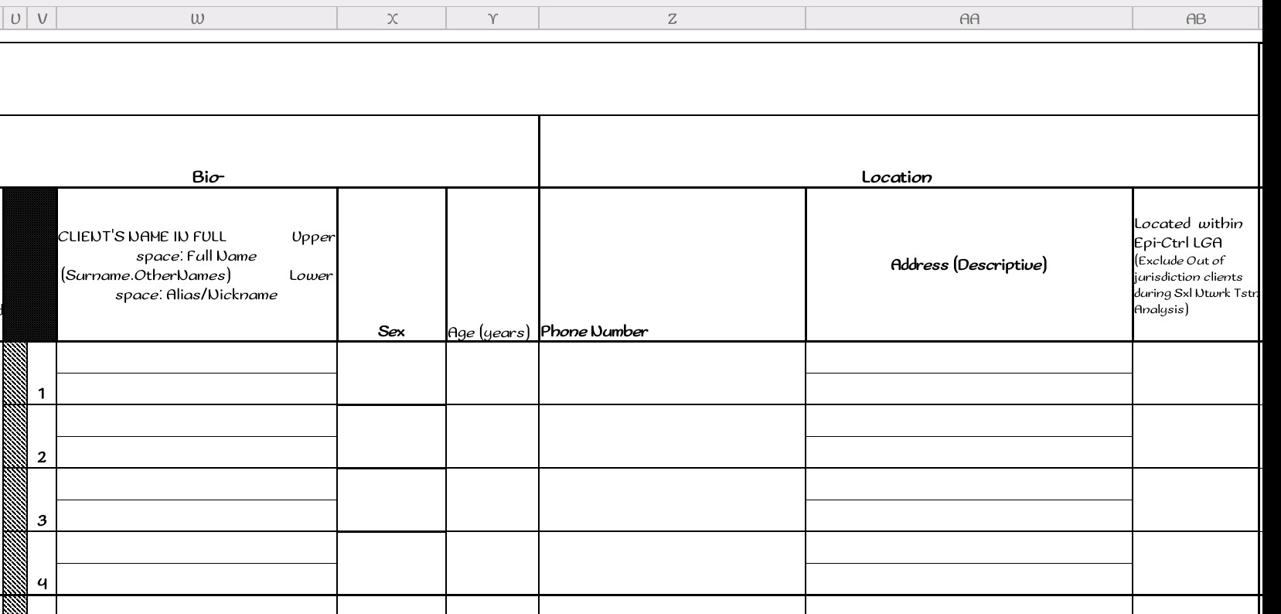
Index network testing Register contd..
This section requires documentation demographic features, phone contact excluding clients out of jurisdiction of the original/index client.

Slide 14
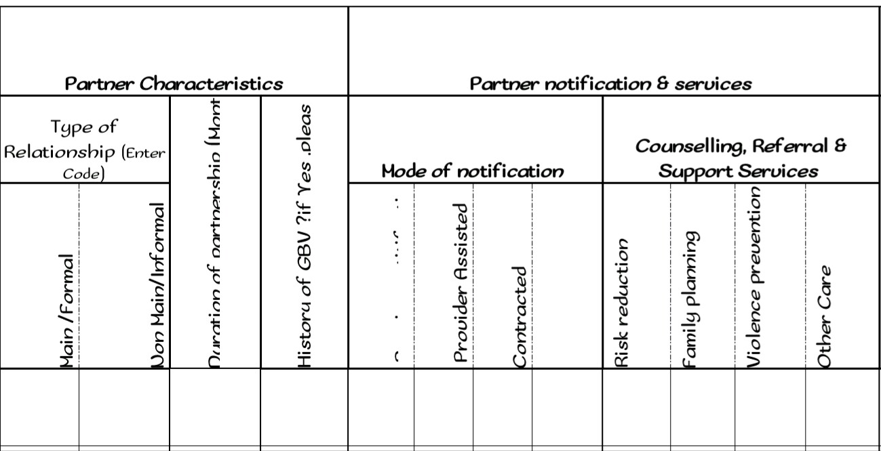
This section requires documentation of partner’s type of relationship, history of GBV, mode of notification and other services required/rendered.

Slide 15
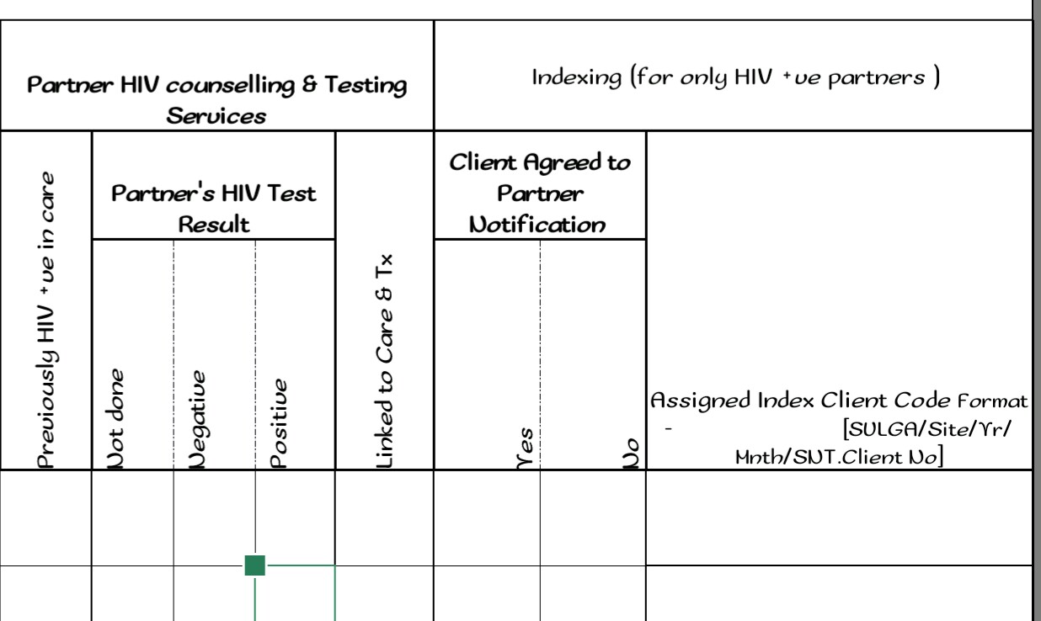
Index network testing Register contd..
This section requires documentation of partner’s HIV test result, if linked to care and agreed to partner notification as well as assigned client code.

Slide 16
Index testing Monthly Summary Form.
….wait for it……..next slide…..

Slide 17
ii

Slide 18
Index network testing MSF..

Slide 19
Good downlines…good network..

