Slide 1


Quality Improvement for Index Testing Services and Social Network Strategies

Slide 2

Module Objectives
After completion of this module, the learner will be able to:
Identify principles of quality improvement
Apply best practices of supportive supervision and mentoring
Notes:
SAY: This module will focus on the following topics:
Principles of quality improvement
Supportive supervision and mentoring

Slide 3
Discussion Questions
What is meant by “quality improvement”?
How would you determine how to improve the quality of an HIV Index Testing program?
What data would you use to improve the quality of an HIV Index Testing program?
Notes:
Ask the three questions on the slide. Facilitate a brief discussion focusing on the responses to the questions.

Slide 4

Principles of Quality Improvement (QI)
  Focus on client needs
  Understanding work as systems
  and processes
  Teamwork
  Focus on the use of data
  Communication and feedback
Notes:
ASK a volunteer to read the principles of QI.
Explain to participants that modern quality improvement approaches based on these principles have been shown to improve the processes of care, even within weak health systems that face severe material and human resource constraints. Team members should be encouraged to work together to understand client needs and expectations, analyze how processes and systems work, and develop, test and implement solutions to improve performance.

Slide 5

Supportive Supervision and Mentoring
Supportive supervision and mentoring of personnel involved in conducting index testing is key to the program’s success
Index testing requires a lot of problem solving, coaching, and self-care smame for SNS.
Notes:
SAY: Supportive supervision and mentoring of personnel involve in conducting index testing are very important to ensuring the success of our index testing efforts and for ensuring counsellors and clients have adequate support.
ASK: What are some examples of supportive supervision and mentoring activities that are done for other HIV testing services?
LISTEN: for responses and acknowledge participant contributions. NOTE that many of the same things that are used for supportive supervision for conventional HIV testing services can also be used for index testing.

Slide 6

Best practices for supportive supervision and mentoring
Using experienced counsellors to offer index testing
Having trainees “shadow” an experienced counsellor for 2-4 weeks for on-site learning
Routinely observing index testing providers and providing feedback on their performance, including completeness of their data records
Offering weekly or monthly opportunities for counsellors to share difficult cases and learn from each other
Rotating counsellors experiencing burn-out back to regular counselling duties
Counsellor self-assessment
Feedback from clients via exit interviews or group discussions
Notes:
ASK: for volunteers to read out loud the examples of best practices for supportive supervision and mentoring for personnel involved in conducting index testing.
Facilitate a discussion with participants.

Slide 7
Recommended Supportive Supervision Schedule for Index Testing Providers
Type of Audit | <1 Year Employment | > 1 Year Employment | Purpose
Interview Observation | Monthly | Quarterly | To assess counsellors’ skills in communicating about index testing with index clients, encouraging partner notification, and conducting partner interviews
Field Observation | Quarterly | Quarterly | To assess counsellors’ skills in conducting home visits to reach partners of index clients
Chalk Talk (Case Conferences) | Twice a Month | Monthly | To provide a forum for counsellors to discuss difficult cases and troubleshoot challenges together
Notes:
SAY: that supportive supervision should be conducted by a trained supervisor who also understands the complexity of index testing and can adequately listen to the concerns of providers, identify the challenges they are having, and help them problem solve and find solutions.
NOTE that there are a number of audits for index testing (or observations or assessments since the term “audit” can make people uncomfortable) that can be used to support high quality service delivery, along with the schedule that we try to keep to for each counsellor or provider.
NOTE that staff who are less experienced (i.e., have only been on the job for less than a year) may need more frequent audits than those who are more experienced.
INDIVIDUAL observation is done to assess a counsellor’s skills in communicating about index testing with index clients, encouraging participation in index testing and partner notification, and conducting partner interviews.
FIELD observation can be done for counsellors who are conducting home visits to reach partners of index clients.
CHALK TALKS are when counsellors come together to discuss difficult cases (anonymously and ensuring confidentiality), so that they can troubleshoot challenges together.

Slide 8

Chalk Talks (or Case Conferences)
Index testing and SNS providers present cases in a confidential and supportive forum
Opportunity for the team to discuss and analyze difficult or challenging cases
Can also be used to review monthly and quarterly performance
Notes:
Chalk talks/case conferences take a minute to plan, but they are great teaching tools and can be very energizing for the team. The supervisor generally coordinates and facilitates the chalk talk, and has the counselors bring their difficult cases. It could be all open cases, cases where they feel stuck, linked cases, etc.
This is not a judging or punitive exercise at all – it is an opportunity for the team to brainstorm and to support each other in managing cases as successfully as possible. It builds a team spirit and breakthroughs are routine. You may learn in a chalk talk that two counsellors are trying to locate the same partner. You do not want two people knocking on someone’s door, and you can use resources more efficiently. One counsellor might say that the client could not provide locating information for their partner but that he has a “shaved head, a limp, plays chess in the park on Friday”, and another counsellor may say, “oh, I know who that is…he’s already tested and is in care”. These sorts of things happen all of the time in chalk talks. Because counsellors are busy and working on individual cases, this is a great forum for overcoming obstacles and achieving synergies.
Bringing in external people like clinicians can be helpful in building their understanding and cooperation with index testing, but certainly you would want to redact the patient information and use aliases like patient 1, partner A, etc.

Slide 9
5. Quality Assurance and Accountability
Safe and Ethical Index Testing Services
1. Monitor Compliance with Minimum Standards
2. Obtain Informed Consent
3. Intimate Partner Violence Risk Assessment and Service Provision
4. Adverse Event Monitoring and Reporting
5. Quality Assurance and Accountability

Slide 10

REMINDER: Minimum Standards for Safe and Ethical Index Testing
All PEPFAR-supported sites must comply with the following minimum standards for safe and Ethical index testing:
  Adherence to WHO HTS 5C’s (consent, confidentiality, counseling, correct test results, and connection to prevention/treatment)
  IPV risk assessment and provision of first line response, including safety check and referrals to clinical and non-clinical services (if not provided on site)
  A site level adverse event monitoring and reporting system
  Providers trained and supervised on index testing procedures including 5Cs, IPV screening, adverse event monitoring, and ethics (respect for the rights of clients, informed consent and ‘do no harm’)

Slide 11
Index Testing Quality Assurance: Pillars & Inputs

Slide 12
Quality and Accountability in Safe and Ethical Index Testing Services
Define minimum quality standards for index testing services
Ensure compliance with minimum standards to demonstrate that index testing services meet international quality standards
Proactively monitor providers and sites on an ongoing and routine basis (incl. MER and SIMS) to identify and remediate concerns
Encourage a multidisciplinary team approach to problem-solving, integrated data use and quality assurance
Review and act on data in a routine and timely manner for improvement and to promote accountability

Slide 13
Tools for Quality Monitoring, Accountability and Action
No single data source provides the complete picture on quality and accountability of index testing services. As such, tools referenced here and included in packet, include:
Minimum Standards Checklist for Providers and Sites (see previous section)
Supportive Supervision and Mentoring Tools for Index Testing
GBV Monitoring and follow-up action tool
Adverse Events Monitoring and Reporting Tools (see previous section)
Monitoring Evaluation and Reporting (MER) Indicators
Site Improvement Through Monitoring System (SIMS) Core Essential Elements (CEEs) or Standards
Community led-monitoring (using mystery shoppers, beneficiary interviews etc.)

Slide 14
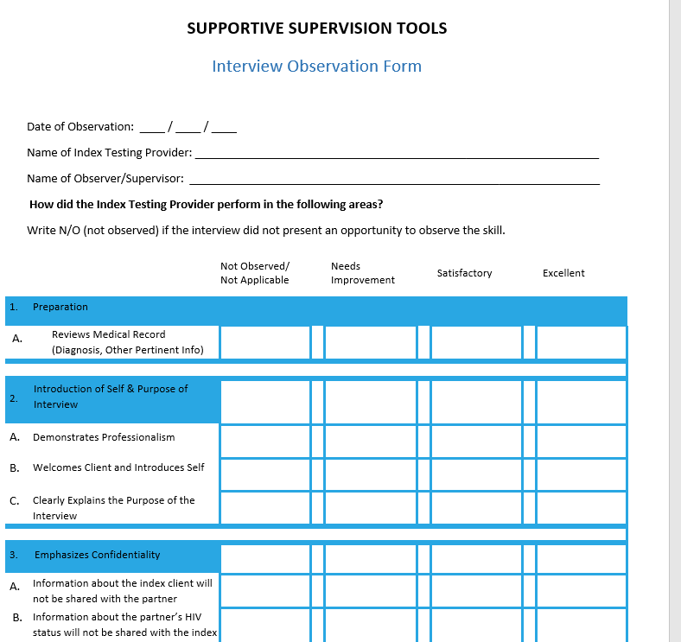
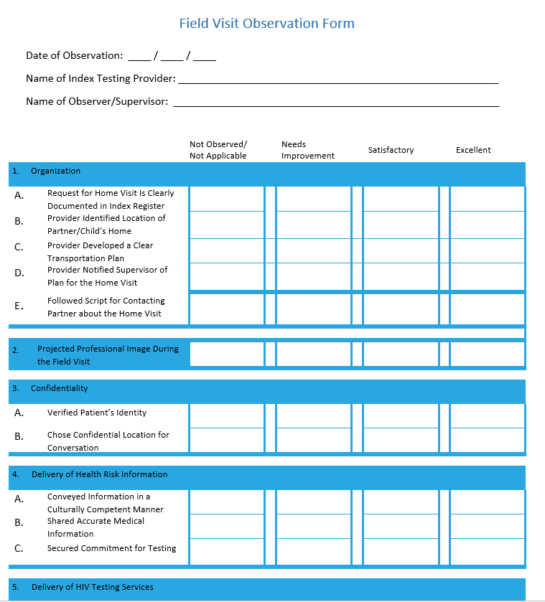
Monitoring Quality Through Supportive Supervision
IPs should directly observe the elicitation interview and provider notification field visits at least every 6 months to ensure that counselors are conducting these services in a safe and ethical manner
Providers should be given immediate feedback, with suggestions for improvement
Providers failing to offer quality services should be re-trained and/or reassigned other duties

Slide 15
Best Practices for Accountability in Supportive Supervision
  Having trainees “shadow” an experienced counsellor for 2-4 weeks for on-site learning opportunities
  Using experienced counsellors to mentor counselors who are struggling
  Routinely observing index testing providers and providing feedback on their performance, including completeness of their records
  Offering daily, weekly or monthly opportunities for counsellors to share difficult cases and learn from each other (case conferences either in-person or virtually)
  Rotating counsellors experiencing burn-out back to regular counselling duties

Slide 16


Monitoring Quality and Accountability Through GBV QA Tool

Slide 17
Monitoring Quality Through SIMS Core Essential Elements
Using existing and new SIMS Core Essential Elements to monitor and improve quality of services related to minimum standards for safe and ethical index testing
Existing CEEs
Site Level
  Confidentiality of services
  Partner Services
  Patient Rights
  Supportive Supervision
  Patient Rights, Stigma and Discrimination
  Client-Centered Services (e.g. services are stigma-free)
  Post-GBV Care Provision
New CEEs Added
Above Site
  Index Testing in HTS National Guidelines
Site Level
  Index Testing Training and Supportive Supervision
  Monitoring Adverse Event from Index Testing
  Secure Handling and Storage of Index Testing Data
  Intimate Partner Violence Risk Assessment and Support

Slide 18
Accountability for Implementing Partners
The IP should assign an index testing point of contact (POC) within their team to oversee index testing services across all supported sites
The IP POC serves as the main counterpart responsible for:
  ensuring all PEPFAR-supported sites meet minimum standards for index testing
  monitoring and reporting any adverse events to the USG Testing Advisor within 2-4 business days
  liaising with community organizations about index testing services at the facility/site level
While community organizations may play a role in monitoring index testing, the IP and IP POC is responsible for and required to have an adverse-event monitoring system in place at all facilities that are funded implemented through program resources.

Slide 19
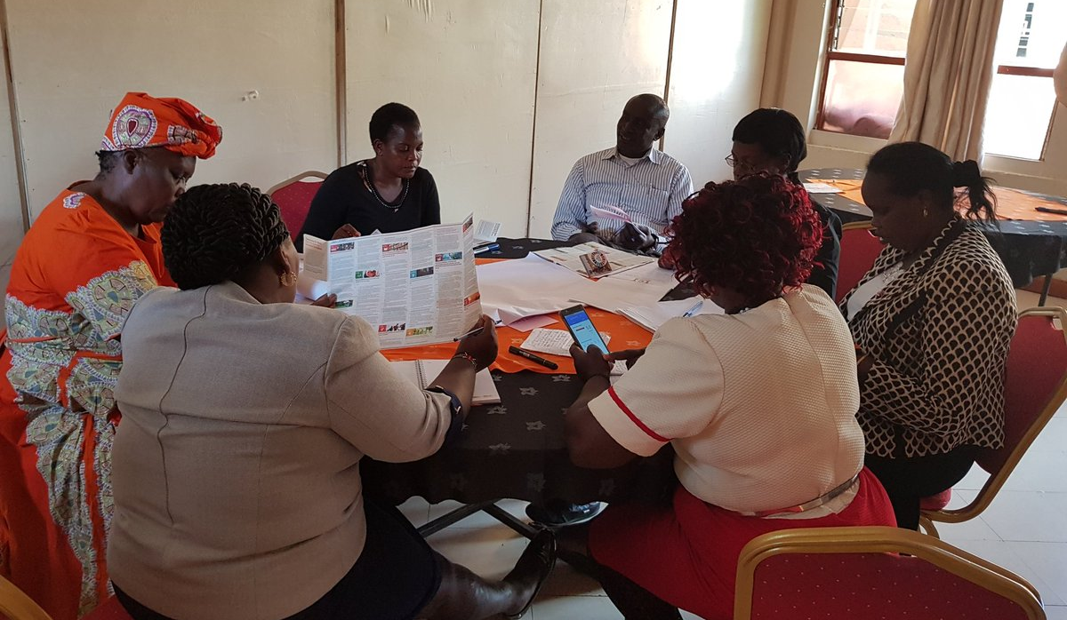
Community Led-Monitoring Can Be Another Important Component for Monitoring the Quality of Index Testing Services and Social Network Testing
Monitoring and improving the quality of Index Testing services is the responsibility of USG and IPs
However, where resources and community interest allow, PEPFAR teams should work with civil society organizations and PLHIV networks to monitor index testing services to ensure they meet the needs of beneficiaries
See PEPFAR Solutions Platform for example tools and frameworks

Slide 20
Community Led Monitoring (CLM)
Community Led Monitoring is an important component of monitoring the quality of index testing services and social network testing.

Slide 21
KP Community monitoring systems are:
Mechanisms to facilitate key populations oversight and feedback on services and programs
• Key Populations community members and networks (and other affected populations) participate
• Can use a range of methods and tools (i.e. WhatsApp, in person, verbal reports)

Slide 22
Why support community monitoring mechanisms for KPs?
To shine a light on client experiences of violence, stigma and discrimination
  Due to the significant stigma, discrimination and violence faced by key populations, as well as the legal threat to their very existence in criminalized settings, key populations often distrust those beyond the community, Lack knowledge of rights/services available to them, Lack faith in response systems, Feel fear/shame coming forward or have normalized violence, Lack resources to navigate services that address violence and other adverse events
To prevent and reconcile harms to KPs in the context of index testing IPV eg
  Forced or inadvertent disclosure of KP status and loss of livelihood or exposure to abuse if KP or PLHIV status is known, Discrimination within health systems, Loss of housing (especially for young KP members), Loss of social network for those already marginalized, including in cases where those named turn against the index case, Mental health and other distress associated with the outcomes above and no or limited access to support

Slide 23
Why support community monitoring mechanisms for KPs? (2)
3) To improve accountability and responsiveness
  Quicker and more systematic responses to abuses
  Tracking trends in abuses could support
    – Moving resources from offending facilities or retraining offending providers
    – Determining whether hostilities against implementers are increasing in some areas and deploy resources as relevant
    – Building a case for greater investment in security/violence response in KP programs
  Track whether adequate responses are provided to those who experience adverse events
  Use data for advocacy with local actors for efforts to address root causes, such as criminalization of same sex sexual relationships

Slide 24
Why support community monitoring mechanisms for KPs? (3)
4) To implement comprehensive and quality KP HIV services
• Engagement and empowerment of KPs is the foundation of any well- designed KP program.
• Focus on KP community led and provided services differentiates KP programs from other programs and it is what allows for, and indeed calls for, strong community monitoring systems embedded within KP programs.
“The score card is a key innovation that allows for interactive evaluation of services and shared setting of quality improvement plans. KPs feel better involved , understood and have better access to quality services. Facility staff are also better equipped to meet the health concerns”- community score card participant.

Slide 25
Accountability, Review and Action
IP Work Plans: Inclusion of minimum standards for safe and ethical Index Testing and concurrent monitoring plan in IP-level work plans
Rapid action: USG and IPs will develop rapid action and time-bound remediation plans to address any site level challenges identified through REDCap assessments AND on-going monitoring/QA activities
Frequent Engagement among IPs, USG staff, CSOs and Sites: PEPFAR teams will review all relevant monitoring, remediation and implementation data with all stakeholders at least monthly
Quarterly Reporting on POART calls: USG teams will provide summary data on POART calls, focusing on use of these data for action through follow-up and remediation

