Slide 1
Rapid community survey on the impacts of the COVID-19 pandemic outbreak on PLHIV in Zimbabwe

Slide 2
Outline
Context
Survey objectives
Results
Recommendations

Slide 3
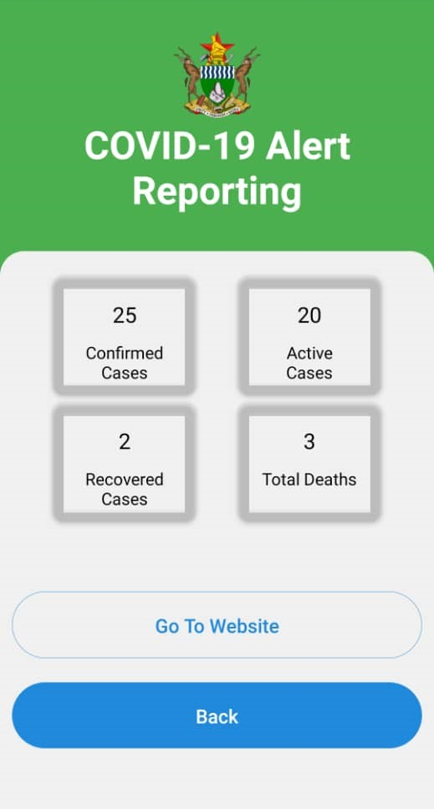
The context
A pneumonia of unknown cause detected in Wuhan, China was first reported on 31 December 2019
As at 19 April 2020, more than 2.4 million confirmed cases globally
COVID-19 and HIV
Patients with severe immunodeficiency usually have high risk of complications with any infectious disease

Slide 4
Survey objectives
Undertake a rapid assessment of impacts of the COVID-19 pandemic outbreak on people living with HIV (PLHIV) in Zimbabwe
Specific areas of inquiry:
Availability of Information on COVID-19 prevention information
Access to preventative materials against COVID-19 for PLHIV & their families
Access to HIV treatment for PLHIV (and other essential HIV services – e.g. MMD)
Access to psychosocial support during the outbreak

Slide 5
Approach
Online national anonymous survey:
Distributed by ZNNP+ and NAC
Survey Duration:
1 week, 3rd to 9th April 2020
Criteria of Survey Participants:
≥18 years old;
People Living with HIV
Limitations:
Time-bound quick evaluation
Online survey unable to cover population with limited internet access
To increase reach, dual approach: SurveyMonkey and WhatsApp Survey

Slide 6
Results

Slide 7
Respondents
A total of 158 PLHIV responded
More than 2/3 of responses via WhatsApp survey platform
Majority (78%) of respondents classify the area in which they live as urban
National COVID-19 pandemic map as of 14/04/2020
Notes:
More than 2/3 of responses via WhatsApp survey platform. 78% of respondents classify the area in which they live as urban.

Slide 8
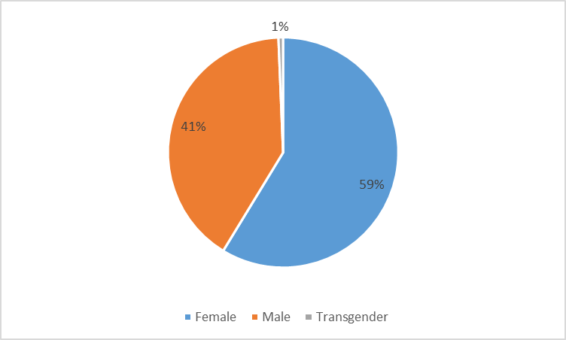
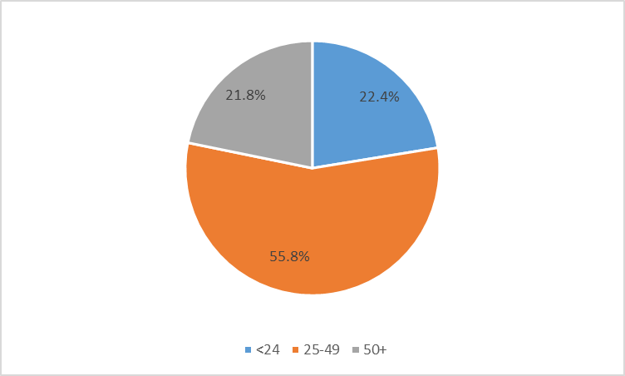
Gender and Age distribution of respondents
Gender
Age
Notes:
Average and median age of respondents = 37.

Slide 9
Types of phones and household HIV burden
Phone type
PLHIV on ARV treatment for HIV in household

Slide 10
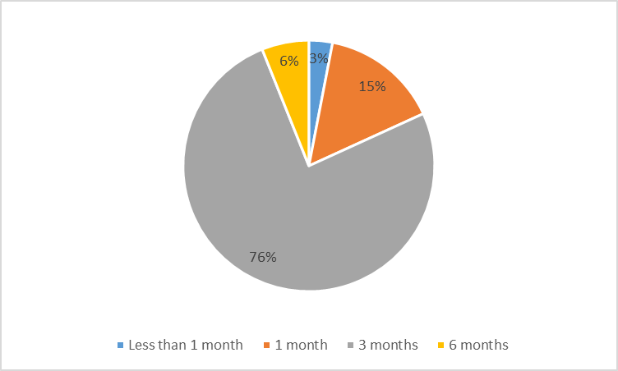
Usual period for which respondent receive HIV treatment
Notes:
3 MMD is close to the 83% of PLHIV at national level.

Slide 11
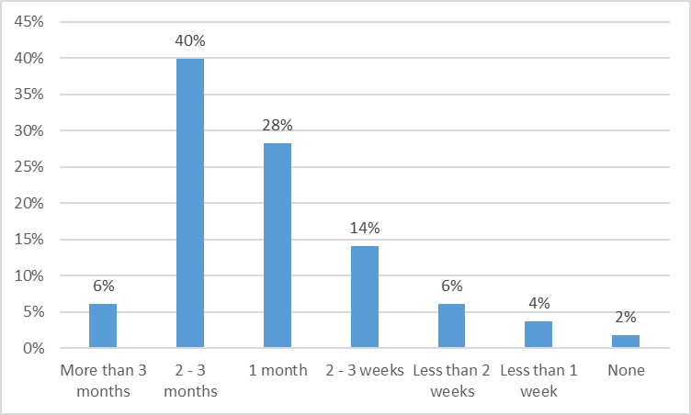
Days/weeks/months supply of ARVs before stock out

Slide 12
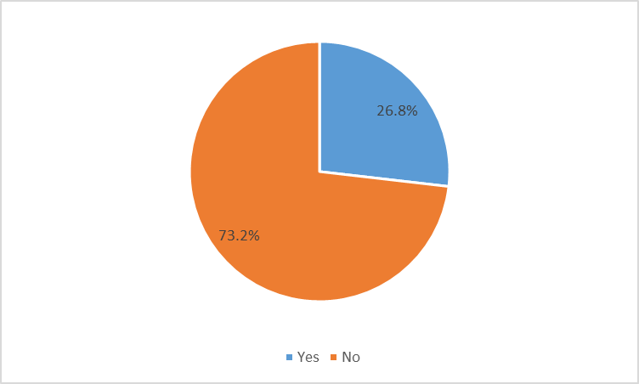
Attempted to refill ARV prescription in the last week

Slide 13
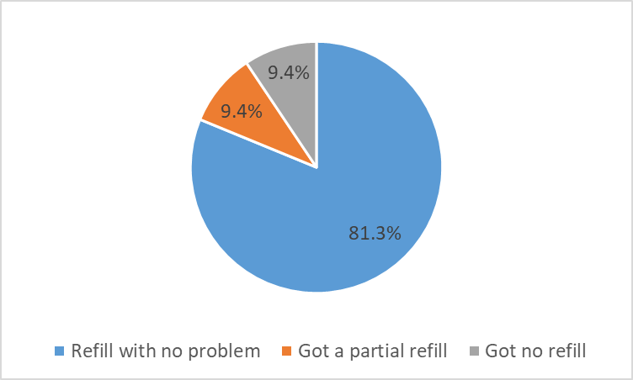
Respondents’ experience with refilling ARV prescription in the last week

Slide 14
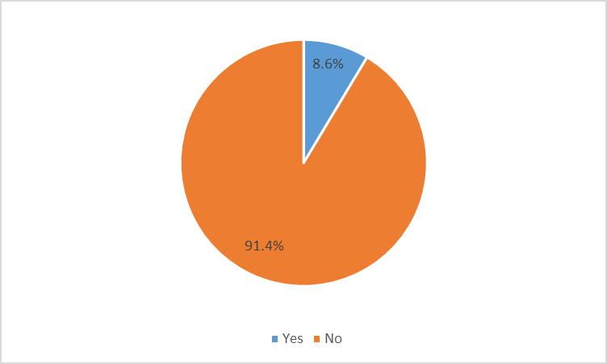
Respondents’ household with children taking ARVs

Slide 15
Approximate days of medication for children
1 = 0
2 = 1
1 = 60
1 = 180

Slide 16
Main challenge in getting ARV treatment on time during the COVID-19 epidemic

Slide 17
Reasons why respondents who did not get refills don’t know where to go to get their medications
Notes:
Refers to those that did not get refills

Slide 18
Level of anxiousness regarding COVID-19
High levels of anxiety
Average score = 3.65
Level of anxiousness on scale (1 to 5) from not anxious to extremely anxious, where 1 is not anxious and 5 is extremely anxious

Slide 19
Respondents’ concerns about COVID-19

Slide 20
Respondents’ ability to access measures to prevent exposure to COVID-19

Slide 21
Barriers to respondents’ efforts for self-isolation

Slide 22
Respondents’ access to other key services

Slide 23
Access to physical support for daily living functions for respondents living with a disability

Slide 24
Other necessary health services that respondents are not able to access right now

Slide 25
Services that are critical for respondents to adhere to HIV treatment during this crisis

Slide 26
Respondents’ knowledge of an organization that they can reach out to for information and support at this time
Notes:
The most commonly mentioned organisations are:
Africaid
NAC
YPNSRHHA
MoHCC
PAPWC
Zvandoitwa
SRC
PSI
GALZ
ZNNP+
ZAN
Zimbabwe Rainbow Community (ZRC)
HIV/AIDS Activist Union Community Trust
ZPCB

Slide 27
Specific health need that needs attention at this time

Slide 28
Other key information
Notes:
COVID 19 PLHIV Rapid Assessment Qualitative Information Analysis
The rapid assessment was done, to determine the status and needs of PLHIV in Zimbabwe in the wake of COVID 19. The study was conducted through a web-based survey monkey and a WhatsApp link. As of the 9th of April 2020, a total of 130 respondents had completed the WhatsApp and 40 had completed the Survey monkey. The following key issues were raised.
Most respondents flagged out the issue of food shortage. Most cited they were facing challenges of food shortage. There are some PLHIV who were making a living trough vending and cross boarder trading among other things. Their livelihoods were severely affected by the lockdown due to COVID 19.
Some cited were not aware how they are going to collect their medication in the wake of lockdown, where they do not have written letters of permission to travel. Some pointed that their next scheduled pickup date is next week meaning they urgently needed information on how they are going to have their resupply.
Some expressed concerns on where they are to collect their resupplies, where their usual pick-up points such as Beatrice Infections hospital have been turned to be COVID 19 emergence centres.
Language seemed to pose a barrier to some clients who were not able to respond to some of the questions being posed.
Other clients shared some of the health challenges that they are facing and expressing the need for face to face interaction with health facilities.
There were some clients who requested knowledge on how they can live a health lifestyle in the wake of COVID 19. This exposes a gap in information on positive living tips during the corona virus outbreak. Some lacked knowledge on COVID 19, and the its implications for PLHIV. Lack of conclusive data on HIV implication on HIV causing discomfort among PLHIV
There were concerns on how the PLHIV in remote and hard to reach areas are going to be reached with information and awareness messages that are being shared.
There were concerns on reaching out to PLHIV who are also living with disabilities, like the visually impaired and other disabilities, with COVID 19 information so that they are not left behind.
Some clients highlighted the challenges that they face in getting medicines for opportunistic infections such as one case who was diagnosed with Deep Vein Thrombosis (DVT) as well as Hypertension, whose estimated cost was ZWL$600.
Concerns were raised by some PLHIV over the way they were handled at some facilities, one cited that there were no longer taking care of clients due to COVID induced sigma. Some of PLHIV were going up without getting their medicines as a result.
Some PLHIV who are outside the country (SA) were unsure on how they are going to have their resupplies due to the lockdown, since they were doing so using the malayitsha (Cross boarder transporter).
Those who had travelled away from their normal drug pick-up points, with no paperwork or any prearrangements not aware of how they are going to get their medicines.
There were reports of cases of shortage of paediatric formulations especially Nevirapine in some facilities even in the private pharmacies.
The following recommendations can be derived from the issues that were raised by PLHIV
Urgent need to disseminate information on COVID, HIV and how people living with HIV can conduct themselves to prevent getting or spreading COVID 19. Information to be sensitive to local languages as well as ensuring inclusivity (catering for those living with disabilities such as braille material for the blind). The medium of communication to be sensitive to the marginalized and hard to reach communities.
Communication on the MoHCC guidelines how all categories of PLHIV are to get their resupplies during and after the lockdown- including those who have travelled within and outside the country. Communication to get to all the health delivery systems and the recipients of the services, including those whose normal pick-up points were turned to be COVID 19 sites
Nutritional support for PLHIV and other vulnerable populations whose livelihood has been affected by the COVID 19, including the lockdown
Address stigma issues with health facilities through capacity building and provision of adequate PPE for the service providers
Ensure all health facilities re adequately stocked with ART and essential medicines including medicines for other chronic conditions

Slide 29
Need follow-up? Granted permission to share contact info with authorities

Slide 30
Short to medium-term recommendations
Situation room and call centre for PLWHIV
Outreach services for MMD refill of ARVs and consultation on OIs
Referral pathways for psychosocial support
Remove user fees for health services to assure universal access to publicly-financed essential health services

