Slide 1
PATHS 2026:
Planning and Action Toolkit for HIV Sustainability 2026
Version 13 April 2026

Slide 2

Background (1/2)
Reductions in funding and changes in the global health architecture are making it imperative for countries to rethink how they deliver HIV and health services, moving away from donor reliance.
At the same time, many countries face reductions in funding for other areas of health programming, including tuberculosis (TB), malaria, sexual and reproductive health (SRH) and non-communicable diseases (NCDs).
In 2024, UNAIDS supported countries to initiate sustainability planning through the development of Sustainability Roadmaps.
Since then, an additional process to negotiate bilateral agreements between the United States Government (USG) and country governments has been implemented.
Countries have leveraged their sustainability roadmaps to inform these bilateral agreements moving away from donor reliance.
At the same time, countries are preparing for Global Fund GC8, which provides an opportunity for reassessment of programme priorities within the new funding context.
With these major changes in funding, it is critical to identify areas of priority, opportunity for innovation, integration and plans for strengthening across the entirety of the health architecture.

Slide 3
Background (2/2)
⚖️ HIV financing landscape is rapidly shifting
💰 Countries must make trade-offs across prevention, testing and treatment, prioritize and integrate HIV with other health services
⚒️Many tools are available to support prioritization, integration and designing sustainable HIV programmes but are not always easy to find

Slide 4

In response, the IAS developed:
PATHS 2026 – Planning and Action Toolbox for HIV Sustainability
A PowerPoint and online toolbox linking users to existing tools and resources from multiple sources to support prioritisation, integration and the transition to more sustainable national HIV progammes.

Slide 5
Table of contents
SECTION 1: PRIORIZATION
SECTION 2: INTEGRATION OF SERVICE DELIVERY
SECTION 3: INTEGRATION OF SYSTEMS
SECTION 4: TRANSITION AND SUSTAINABILITY

Slide 6



PATHS 2026 provides links to tools that support:
SECTION 1: PRIORITIZATION
SECTION 2:
INTEGRATION OF SERVICE DELIVERY
SECTION 3:
INTEGRATION OF SYSTEMS
SECTION 4: TRANSITION AND SUSTAINABILITY

Slide 7
SECTION 1:
PRIOITIZATION
1.1 Key questions
1.2 Resources
  TIER & TIER-Plus
  From WHO
  From the Global Fund
  From Avenir
1.3 Country experiences

Slide 8
Section 1.1:
Key questions
Who to engage
Situation analysis
Domains to consider
Model of prioritization
Use of modelling or TIER 2.0
Communication plans
Download key questions here.

Slide 9

Section 1.2: Resources
TIER, IAS – the International AIDS Society, 2025
This tool is designed to support countries in their planning and prioritization of HIV programme elements in the context of funding shifts. It provides a structured framework to prioritize HIV programme components – across testing, treatment, and prevention – based on epidemiological context and progress towards the 95-95-95 targets.
The tool uses illustrative examples of prioritization across four scenarios:
  A high-burden country achieving 95-95-95 targets across all populations,
  A high-burden country achieving the targets but not across all populations,
  A high-burden country not yet achieving one or more of the 95-95-95 targets, and
  A low-burden country not yet achieving one or more of the 95-95-95 targets.
Also available in Spanish, Portuguese and French

Slide 10
Section 1.2: Resources
TIER, IAS – the International AIDS Society, 2025
For each scenario, a suggested prioritized list of interventions is provided across key programme areas.
Users can select the scenario most relevant to their context, and then adapt, review and adjust the priorities noting the rationale for the decisions made.
Interventions are prioritized into three illustrative tiers:
Minimum - Services that are critical to maintain for continuity of care and health outcomes
Standard - Important to sustain; should be reassessed frequently for continuation as funding allows
Optimal - To be supported when additional resources are secured or efficiencies gained.

Slide 11

Section 1.2: Resources
TIER-Plus coming soon 2026
This updated tool will enable stakeholders to compare outcome and cost trade-offs across HIV interventions through an accessible, interactive platform.
The tool will consider 30 core interventions across prevention, testing, and treatment and estimate costs and impact on six key outcomes for each intervention:
    adult acquisitions,
    infant acquisitions,
    mortality,
    and the three 95s (diagnosis, treatment, viral suppression)
It will be an interactive platform enabling users to adjust coverage levels and visualize resulting effects on outcomes and costs.
It will be able to demonstrate how indicators may change over a 1-year time horizon.
Notes:
Link to slide deck until tool available

Slide 12
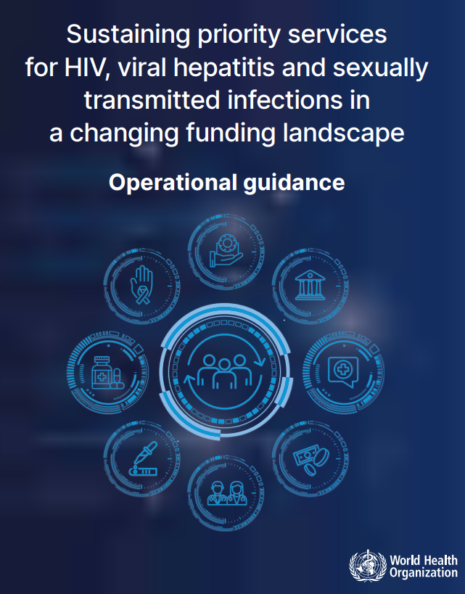
Section 1.2: Resources
Sustaining priority HIV, viral hepatitis and STI services in a changing finding landscape: operational guidance, World Health Organization, 2025
The guidance introduces a step-wise priority-setting framework that organizes services into three tiers based on their contribution to achieving national and global health outcomes.
The guidance also includes:
key steps to assess and monitor service disruptions and health financing risks;
a systematic process for setting priorities for services and interventions;
cross-cutting enablers such as health workforce strategies, resilient supply chains, integrated data systems and inclusive governance;
an emphasis on people-centred approaches and sustained community engagement to ensure that services remain accessible, acceptable and responsive to those most severely affected;

Slide 13
Section 1.2: Resources
Pooled procurement reference pricing from the Global Fund
The links below provide benchmark pricing of HIV diagnostics and medications procured through the Global Fund’s pooled procurement mechanism.
These reference prices can serve as target prices to inform national budget planning, prioritization and price negotiations in both national and regional procurement.
The Global Fund, version March 2026, “Pooled Procurement Mechanism Reference Pricing: ARVs”
The Global Fund, version April 2026, “Pooled Procurement Mechanisms Reference Pricing: Strategic medicines used in HIV programs”
The Global Fund, version Q4 2025, “Pooled Procurement Mechanisms Reference Pricing: RDTs”

Slide 14
Section 1.2: Resources
Avenir
SPECTRUM
Suite of epidemiological tools to assess progress of HIV programme
Optimised Treatment Costing
This tool calculates total and unit costs of providing ART to patients (adults/PMTCT/paediatric/key populations) by status (newly initiating/stable/unstable) for five years for several different user-defined scenarios.
It allows the user to first set up a "Current" scenario, and then 3 different "Optimized” scenarios for each of five different policy levers (Task allocation for provider visits at the facility level, Visits, Laboratory tests, Antiretroviral drugs, and Other commodities).
The user can then mix and match among the levers, allowing for many different combinations, to compare up to three "Optimized" scenarios with the "Current" scenario.

Slide 15
Section 1.3: Country experiences
National strategy for prioritization: Mozambique and Ghana
CQUIN use of adapted TIER tool
  Country presentations (November 2025)
  Country posters (November 2025)

Slide 16
SECTION 2: INTEGRATION SERVICE DELIVERY
2.1: HIV and NCD integration
2.1.1 Key questions
2.1.2 Resources
2.1.3 Key research
2.1.4 National guidance examples
2.2: HIV and family planning/SRH integration
2.2.1 Key questions
2.2.2 Resources
2.2.3 Key research
2.2.4 National guidance examples
Notes:
Have all as direct links 2.1

Slide 17
Section 2.1: HIV and NCD integration – Key questions
Cascade data across chronic conditions
How are services currently delivered
What model of integration to be adopted
Where, who and when are HIV and chronic condition services delivered
Are there differences in how patients access medicines and diagnostics across conditions? (What is included in national health insurance schemes?)
Download key questions here.

Slide 18

Section 2.1. HIV & NCD integration - Resources
World Health Organization
WHO recommendations for the integration of hypertension, diabetes and mental health with HIV services, 2025.
This 2025 update provides the new synthesis of evidence for the integration of hypertension, diabetes and mental health services with HIV care

Slide 19
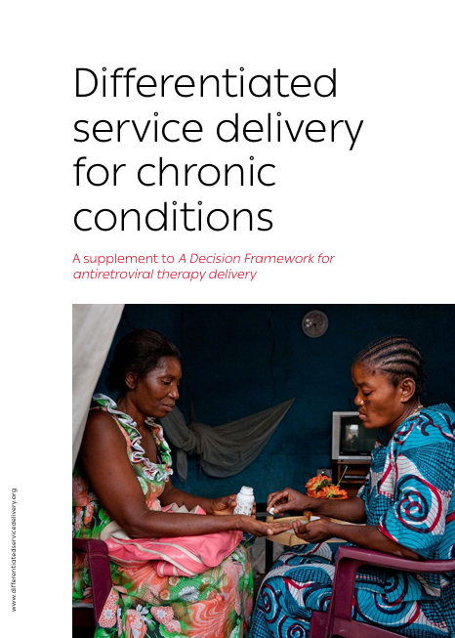
Section 2.1. HIV & NCD integration - Resources
IAS – the International AIDS Society
DSD for chronic conditions. A supplement to A Decision Framework for antiretroviral therapy delivery, 2024.
This framework outlines how the principles of DSD can be applied across chronic conditions. Key components include defining criteria for “established on treatment”, WHO guidance and evidence on the frequency of clinical visits, support for task-sharing and case examples of integration and chronic disease DSD models.

Slide 20
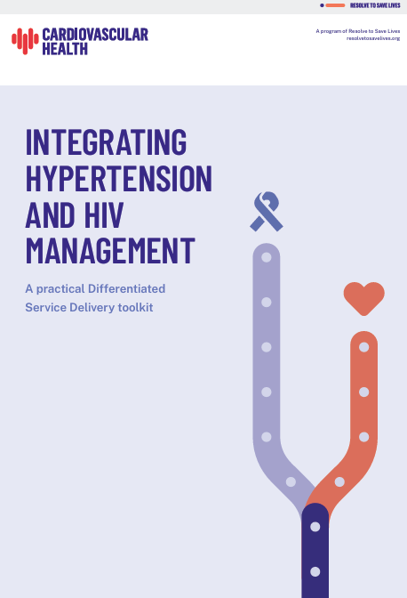
Section 2.1. HIV & NCD integration - Resources
Resolve to Save Lives
Integrating Hypertension and HIV Toolkit: A Practical Differentiated Service Delivery toolkit, 2023
This practical toolkit demonstrates how DSD principles can be adapted for chronic diseases, particularly hypertension. It includes example standard operating procedures (SOPs) for each of the four DSD models and tools and templates to support programme design and implementation.
Patient-Centered, Sustainable Hypertension Care: The Case for Adopting a Differentiated Service Delivery model for Hypertension in low- and middle-income countries

Slide 21

Section 2.1. HIV & NCD integration - Resources
Genesis Analytics
Integrating HIV programmes into primary health care, 2024
This document presents a flexible pathway for integrating HIV services into PHC systems – or integrating other health services into HIV programmes. It provides detailed step-by-step considerations to guide the Ministries of Health and Finance, HIV and PHC programme managers, implementing partners and donors.
The approach emphasizes the need for responsive, context-specific implementation strategies tailored to country-specific settings and addressing integration at service delivery, systems, financing and governance levels to underpin successful scale-up of integration efforts.

Slide 22
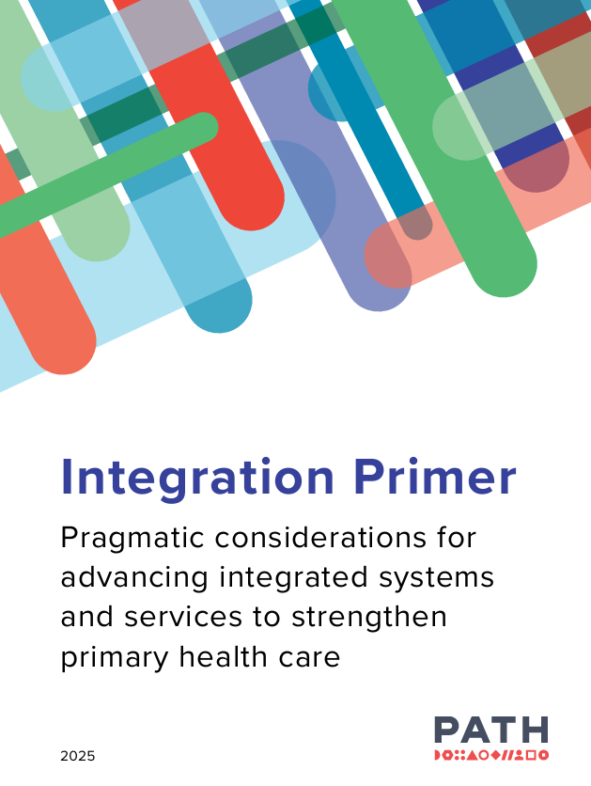
Section 2.1. HIV & NCD integration - Resources
PATH
Integration Primer – Pragmatic Considerations for Advancing Integrated Systems and Services for Strengthened Primary Health Care, January 2026 (updated version)
This refreshed primer aims to equip policymakers, health system planners, implementers, advocates, and donors with pragmatic guidance, learnings, and tools as they advance integrated systems and services to strengthen PHC.
The document includes The Readiness Assessment and Prioritization for Integration Decisions (RAPID) tool designed to support sub-national health manager and planners.

Slide 23
Section 2.1. HIV & NCD integration - Research
INTE-AFRICA STUDY
The INTE-Africa study evaluated a fully integrated model of HIV, hypertension, and diabetes care in sub-Saharan Africa, including participants with chronic conditions who did not have HIV. This large, randomized study was conducted in two countries- Tanzania and Uganda- and followed more than 6,000 participants attending 32 health facilities for 12 months.
The key findings were that integrated management resulted in high rates of retention in care for people with diabetes, hypertension, or both. Viral suppression rates were not adversely affected, and the integrated model was cost-saving for health services.
The cost results showed the mean monthly service cost managing two conditions in a single individual was: $39.11 (95% confidence interval (CI): 33.99, 44.33) for HIV and diabetes, $32.18 (95% CI: 30.35,34.07) for HIV and hypertension and $22.65 (95% CI: 21.86, 23.43) for diabetes and hypertension. These costs were 34.4% (95% CI: 17.9%, 41.9%) lower than managing any two conditions separately in two different people. Managing all three conditions in a single individual was 48.8% (95% CI: 42.1%, 55.3%) cheaper than managing them separately. Out-of-pocket expenditure per participant per visit was $7.33 (95% CI: 3.70, 15.86), representing 23.4% (95% CI: 9.9, 54.3) of the total monthly service expenditure per participants and 11.7% (95% CI: 7.3, 22.1) of their individual total household income.

Slide 24
Section 2.1. HIV & NCD integration - Research
WHO systematic review on integration of hypertension and diabetes and mental health
Literature database for HIV service integration, Genesis Analytics (Pty) Ltd, 2024. This user-friendly dashboard is a consolidated database of 170 studies examining pathways to HIV integration. The “consolidated database” sheet offers a collection of literature on HIV service integration. There are also specialized sections on “costing literature” and “cost effectiveness”.

Slide 25
Section 2.1. HIV & NCD integration - Research
Early findings from the integration of hypertension care into differentiated service delivery models for HIV in Uganda: a mixed‐method study, 2025
Aligning HIV treatment and hypertension clinic visits and dispensing as a first step towards service delivery integration in South Africa, 2025
Ongoing research on integration of HIV with chronic disease services
  Christian Health Association: Evaluation of Integrated Services in Kenya

Slide 26
Section 2.1. HIV & NCD integration – National guidance
South Africa: Adherence Guidelines for HIV, TB and NCDs (Updated April 2023)
Kenya: AIDS strategic integration framework 2025-2030

Slide 27
Section 2.2. HIV and family planning/SRH integration–
Key questions
What is the current epidemiological and service delivery context for HIV and family planning?
How are HIV and family planning services currently delivered?
What model of integration has been/will be adopted?
Where, by who and when are family planning services provided in an integrated setting?
What family planning methods are available and accessible in HIV service settings?
Are monitoring, supply chain and data systems coordinated?
Download key questions here.
SECTION 2: INTEGRATION SERVICE DELIVERY

Slide 28
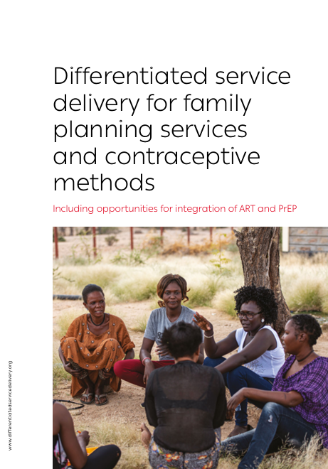
Section 2.2. HIV and family planning/SRH integration– Resources
IAS
Differentiated service delivery for family planning services and contraceptive methods, 2025
This framework provides an outline of how the principles of differentiated service delivery may be used across methods of contraception to provide integrated HIV and family planning services.
SECTION 2: INTEGRATION SERVICE DELIVERY

Slide 29
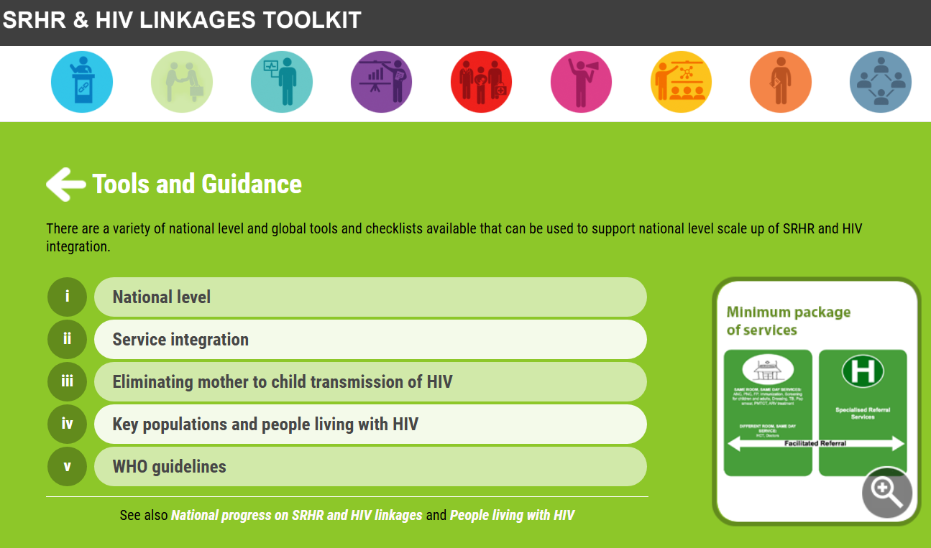
Section 2.2. HIV and family planning/SRH integration– Resources
WHO
SRHR & LINKAGES TOOLKIT
Integration of HIV testing and linkage in family planning and contraception services: implementation brief, 2021
Actions for improved clinical and prevention services and choices: preventing HIV and other sexually transmitted infections among women and girls using contraceptive services in contexts with high HIV incidence, 2020
Operational considerations for increasing access to cervical cancer screening for women living with HIV , 2023
SECTION 2: INTEGRATION SERVICE DELIVERY

Slide 30
Section 2.2. HIV and family planning/SRH integration– Research
Integration of family planning services into antiretroviral for HIV in differentiated models of care in South Africa, 2026
  Only 21% of women collected family planning medications on the same day as ART
SECTION 2: INTEGRATION SERVICE DELIVERY

Slide 31
Section 2.2. HIV and family planning/SRH integration– National guidance
Implementation Guide for the National Strategy for Integration of Sexual Reproductive Health and Rights and HIV/AIDS 2017 – 2021, Uganda
SECTION 2: INTEGRATION SERVICE DELIVERY

Slide 32
SECTION 3: INTEGRATION OF SYSTEMS
3.1 Human resources
3.2 Laboratory systems
3.3 Supply chain
3.4 Monitoring and evaluation
SECTION 3: INTEGRATION SYSTEMS
Notes:
Have all as direct links 2.1

Slide 33
Section 3.1 Human resources - Key questions
Download key questions here.
SECTION 3: INTEGRATION SYSTEMS

Slide 34
Section 3.2: Laboratory
Key questions
  Download key questions here.
Resource
  African Society of Laboratory Medicine
    LabCoP Cookbook of best practices: Recipe #1: Sample transport system, 2019.
Country example
  Zimbabwe Ministry of Health and Child Care
    Integrated sample transportation system (IST) concept note.
Research
  Leveraging private sector transportation/logistics services to improve the National Integrated Specimen Referral Network in Nigeria, 2019.
SECTION 3: INTEGRATION SYSTEMS

Slide 35
Section 3.2: Supply chain
Key questions
  Download key questions here.
Country example: Ghana
  Ghana health supply chain master plan 2025-2029, Ghana Ministry of Health.
  The Ghana Health Supply Chain Master Plan describes the development of an integrated supply chain system aligned with the goal of achieving Universal Health Coverage. The domains considered in the plan include strategic planning and management, forecasting and supply planning, procurement and customs clearance, distribution, quality and pharmacovigilance and healthcare waste management.
SECTION 3: INTEGRATION SYSTEMS

Slide 36
Section 3.4:
Monitoring and evaluation
Key questions
Download key questions here.
Resource
Data decision making tool: The slides in this tool provide a go-to hub for exploring essential datasets, practical tools, and best practices for planning, monitoring, and evaluating HIV programmes. Through its intuitive structure, this guide equips you to:
  Navigate diverse data resources tailored to your programme's needs,
  Understand when and how to collect and use data
  Assess the real-world impact of HIV interventions.
SECTION 3: INTEGRATION SYSTEMS

Slide 37
Section 3.4
Monitoring and evaluation
Resources
  Genesis Analytics
  Selecting Health Systems Metrics for HIV Response Sustainability Planning, 2024
  Health Metrics Database for Sustainability Planning, 2023
  The tools recommend a limited set of the most suitable and high-quality indicators that can be used to track progress towards goals. The recommended indicators are framed within an easy-to-use typology that organizes the indicators by health system sub-domain and by generic sustainability goal statements for those sub-domains.
  Stakeholders are encouraged to consider the array of recommended health systems indicators in this reference and select the most appropriate indicators to suit their country's context.
  For each indicator, a brief rationale is provided to assist with the selection process. The suitability of each indicator for various country contexts is also provided, again to support stakeholders with selection.
SECTION 3: INTEGRATION SYSTEMS

Slide 38
Section 3.4 Monitoring and evaluation
Resources & country experience
CQUIN prioritization of M&E indicators
CQUIN national M&E vulnerability assessment tool and webinar
  The tool assesses the impact of funding shifts on the ability to continue collecting defined indicators and the use of specific M&E tools
Kenya: Moving towards an integrated strategic information system for chronic conditions
Uganda experience of developing an integrated approach to M&E
SECTION 3: INTEGRATION SYSTEMS

Slide 39
SECTION 4: TRANSITION AND SUSTAINABILITY
4.1 Memorandums of Understanding (MOUs) with the U.S. government (USG)
4.2 Global Fund (GF) Grant Cycle (GC) 8
4.3 UNAIDS sustainability approach
4.4 Publications
SECTION 4: TRANSITION AND SUSTAINABILITY
Notes:
Have all as direct links 2.1

Slide 40
Section 4.1: MOUs with the USG
Memorandums of Understanding with U.S. government
Draft template
Technical guidance for completion of the draft template
SECTION 4: TRANSITION AND SUSTAINABILITY

Slide 41
Section 4.1: MOUs with the USG
The following links provide access to available MoUs and track available information on the progress and barriers to agreements being signed:
  KFF Tracker: American First MOU Bilateral Global Health Agreements, KFF, March 2026
  Tracking the “American First” Bilateral Health Agreements, Think Global Health, March 2026
SECTION 4: TRANSITION AND SUSTAINABILITY

Slide 42
Section 4.2: GF GC8
Technical guidance
Key focus areas in the applicant guidance include:
  Prioritization: ensuring rigorous optimization of interventions, including considerations of value for money in investments
  Integration: integration of services and systems across diseases and into primary health care will be essential in GC8, not just as an aspect of implementation efficiency and value for money, but as an opportunity to deliver greater impact with the funds available.
  Increasing self-reliance over time: investments from the Global Fund in GC8 should support countries to follow pathways to effective transition from Global Fund financing, with co-financing as a key tool along the way.
  Expediting access to innovations: ensuring timely access to innovations can help drive down the disease burden more effectively, to make health investments go further.
Operational Update on GC8 Materials
SECTION 4: TRANSITION AND SUSTAINABILITY

Slide 43
Section 4.2: GF GC8
Resources
Results for Development
Sustainability Planning for HIV/AIDS, Tuberculosis and Malaria Programs in High Impact Africa Countries: Guidance for the Global Fund on How to Support a Successful Transition to Domestic Financing, 2024
This guide provides suggested approaches and analytical tools for implementing the Global Fund’s Sustainability, Transition and Co-Financing (STC) Policy in High Impact Africa countries.
It is meant to support structured dialogue to inform policy decisions that can help sustain progress on programs that address HIV/AIDS, tuberculosis and malaria as donor funding declines or ends, given the context of a country’s health financing system and reform plans.
SECTION 4: TRANSITION AND SUSTAINABILITY

Slide 44
Section 4.3
UNAIDS sustainability approach
UNAIDS sustainability webpage
UNAIDS has developed a range of supporting documents to assist governments in the development of their sustainability roadmaps. The tools and guidance include information on: Key strategic priorities
  Estimated costs
  Monitoring and evaluation (M&E) plan
  Quality management plan
  Defined timelines and responsibilities
  Risk mitigation strategies
  Monitoring and oversight of sustainability roadmaps
  Progress update
SECTION 4: TRANSITION AND SUSTAINABILITY

Slide 45
Section 4.4: Publications
Time driven activity-based costing (TDABC), 2022
The principle of TDABC is to measure the costs of all resources used to care for patients as they move through the health system and use time as the measurement unit for assigning costs to resources.
This methodology is being used by ministries of health in Uganda, Kenya and Tanzania as they move from vertical HIV services to integrated care pathways.
Costing of HIV services in Uganda and Tanzania
SECTION 4: TRANSITION AND SUSTAINABILITY

Slide 46
Section 4.4: Publications
Towards a sustainable HIV response: strengthening Zimbabwe's domestic financing for HIV programs amid declining donor support, 2025
Shaping sustainable paths for HIV/AIDS funding: a review and reminder, 2025
Advancing Sustainable HIV Services Through Integration in Primary Healthcare In Sub-Saharan Africa: A Perspective on Practical Recommendations, 2025
Innovative approaches to HIV/AIDS financing: lessons learned from the Sustainable Financing Initiative (SFI), 2025
SECTION 4: TRANSITION AND SUSTAINABILITY

Slide 47
For further information, any questions, or if you have resources you would like to contribute to the PATHS 2026 toolbox, please contact: dsd@iasociety.org

