Slide 1


Discontinuation from community-based antiretroviral adherence clubs in Gugulethu, Cape Town, South Africa
Andile Nofemela, Cathy Kalombo, Catherine Orrell, Landon Myer
Centre for Infectious Diseases Epidemiology and Research (CIDER)
Division of Epidemiology and Biostatistics
School of Public Health & Family Medicine, University of Cape Town

Slide 2
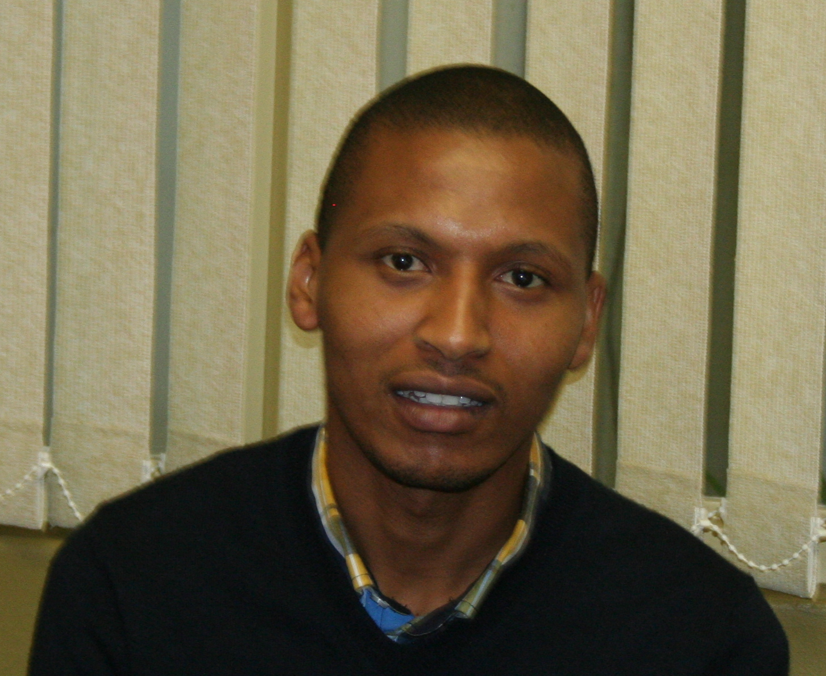
Andile Nofemela, 1984-2016

Slide 3
Antiretroviral treatment (ART) initiations in South Africa
2001 – 2015

Slide 4
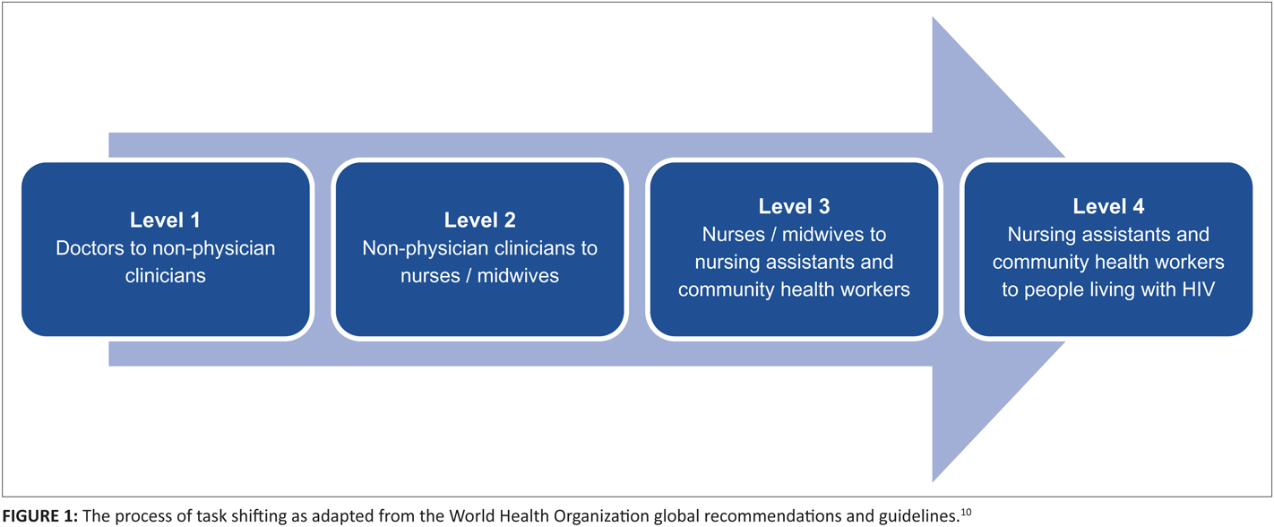
The movement to differentiated care
Community-based Adherence Clubs
Crowley 2015

Slide 5
Community-based ART Adherence Clubs (ACs)
ACs enrol stable ART patients (>6-12 months on ART with VL<400 & CD4>200) into a lay-counsellor-led programme of 2-4 monthly ART dispensing at a local community venue
Club sessions led by Community Health Workers
Every 2-4 months
Rapid symptom assessment
Collection of 2-4 months ART supply
Quick group adherence support
Distribution of condoms
Health education talks
Clinical Club sessions led by PHC Nurses
Annually
Phlebotomy for CD4 and viral load
Clinical consultation: history, chronic disease screening
Family planning consultation

Slide 6
Adherence clubs hold great promise
Preliminary assessments suggest ACs allow high-volume ART delivery led by lay health workers
  outcomes similar to large clinician-led primary health care (PHC) services
Important questions remain for scale-up
  Adaptations of ACs for different health systems contexts?
  AC models for different patient populations?
  Service packages to include in AC (beyond ART delivery)
  Long-term outcomes? Why patients leave ACs?
  How patients move between ACs & PHC clinics

Slide 7


Aim
To investigate (i) frequency and (ii) causes of discontinuation from the community-based ART Adherence Clubs in Gugulethu, Cape Town

Slide 8
Methods
Retrospective cohort study
Routinely-collected data linked to the Gugulethu Community Health Centre, June 2012 to November 2015
  91 clubs operated at local community venue
  Data from AC registers and National Health Laboratory Services
Frequency of discontinuation from clubs over time as rates per 100 person-years:
  Death, Transfer out, referral back to PHC, Loss to follow-up (LTF)
  Referral back to PHC allowed re-entry into AC
  LTF: >6 months without a club visit before the end of April 2016 without an alternate known outcome
Proportional hazards models to examine risk factors
  Extensions for competing risks

Slide 9
Results (1)
3359 patients enrolled into ACs
Median age, 37 years
71% female
Median duration of ART use before AC, 3.5 years
36,075 AC visits
7859 person-years of follow-up in ACs
Median duration in AC, 2.3 years

Slide 10
Results (2)
Rates of discontinuation from ACs during analysis period:
Death: 0.03 /100 person-years
Transfer out: 0.09 /100 person-years
LTF: 9.4 /100 person-years
Referral back to PHC: 20.1 /100 person-years

Slide 11
Referral back to PHC
4% of all AC visits resulted in referral back to PHC clinic
  High viral load at routine monitoring: 13%
  Missed club visit / suspected non-adherence: 25%
  Symptoms of tuberculosis: 17%
  ↑ blood pressure / possible HPT symptoms: 6%
  ↑ blood glucose / possible HPT symptoms: 12%
  Other reasons: 26% (other symptoms; questions for clinician)

Slide 12
Loss to follow-up
After 36 months in AC, 26% of patients were LTF
Independent of gender & duration of ART use, LTF was increased in patients <25 years of age
  HR: 1.7; 95% CI: 1.2-2.5
In the subset of patients who had VL data available
  prior raised VL in the clubs was strongly predictive of subsequent LTF (HR: 4.4; 95% CI: 2.9-6.7)
No association between time on ART before entry into clubs and referral back to clinic (p=0.63) or LTF (p=0.92)

Slide 13
Discussion
High levels of LTF over time
  Drivers of non-retention in community-based vs facility-based care?
High frequency of referrals back to primary care clinic
  No data on completion of referrals or outcomes
  Referrals of patients represent ‘weak link’ in chronic care systems
Should we strengthen AC services to address common reasons for referral?
  TB → IPT
  Missed visits / non-adherence → enhanced adherence counselling?
  HPT, DM care? Other medical complaints?
Balance: maintaining streamlined ART care vs meeting diverse patient needs

Slide 14






Acknowledgements
Shahieda Jacobs, Stephanie Fourie
Jo Allerton, Jasantha Odayar
Desmond Tutu HIV Foundation
Provincial Government of the Western Cape
ART Adherence Club counsellors
Clinical staff of Gugulethu CHC
Adherence Club patients

