Slide 1
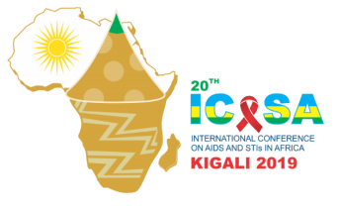
Population-wide gender differentials in HIV service access and outcomes in the Western Cape, South Africa: 2007 – 2018
Closing the gap on reaching men: Time for action
ICASA 2019 satellite
Meg Osler, Morna Cornell, Nathan Ford, Katherine Hilderbrand, Eric Goemaere, Andrew Boulle
5 December 2019

Slide 2
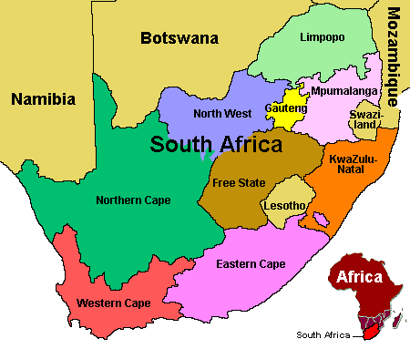
METHODS
Population-wide linked anonymised data, including vital registration linkage, for the Western Cape province of South Africa
  167388 adults included in analysis
Temporal trends across ART eligibility periods by gender
Effectiveness of ART around each successive CD4 eligibility threshold explored through regression discontinuity analyses
Western Cape: population 6.8 million
434,533 people with HIV
>190,000 people on ART

Slide 3
RESULTS
Median CD4
% ART Start

Slide 4
RESULTS
Treatment
eligibility
thresholds
Death pre-ART
Death on ART
CD4 200 | 1.26 (1.19-1.34)
CD4 350 | 1.24 (1.15-1.34)
CD4 500 | 1.13 (0.97-1.31)
1.41 (1.28-1.55)
1.33 (1.21-1.45)
1.65 (1.46-1.88)

Slide 5
Conclusions
Men presented with more advanced disease
Were less likely to initiate ART
Had higher pre-ART and on-ART mortality
Benefited less from guideline-guided ART access

