Slide 1

Men’s use of facility-based health services in Malawi
Preliminary findings from the “Scaling Facility HIV Self-Testing” study
Closing the gap on reaching men: Time for action
ICASA 2019 satellite
On behalf of Kathryn Dovel Kelvin Balakasi, Isabella Robin, Misheck Mphande, Naoko Doi, Pericles Kalande, Sundeep Gupta, Brooke Nichols
5 December 2019
Notes:
On behalf of Kate Dovel and the entire study team, I am happy to present preliminary findings on adult men’s use of facility-based health services in Malawi.

Slide 2
Background
Men remain underrepresented in HIV testing and treatment services
  Community-based strategies are often seen as essential to reaching men
  Men have few reasons for routine facility-based health visits, and may avoid health facilities
However, little is known about the frequency with which men actually attend facilities, and what services are received
Notes:
Men remain underrepresented in an array of health services, including HIV testing and treatment. The public health community often assumes that men do not attend health facilities, and therefore, we must go into the community in order to find them. However, little is known about the frequency with which men attend health facilities, and services received when they do attend facilities. This is important in order to better understand how and where we can reach men.

Slide 3
Study objective
Overarching Objective:
Assess the potential impact of facility HIVST on (1) community level testing coverage among men and youth and (2) facility efficiencies
Aim 1: Examine under-reached populations (men and youth aged 15-24 years) use of facility-based health services in the past 24 months
Aim 2: Assess facility-based HIVST when implemented by lower-level healthcare workers and combined with a simple screening tool
Aim 3: Estimate the time to achieve different levels of community-level testing coverage among under-reached populations (men and youth) with the scale-up of facility HIVST within the community catchment area of each facility
Notes:
The study team conducted a multi-phase study to understand the potential impact of facility HIVST when implemented as part of routine services. The first Aim was to examine men and youth’s use of facility-based health services in the past 24-months. In this presentation I will focus on preliminary results for adult men over 24 years of age.

Slide 4
Methodology for Aim 1
Aim 1: Community Survey
Design: Cross-sectional, community survey
Sampling Strategy: Multistage sampling. 36 villages randomly selected from the 6 facility catchment areas. 1,897 individuals randomly selected using national village registers. Individual sampling stratified by age.
Eligibility: Youth (15-24 years) or Adult Men (25-65 years); slept >15 nights in selected villages in last 30 days
Timeline: August - October, 2019
Notes:
Briefly, Aim 1 was completed using a representative, community-based survery in 36 villages in Central and Southern Malawi (Northern Malawi was excluded due to low HIV prevalence and incidence rates). The team used a multistage sampling technique. 6 facilities were selected based on PEPFAR priority sites. 36 villages within the 6 facilities were randomly selected, and individuals were randomly selected within each village. Eligibility criteria included all youth aged 15-24 and adult men – adult women were not included in the study.

Slide 5
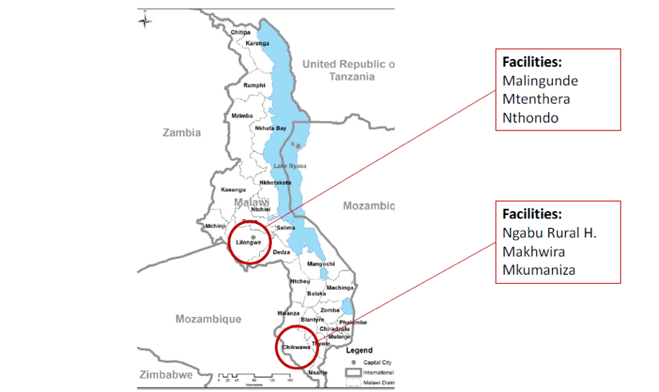
Facility-level sampling
(6 villages per facility)
Notes:
Here is a map showing study locations – note that the districts of Lilongwe and Chikwawa are high priority districts for PEFPAR where Partners in Hope is an implementing partner.

Slide 6
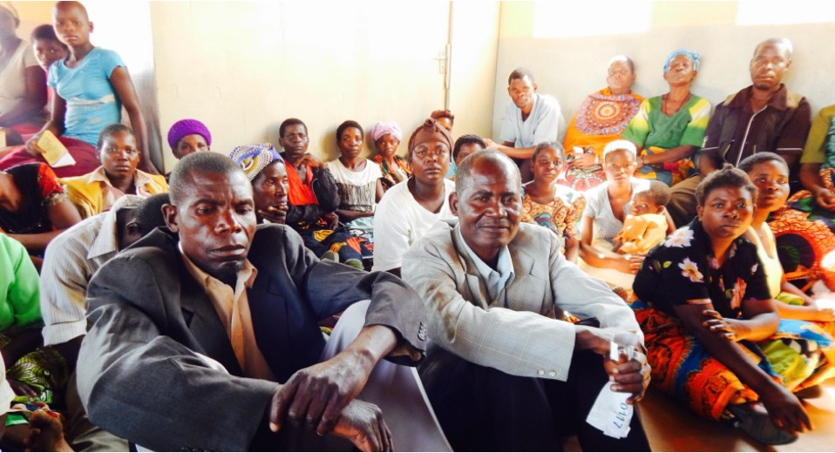
Preliminary results

Slide 7
Study enrolment
Notes:
This figure shows study enrollment. There is a lot of information here. What is important to note is that only 3% of individuals were not found. Lilongwe District in Central Malawi had higher rates of ineligibility and lower HIV prevalence. This is consistent with other studies. In total, 1,407 individuals were enrolled. Including 882 men.

Slide 8
Respondent characteristics
Demographics
Demographic variables | Men (25+ years) (n/%)
n | 822
Mean age, years (IQR) | 40.2 (32-47)
Mean education, years (IQR) | 5.6 (3-8)
Mean household asset 15-point scale (IQR) | 5.3 (3-7)
Currently have financial savings | 283 (34.4)
Typically work ≥5 days per week | 524 (63.8)
Slept 3+ nights away from home in last 30 days | 226 (27.5)
Median number of children living in the household (IQR) | 3.7 (2-5)
Notes:
Among adult men, the mean age was 40 years, with a primary education, and most working at least 5 days per week. Over 27% of men also spent at least 3 nights away from their home in the last 30 days, usually for work. This reflects the typical man we are trying to reach with HIV programs.

Slide 9
Respondent characteristics
Sexual risk behavior and use of HIV services
Demographic variables | Men (25+ years) (n/%)
n | 822
Sexual risk behaviour
Married/living together | 786 (95.6)
≥2 sexual partner in past 12 months | 264 (32.1)
Sexual partner is HIV+ | 16 (2)
HIV services
Ever tested | 670 (81.5)
Mean years since last HIV test (IQR) | 1.8 (0.2-1.7)
Frequently talk with someone who is actively taking ART | 126 (31.2)
Notes:
Here we examine sexual risk behaviours among adult men in the study. The vast majority of men were married, 32% reported 2 or more sexual partners in the past 12 months. Use of HIV services was fairly common among the population, with nearly 82% ever tested for HIV and the mean years since last HIV test at 1.8 years. The population was familiar with HIV and ART – 31% frequently talked (or was friends with) someone who was on ART.

Slide 10
Respondent characteristics
Use of health services within 24months
Demographic variables | Men (25+ years)
n | 822
Use of health services ≤24months ago
Attended facility TOTAL (as a guardian or client), n (%) | 770 (93.7)
Attended facility as a client, n (%) | 652 (79.3)
Attended facility as guardian, n(%) | 663 (80.7)
Number of facility visits TOTAL, mean (IQR) | 4.62 (2-6)
Number of facility visits as a client, mean (IQR) | 2.96 (1-4)
Number of facility visits as a client, mean (IQR) | 1.66 (1-3)
Notes:
Importantly, men frequently visited health facilities. We examined men’s total attendance as either a client or as a guardian – meaning escorting someone else who is receiving health services – and men’s attendance as only a client, receiving health services for themselves. We defined a guardian as someone who is at the health facility while the other person receives services – men who dropped their wives at the facility and left were not counted as a guardian. However, a guardian may wait somewhere inside the facility gate and not enter the consultation room with the patient they are escorting.
Nearly 94% of men attended at least one facility appointment in the past 24 months – 79% attended a facility as a client during that same period. The number of visits made were also high – during the 24month period, the mean number of visits was 4.6 for all visits and nearly 3 visits for men’s own health care.

Slide 11
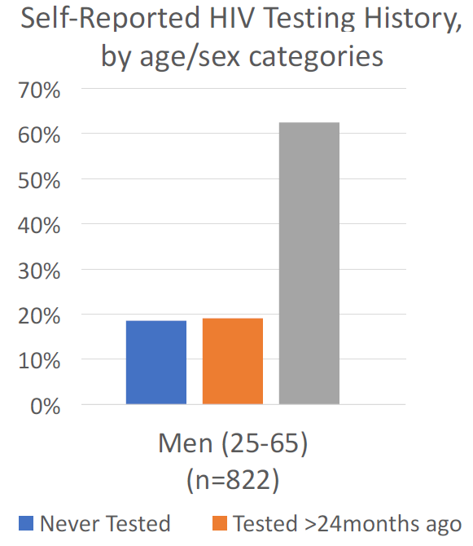

Who is missed in HIV testing?
38% of men 25-65 years old in need of testing
Notes:
But what about men who are missed from testing services. Do they frequent health facilities? The team examined this. Among adult men, 38% were in need of testing, with a little under 20% having never tested for HIV.
(Note, we use a conservative definition of “in need” as someone tested>24 months ago)

Slide 12
Among those tested >24months ago, who attends a health facility?
Notes:
Among those not tested in the past 24 months, nearly 90% attended a health facility, about 75% did so as a client, accessing health services for themselves.

Slide 13
Among those NEVER tested, who attends a health facility
Notes:
The frequency of attendance decreases for those never tested before. However, the numbers are still encouraging. 75% of men who never tested for HIV attended the facility as either guardians or for their own health, 50% attended the facility as a client for their own health. Here we see that even men who do not seek care for themselves do come to facilities as a guardian (50% vs 75%).

Slide 14
Among those tested >24months ago or NEVER tested, what happened during facility visits?
Demographic variables | Men (25+ years) (n/%)
 | Guardian | Client
Number of visits in past 24 months | 507 | 604
Top 3 reasons for health care visit
OPD: feeling sick | 395 (77.9) | 428 (70.9)
OPD: injury | 31 (6.1) | 44 (7.3)
Delivery | 31 (6.1) | 0 (0)
Offered HIV testing | 59 (11.6) | 146 (24.2)
Reason for not testing
Not ready (prepared) to test for HIV | 69 (13.6) | 80 (13.2)
Do not need an HIV test (no perceived risk) | 82 (16.2) | 77 (12.7)
Not offered HIV testing | 132 (26.0) | 218 (36.1)
Notes:
What happened when men in need of testing attended a health facility? We break down findings by guardian and client visits. The majority of visits were to the outpatient department (or OPD). Only 11% of guardians and 24% of clients were offered HIV testing (remember this analysis is only among those who are IN NEED of testing, so none of them accepted the offer to test). When asked why they did not test even though they were at the health facility, over a quarter said they did not test because they were not offered HIV testing services.

Slide 15
Conclusions
Men older than 25 years DO frequent health facilities in Malawi.
Wider coverage of facility testing may decrease unmet need among adult men
Next Steps: Similar health facility attendance studies should be replicated in other settings.
Findings highlight the need to interrogate in each context the assumption that men cannot be reached through facility services.
Notes:
This study finds that men do frequent health facilities, even those in need of HIV testing, although facility attendance was lower among men who never tested.
Findings highlight the fact that we should not overlook the potential role of facility-based interventions. Additional research is needed to assess if similar findings exist in other settings. As we continue to think about innovative ways to reach men, these findings challenge us to examine our assumptions about men and health facilities.

Slide 16


Acknowledgements
Study activities were funded by the United Kingdom Department for International Development (DFID) grant number: 300380
KD receives support from the UCLA CFAR grant AI028697 and the UCLA AIDS Institute. KD’s time was partially supported by the National Institute of Health Fogarty International Center K01-TW011484-01.
We are grateful to the Research Assistants and respondents who contributed to this work

