Slide 1


The importance of community-led advocacy and demand creation to reach men
Closing the gap on reaching men: Time for action
ICASA 2019 satellite
Nelson Otwoma
National Empowerment Network of People living with HIV/AIDS in Kenya (NEPHAK), Kenya
5 December 2019

Slide 2
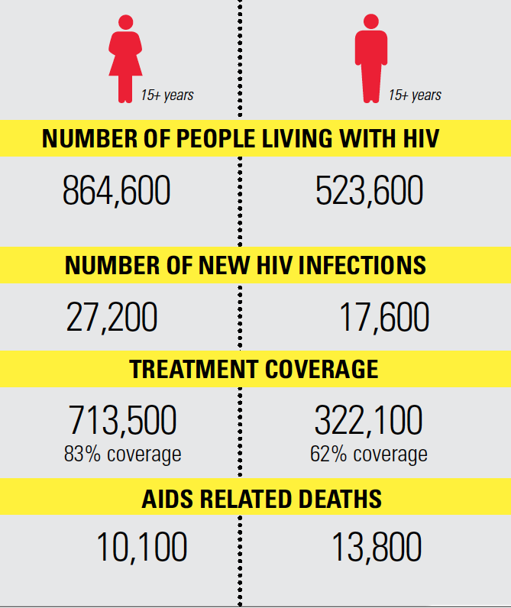
Men & HIV in Kenya
Despite progress, men and boys are being left behind in the acceleration to epidemic control
Challenges range from poor health seeking behaviour by men to overtly feminized health care systems
62% ART coverage in men vs. 83% in women
Source: Kenya 2018 AIDS response progress report

Slide 3
Progress towards 90-90-90 targets for men and women
Source:

Slide 4
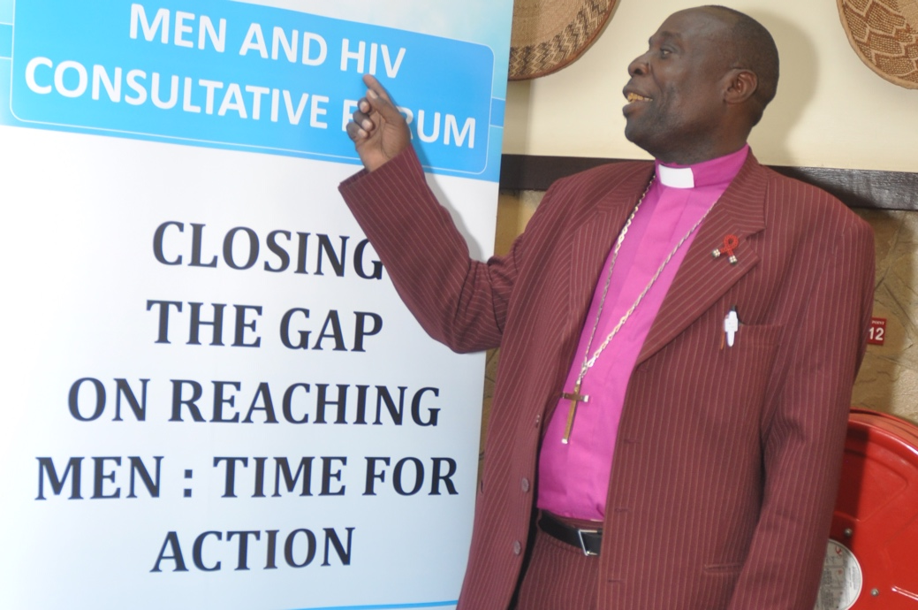
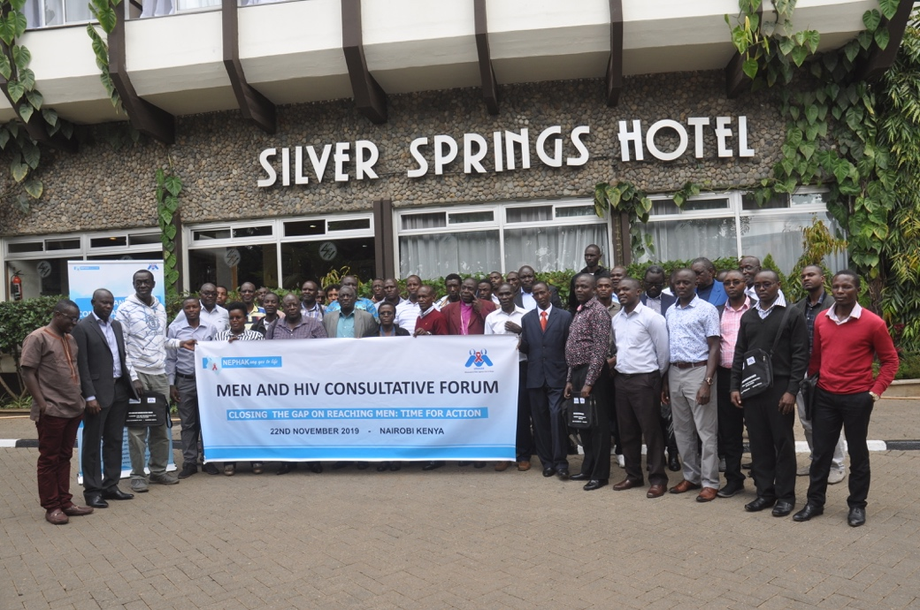
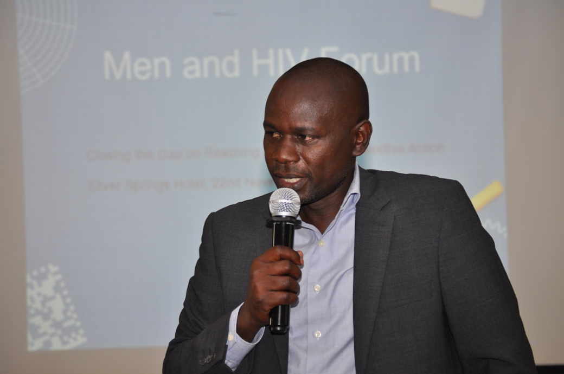
NEPHAK Nov 2019 consultation
Forum to deliberate on community-led advocacy and demand creation for reaching men with HIV and other health services
56 participants, including government (MoH); partners and CSOs working with and for men

Slide 5
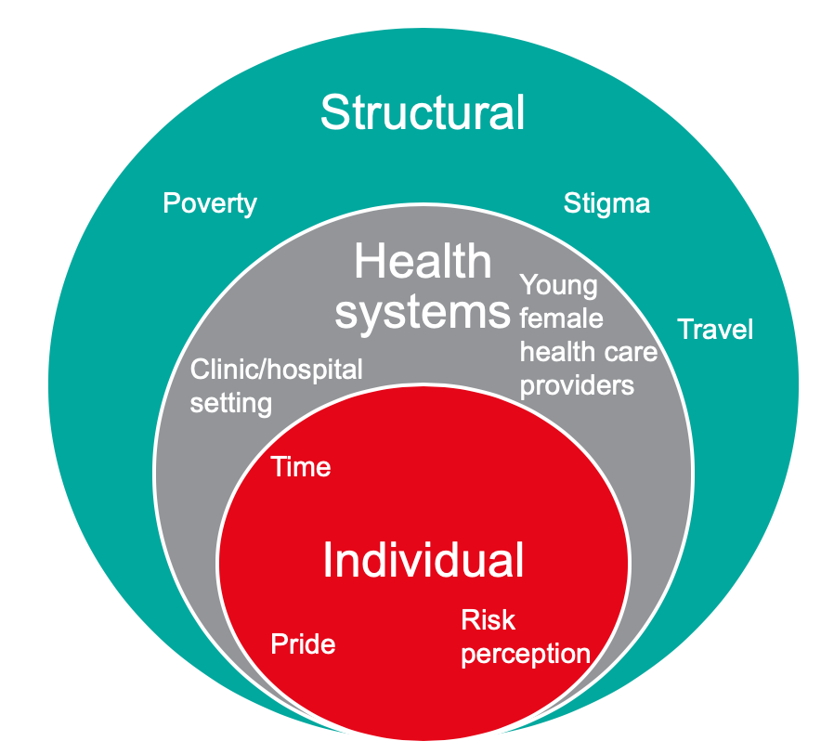
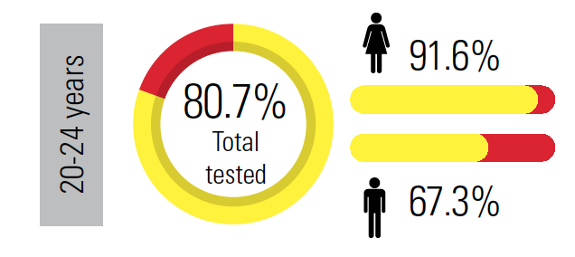
What are the challenges?
Men not seeking HIV testing to desired levels and those testing, often test late
Men testing HIV positive do not readily accept treatment
Those on ART are not optimally adhering remaining vulnerable to opportunistic infections

Slide 6
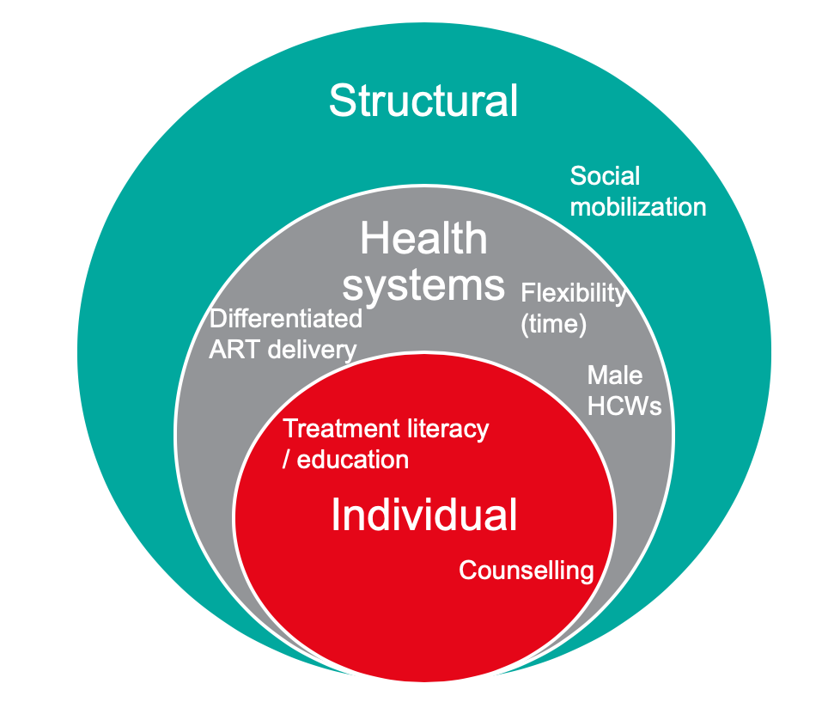
What are the solutions?
Getting men and boys to improve their uptake of HIV and health services will require solutions tailored to the challenges

Slide 7
Key takeaways (1)
Target advocacy and communications for demand creation and sustained uptake of HIV and health services.
Review the Male Engagement Guidelines
  Including framing and messaging
Intensify social mobilization reaching out to men and boys with HIV information
  Create HIV awareness at non-health sessions (sports, religious settings and cultural events)

Slide 8
Key takeaways 2
Better integrate HIV into other health services to minimize stigma and tackle other structural barriers (including time taken to access services)
  HIV services within the broad range of health services especially the screening for NCDs
Recognize and be responsive to the diversity among men
  Appreciate the diversity among men (age, education, employment, income, rural urban)
  Address individual needs of men (broadening the scope of DSD beyond ART)

Slide 9
Plans for action
Build capacity of Male Champions and foster partnership with allies within the health sector and beyond
Intensify targeted advocacy and communications to influence policy and practice (review male engagement guidelines)
Undertake operations research on the overcoming barriers to HIV and health service uptake by men
Mobilize resources to support men and HIV work: PEPFAR COP 20; GFATM 2020 application etc.

