Slide 1
Approaches and strategies from UNAIDS & WHO Closing the gap on reaching men: Time for action
ICASA 2019 satellite
Nathan Ford (WHO) and Lycias Zembe (UNAIDS) 5 December 2019

Slide 2
Men are not accessing HIV services, are lagging on progress towards 90-90-90
1st 90
3rd 90
87
https://aidsinfo.unaids.org/

Slide 3
Regional differences on progress towards 90-90-90 - men versus women
82-72-76
61-66-75
https://aidsinfo.unaids.org/

Slide 4
WHO & UNAIDS supported approaches and strategies
Three levels of coordination
Global and regional
Creating a platform to share what works through regional and global meetings
Global men working groups for various technical areas – for example MEN Testing (MENT) working group
Strengthening coordination and technical support of men and HIV agenda
Fostering strategic alliances and partnerships for resource mobilisation
Country level
Develop a national acceleration plan
Develop a men’s health strategy
National working groups on men’s health
Strengthening collection of sex disaggregated data across interventions

Slide 5
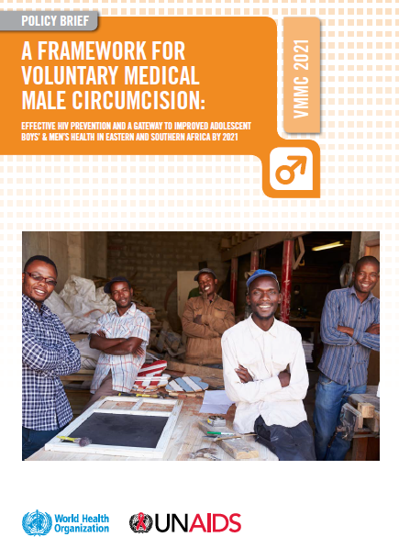
Global policy example to improve men access to HIV services - VMMC policy
Focused action for scale up
Policies and services for greatest impact
Accountability for quality and results
Innovation for acceleration and the future

Slide 6
Country policy example: Men engagement in cities - Namibia
Cities contribute substantially to the HIV epidemic
They are at the forefront of global development
Policies addressing me-s health in cities are key to addressing men HIV health services outcomes

Slide 7
Programmatic strategies and approaches
HIV self-testing
Community ART refill group for men
Ongoing review - Preliminary findings

Slide 8
Engaging in best practice sharing
Getting men back to services with men's services Muziwandile Sibiya, MSF, South Africa | Male-centered mobilization and health outcomes Heidi van Rooyen, HSC, South Africa | Reaching men and engaging them in HIV care – lessons from Malawi Michael Nyirenda, Partners in Hope, Malawi
Understanding and reaching young men with HIV services Shawn Malone, PSI, South Africa | Reaching men and engaging them in HIV care – lessons from PopART Zambia Musonda Simwinga, Zambart, Zambia | Hearing from the men: HIV risk profiles of male partners Julie Pulerwitz, Population Council, USA
Promundo – Translating research into policy adoption Gary Barker, Promundo, USA | Society’s successful man: What this means for TB intervention design Jeremiah Chikovore, HSRC, South Africa | Community mobilization to engage men in GBV and HIV prevention, Mpumalanga South Africa Sheri Lippman, UCSF, USA

Slide 9
Next steps
Shifting the narrative to men’s health for men
Three-level coordination and advocacy
global, regional and country
Sharing of best practices
Translating men and HIV frameworks, evidence to policy and practice and key actions for men
Scaling up programmes known to work for coverage and impact

