Slide 1
MenStar Coalition Closing the gap on reaching men: Time for action
ICASA 2019 satellite
Heather Watts
OGAC 5 December 2019

Slide 2
What is the MenStar Coalition?
The MenStar Coalition was launched by the Elton John AIDS Foundation (EJAF), the U.S. President’s Emergency Plan for AIDS Relief (PEPFAR), Unitaid, The Global Fund to Fight AIDS, Tuberculosis and Malaria (GF), the Children’s Investment Fund Foundation (CIFF), Johnson & Johnson (J&J), and Gilead Sciences at the International AIDS Society Conference in Amsterdam in July, 2018
We plan to reach an additional 1 million men with HIV treatment, and support over 90% of men in this age group to be
virally suppressed to effectively interrupt HIV transmission.

Slide 3
MenStar is a coordinated effort to clearly understand obstacles and differentiate treatment for men
90 -
90% of all PLHIV know their status
90 -
90% of all people living with HIV receive sustained ARV therapy
90
90% of those will have viral suppression
Pre-Testing /
Decision to Test
Test
In treatment
Virally Suppressed
J&J Insights
Gates Foundation Insights
HIV Self Testing Demand
Creation
(EJAF/CIFF/Unitaid)
HIV Self Testing Distribution
(Unitaid)
Brand Creation for Men’s HIV Services in South Africa (PEPFAR/Gilead/J&J)
Policy and Service Delivery Changes; Medication Improvements (PEPFAR/Global Fund)
Notes:
All the partners are doing work that is inter-dependent…linking demand with supply
[We also had a slide mapping these solutions to the cascade, so you can see how each of the Funding Partners have certain Testing, Treatment, and Retention solutions…]

Slide 4
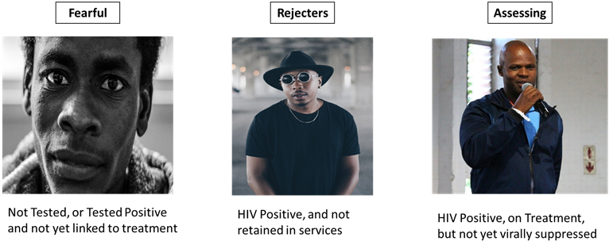
MenStar is a different approach to reaching men with HIV services
We know men are different, yet we try to drive them to the same treatment services
Client-centred approach: HIV service delivery can be adapted to appeal to the preferences and aspirations of diverse male clients
Notes:
Insights are just that until we translate them and make them practical for our program
Must demonstrate that we understand who they are, and what they need
For us, we’re talking about YOUNGER, HEALTHIER clients
Who are these people: Acceptor/Neutral/Assessing, Rejectors, Fearful

Slide 5
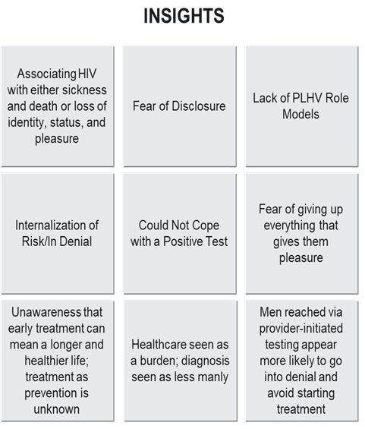
Using insights to make changes to demand creation solutions
Demand Creation Solutions
1. HIV Self Testing campaigns (Kenya)
Chukua Selfie
HIV Self Testing Design Challenge Fund for service delivery models: in male-dominated community hotspots, in male-dominated businesses and in private sector pharmacies
MTV Shuga: including HIVST in story lines
2. Brand Creation for Men’s HIV Services (South Africa)
Notes:
[WON’T READ THIS SLIDE – JUST A QUICK POINT – BUT I WOULD READ THE TEXT BELOW]:
You’ve just heard from Shawn on the insights garnered and potential solutions…we’re also using these insights to create solutions AT SCALE on both the demand creation and supply side.
that we know the client through our insights research, what do we do differently to reach them?
Communicate to these men in different ways – demand generation - Private sector will help get the people to the clinics (demand creation) – especially Fearful and the Rejectors

Slide 6
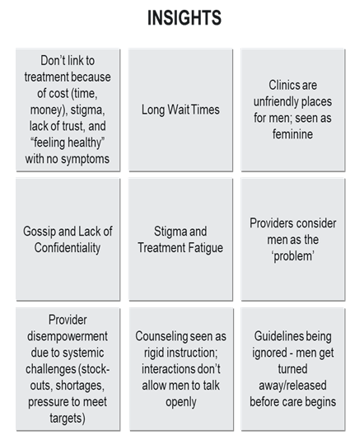
Using insights to make changes to supply side solutions
Supply Side Solutions
The STAR Project for Self Testing in Africa
2. Improved service delivery experience:
Empathy/compassion training for providers.
Longer hours for greater access
Appointment follow-ups
Shorter wait times
Men’s Corners
Adherence counseling targeted at men
Branded cues within the clinics
3. Digital patient empowerment tools
4. Support rapid and safe transition to TL
5. Decentralized external ART pick up points
Notes:
2. We need to provide services to them in different ways. It’s up to PEPFAR, Global Fund, and Governments to keep them in the clinics – especially the Assessors:
“They won’t return to the clinics if they don’t like the services they’re receiving.”

Slide 7
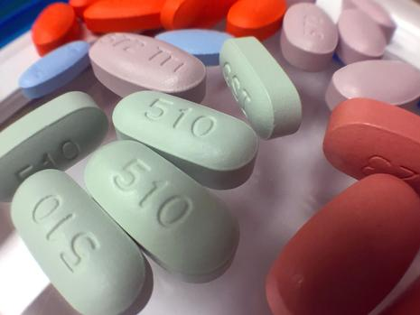
Here’s how we’re improving the supply side
1. Improve the Service Delivery Experience
2. Better Drugs
Notes:
Here is what we as PEPFAR are focused on, to improve the “supply side”
Better Service Delivery (see next slide for examples)
Better drugs [I took out the detailed slide on this, but here are the notes]:
TLD Roll out and U=U are both MPRs this year.
Better product – clinical benefits - fewer side effects, well tolerated, fewer drug interactions, effective, higher barriers to resistance, smaller pill
overall benefits of HIV treatment (U=U), specifically 1) it greatly improves well being of people living with HIV –and keeps PLHIV alive and 2) it eliminates new HIV transmissions
emotional benefits of TLD (enables a return to normalcy; eliminates feeling of men as vectors/infectious)
lifestyle benefits of TLD (transforms social, sexual, and reproductive health)
Talk about how Private Sector will re-brand U=U to communicate this

Slide 8
1. The Service Delivery Experience
Notes:
Minimum Site Standards
Service Delivery / Site Level: Align with Site Level Standards in COP Guidance
Make healthcare access more convenient for men
Multi Month Drug Dispensing
Measured wait times with specific interventions to reduce (e.g. fast-track lanes for medication pick up) Improved clinic operations, with easier booking systems, and improved patient flow - Mention the insight around convenience – what time means for the clients (lost wages)
Extended hours (including morning, evening and weekend hours)
Expand decentralized pick up points for dispensing of ARV refills to stable patients
Systems for calling/SMSing patients to return lab results or to answer questions
Improve empathy of healthcare providers
Sensitization of health care workers on the issues that men face and training on customer service, gender sensitization, empathy, compassion, and the best and most appropriate ways to engage men
Providers are equipped with “Welcome Back” messages for clients returning to care
Make efforts to hire additional male staff (or empathetic staff)
Re-design clinics to be more Welcoming:
Hospitable and Friendly
Men’s Health Corners (male-only spaces/clinics)
Specific male only hours
Client satisfaction monitored regularly and used for ongoing improvements in areas of convenience, hospitality, responsiveness, and effective support
Supportive and Responsive
Accountable and managed
Patient Support Strategies
Escorted linkage, ideally with a male escort / peer navigator / linkage facilitator
Peer to peer support groups among MLHV (adherence clubs, PLHV champions, peer navigators)
Digital engagement
Offer alternative testing strategies which can be done privately
Adapt clinics to include more attention to confidentiality
HIV Self Test kit distribution, both primary and secondary
Enhanced focus on confidentiality and privacy by offering more private counseling rooms and men only waiting rooms.

Slide 9
Early outcomes
Notes:
Here is what we as PEPFAR, and our MenStar partners are doing…

Slide 10
Kenya: Self-testing distribution in PEPFAR 2018 - 2019
Following a demand generation campaign launched Q2 2019, HIVST distribution increased
Notes:
In response to a demand generation campaign for self testing in Kenya, distribution of HIV Self Test kits increased

Slide 11
ART Initiations at health facilities post HIVST among men
Malawi: Self-testing for men Unitaid’s PSI STAR Project
Key insights
Distribution of HIVST focused on reaching men
Facilities reflect different changes in ART demand pattern
Sharp increase in ART demand by men at Ndirande HC and in both men and women at South Lunzu HC case.
More moderate increase for both men and women at Chilomoni HC
Notes:
This slide is from the Unitaid STAR project (one of the MenStar Coalition partners) and illustrates that there is a sharp increase in ART demand by men using HIVST

Slide 12
Malawi: Male friendly HIV services
Three men-friendly clinics (EGPAF supported):
exclusively for men and staffed by male providers
provide integrated HIV, SRH, NCD services
during extended hours (Saturdays, 07h30-14h00)
Outreach testing provided at workplaces and community locations which men usually attend with active linkage
High acceptance rate of HIV testing at men-friendly clinics (92%)
66% eligible for testing
92% of eligible tested
4.3% positive

Slide 13
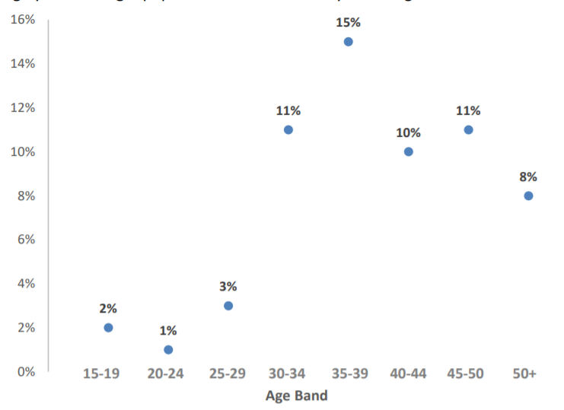
Malawi: HIV testing yield from male friendly HIV services
High yield of HIV testing at men-friendly clinics vs national average
(5% vs 3% nationally) increasing significantly >30 years

Slide 14
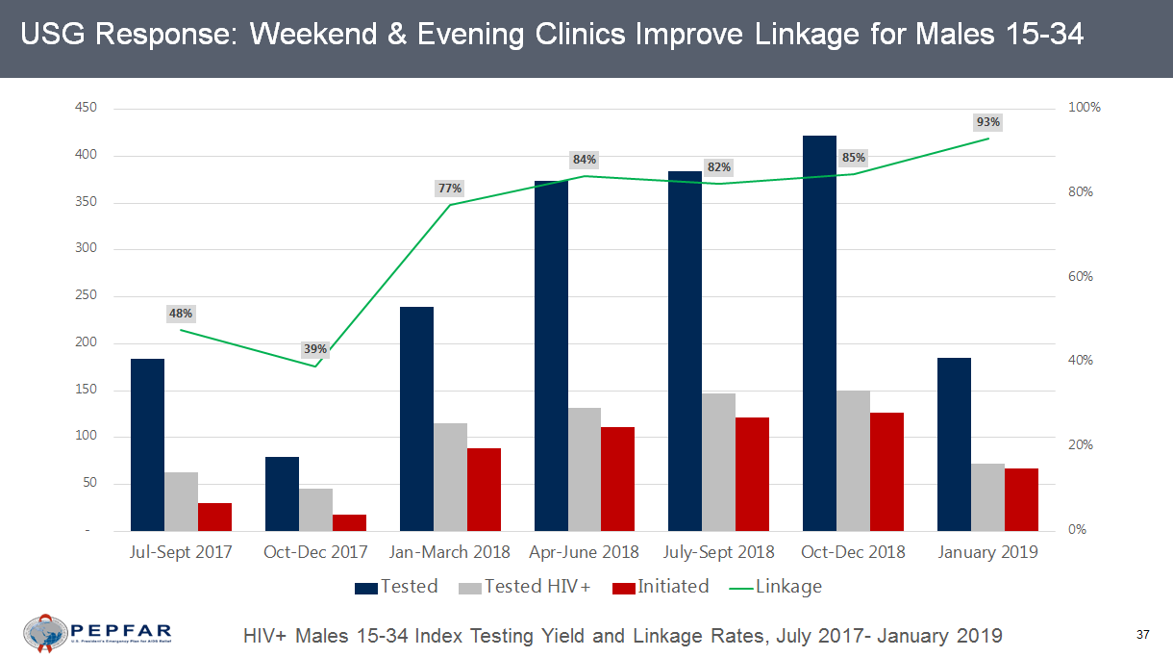
Zambia: Weekend & evening clinics

Slide 15
Zambia: Men on ART 2018-2019

Slide 16
Policy changes aligned to WHO normative guidance
Optimized case-finding policies in support of targeted testing for the most at-risk
Updated self-testing guidance and strategies
Test and Treat
Transition to TLD and elimination of Nevirapine-based regimen
Policy advancements from COP19:
Patient-centered approach
Elimination of formal and informal user fees
Adoption and implementation of DSD models incl. multi-month scripting and dispensing, expansion of external ART pick up points and extended hours
Incorporation of recency testing into testing modalities
Annual viral load policy
Notes:
Underlying all our MenStar efforts are policy changes – this is how donors like PEPFAR and Global Fund are also contributing (i.e., ensuring these policies are adopted and implemented with fidelity on the supply side).

Slide 17
What are the plans for MenStar in 2020?
Issue formal guidance on the MenStar approach
Implement programs against the guidance
Launch of a new brand for men living with HIV in South Africa
Track and measure results
Report results:
IAC Conference
World AIDS Day
Notes:
Use this as an opportunity to crowd source solutions / evidence /programmatic examples to help us build the MenStar Guidance!

