Slide 1
Differentiated Service Delivery
Key Populations Perspective
Othoman Mellouk
Co-Chair of MSMGF
Access to Treatment Lead at ITPC

Slide 2
Conflict of Interest
No conflicts of interest to declare

Slide 3
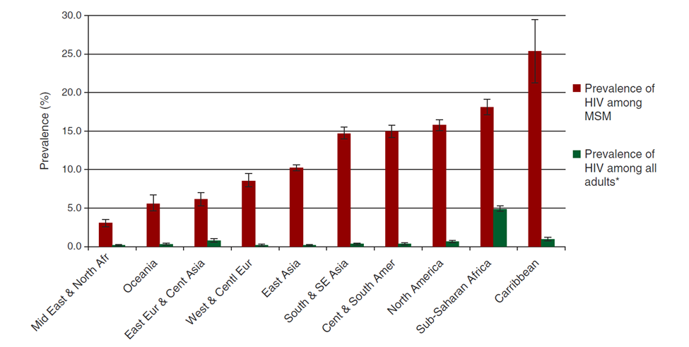
HIV prevalence is disproportionately high among KPs
BEYRER, ET AL., LANCET, 2012

Slide 4
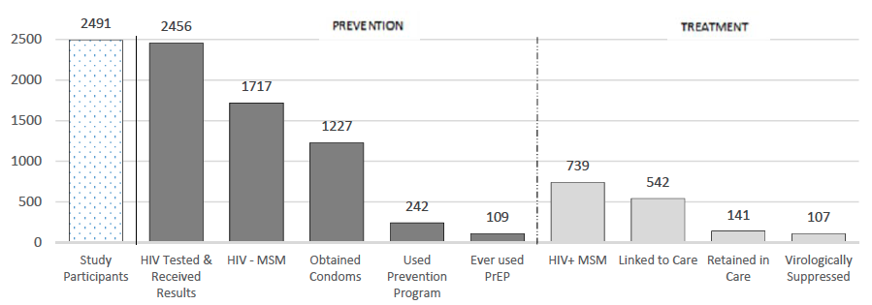
Cascades reveal challenges
AYALA G., SANTOS G-M., JAIS, 2016.
Notes:
Utilization
treatment
25% are pos but not linked
Further 55% not retained retained in care
Leaving only 20% of those surveyed in care
Prevention
70% obtained condoms within past year
14 % participated in prevention program
6% had ever used PrEP

Slide 5
Key populations are KEY because of:
High levels of stigma and discrimination
Violence and Human rights abuses
Criminalization of drug use, sex work, same-sex sexual activity
To be taken into consideration in DSD for KPs

Slide 6
Differentiated care models for KPs require:
Smart investment, not divestment.
Thorough assessment, screening and diagnostics;
Safe spaces;
Interventions and services that are principled – acceptable, accessible, evidence-informed, and rights-based;
Participatory approaches that center community; and
Particular attention to the specific needs of key populations.

Slide 7
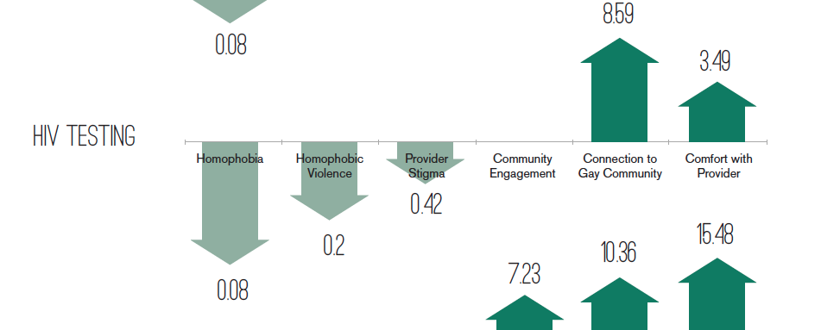
HOW People are treated Matters
Makofane et al. 2014, MSMGF
Notes:
Call out Service Delivery Location figures in JIAS paper

Slide 8
Funding inequity also matters
$4 billion/year
$254 million
$82 million
    The Global Fund raises and invests to support HIV, TB and Malaria programs
    Investment in key populations programming approved during the NFM (by 31st July 2015)
    Resources committed for programmes for men who have sex with men and transgender people* during the NFM (as of 31st July 2016)
Global Fund, 2016
Notes:
6.3% and 2
6.3% and 2% respectively.
It is important to note that from our quick review the national investment is largely focused on the prevention of HIV amongst sex workers. These programmes vary in terms of focus, scope, approach and the extent to which sex workers are engaged/implemented

Slide 9
Community already plays KEY roles
Accessing services through an LGBT-led CBO has a dramatically large and positive association with utilization of HIV prevention, testing and treatment.
  Risk reduction programs (OR 76.72; CI 58.18-102.34, p=0.00)
  Condoms (OR 4.81; CI 4.09-5.68; p=0.00)
  Lubricants (OR 5.77 CI 4.83-6.90; p=0.00)
  HIV testing (OR 11.07; CI 8.67-14.23; p=0.00)
  ART(OR 1.92; CI; 1.19-3.10; p=0.00)
  GMHR, 2014
Notes:
Make the point that there are many organizations with a lot of experience and some of it has been condensed into tools like the MSMIT.
We need to figure out how to leverage this experience (the second panel will tackle that issue)
UNAIDS released:

Slide 10
Community-based organizations in DSD can:
Deliver and tailor services
Provide safe spaces
Link with friendly healthcare providers
Drive demand for quality, evidence-informed and rights-based services
Monitor service implementation and document human rights abuses, and
Mobilize for advocacy.

Slide 11
However:
New concepts do not mean work on enabling environment is accomplished
Investment should increase in KP programs beyond DSD implementers
For KPs « full packages » are needed
Protection/safety of space, services and community personnel needs to be strenghtened

Slide 12
Community monitoring is KEY for success
Community service observatories
Systems and mechanisms to receive feed back and complaints of KP users

Slide 13
Nothing for us without us !!!
Thank You

