Slide 1




Pilot Study of a Multi-Pronged Intervention
Using Social Norms and Priming to Improve Adherence to ART and Retention in Care
Among Adults with HIV in Tanzania
Sandra McCoy, Carolyn Fahey, Aarthi Rao, Ntuli Kapologwe,
Prosper F. Njau, Sergio Bautista-Arredondo
Notes:
I’m delighted to be here today to present on behalf of my coauthors at UC Berkeley,
the Tanzanian Ministry of Health, Community Development, Gender, Elderly and Children, and the
National Institute of Public Health in Mexico.

Slide 2
Poor adherence and retention undermines
TasP and other strategies to end the epidemic
35% of people living with HIV (PLHIV) in Africa have dropped out of care within 3 years of starting treatment (Fox, 2015)
Traditional behavioral approaches to motivate people to stay in care or adhere to ART often rely on individuals’ innate desire to remain healthy
  Information, education, communication
  Often ignore that decisions are influenced by emotions, contexts, and systems as well as decision-making shortcuts outside of conscious awareness (Dolan, 2012)
Notes:
Is it well-documented that poor adherence to ART and disengagement from care threatens the effectiveness of ‘treatment as prevention’ (TasP) and other strategies to end the epidemic.
For example, 35% of people living with HIV (PLHIV) in Africa have dropped out of care within 3 years of starting treatment (Fox, 2015)
Traditional behavioral approaches to motivate people to stay in care or adhere to ART often rely on individuals’ innate desire to remain healthy
This includes strategies that use Information, education, communication to change behavior
However, these types of programs often ignore that decisions are influenced by emotions, contexts, and systems as well as decision-making shortcuts outside of conscious awareness. (Dolan, 2012)

Slide 3
Behavioral science accounts for predictable irrationalities and biases in human behavior
Applies behavioral economics and psychology to behavior change
Priming occurs when a stimulus (e.g., images, smells) subconsciously or indirectly influences another behavior (Bargh 1996, Bargh 2014)
Social influence occurs when a person's emotions, opinions, or behaviors are affected by others
  For example, HIV prevention programs based on opinion leaders attempt to influence social norms (NIMH Collaborative HIV/STD Prevention Trial Group, 2010)
Notes:
In contrast, there is growing interest in interventions from behavioral science to account for the predicable irrationalities and biases in human behavior.
These strategies draw on constructs from behavioral economics and psychology to change behavior without relying solely on intrinsic or extrinsic motivation. and encompass approaches such as incentives, defaults, and commitments which have been increasingly utilized to promote weight loss, smoking cessation, and the adoption of other beneficial health behaviors.
In this study, we focused on two behavior change approaches from behavioral science. The first is priming, which is when a stimulus subconsciously or indirectly influences another behavior.
Priming occurs when …
The second behavior change approach is social influence…which is when….
For example, HIV prevention programs based on opinion leaders attempt to influence social norms
Simple associational cues (e.g., images, smells) activate aspects of one’s memory that then become more influential in processing new stimuli.

Slide 4
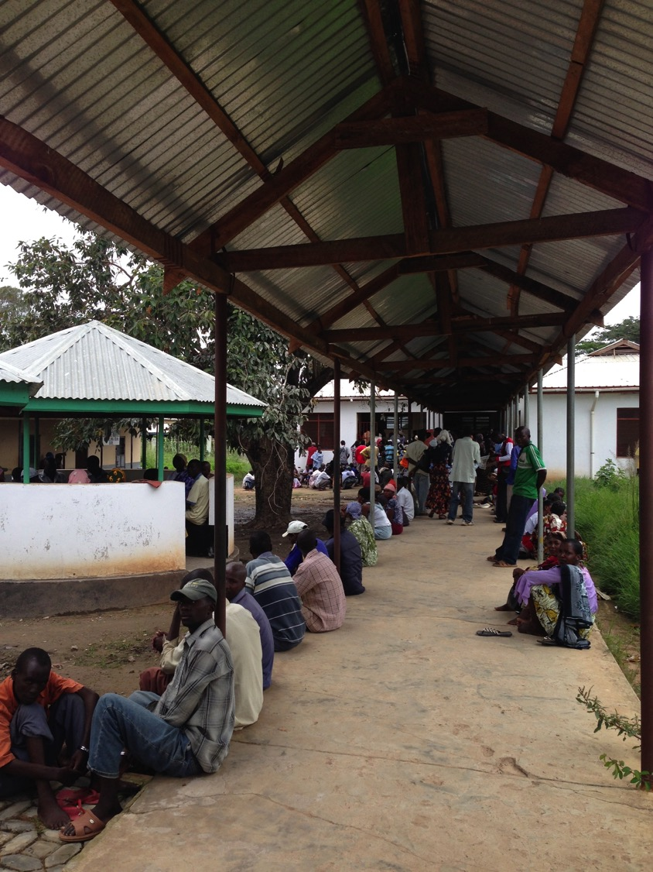
Common
Clinic Experience
Long wait times
Anxiety about negative provider interactions and stigma
Concern about disclosure
Clinic valued as a source of social support
Notes:
We hypothesized that a low-cost intervention based on priming and social influence would be well suited for the typical clinic experience in many parts of the world, where:
Patients experience long wait times where there would be opportunity to be exposed to a prime and/or other clinic-based interventions.
Anxiety about provider interactions
Concerns about disclosure
But also where patients report that providers and fellow patients can be a valuable source of social support.

Slide 5
Study Goals
Objective: Evaluate the feasibility, acceptability, and short-term effectiveness of an intervention based on social norms and priming to improve adherence and retention in care among PLHIV in Tanzania.
Trial Registration: Clinicaltrials.gov, NCT02938533
Ethical Approvals: National Institute for Medical Research and UC Berkeley
Protocol / Results: McCoy SI et al. PLoS ONE 12(5): e0177394.

Slide 6
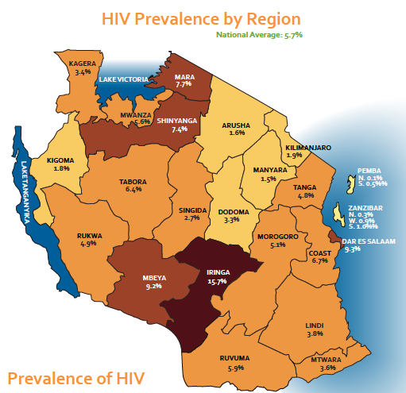
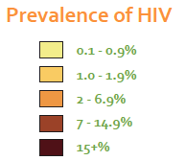
Study Setting & Population
Two HIV primary care clinics in Shinyanga, Tanzania
Inclusion criteria:
  ≥18 years
  living with HIV infection
  On ART at study initiation
Notes:
The study was conducted at two hiv primary care clinics in Shinyanga Region.
Patients were eligible for the study if they were:
≥18 years
living with HIV infection, and
On ART at study initiation.

Slide 7
Patient-Centered Design
Empathize
Define
Prototype
Test
Ideate
A creative, empathetic approach that draws on ethnographic methods and relies on rapid prototyping and user testing (IDEO.org, 2015)
Household and clinic observations, photo-based interviews, and
in-depth semi-structured interviews with patients and providers
Identified patient segments and created journey maps
  Tools used to guide business and marketing innovation, which describe a group’s perception of health, barriers to ART adherence, and potential interventions
Sources: The Hasso Plattner Institute of Design, Stanford University
McCoy SI et al. PLoS ONE 12(5): e0177394.
Notes:
To develop the intervention, we used patient-centered design, a creative, empathetic approach that draws on ethnographic methods and relies on rapid prototyping and user testing
This process included the collection of data from household and clinic observations, photo-based interviews, and in-depth semi-structured interviews with patients and providers.
We also identified patient segments and created patient journey maps, which are…
***
Learn about AGYW and ADDO owners and what matters to them.
Define their points-of-view based on needs, preferences, & pain-points.
Use these insights to brainstorm creative solutions using behavioral economics.
Build a representation of one or more solutions.
Share prototypes. Use their feedback to refine solutions.

Slide 8
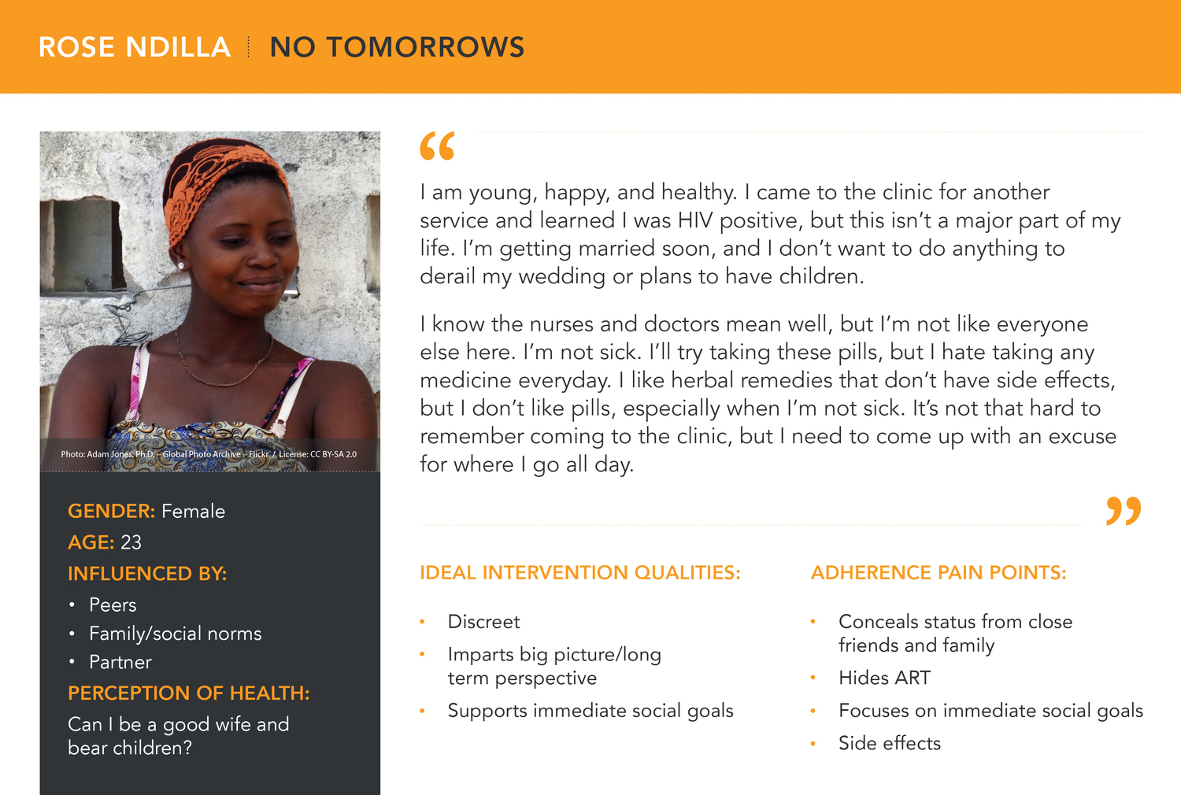
We created personas for 5 patient segments to illustrate nuanced challenges facing patients.
The “No Tomorrows” segment describe young people who are asymptomatic and primarily motivated by social aspirations such
as marriage.
Ideal interventions for this segment are discreet, support immediate social goals, and impart a long-term perspective.
To view all 5 patient segments visit: http://mccoy.sph.berkeley.edu/patient-personas/
Notes:
For example, this slide displays one of our patient segments and fictionalized patient personas.
This segment, known as “no tomorrows”, describe young people who are asymptomatic and primarily motivated by social aspirations such as marriage.
Ideal interventions for this segment are discreet, support immediate social goals, and impart a long-term perspective.

Slide 9
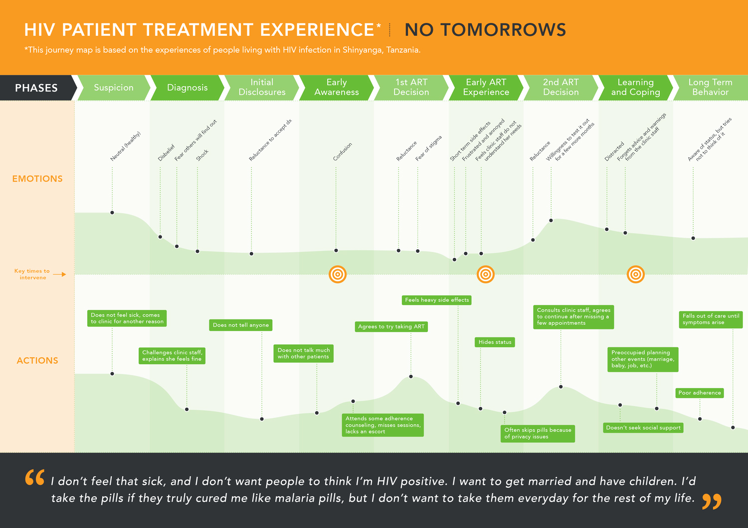
We also created patient journeys to map the treatment experience.
Patient “journey maps” chart the experiences of each of segment of people living with HIV from diagnosis to long-term adherence behavior.
Notes:
We created a corresponding “journey maps” for each segment to represent stages in the treatment experience that influence adherence and potential areas for intervention
Insights from this process guided the development of candidate solutions that were iteratively tested in a series of focus groups

Slide 10

Multi-component intervention leverages social norms and a self-relevant prime
Relevant Insights from Formative Work
Intervention Description
Patients lack reminders of support available at the clinic through peers and providers
The ubiquitous Baobab tree is strongly associated with health, resilience, and community
Locally recognizable image of a Baobab tree and local idiom: “Together we can hug the Baobab tree”
Appears on every component
Prime
Notes:
Our final intervention had three components that were related to insights from the formative work. This included the priming image, take-home components, and a clinic-component.
Our prime was an image of the recognizable Baobab tree coupled with a local idiom that “together we can hug the Baobab tree.”
The prime appeared on every component of the intervention was intended to remind patients of the social support available at the clinic through peers and providers.

Slide 11

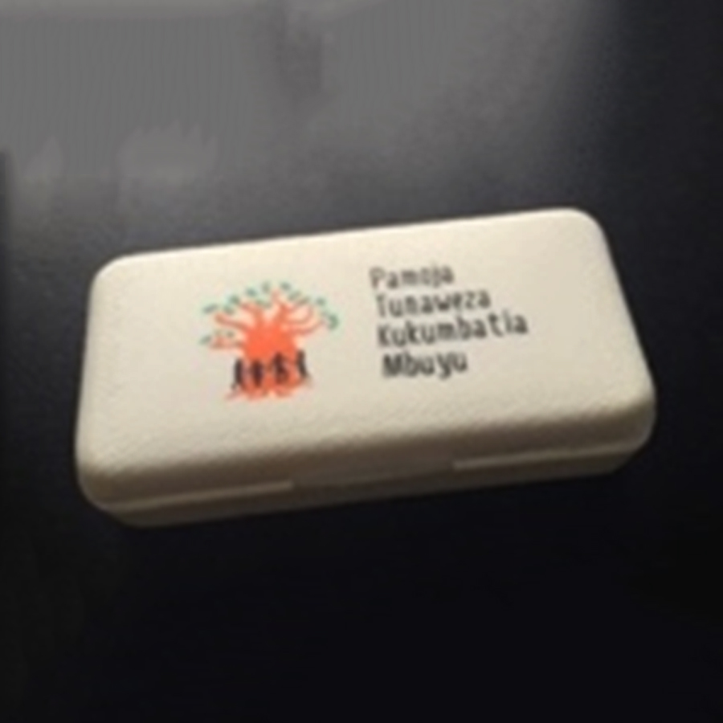
Multi-component intervention leverages social norms and a self-relevant prime
Relevant Insights from Formative Work
Intervention Description
Patients lack reminders of support available at the clinic through peers and providers
The ubiquitous Baobab tree is strongly associated with health, resilience, and community
Locally recognizable image of a Baobab tree and local idiom: “Together we can hug the Baobab tree”
Appears on every component
Prime
Disclosure and stigma are significant challenges – patients go to great lengths to hide treatment
Patients lack frequent touch points with the clinic
Patients ignore clinic materials and instead associate health with images from daily life
Useful take home item that features the prime and reminds patients of the clinic
One group received a calendar with images featuring health/vitality and others received a pill box with the approximate dimensions of a feature phone
Take-home Component
Notes:
The intervention also included take home components that featured the prime. The idea was to remind patients of the clinic between infrequent monitoring visits.
Some patients received a calendar with images featuring health and vitality.
Other patients received a pill box with the approximate dimensions of a feature phone to help maintain privacy when they needed to transport their medication.

Slide 12
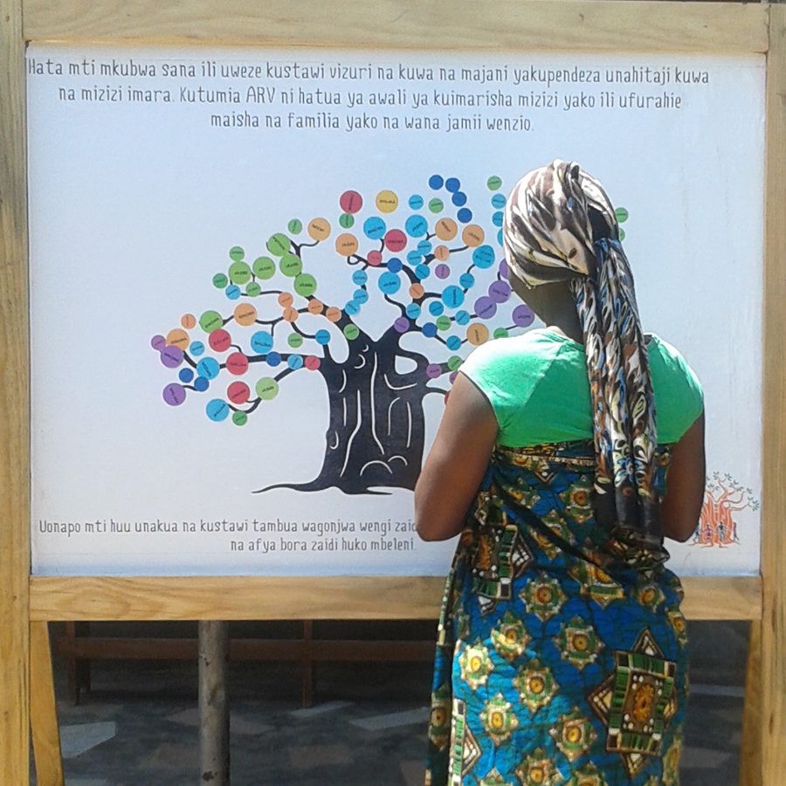
Multi-component intervention leverages social norms and a self-relevant prime
Relevant Insights from Formative Work
Intervention Description
Patients lack reminders of support available at the clinic through peers and providers
The ubiquitous Baobab tree is strongly associated with health, resilience, and community
Locally recognizable image of a Baobab tree and local idiom: “Together we can hug the Baobab tree”
Appears on every component
Prime
Disclosure and stigma are significant challenges – patients go to great lengths to hide treatment
Patients lack frequent touch points with the clinic
Patients ignore clinic materials and instead associate health with images from daily life
Useful take home item that features the prime and reminds patients of the clinic
One group received a calendar with images featuring health/vitality and others received a pill box with the approximate dimensions of a feature phone
Take-home Component
Patients seek trustworthy and well run clinics,
but provider interactions are unpredictable
Patients value clinic as a source of social support
Some patients assume others are non-adherent
Interactive poster for positive provider-patient interactions – patients place sticker after 3 consecutive appointments
As image grows, patients visualize that others succeed in attending appointments
Clinic-based Component
Notes:
The intervention also included a clinic component, which was an interactive poster that rewarded appointment attendance.
Patients who attended three consecutive on-time visits were congratulated and given a colored sticker to place on a poster that was publicly displayed at the clinic.
The accumulation of stickers over time completed a locally-relevant images, which conveyed that regular clinic attendance is normative.
For example, one poster was in the shape of a Baobab tree and the stickers were the ªleavesº.

Slide 13
Evaluation Design
Feasibility and acceptability: Patient satisfaction with an anonymous survey of clinic ART patients at baseline and endline (6 months)
Short-term effectiveness: Quasi-experimental, 6-month pilot study
Intervention implemented every two weeks for 6 months starting 8/2015
  Given 30- & 60-day schedules, most exposed only to intervention or standard of care
  Association between intervention exposure and outcomes expressed as ORs and mean differences (weighted to account for sampling strategy)
Notes:
We measured feasibility and acceptability with an anonymous survey of ART patients at baseline and endline
Short term effectiveness was measured through a quasi-experimental 6 month pilot study.
In brief, the intervention was implemented every two weeks for 6 months. Because the majority of patients have strict 30 or 60 day visit schedules, most patents were only exposed to the intervention or standard of care during the study period.
We estimated the association between intervention exposure and the outcomes after weighting to account for the sampling strategy.

Slide 14
Outcomes
Primary Outcomes:
Retention in care at 6 months
  ≥1 visit 150–210 days after baseline (6 months +/- 30 days)
ART adherence at 6 months
  Measured with the medication possession ratio (MPR), the
  proportion of days that an individual is in possession of ≥1 ART dose
  MPR ≥95%
Secondary Outcome:
Appointment adherence during the 6-month study period
  Proportion of scheduled visits that were completed
Notes:
The primary outcomes were retention in care at 6 months and ART adherence at 6 months, measured with the medication possession ratio (MPR), the proportion of days that an individual is in possession of >1 ART dose.
We MPR at an adherence threshold of 95%
The secondary outcome was appointment adherence during the 6 month study period.

Slide 15
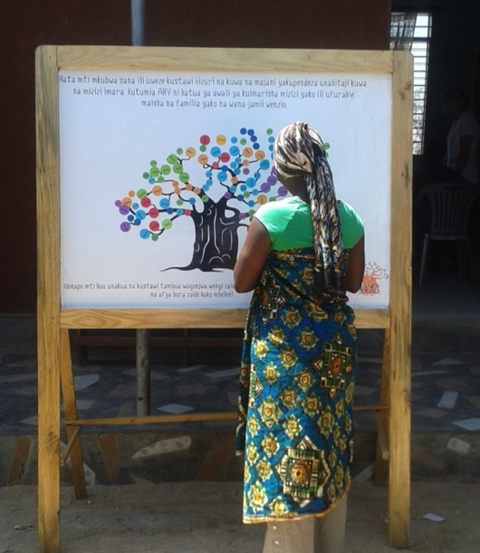
Results: Feasibility and Acceptability
Perceptions of adult clinic attendees |  | Baseline (n=189) | Endline (n=216)
 |  | N (%) | N (%)
Staff support treatment goals |  | 180 (95.3) | 216 (100)*
Staff support life goals |  | 94 (49.8) | 143 (66.2)*
Enjoy being at the clinic |  | 154 (81.5) | 186 (86.5)
Other patients support me |  | 114 (60.3) | 153 (70.8)*
Unanswered questions today |  | 72 (38.1) | 53 (24.5)*
Likelihood of others being adherent |  | 60 (31.7) | 116 (53.7)*
Very satisfied with services and care |  | 65 (34.6) | 115 (53.2)*
* p<0.05 from chi-squared test
Notes:
I’ll now present the study findings. This slide displays the results of the anonymous patient satisfaction survey, which was completed with 405 patients.
We find that after 6 months, the intervention may also have increased patient support and satisfaction with services at the clinic.
Compared to baseline, at endline we found significant increases in staff support of treatment goals (100% vs. 95%) and life goals (66% vs. 50%),
support from other patients (71% vs. 60%)
the perceived likelihood of other patients’ high levels of adherence (54% vs. 32%)
and being very satisfied with clinical services and care (53% vs. 35%).
Open-ended questions revealed that patients found the interactive poster and process of earning a sticker acceptable, noting that it made them feel “good for being recognized”

Slide 16
Results: Patient Characteristics
Characteristicª |  | Intervention | Comparison | p-value^{c}
 |  | N=320 (%) | N=118 (%)
Age
 | 18-29 | 18% | 16% | 0.80
 | 30-39 | 32% | 35%
 | 40-49 | 28% | 26%
 | ≥50 | 22% | 23%
Female |  | 62% | 54% | 0.07
Time on ART at Baseline
 | 90 days or less | 13% | 10% | 0.07
 | 3-12 months | 19% | 14%
 | 1-3 years | 28% | 39%
 | More than 3 years | 40% | 37%
Baseline Appointment Attendance^{b} |  | 74% | 73% | 0.78
Weighted statistics to account for sampling strategy.
Attendance at the last two scheduled appointments prior to the intervention period.
Chi-squared test.
Notes:
In the quasi –experimental pilot study, patients were randomly sampled from medical records in order to yield a final sample that oversampled exposed patients.
The final analysis included 320 patients exposed to the intervention and 118 patients unexposed to the intervention.
Patient characteristics are shown on this slide for the 438 randomly sampled patients.
At baseline, age, sex, time on ART, regimen and appointment adherence were similar in the intervention and comparison groups.

Slide 17
Results: Retention and ART Adherence
OR_{a} (95% CI): 1.73 (1.08, 2.78)*
1.51 (0.96, 2.37)
Mean diff: 0.04 (-0.01, 0.09)
* p<0.05. Quasi-experimental study with 438 patients (320 intervention, 118 standard of care) in Tanzania, 2015-2016.
Notes:
This slide displays the results of the pilot study.
In unadjusted and adjusted analyses, PLHIV exposed to the intervention were significantly more likely to be in care after 6 months (87% vs. 79%, ORa = 1.73, 95% CI: 1.08, 2.78, p<0.05)
Those exposed to the intervention were also more likely to achieve MPR95% (70% vs. 59%, ORa = 1.51, 95% CI: 0.96, 2.37, p = 0.07), although this result was not statistically significant after adjustment for clinic.
The intervention and comparison groups had similar average appointment adherence during the six month study period (73% vs. 66%, adjusted mean difference = 0.04, 95% CI: -0.01, 0.09, p = 0.09).
*****
During the study period, MPR≥95% was achieved by 64% of sampled patients, 83% of patients remained in care after 6 months, and mean appointment attendance was 69%.

Slide 18
Limitations
Study conducted at two facilities in Tanzania
  Future studies needed to understand the generalizability of the approach
Intervention evaluated as a combination package
  The effect of individual components not measured
Imperfect measurement of intervention exposure
  IV sensitivity analysis supports primary analysis that the intervention may have improved retention in care and potentially ART adherence
Viral load not measured
  MPR correlated with viral suppression (McMahon et al., 2011; Hong et al., 2013)
Notes:
This study has several limitations.
First, the intervention was designed and evaluated among patients attending two clinics in Tanzania. Future studies will need to understand the generalizability of the approach
The intervention was evaluated as part of a combination package, s we are unable to make statements about the effectiveness of individual intervention.
Given that the intervention was implemented every two weeks, we have imperfect measurement of exposure to the intervention
However, we conducted a sensitivity analysis using an instrumental variable (IV) approach to estimate the intervention's effectiveness based on their exact visit dates, and the results support the findings presented here.
Lastly, we did not measure viral load. However, MPR is highly correlated with short-term viral suppression
*****
In these 2-stage least squares regression models, treatment assignment (as determined by baseline visit week) was an instrument for the actual treatment exposure, defined as 50% of attended visits occurring during intervention periods

Slide 19
Discussion (1)
Novel approach: design thinking + behavioral science + evaluation
  (McCoy & Rao. Optimizing on the Edges. Stanford Social Innovation Review; 6/2017)
  Goal to address behavioral gaps by improving the patient experience
Low-cost intervention was feasible and acceptable to patients and staff
  Intervention associated with temporal improvements in perceived
  support from staff and other patients and satisfaction with clinic services.
Notes:
We developed and conducted a pilot evaluation of a combination intervention that used design thinking to apply tools from behavioral science to the problem of poor retention and adherence in Tanzania.
Our goal was to address behavioral gaps by improving the patient experience using the motivational levers of priming and social influence.
We found that the low-cost intervention was feasible and acceptable to patients and staff, and may have bolstered perceived social support at the clinic, as intended, and increased satisfaction with clinic services.

Slide 20
Discussion (2)
The intervention was positively associated with retention in care and potentially with MPR≥95% over a short 6-month follow-up period.
Although the intervention is specific to this study population, the design and evaluation approach may lead to locally relevant solutions in different geographic areas and for various health outcomes.
Notes:
The intervention was positively associated with retention in care and potentially with MPR≥95% over a short 6-month follow-up period.
Although the exact intervention is specific to this study population, the design and evaluation approach is widely applicable and may lead to locally relevant solutions in different geographic areas and for various health outcomes.
These promising findings suggest that the application of innovative, low-cost approaches from behavioral economics and psychology, such as social norms and priming, may enhance the HIV care continuum and bolster the effectiveness of ART programs, including TasP.

Slide 21


Acknowledgements
UC Berkeley
Ms. Aarthi Rao
Ms. Carolyn Fahey
Ms. Nancy Czaicki
Shinyanga Regional Medical Office
Dr. Ntuli Kapologwe
Ms. Agatha Mynippembe
Mr. Kassim Hassan
Financial Support
Bill & Melinda Gates Foundation
(Grand Challenge Explorations)
Ministry of Health, Gender, Community Development,
Elderly and Children
Dr. Prosper Njau

Slide 23
Study Flowchart
First 4 study weeks
(August 10 – September 4, 2015)
2 weeks allocated to intervention
2 weeks allocated to standard of care
393 patients sampled retrospectively from clinic registers in Jan-Feb 2016
149 patients sampled retrospectively from clinic registers in Jan-Feb 2016
73 patients excluded:
53 had no other medical records
20 did not meet inclusion criteria
14 children
6 not yet on ART
31 patients excluded:
20 had no other medical records
10 did not meet inclusion criteria
10 children
1 transferred same day sampled
320 patients analyzed
118 patients analyzed
Notes:
In the quasi –experimental pilot study, patients were randomly sampled from medical records in order to yield a final sample that oversampled exposed patients.
The final analysis included 320 patients exposed to the intervention and 118 patients unexposed to the intervention.
*******
These analyses excluded 104 of 542 sampled patients: patients <18 years (n = 24), patients not yet on ART (n = 6), patients without medical records (n = 73), and patients (n = 1) who transferred before the first scheduled visit. The proportion of excluded patients did not differ by study group (21% comparison vs. 20% intervention, p = 0.66).

Slide 24

These results appear to stem from our intervention’s ability to strengthen clinic-based relationships,
change expectations, and motivate patients to achieve their goals.
Prescriber Interaction
Waiting room experience
Returns
home
Falls off
treatment
Typical experience
Typical experience
Typical experience
Typical experience
Health provider scolds patient for missing appointments
Patient does not disclose fears or treatment goals
Patient assumes everyone skips appointment
Patient ignores adherence materials
Patient returns to work, forgets about clinic
Patient feels isolated, has no connection to clinic
Patient starts to
take medication intermittently, experiences treatment interruptions or falls out of care
Intervention experience
Intervention experience
Intervention experience
Intervention experience
Patient views health staff favorably when viewing poster interactions
Provider views patients more positively when noticing eligibility for sticker; relationships build
Patient creates subconscious connection between prime image and positive recognition
Patient sees many others succeed w/ visit adherence
Patient sees prime on useful object (pill box / calendar) and is reminded of other patients and staff
Patient sees Baobab trees and is reminded of prime’s message
Prime subconsciously influences patient to stay on treatment to achieve personal goals and receive positive recognition from staff

