Slide 1

HIV Testing Services among Key
Populations, Adolescent Girls, and
Men in Eastern and Southern Africa
A review of research, policy and programming
Presented by: Sue Napierala Mavedzenge

Slide 2
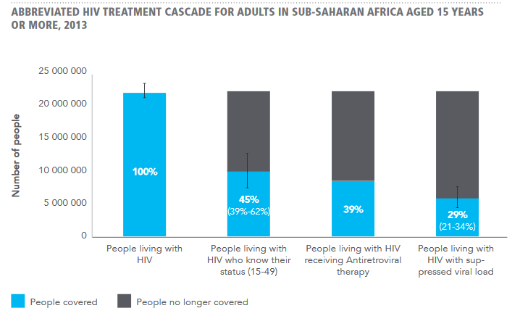
Background
HIV Testing
Linkage to Care
Source: 90-90-90 An ambitious treatment target to help end the AIDS epidemic. UNAIDS. 2014

Slide 3
Barriers to testing and linkage
Criminalization
Stigma/discrimination
Policy
Community/ Organization
Interpersonal
Individual
Age of consent laws
Lack of confidentiality
Clinic access
Low uptake of referral for Rx
Fear of test result
No/low perceived risk
Physical and sexual violence
Low HIV knowledge

Slide 4
Decriminalization
Age of consent laws
Policy
Involve target populations in program development
Provider delivered testing
Testing Strategies
Provider training to reduce stigma
Outreach strategies
Dedicated services, static or mobile
Combination services
Leveraging social networks: Peer educators/navigators
Self-testing
Prevention:
Combination services
Routine testing programs
VMMC
PrEP
Linkage
Care: ART initiation, with/without CD4

Slide 5
As we move forward, additional considerations
Defining and measuring linkage
Measure stigma
Size estimations of key populations
A focus on yield
Cost-effectiveness

