Slide 1










The CQUIN Learning Network:
Partnering to Advance Differentiated Care
Differentiated Care for Individuals at High Risk of Disease Progression
Dr. Maureen Syowai Kathuku-Kaati
ICAP Kenya
IAS Satellite Meeting, July 23, 2017

Slide 2
Outline
Defining “high risk”
Why do people at high risk need DSDM?
Experience from Kenya

Slide 3
Outline
Defining “high risk”
Why do people at high risk need DSDM?
Experience from Kenya

Slide 4
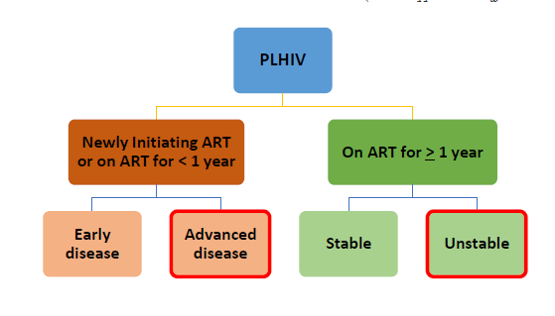
Defining “High Risk”

Slide 5
Defining “High Risk”
Presenting with advanced disease
  CD4 < 200 cells/mm³
  WHO stage 3 or 4
“Unstable” on ART, e.g. on ART for > 1 year but
  Not virally suppressed
  Advanced immunosuppression
  Adverse drug reactions
  Active opportunistic infection
  Nonadherent to ART
  Substance use
  Mental illness

Slide 6
Why Focus on Patients at High Risk?
The proportion of people starting ART in LMIC with CD4 < 200 is falling, but remains high (30-40%)
Mortality amongst this population is high, particularly in the first 3-6 months on ART (8-26% in SSA)
Systems and strategies for patients on ART but virally unsuppressed (patients with “unstable” HIV) lack a robust evidence base

Slide 7
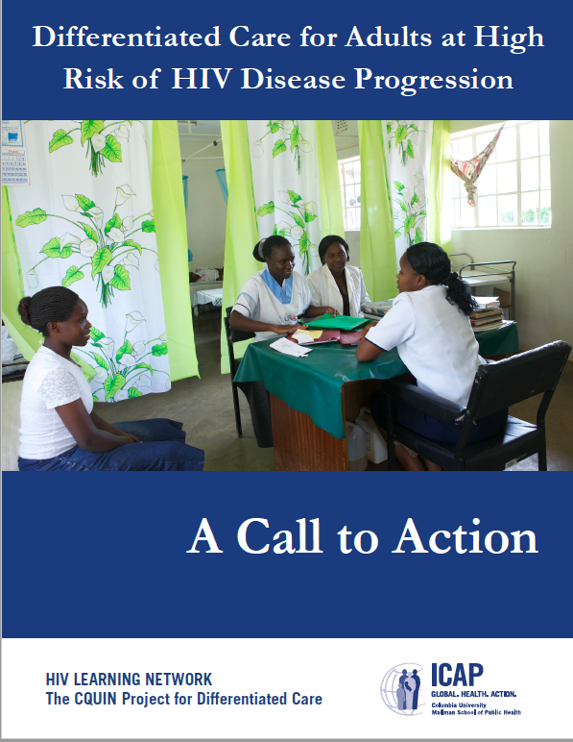

Slide 8
Outline
Defining “high risk”
Why do people at high risk need DSDM?
Experience from Kenya

Slide 9
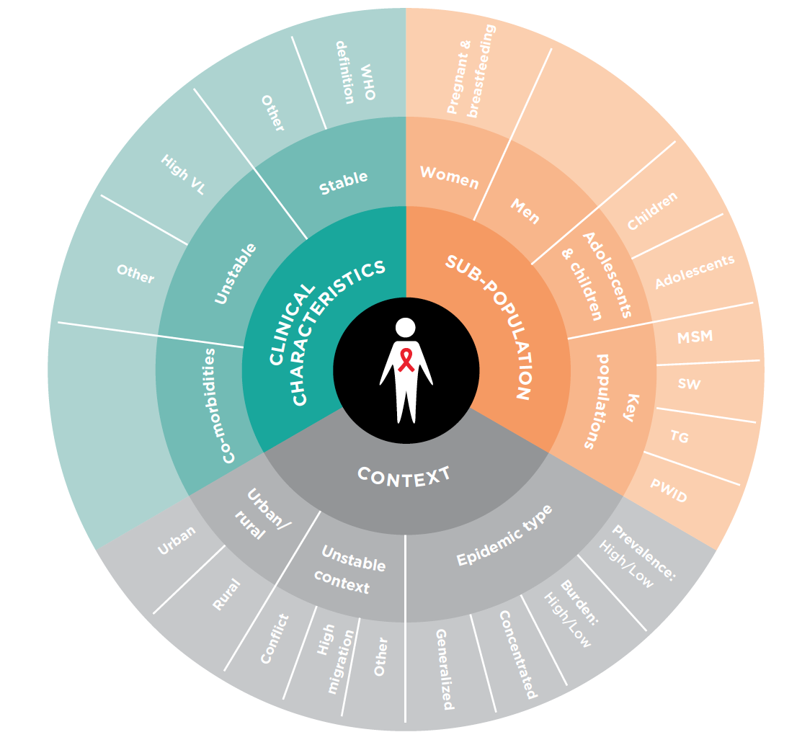

DSD Extends Beyond Stable Patients

Slide 10
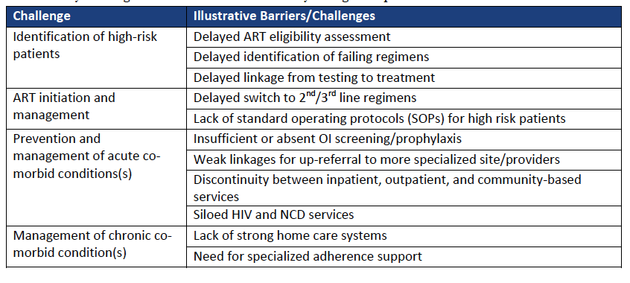
Programmatic Challenges

Slide 11
Illustrative Programmatic Challenges
How can we swiftly identify P@HR and “flag” them for rapid and prioritized services?
How can we provide services that are both intensified and patient-centered?

Slide 12
DSDM for P@HR
SERVICE FREQUENCY | SERVICE INTENSITY
Weekly or biweekly visits? | Enhanced prophylaxis? Enhanced counseling?
SERVICE LOCATION | SERVICE PROVIDERS
Specialty clinics? Intermediate care facilities? Housing near facility (like maternity waiting homes)? Home-based care? | NIMART “plus”? Super-mentors in Kenya Oversight committees

Slide 13
Outline
Defining “high risk”
Why do people at high risk need DSDM?
Experience from Kenya: patients with advanced HIV

Slide 14
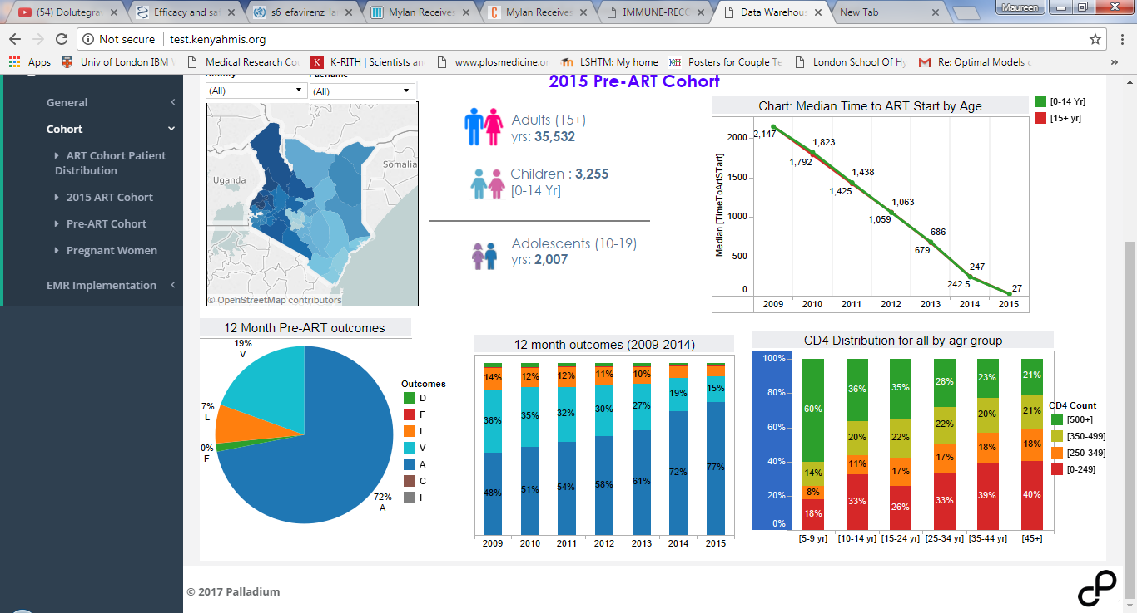
CD4 Distribution at Enrolment in Kenya
CD4 Distribution at enrolment among PLHIV > 5 yrs enrolled in 2015
PLHIV with CD4 count of 0 to 249 cells/mm³ represented 35% of the population
CD4 Distribution at enrolment by age group among PLHIV > 5 yrs enrolled in 2015
Late entry into care for PLHIV 10-14 yrs, and PLHIV > 35 yrs
Source: NASCOP National Data Warehouse

Slide 15
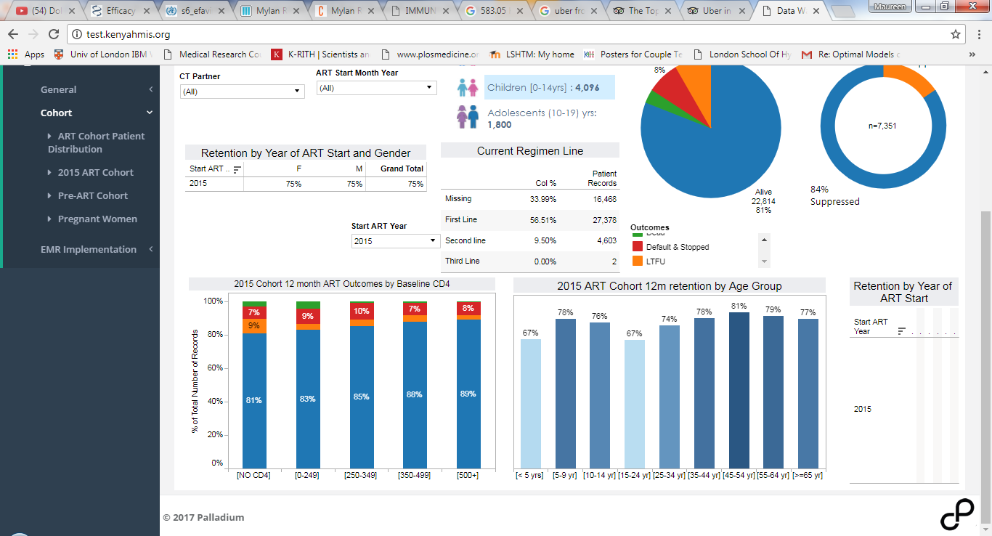
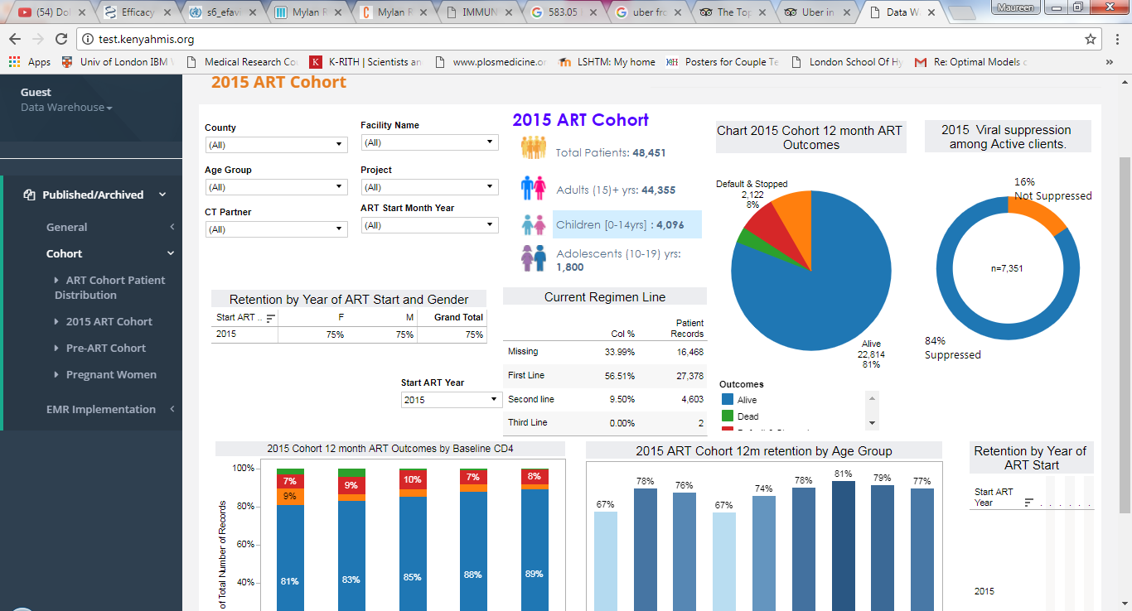
2015 Cohort 12 Month Outcomes
2015 12 Month Pre-ART Cohort Outcomes
Overall mortality of 1%
2015 Cohort 12 month ART outcomes by baseline CD4
5 % mortality for 0-249 CD4 count

Slide 16
ICAP in Kenya Program
At the end of September 2015, ICAP in Kenya program data review revealed an increase in mortality and lost to follow-up among PLHIV
Reviewed program data for PLHIV initiated on ART at 62 ICAP supported facilities from January 2013 to December 2013
Assessed patient outcomes for PLHIV with CD4 < 100 cells/mm³ at 6 months and 12 months after ART initiation

Slide 17
CD4 Count and TB Status at ART Initiation (62 facilities)
Data source: C-PAD

Slide 18
Treatment Outcomes for Severely Immunosuppressed PLHIV (n=479)

Slide 19
Survival Analysis
Expanded the analysis further to patients with 80 months follow-up time after enrolment into care at ICAP-supported facilities
Conducted a Kaplan Meier Survival analysis and further disaggregated the data by CD4 count and by age of patient at the time of enrolment into care

Slide 20
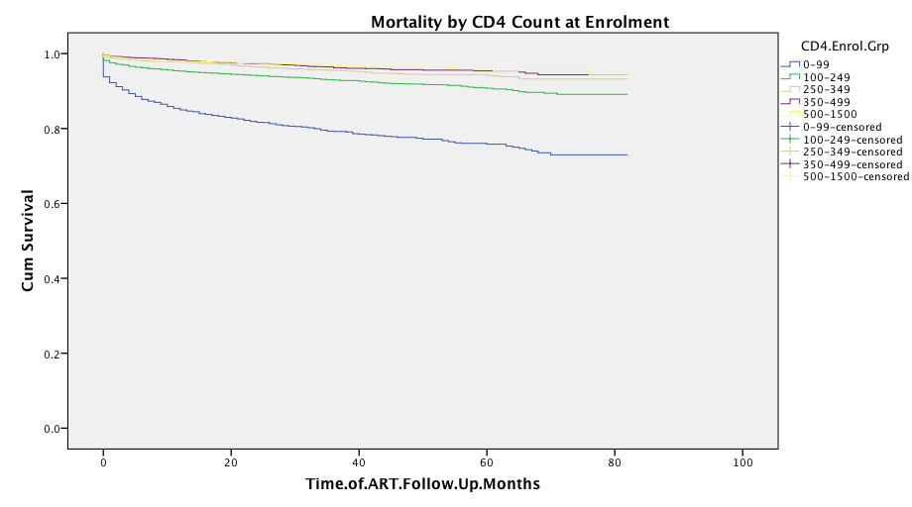
Survival Analysis Stratified by CD4
Mortality is highest for clients enrolled with CD4 <100 cells/ml
Data source: C-PAD

Slide 21
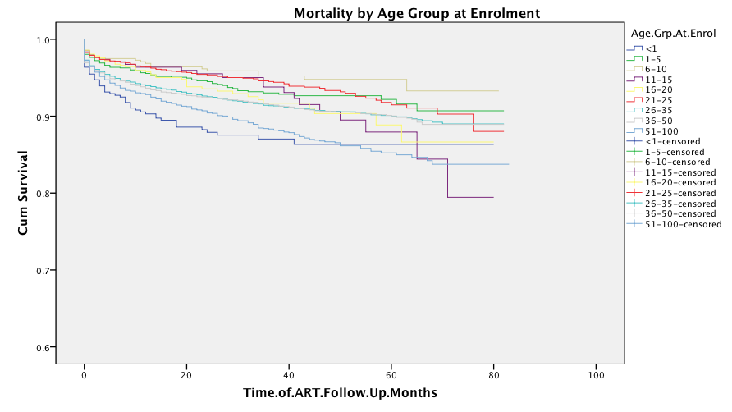
Survival Analysis Stratified by Age
Mortality does not significantly differ by enrollment age (p>0.05)
Infants (<1 yr.) have a higher relative mortality rate compared to other age groups
Data source: C-PAD

Slide 22
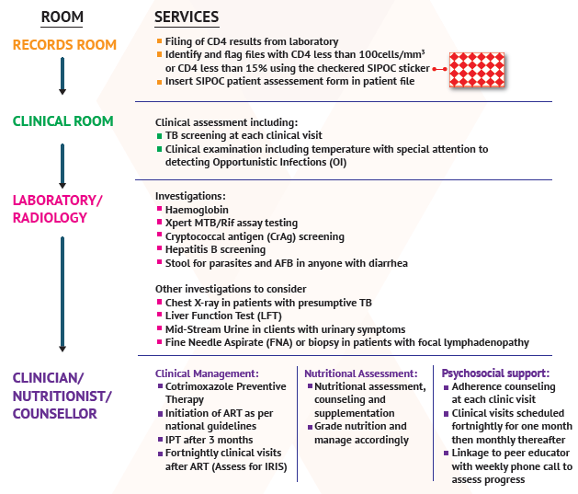
Modified Approach to Patient with Severe Immunosuppression

Slide 23
Conclusion
Other Care Models for Patients at High Risk of Disease Progression in SSA
  REALITY study
  Lighthouse ALUP model
In spite of convincing evidence, the quality and coverage of DSDM for P@HR is substandard
There is need to take the opportunities presented by these models to scale
CQUIN provides an opportunity to move from policy to practice

