Slide 1

Readiness for antiretroviral therapy: implications for linking HIV-infected individuals to care and treatment
Brendan Maughan-Brown
Southern Africa Labour and Development Research Unit (SALDRU)
University of Cape Town
Philip Smith, Linda-Gail Bekker
The Desmond Tutu HIV Centre, University of Cape Town
Omar Galárraga, Caroline Kuo, Abigail Harrison, Mark Lurie
Brown University School of Public Health
IAS 2017- Paris- 24 July, 2017

Slide 2
Background
Early linkage key to maximize ART benefits
South Africa:
  Treat-all (September, 2016)
  50% PLWHA on ART
  32%-50% ART-eligible patients not initiating by endline of several studies
  Linkage poorer from community-based HIV-testing
  Mobile clinics reach undiagnosed
    Important for Treat-all
    Challenge: linkage to care from these services

Slide 3
Background
ART readiness a predictor of ART initiation
  lower readiness = poorer adherence
Little known about ART readiness at diagnosis and ART referral
Important to understand psychosocial drivers of readiness
  Inform strategies to increase early linkage
  Treat-all era: diagnosis = ART referral
    What are the immediate psychosocial barriers?
  Important for differentiated care

Slide 4
Study aim
Assess demographic and psychosocial factors associated with ART readiness among patients referred for ART by a mobile health clinic in Cape Town, South Africa

Slide 5
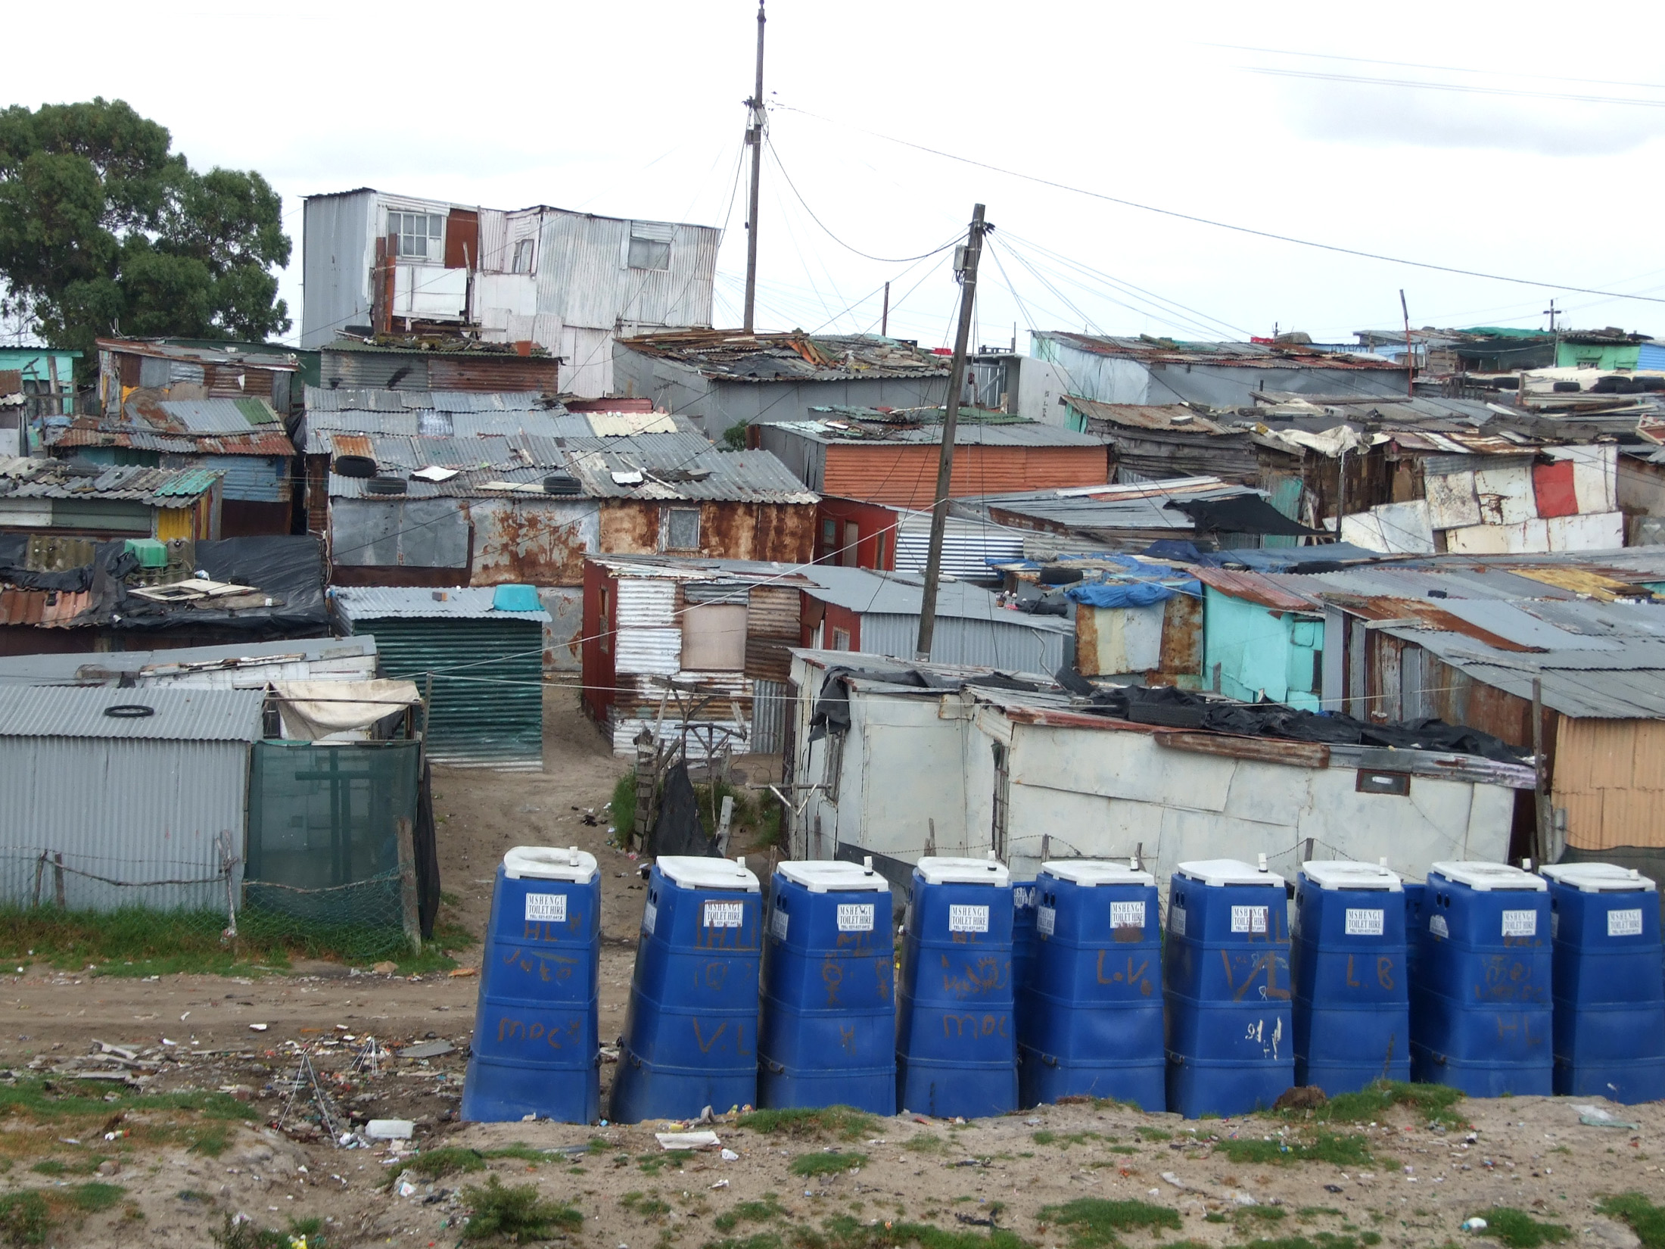
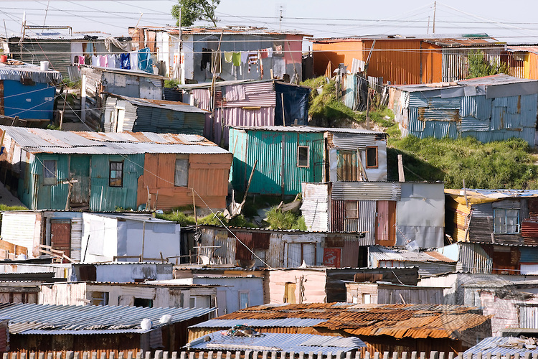
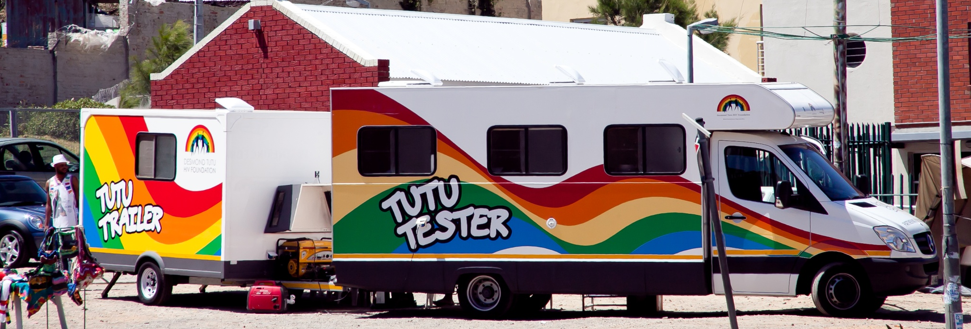
Methods
Baseline survey of iLink Study
  Pilot RCT: CEI effect on ART initiation
Enrollment at mobile health clinic
Resource poor area in Cape Town
Eligibility
  Referred for ART (CD4≤500 cells/µl)
  18+ years, never on ART
April 2015 – May 2016
Face-to-face questionnaire

Slide 6
Methods: Measures
ART readiness
Based on 3 elements required for readiness
An awareness that treatment will be beneficial
  ‘Overall, how confident are you that ARVs would have a positive effect on your health?’
Motivation to initiate treatment
  ‘How motivated are you to start ARVs?’
Intention to start treatment soon
  ‘How likely is it that you’ll visit an HIV/ARV clinic in the next 30 days?’
Plus a self-assessment of ART readiness
  ‘How ready do you feel to start ARVs?’
Main binary variable: “Very” to all questions = ‘ready’

Slide 7
Methods: Independent Measures
Demographic and SES
Age
Gender
Education
Employment
Household monthly income
Health
Self-perceived health
    ‘In general, how was your health in the last week?’
Depression
  ‘About how often during the past 30 days did you feel depressed?’

Slide 8
Methods: Independent Measures
Psychosocial
Knowledge about ART
Perceived likelihood of testing positive
Witnessed positive ART effect
  Knows friend/family taking ART and seen positive effect
Perceived likelihood of experiencing side-effects
Internalised stigma
  Feeling guilty or ashamed to have HIV
Perceived stigma
  Likely to be treated badly by friends, community, health prof. etc.
Disclosure intentions
Subjective norms about ART initiation
  How many people like yourself start ART < 3 months
Discount rates (present focused?)
  Select R200 now vs R500 in 1 month

Slide 9
Methods: Analysis
Factors associated with ART readiness
Multiple logistic regression models
  Dependent var: ART readiness (0/1)
  Independent var: separate models for each
  Controls: gender, age and education (years)

Slide 10
Results: Sample
N=87
Female: 64%
18-39 years old: 72%
Good health: 52%

Slide 11
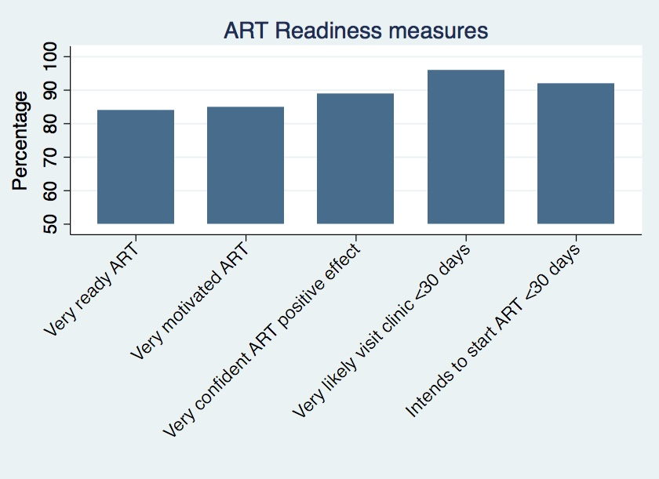
Results: ART readiness
Overall ‘ready’
All: 72%
Female: 70%
Male: 77%
84
85
89
96
92

Slide 12
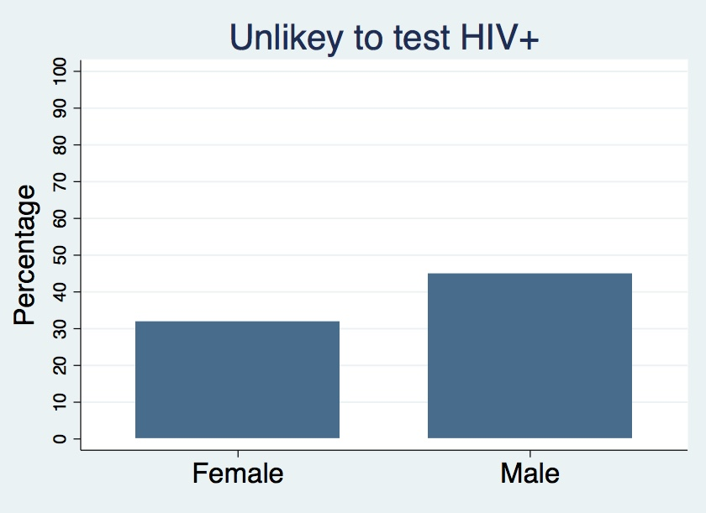
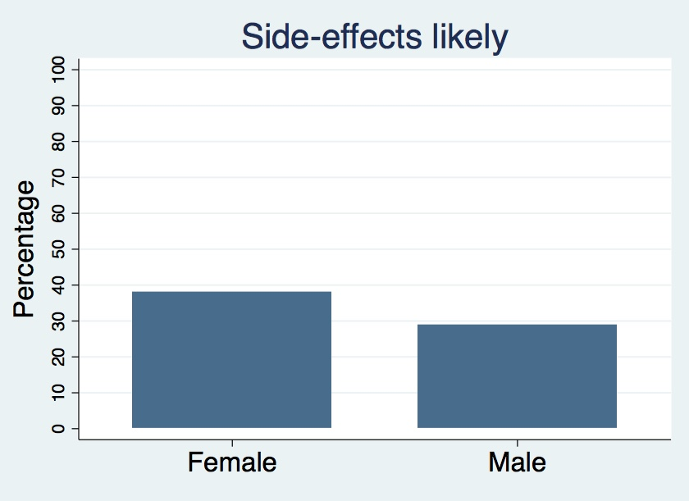
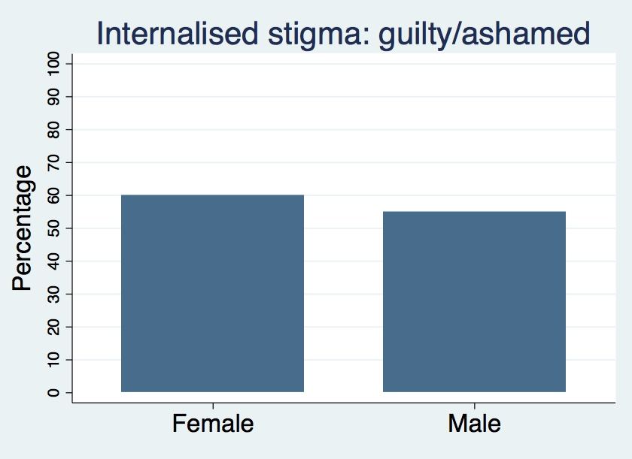
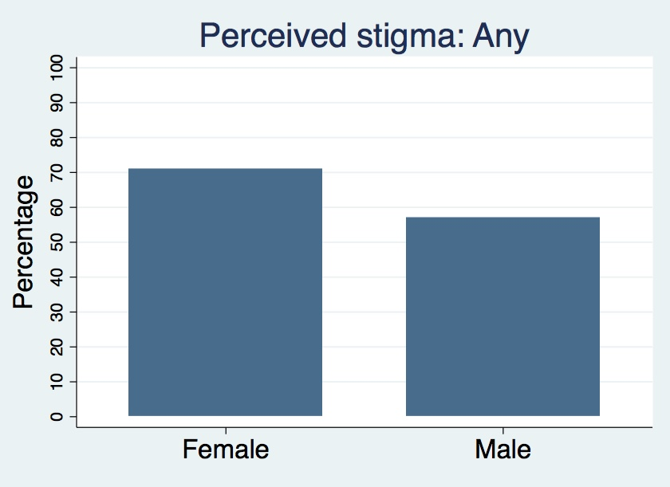
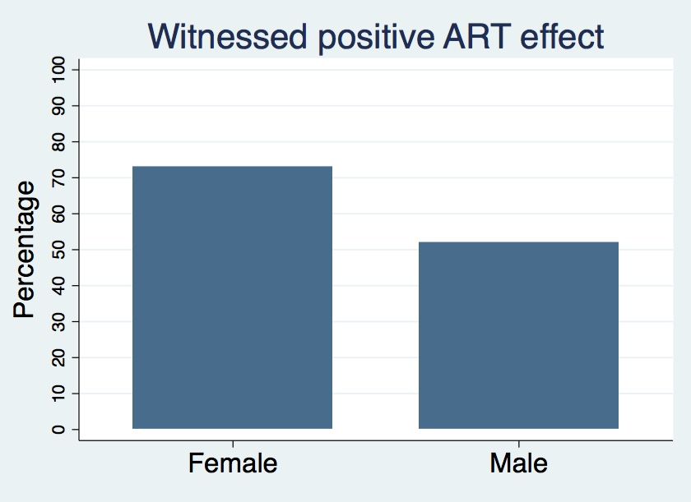
Results: key psychosocial factors
Fig. 1
Fig. 2
32
45
38
29
84
85
89
92
Fig. 3
Fig. 4
Fig. 5
60
55
71
57
73
52
Difference: 21, p<0.05

Slide 13
Results: Determinants of ART Readiness
Readiness lower among individuals
In good health (aOR:0.44, p<0.1)
Who did not think they would test HIV-positive (aOR:0.26, p<0.05)
Readiness greater among individuals
With good ART knowledge (aOR:4.31, p<0.05)
Knowing someone who had experienced positive health effects from ART (aOR:2.65, p<0.05)
Large effect size (but not statistically significant)
Internalised stigma negatively associated (aOR:0.48, p=0.168)
Believe side-effects likely negatively associated (aOR:0.17, p=0.132)
Likely disclose to sex partner positively associated (aOR:2.88, p=0.117)

Slide 14
Conclusions
Psychosocial factors impeding ART readiness common at diagnosis
Results indicate need for interventions at ART referral to
Deal with surprise at a positive diagnosis
  Importance: denial is often a barrier to ART initiation
  Future research: Effective counselling approaches to help individuals come to terms with diagnosis
Promote readiness among healthy feeling individuals
  ART may be perceived as >risk than immediate benefit
    High costs: eg. stigma and side-effect concerns
  Future research: Effective messaging on multiple benefits and importance of early ART
Interventions could leverage personal experience of positive treatment effects to improve ART readiness
    Especially among men

Slide 15




Acknowledgments
iLink Study funding
National Research Foundation, South Africa, through the Research Career Advancement Fellowship
South African Social Science and HIV (SASH) Programme, an initiative funded by the Eunice Kennedy Shriver National Institute of Child Health & Human Development of the National Institutes of Health (Award #R24HD077976)
Investigators
Brown University School of Public Health, USA
Desmond Tutu HIV Foundation, University of Cape Town
Southern Africa Labour and Development Research Unit (SALDRU), University of Cape Town
Collaborating Partners
Desmond Tutu HIV Foundation, University of Cape Town
To all the study participants, Tutu Tester Mobile Clinic staff, and
iLink Study field staff

