Slide 1





Multi-month prescription of antiretroviral therapy amongst children and adolescents: experiences from the Baylor International Pediatric AIDS initiative (BIPAI) in six African countries
IAS Conference, July 24, 2017
Abstract number: MOAD0105
R.S. Wanless¹, M. Kim², R. Golin³ , A. Amzel³, S. Ahmed², J. Mhango², D. Damba⁴, A. Kayabu⁵, M. Chodota⁶, S. Dlamini⁷, N. Chidah⁸, M. Mokhali⁹, N. Calles², Chantal Caviness¹, E.J. Abrams¹⁰
Funded by USAID supported Technical Support to PEPFAR Programs (TSP), Award number AID-674-A-16-00003
Notes:
Hello my name is Maria Kim. I will be presenting on…. This study was funded by USAID through the Technical Support to PEPFAR programs.
¹Baylor International Pediatric AIDS Initiative, Houston, United States, Baylor International Pediatric AIDS Initiative, Children's Clinical Center of Excellence, Lilongwe, Malawi, ² Baylor International Pediatric AIDS Initiative, Lilongwe, Malawi, ³United States Agency for International Development, Washington, United States ⁴Baylor International Pediatric AIDS Initiative, Kampala, Uganda, ⁵Baylor International Pediatric AIDS Initiative, Mwanza, Tanzania, United Republic of, ⁶Baylor International Pediatric AIDS Initiative, Mbeya, Tanzania, United Republic of, ⁷Baylor International Pediatric AIDS Initiative, Mbabane, Swaziland, ⁸Baylor International Pediatric AIDS Initiative, Gabarone, Botswana, ⁹Baylor International Pediatric AIDS Initiative, Maseru, Lesotho,, ¹¹International Center for AIDS Care and Treatment Programs, Mailman School of Public Health, Columbia University, New York, United States

Slide 2
No potential conflict of interest to report
Notes:
no potential conflict of interest to report

Slide 3
Background
To improve antiretroviral treatment (ART) coverage and help reach the 90-90-90 targets, differentiated approaches to care are necessary
Potential models include reduced frequency of clinic visits for stable patients
There is a paucity of data regarding the impact of differentiated care models (including reduced clinic visits) on pediatric & adolescent outcomes
Baylor International Pediatric AIDS Initiative (BIPAI) has centers of excellence (COE)s in Botswana, Lesotho, Swaziland, Malawi, Uganda and Tanzania. These COEs provide free, comprehensive HIV care for HIV-infected children and adolescents
Notes:
To improve ART coverage and help reach the 90-90-90 targets, differentiated approaches to care are necessary
Potential models include reduced frequency of clinic visits for stable patients
Unfortunately, there is a paucity of data regarding the impact of differentiated care models (including reduced clinic visits) on pediatric & adolescent outcomes
Baylor International Pediatric AIDS Initiative abbreviated as BIPAI, has centers of excellence (COE)s in Botswana, Lesotho, Swaziland, Malawi, Uganda and Tanzania. These COEs provide free, comprehensive HIV care for HIV-infected children and adolescents.

Slide 4
Objective
To evaluate the feasibility and describe the experience of delivering multi-monthly ART prescription schedules by conducting a retrospective analysis of clinical outcomes and comparing monthly (MP) with multi-monthly ART prescription schedules (MMP) for children and adolescents (0-19 years) attending BIPAI COEs
Notes:
Our objective was to evaluate the feasibility and describe the experience of delivering multi-monthly ART prescription schedules by conducting a retrospective analysis of clinical outcomes and comparing monthly (MP) with multi-monthly ART prescription schedules (MMP) for children and adolescents (0-19 years) attending BIPAI COEs.

Slide 5
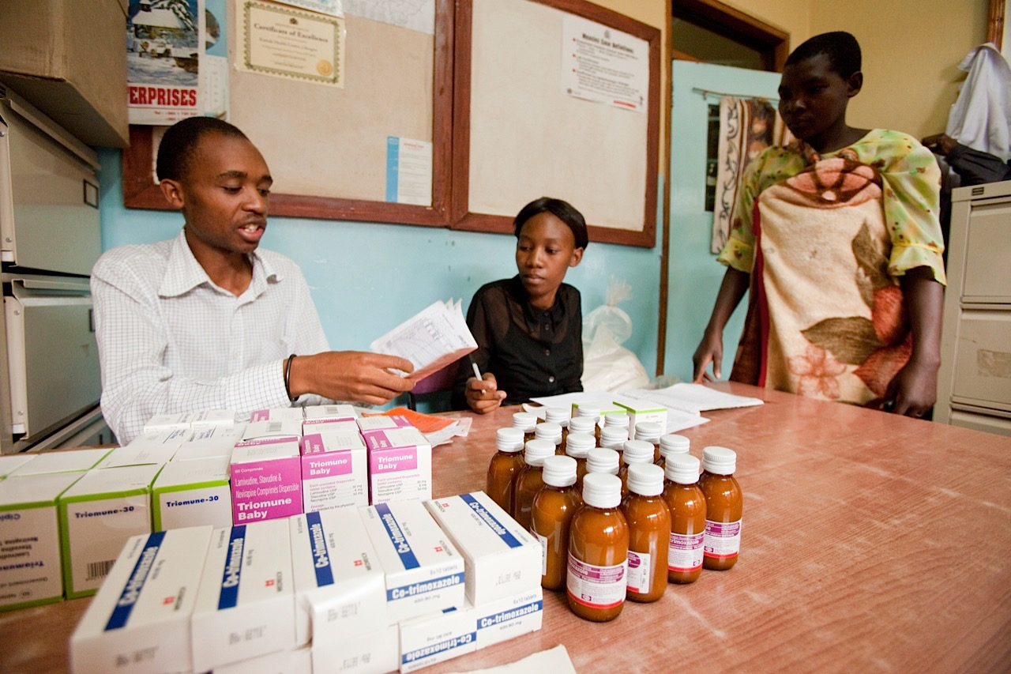
Methods- MMP
MMP was introduced at each COE in line with national policy
The decision to switch to MMP was made on an individual patient basis and varied by provider and facility
Patients were transitioned to MMP when deemed to be clinically stable and ART adherent, typically after 6 to 9 months of monthly prescriptions
  Clinically stable: improving CD4+ count, undetectable viral load and minimal HIV associated morbidity
  ART adherence: pill count 95- 105% by pharmacy refill data
Notes:
MMP was introduced at each COE in line with national policy.
The decision to switch to MMP was made on an individual patient basis and varied by provider and facility
In most cases this meant patients were transitioned to MMP when deemed to be clinically stable and ART adherent, typically after 6-9 months of monthly prescriptions.
Clinically stable was defined as: improving CD4+ count, undetectable viral load and minimal HIV associated morbidity
ART adherence was defined as: (pill count 95-105% by pharmacy refill data)

Slide 6
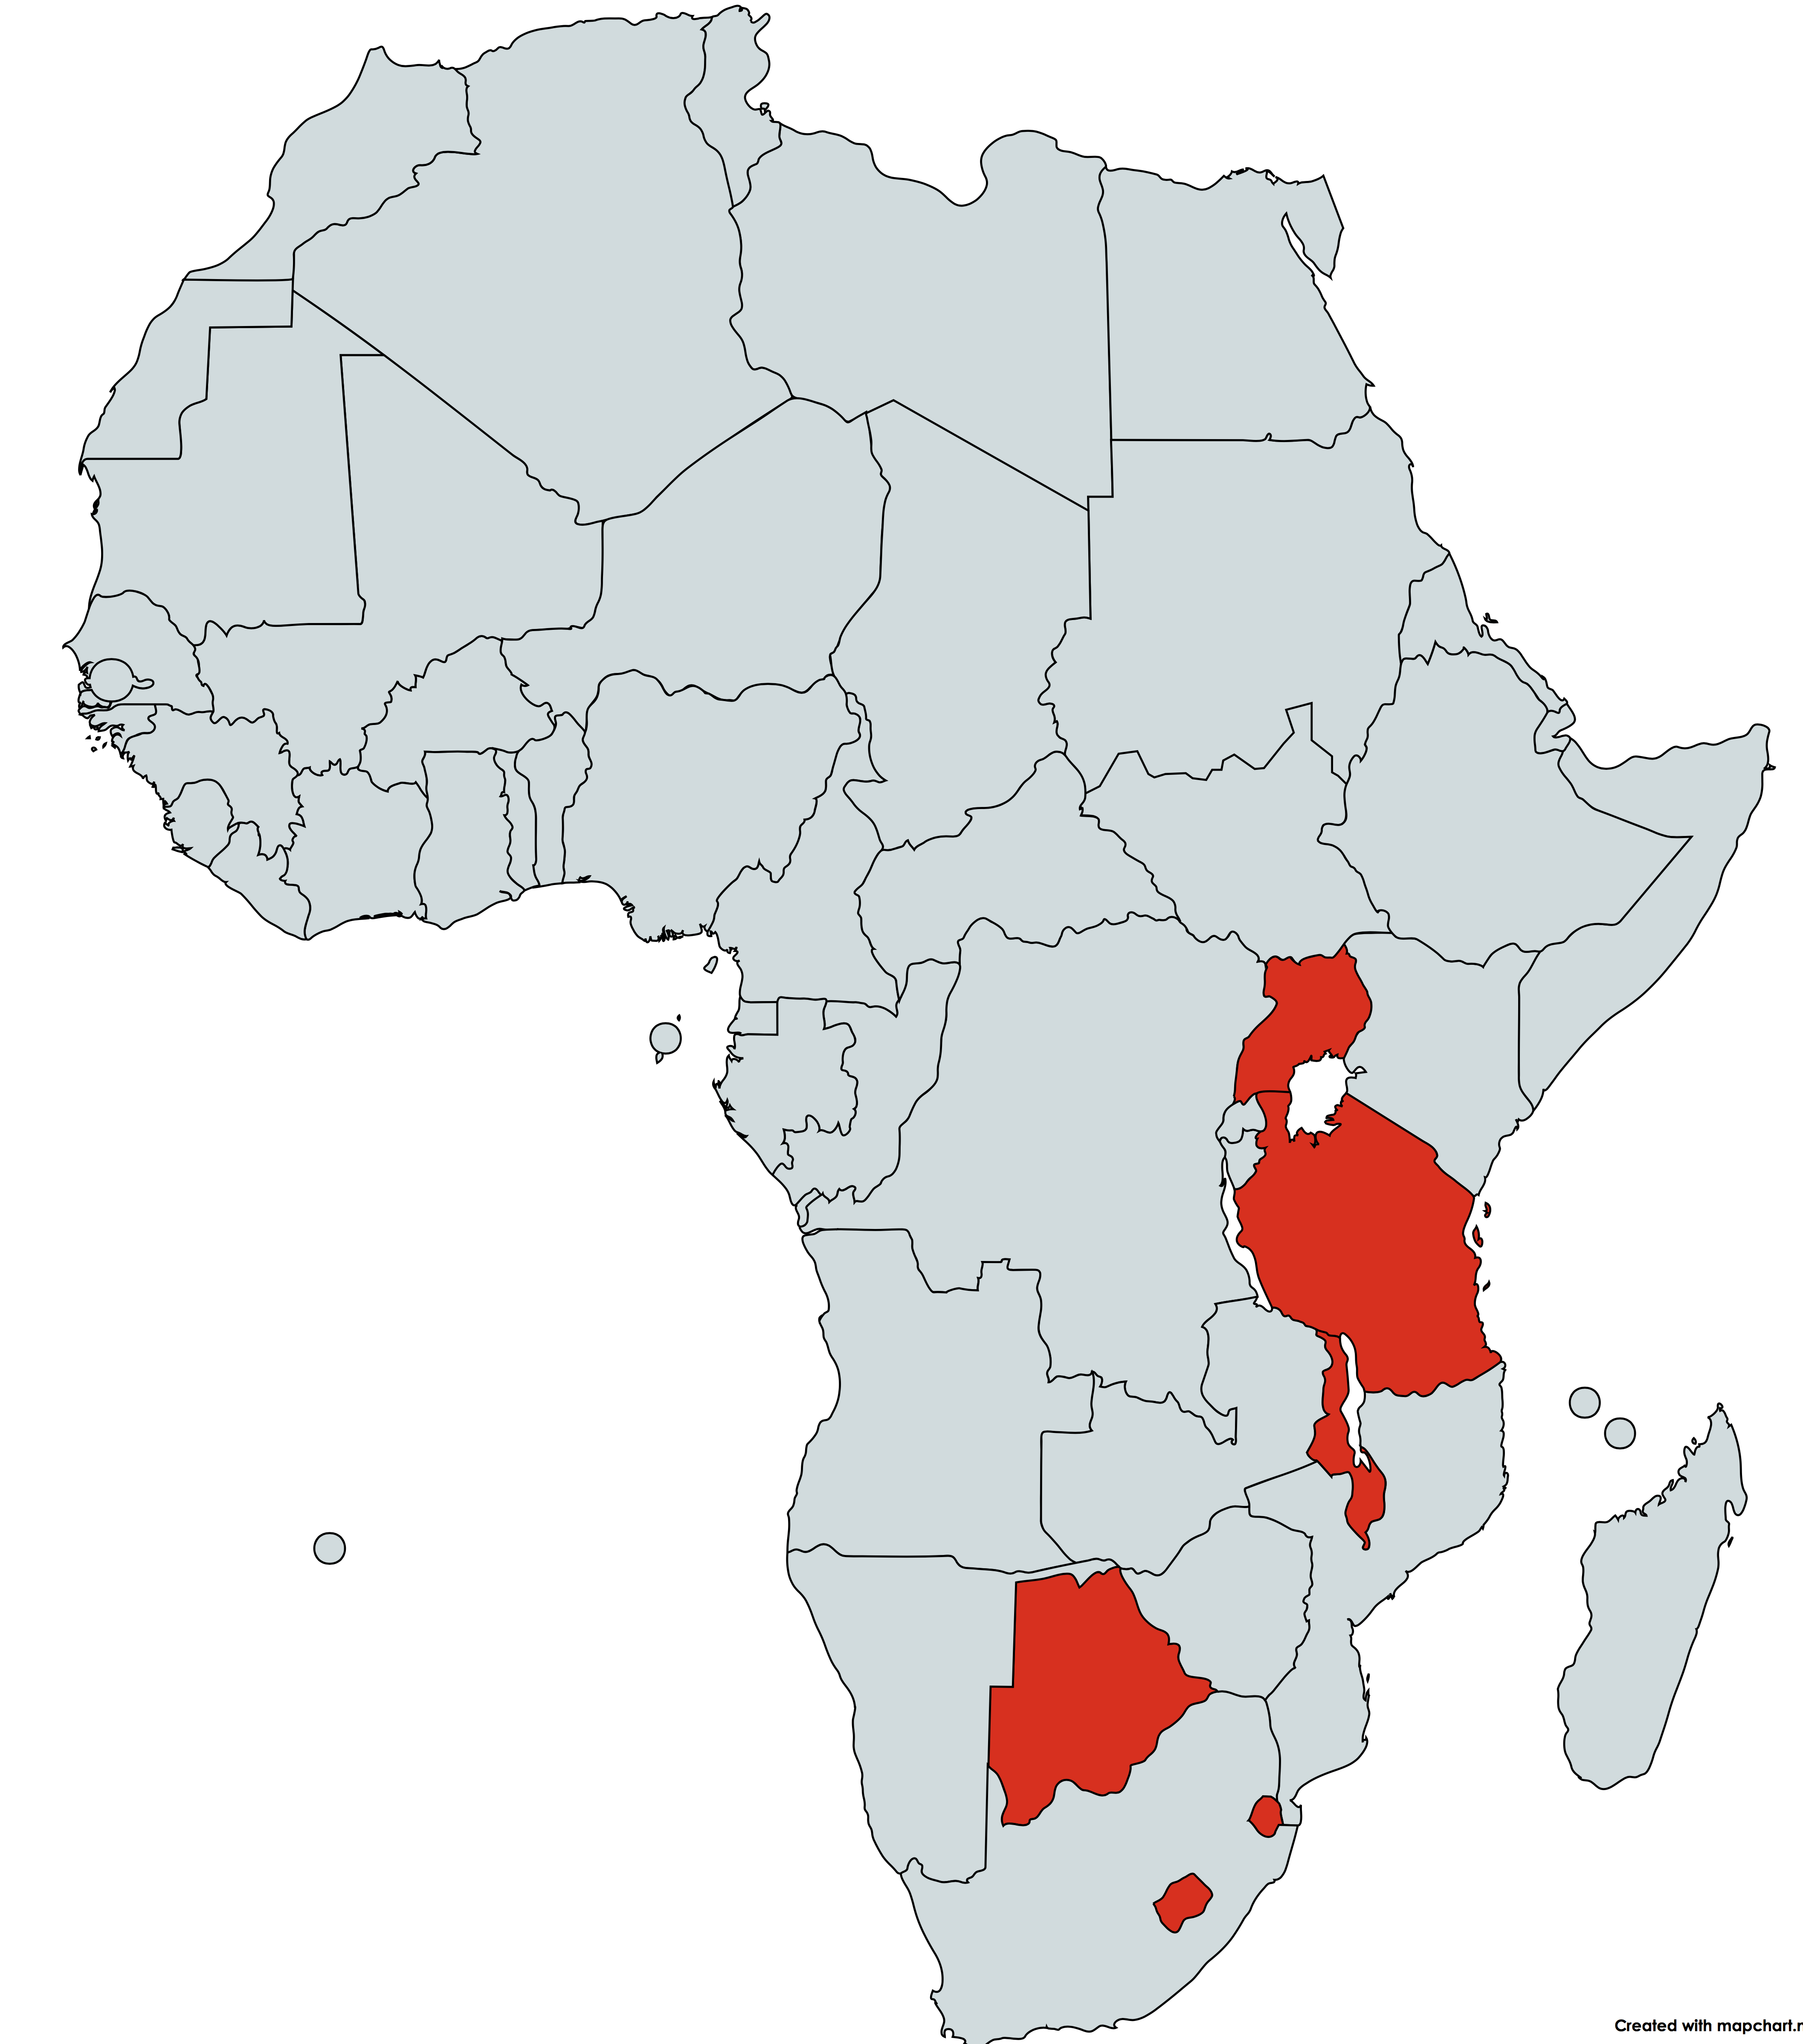
Methods
Design: Retrospective review of electronic patient medical records
Setting: Seven urban clinics in six African countries
Patient records reviewed: Patients 0-19 years of age initiated on ART from Jan 1, 2003 to June 30, 2015
Notes:
We conducted a retrospective review of electronic patient medical records
From seven urban clinics in six African countries
We reviewed records of patients 0-19 years of age initiated on ART from Jan 1, 2003 to June 30, 2015

Slide 7
Methods- Analysis
Patient visits were classified as either monthly (MP) or multi-monthly (MMP) based on the number of days between scheduled clinical visits. MMP was defined as 56-180 days
Adherence (pill count 95-105%), loss-to-follow up (LTFU) (as recorded in the EMR), CD4+ (> 350 for patients ≥5 years; CD4 % > 25% for <5 years old), viral load (undetectable [< 400 copies/ml] vs. detectable) were compared between MP and MMP patients by two-sample tests for binomial proportions
Mortality compared by log rank test
To avoid immortal time bias, MMP patients contributed person-time to the MP group between ART initiation and the start of MMP
Notes:
Patient visits were classified as either monthly (MP) or multi-monthly (MMP) based on the number of days between scheduled clinical visits. MMP was defined as 56-180 days
Outcomes were defined as follows: Adherence- a pharmacy pill count of 95-105%, loss-to-follow up (LTFU)- as recorded in the EMR , CD4+ (> 350 for patients 5 years of age or older, or > 25% for those less than 5 years of age. viral load (undetectable [< 400 copies/ml] vs. detectable).
These outcomes were compared between MP and MMP patients by two-sample tests for binomial proportions.
Mortality was compared by log rank test.
To avoid immortal time bias, MMP patients contributed person-time to the MP group between ART initiation and the start of MMP.

Slide 8
Methods- Analysis
22,658 patient records were reviewed
2,186 records were excluded because they had less than 12 months of follow up data when the dataset was closed
20,472 patient records were included in the analysis
    15,234 (74%) were 0-9 years old and 5,238 (26%) were 10-19 years old at ART initiation
5,245 (26%) were MP and 15,227 (74%) were MMP
Analysed as intent to treat
Notes:
We reviewed 22,658 patient records
2,186 records were excluded because they had less than 12 months of follow up data when the dataset was closed
20,472 patient records were included in the analysis
74% were 0-9 years old and 26% were 10-19 years old at ART initiation
26% remained in the MP group and 74% transitioned to MMP
The analysis was performed as intent-to-treat (If someone asks- Only 14.3% of all MMP reverted to MP patients.

Slide 9
Aggregate clinical outcome data comparing MP and MMP patients
As compared to MP, MMP patients had lower mortality and LTFU, as well as superior ART adherence and response to ART by CD4+ and VL measurements
Clinical outcome | MP N (%) | MMP N (%) | P-value
Mortality -deaths per 100 pt. years | 2.08 | 0.45 | p < 0.0001
Loss to follow-up | 5245 (13.5%) | 15,227 (2.6%) | p < 0.0001
Adherence (pill count 95-105%) | 4681 (59.5%) | 4969 (78.2%) | p < 0.0001
CD4+ (> 350 or > 25 %) | 4969 (77.1%) | 15,170 (92.3%) | p < 0.0001
VL (% undetectable <400 copies/ml) | 2455 (67.9%) | 12,397 (84.3%) | p < 0.0001
Analyses by country and by disaggregated age groups (< 1, 1 to 4, 5 to 9, 10 to 14, 15 to 19 years) yielded broadly similar findings
Notes:
As compared to MP, MMP patients had lower mortality and loss to follow up as well as superior ART adherence and response to ART by CD4+ and VL measurements.
Mortality was 2.08 deaths per 100 patient years in the MP group vs. 0.45 in the MMP group.
Analyses by country and by disaggregated age groups yielded broadly similar findings as follows:

Slide 10
Mortality, by country
By country, mortality was significantly lower in MMP as compared MP
Country | MP Deaths per 100 pt yrs | MMP Deaths per 100 pt yrs | P –Value¹
All locations | 2.08 | 0.45 | < 0.0001
Botswana | 1.00 | 0.29 | < 0.0001
Lesotho | 2.41 | 0.39 | < 0.0001
Swaziland | 2.65 | 0.35 | < 0.0001
Malawi | 3.58 | 0.56 | < 0.0001
Uganda | 1.75 | 0.51 | < 0.0001
Tanzania (Mbeya) | 1.53 | 0.85 | 0.022
Tanzania (Mwanza) | 1.51 | 0.40 | 0.001
¹Survival compared between MP and MMP by log rank test
Notes:
By country, mortality was significantly lower in MMP as compared to the MP group

Slide 11
LTFU, by country
By country, a smaller proportion of those in MMP were LTFU as compared to MP
Country | MP |  | MMP |  | P-value
 | N | LTFU % | N | LTFU %
All locations | 5245 | 13.5% | 15227 | 2.6% | < 0.0001
Botswana | 537 | 8.4% | 2035 | 1.0% | < 0.0001
Lesotho | 818 | 16.5% | 2020 | 3.2% | < 0.0001
Swaziland | 534 | 15.7% | 1468 | 3.3% | < 0.0001
Malawi | 1214 | 17.2% | 2548 | 3.2% | < 0.0001
Uganda | 1044 | 18.0% | 5654 | 2.8% | < 0.0001
Tanzania (Mbeya) | 667 | 2.8% | 819 | 1.1% | 0.014
Tanzania (Mwanza) | 431 | 6.0% | 683 | 0.7% | < 0.0001
Notes:
By country, a smaller proportion of those in MMP were LTFU as compared to MP

Slide 12
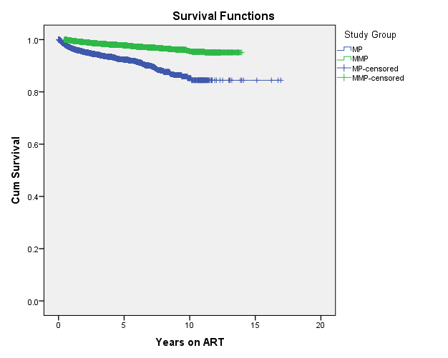
Kaplan-Meier curve comparing survival curves for MP and MMP for all patients
Notes:
Survival, by Kaplan Meier analysis was better in the MMP group.

Slide 13
Mortality & LTFU, by age group
For each age group- LTFU and mortality varied but were lower in the MMP vs. MP groups
 | Mortality Rates (Deaths per 100 pt. yrs) |  |  | LTFU
Age group | MP | MMP | P-Value¹ | MP | MMP | P-Value²
All ages | 2.08 | 0.45 | < 0.0001 | 13.5% | 2.6% | < 0.0001
< 1 year | 3.81 | 0.54 | < 0.0001 | 16.6% | 2.9% | < 0.0001
1 to 4 years | 1.77 | 0.30 | < 0.0001 | 18.6% | 2.7% | < 0.0001
5 to 9 years | 1.09 | 0.36 | < 0.0001 | 10.0% | 1.7% | < 0.0001
10 to 14 years | 2.54 | 0.77 | < 0.0001 | 8.5% | 3.0% | < 0.0001
15 to 19 years | 4.65 | 2.25 | 0.003 | 13.7% | 4.2% | < 0.0001
¹Survival compared between MP and MMP by log rank test
² p values comparing % of patients between MP and MMP patients by Chi-Square Tests
Notes:
For each age group- LTFU and mortality varied but were lower in the MMP vs. MP group

Slide 14
Adherence, CD4+, VL, by country
By country- adherence, CD4+, and VL were better in the MMP vs. MP group
 | Good adherence by pill count (95-105%) |  |  | CD4+ (>350 cells/mm³ or >25 %) |  |  | Viral load (% undetectable <400 copies/ml)
Country | MP | MMP | P-Value | MP | MMP | P-Value | MP | MMP | P-Value
All countries | 59.5% | 78.2% | < 0.0001 | 77.1% | 92.3% | < 0.0001 | 67.9% | 84.3% | < 0.0001
Botswana | 66.9% | 86.8% | < 0.0001 | 78.4% | 96.3% | < 0.0001 | 74.2% | 90.8% | < 0.0001
Lesotho | 65.4% | 86.9% | < 0.0001 | 83.2% | 95.4% | < 0.0001 | 68.8% | 91.5% | < 0.0001
Swaziland | 77.2% | 91.9% | < 0.0001 | 76.7% | 94.6% | < 0.0001 | 57.6% | 84.6% | < 0.0001
Malawi | 58.0% | 86.2% | < 0.0001 | 70.8% | 89.2% | < 0.0001 | 76.0% | 88.9% | < 0.0001
Uganda | 38.4% | 65.1% | < 0.0001 | 74.8% | 91.5% | < 0.0001 | 64.1% | 79.4% | < 0.0001
Tanzania (Mbeya) | 52.3% | 67.8% | < 0.0001 | 79.8% | 86.1% | 0.001 | 47.2% | 49.3% | 0.710
Tanzania (Mwanza) | 72.1% | 87.1% | < 0.0001 | 81.2% | 92.1% | < 0.0001 | 45.6% | 48.7% | 0.710
Notes:
Overall by country- adherence, CD4+, and VL outcomes were also better in the MMP vs MP group. In Tanzania, viral load suppression followed a similar trend, however, these findings were not statistically significant. The Tanzanian COE’s were not opened until 2010, and therefore had less patient experience and data than the other COEs.

Slide 15
Adherence, CD4+, VL, by age
For each age group- adherence, CD4+, and VL varied but were better in the MMP vs. MP group
 | Good adherence by pill count (95-105%) |  |  | CD4+ (>350 cells/mm³ or >25 %) |  |  | Viral load (% undetectable <400 copies/ml)
Age group | MP | MMP | P-Value | MP | MMP | P-Value | MP | MMP | P-Value
All ages | 59.5% | 78.2% | < 0.0001 | 77.1% | 92.3% | < 0.0001 | 67.9% | 84.3% | < 0.0001
< 1 year | 52.5% | 74.4% | < 0.0001 | 92.2% | 99.4% | < 0.0001 | 63.1% | 87.1% | < 0.0001
1 to 4 years | 58.2% | 77.5% | < 0.0001 | 90.2% | 98.0% | < 0.0001 | 72.5% | 86.9% | < 0.0001
5 to 9 years | 59.2% | 79.5% | < 0.0001 | 73.1% | 91.5% | < 0.0001 | 68.6% | 85.0% | < 0.0001
10 to 14 years | 63.1% | 79.8% | < 0.0001 | 64.5% | 82.2% | < 0.0001 | 65.6% | 77.4% | < 0.0001
15 to 19 years | 69.6% | 79.2% | < 0.0001 | 54.1% | 75.1% | < 0.0001 | 70.6% | 78.9% | 0.120
Notes:
For each age group, adherence, CD4+ and VL outcomes varied but were better in the MMP vs. MP group. This is not surprising, given that those who remained in MP, for the most part, had either adherence or other clinical issues. However, it once more suggests no negative consequences of transitioning to MMP.

Slide 16
Discussion
By definition, patients in MP, remained on monthly prescription schedules because they were deemed to have either adherence or clinical issues. Therefore, it is not surprising that their clinical outcomes were worse than MMP patients.
We considered comparing clinical outcomes of patients before and after entry into MMP. Unfortunately, due to insufficient data, a meaningful comparison was not possible.
All patients attended BIPAI COEs which were comparatively well resourced which may limit generalizability to other health settings.
Notes:
By definition patients in MP, remained on monthly prescription schedules because they were deemed to have either adherence or clinical issues. Therefore, it is not surprising that their clinical outcomes were worse than MMP patients.
We considered comparing clinical outcomes of patients before and after entry into MMP. Unfortunately, due to insufficient data, a meaningful comparison was not possible.
All patients attended BIPAI COEs which were comparatively well resourced which may limit generalizability to other health settings
Therefore, translation of the BIPAI experience to primary health centres may require thoughtful planning, staffing and training
However, the BIPAI clinics see very large numbers of patients daily, suggesting that the approach can be implemented at busy sites

Slide 17
Conclusion
This analysis of more than 15,000 children and adolescents from six African countries demonstrates that a transition to multi-monthly prescription schedules was feasible and safe with evidence of positive health outcomes in terms of immunologic status, ART adherence, virologic suppression, retention, and mortality.
Notes:
This analysis of more than 15,000 children and adolescents from six African countries demonstrates that a transition to multi-monthly prescription schedules was feasible and safe with evidence of positive health outcomes in terms of immunologic status, ART adherence, virologic suppression, retention, and mortality.

Slide 18
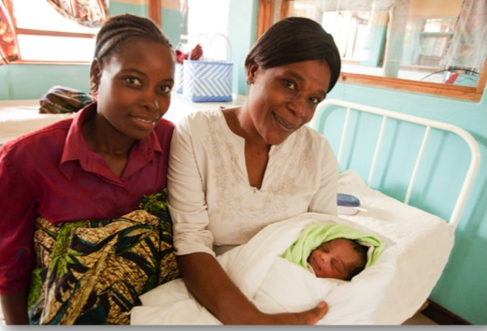
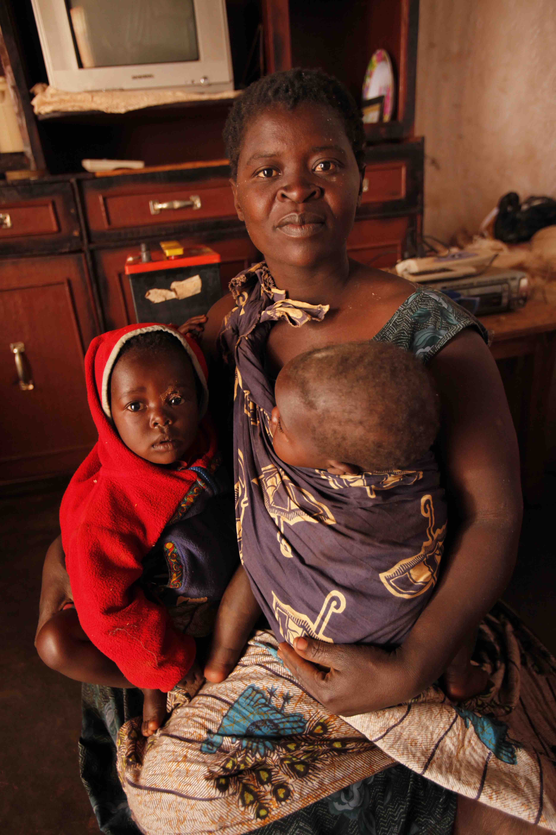
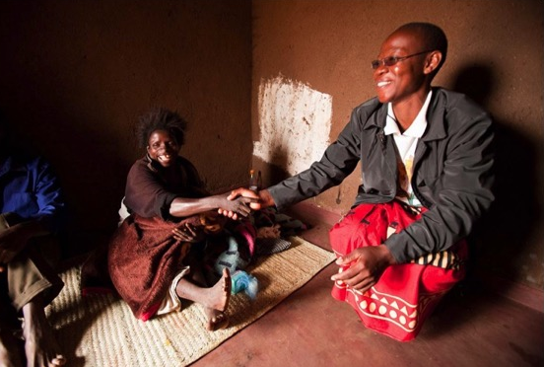

Acknowledgements
BIPAI Network including:
Dr. Peter N. Kazembe (Malawi)
Dr. Edith Mohapi (Lesotho)
Dr. Khosie Hlatshwayo(Swaziland)
Dr. Lumumba Mwita (Tanzania)
Dr. Adeodata Kekitiinwa (Uganda)
Prof. Gabriel Anabwani (Botswana),
Drs. Mark Kline and Gordon Schutze
Health care workers, data and admin staff
USAID Regional HIV AIDS Program, USAID Washington, and the Technical Support to PEPFAR Programs (TSP) team including:
Faith Xulu
Thembeka Sonkwele
Bradley Cronk
Dr. Rachel Golin
Dr. Anouk Amzel
Dr. Saeed Ahmed (COP TSP)
Jon Crisp
Dr. Katie Simon
Children, adolescents, and families who inspire us with their perseverance and courage
Notes:
This study was made possible due to over a decade of work conducted by the BIPAI Network- therefore we would like to thank BIPAI leadership as well as all the health workers, data, and administrative staff who work hard every day to provide high quality care for patients and their families. Funding and support was provided by the USAID Regional HIV AIDS program & USAID Washington teams via the TSP award. We also want to thank the children, adolescents, and families who inspire us with their perseverance and courage.
Thank you. We welcome questions, comments and suggestions.

