Slide 1
UNIT 8:
INDEX TESTING SERVICE

Slide 2
  Introduction to Index Contact Testing
Goal of Index Contact Testing
The objective of partner notification is to break the chain of HIV transmission by offering HTS to persons who have been exposed to HIV and linking them to HIV treatment, or HIV prevention services (e.g. VMMC, PrEP, condoms), if negative.
Target audience for Index Contact Testing guidance
This Index Contact Testing guidance targets all health care workers particularly those providing HTS and PMTCT services at the facility and community levels.
Also targeted are HIV prevention implementing partners, facility in charges and county health management teams.

Slide 3
Objectives of Index Contact Testing
To reduce new HIV infections
To scale up HTS for unreached populations
To refer and link to care newly diagnosed persons

Slide 4
Definition of Terms
Index Contact Testing, also known as contact tracing, is a voluntary process where trained health workers ask people diagnosed with HIV about their sexual partners or drug injecting partners, and with the consent of the HIV-positive client, offer these partners voluntary HIV testing services (HTS).
Passive HIV partner notification services refer to when HIV-positive clients are encouraged by a trained provider to disclose their HIV status to their sexual and/ or drug injecting partners by themselves, and to suggest HTS to the partner(s) given their potential exposure to HIV infection.

Slide 5
Definition of Terms Cont..
Index Contact Testing refers to a voluntary process where consenting HIV positive clients are assisted by a trained provider to elicit their sexual and/or drug injecting partner(s) and notify them of their potential exposure to HIV infection with an aim of offering them HTS. Clients are empowered/assisted to disclose their HIV status to their partners.
Contract referral: HIV-positive clients enter into a contract with a trained provider and agree to disclose their status and the potential HIV exposure to their partner(s) by themselves and to refer their partner(s) to HTS within a specific time period. If the partner(s) of the HIV-positive individual does not access HTS or contact the health provider within that period, then the provider will contact the partner(s) directly and offer voluntary HTS.

Slide 6
Definition of Terms Cont..
Provider referral: With the consent of the HIV-positive client, a trained provider confidentially contacts the person’s partner(s) directly and offers the partner(s) voluntary HTS.
Dual referral: A trained provider accompanies and provides support to HIV positive clients when they disclose their status and the potential exposure to HIV infection to their partner(s). The provider also offers voluntary HTS to the partner(s).
Index client: an individual newly diagnosed as HIV-positive and/or an HIV-positive individual who may or may not be enrolled in HIV treatment services
Index testing: voluntary process where counselors and/or health care workers ask index clients to list all of their: (1) sexual or injecting drug partners within the past year, and (2) children and offer them HTS.

Slide 7
Definition of Terms Cont..
Sexual partners: Individuals who have any form of sex, whether vaginal, anal, oral sex with the index client. These include casual and steady sexual partners.
Elicitation of partners: This refers to the listing of all sexual and/or drug injecting partner(s) of an index client.

Slide 8
Index Contact Testing Rationale
Index Contact Testing increases uptake of HTS among sexual partners of HIV-positive individuals, resulting in high proportions of HIV diagnosis and linkage to care.
Why focus on Sexual partners?
Main mode of HIV transmission: Heterosexual
  Sub-Saharan Africa (SSA) ~70% of incident HIV infections¹
Significant proportion of individuals unaware of HIV status
  Sexual partners of HIV positive individuals are at high risk of HIV acquisition

Slide 9
  Index Contact Testing Index Contact Testing guiding Principles
All forms of HTS, including aPNS should adhere to HTS core principals the 6Cs:
Consent, Confidentiality, Counselling, Correct test results, Connection (linkage to prevention, care and treatment services Correct environment
Coerced or mandatory testing is never appropriate, whether that coercion comes from a health-care provider or from a partner, family member, or any other person.
In addition to the 5 C’s, the following principles guide HIV partner notification services and should be considered and adhered at all times.

Slide 10
Index Contact Testing Guiding principals
Client centered and client focused
Confidential
Voluntary and non-coercive
Non-judgmental
Culturally and linguistically appropriate
Accessible and available to all
Comprehensive and integrative

Slide 11
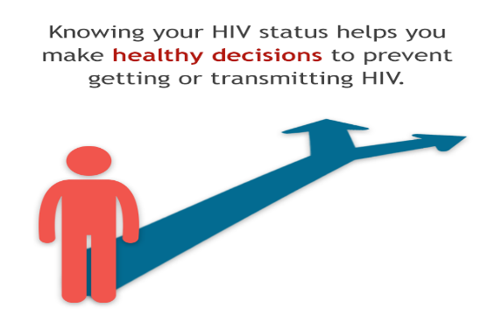





The Index Contact Testing concept
New index client
Elicitation
-VE
-VE
+VE
Elicitation
+VE
-VE
+VE
Elicitation
-VE
+VE
-VE
Elicitation
+VE
+VE
+VE
+VE
Elicitation
+VE
-VE
?
+VE

Slide 12
Index Contact Testing Entry Points and Process
Index Contact Testing can be offered through passive and active approach and clients can access services through the following entry points:
  Routine HTS/PMTCT services
    aPNS is incorporated in the HTS protocol. All clients seeking HTS should be introduced to aPNS and its benefits in all stages of HTS (Pretest, Testing, Post test, Assessment of other health conditions and referral and linkage).
  Comprehensive Care Clinic (CCC)
    At the CCC, HCWs should initiate Index Contact Testing to clients enrolled in CCC particularly those that did not receive counseling on Index Contact Testing during routine HTS. For those that were offered aPNS, it is recommended that they are probed regularly for change of partners as they progress with care and treatment services.

Slide 13
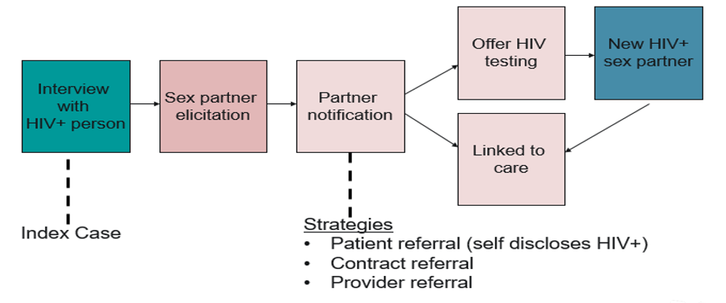
In
Index Contacts Testing Conceptual Frameworkg Index Contacts Testing

Slide 14
Policies and Guidance
These guidelines are anchored in international and national policy and legal framework
  The Constitution of Kenya
  Health Act 2017
  Public Health Act
  HIV Prevention and Control Act 2006
  World Health Organization (WHO) HIVST and Partner Services Guidelines (2016)
  Kenya HIV Testing Services Operational Manual 2022

Slide 15


Thank you

Slide 16
Passive HIV Partner Notification Services
Provider delivers counselling and encourages HIV-positive clients to disclose their HIV status to their partner(s) and notify them of their possible HIV exposure, either in-person or by telephone call, text message, e-mail, etc.
Provider gives HIV-positive clients a letter or card inviting their partner(s) to attend the health facility. When the partners present themselves at the health facility, they are offered HTS.
HIV-positive clients may use anonymous messaging services such as a phone call, e-mail or Internet to notify their partner(s) on their own.

Slide 17
Index contact testing services
Provider delivers counselling and offers HIV-positive clients assistance with disclosure and notifying their partner(s) through one of the 3 referral methods.
Provider contacts partner(s) either by phone, Internet, e-mail or an in-person home visit to inform them of their potential exposure to HIV infection and offers those HIV testing services (HTS).
Provider offers comprehensive HTS to sexual partners to index clients. If the sexual partner is tested at home, provide testing and referral services to the household of the HIV-positive individual.

Slide 18
  Benefits of Index contact testing
Individual (index or sex partner)
  Timely access to ART therefore increasing quality of life
  Improves adherence and retention to treatment
  Increased access to prevention options including counseling, condoms, VMMC, PEP and PrEP
  Enhanced self-worth; client empowerment)
  Enhanced support for those not ready to notify sex partners

Slide 19
Benefits of Index contact testing
Family
  Mutual Knowledge of HIV status increases trust
  Mutual support to access HIV prevention, treatment and care services
  Improves support for the prevention of mother-to-child transmission
  Prioritization of effective HIV prevention for sero-discordant couples (Condoms, Antiretroviral therapy, Pre-exposure prophylaxis) for HIV-negative partners

Slide 20
Key considerations in Index contact testing include
Potential for Intimate Partner Violence (IPV) – Index contact testing provider should screen for IPV
Risk of stigma with unintentional disclosure of HIV status
Laws or policies that stigmatize, criminalize or discriminate against key populations or people living with HIV
Difficulty in identification of partners - some people and groups such as key populations may be reluctant to name partners and/or may not know their partners.

Slide 21
Key considerations in Index contact testing include Cont…
This depends on relationship dynamics and the Index contact testing provider should explore innovative approaches and provide further counselling to the index client.
Locating and notifying partners - locating partners may be difficult, particularly for non-primary/casual partners and for mobile, vulnerable or key populations.
Index contact testing providers can seek escort of CHWs, peer counselors, mentor mothers to help locate homesteads or preferred test areas in the community. Consider telephone referrals for distance partners

Slide 22
  Ethical Issues in Index contact testing
The ethical concerns around Index contact testing revolve around responsibilities of patients who test HIV positive, around the responsibilities of the health care providers in the context of knowledge that a client or patient, whom they know, has tested HIV, and the responsibility of those in the know about a known HIV status to those partners who don’t.
Index contact testing is a voluntary and anonymous public intervention to increase knowledge of HIV status by individuals who may have been exposed through sexual contact, needle sharing or any other high risk activity.

Slide 23
Social Network Strategy Review

Slide 24
What is social network strategy (SNS) for HTS?
SNS can be particularly useful in finding key populations and others who are at risk for HIV but have not had easy access to HTS
A recruitment strategy for reaching and providing HIV counseling, testing, and referral services (HTS) to persons who are unaware of their HIV infection by using social network connections to locate individuals at the highest risk for HIV
Notes:
So, what is social network strategy? It is a case-finding strategy that uses social network connections to locate individuals at the highest risk for HIV.
It has been used to find new HIV cases among populations who have difficulty accessing HIV testing services (e.g., key populations). It has also been used to find previously diagnosed individuals who were out of care, and who may then be linked to ART for the first time or re-engaged in ART services (e.g., Ukraine’s Optimized Case Finding).

Slide 25
Social Network Strategy
Underlying assumption – People in the same social network share similar risk behaviors for HIV
Overall strategy – Enlist PLHIV and high-risk, HIV-negative persons (recruiters) to identify individuals from their social, sexual, and drug-using networks (network members) for HTS
Tactic – Use monetary or non-monetary incentivizes to encourage testing and recruitment of network members
Notes:
The underlying assumption of SNS is that people in the same social network share similar risk behaviors for HIV.
The overall strategy is to enlist HIV-positive and high-risk, HIV-negative persons to recruit individuals from their social, sexual, and drug-using networks for HIV testing services. Once recruited and tested, network members become recruiters and refer members of their networks for testing. This process continues, creating chains of recruitment that can penetrate hidden networks.
SNS is sometimes distinguished from index partner testing through the use of a small reward or incentive, which could be monetary or non-monetary, and the use of recruitment coupons.

Slide 26

Recruitment Through Coupons/Vouchers
Notes:
Shown here is a simple graphic depicting the exponential recruitment potential of SNS using coupons. The initial recruiter receives coupons to recruit her network members. Those network members recruit other network members, and the cycle continues throughout the network.

Slide 27
Four Phases of SNS

Slide 28
SNS Implementation – Four Phases
1
Initial Recruiter Identification
2
Recruiter Instruction
3
Recruitment of Network Members
4
Testing of Network Members & Invitation to Become a Recruiter
Notes:
Now, we will discuss SNS implementation. SNS is implemented in four phases:
Phase 1: Initial recruiter identification
Phase 2: Recruiter Instruction
Phase 3: Recruitment of network members
Phase 4: Testing of network members and invitation to become a recruiter
Then the cycle starts again at the second phase.
Now we will discuss each phase of implementation.

Slide 29
Seeds should be:
Phase 1: Initial Recruiter Identification (Seeds) (1)
HIV positive and/or high-risk negative
Willing to refer network members to HTS
Comfortable talking about HIV
Knowledgeable about HTS and testing locations
Notes:
In phase 1, we identify the initial recruiters or seeds. Seeds should be:
HIV positive and/or high-risk negative
Willing to refer network members to HTS
Comfortable talking about HIV
Knowledgeable about HTS and testing locations

Slide 30
Instruction includes:
Phase 2: Recruiter Instruction (1)
Brief orientation to program
Explanation of their role as a recruiter
May include written description of role
Coaching on how to approach peers for HIV testing and counseling (SNS-Form A)
Notes:
The second phase is to instruct the recruiter on recruitment by providing a brief overview of the program, explain their role as a recruiter, and provide coaching on the best practices for recruitment.

Slide 31
Recruitment Instruction Sheet
Phase 2: Recruiter Instruction (2)
Step 1
Step 4
Step 5
Step 6
Step 2
Identify people in your network who [insert target audience] and who may be at risk of HIV infection.
Consider if these network members may be interested in receiving an HIV test if they can receive a small incentive when they get tested.
Tell your network member that the results of his/her HIV test will never be shared with you.
A friendly professional can be reached by the phone number for any questions about HIV testing location or about their test results.
Contact the HIV testing location to inquire about any referral incentives owed to you.
Step 3
You will receive referral coupons to give to them to direct them to a friendly and confidential HIV testing location.
Step 7
Instructor: Refer to the SNS Coaching Guide for more intensive coaching to improve recruitment of high-risk network members.
Notes:
Team should prepare a script to assist staff in providing recruitment instructions. These instructions should include these items:
Identify people in your network who [insert target audience] and who may be at risk of HIV infection. Note, the target audience for recruitment will depend on the KP group of interest.
Consider if these network members may be interested in receiving an HIV test if they can receive a small incentive when they get tested.
You will receive referral coupons to give to them to direct them to a friendly and confidential HIV testing location.
Tell your network member that the results of his/her HIV test will never be shared with you.
A friendly professional can be reached by the phone number for any questions about HIV testing location or about their test results.
Contact the HIV testing location to inquire about any referral incentives owed to you.
I repeat, these are basic instructions for recruitment training. Each SNS program should develop their own specific instructions that reflect their epidemic and context. In addition to these basic instructions, SNS staff can refer to the SNS Coaching Guide for more intensive coaching to improve recruitment of high-risk network members.

Slide 32


Phase 3: Recruitment of Network Members (1)
Peer recruitment can increase yield
HIV+
Both HIV+ and HIV- clients can recruit
HIV–
Notes:
Phase 3 is the actual recruitment of network members by recruiters. As shown here, recruitment starts with an HIV-positive person who recruits 4 network members. Both HIV-positive and HIV-negative clients are given coupons to recruit. Recruitment and testing are incentivized to drive the recruitment and testing process.

Slide 33
Phase 4: Testing of Network Members & Offering an Opportunity to Recruit
Conduct rapid HIV test
If positive, link to HIV care and treatment
If negative, offer HIV counseling and prevention services as indicated (e.g. condoms, lube, PrEP, etc.)
Offer high-risk members opportunity to recruit their social, drug-using, and sexual network members for HTS
Notes:
The fourth and final phase involves testing network members and offering them the opportunity to recruit members of their network for HIV testing. In this phase:
A rapid HIV test is conducted
If positive, link to HIV care and treatment
If negative, offer HIV counseling and prevention services as indicated (e.g. condoms, lube, PrEP, etc.)
Lastly, you should offer high-risk members opportunity to recruit their social and sexual network members for HTS and the cycle continues.

Slide 34
Potential Concerns and Implementation Considerations
Potential concern | Implementation consideration
Potentially coercive and may result in risk to individual (e.g. abuse from spouse) | Not reported by programs as significant issue Formative research and piloting can identify value of incentive that represents ‘nudge’ from inaction to action, not coercion Incentives should be small
Long-term sustainability of offering incentives | Incentives should be small or can be lottery-based Food, transportation, or phone vouchers, personal hygiene kits, make-up kits, childcare services, or promotional products Case finding can be short term strategy until yield and/or new recruits drop
Same positive individual will re-test to receive incentive | Use of unique identifiers or biometrics to prevent frequent re-testing Use identifying physical marks or descriptions to track participants (tattoos, scars, baldness, etc.)
HIV confidentiality | Offer incentives regardless of test result
Notes:
There are concerns that have been raised regarding SNS, and we want to address them here.
1. Some have raised the concern that the incentive may be coercive. Programs should know that this has not been reported this as a significant issue. Moreover, formative research and piloting can identify value of incentive that represents ‘nudge’ from inaction to action, not coercion. Also, incentives should be small.
2. The issue of long-term sustainability of offering incentives has been raised also. We remind you that incentives should be small. Additionally, programs can use a lottery-based system where successful recruitment earns a raffle ticket to regularly awarded prize. Previous programs have used food, transportation, or phone vouchers, personal hygiene kits, make-up kits, childcare services, or promotional products as incentives. Also, case finding can be a short term strategy until yield and/or new recruits drop.
3. Regarding the concern of repeat participants, unique identifiers or biometric devices can be used to prevent repeats. Also, staff should be training to record physical marks or descriptions of participants in order to reduce repeats
4. Lastly, regarding HIV confidentiality, recruiters should told that HIV statuses are not shared incentives are not offered based on HIV status of the recruit.

Slide 35


