Slide 1
Putting the client at the centre of differentiated care
by Janet Tatenda Bhila

Slide 2

Where we are now
95% estimate of HIV service is currently facility based
It is based on a one size fits all clinic based model
What is differentiated care?

Slide 3

Needs of PLHIV
Adherence and retention support (viral load monitoring, support in switching to a different line of medicine)
Clinical support
Reduced frequency of clinical visits
Peer and social support

Slide 4

Differentiated Care Framework

Slide 5
Best Practices
Malawi- Appointment spacing for clinical and drug refill or visit
South Africa- peer educator led ART refill groups
DRC- community ART distribution points
Mozambique and Zimbabwe- Patient led and community ART refil groups
  These have proven to reduce time and cost of travel to clinic and less income loss
  All these are done to maintain and retain clients in care, to avoid attrition

Slide 6
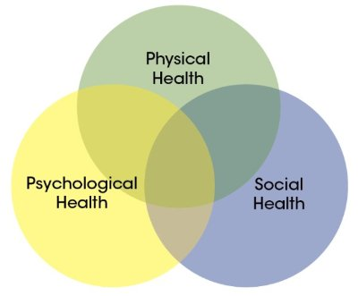
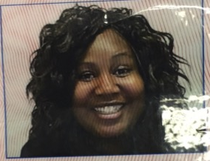
The Client

Slide 7
Ways of differentiating care
Cognitive Behavioural Therapy (CBT)
  More time to express depression, or anxiety
Home visits
CARGS/CATS
Reduce stigma
Adolescent clubs
Remunerate nurses,counsellors
Increase doctors at point of care

Slide 8
