Slide 1
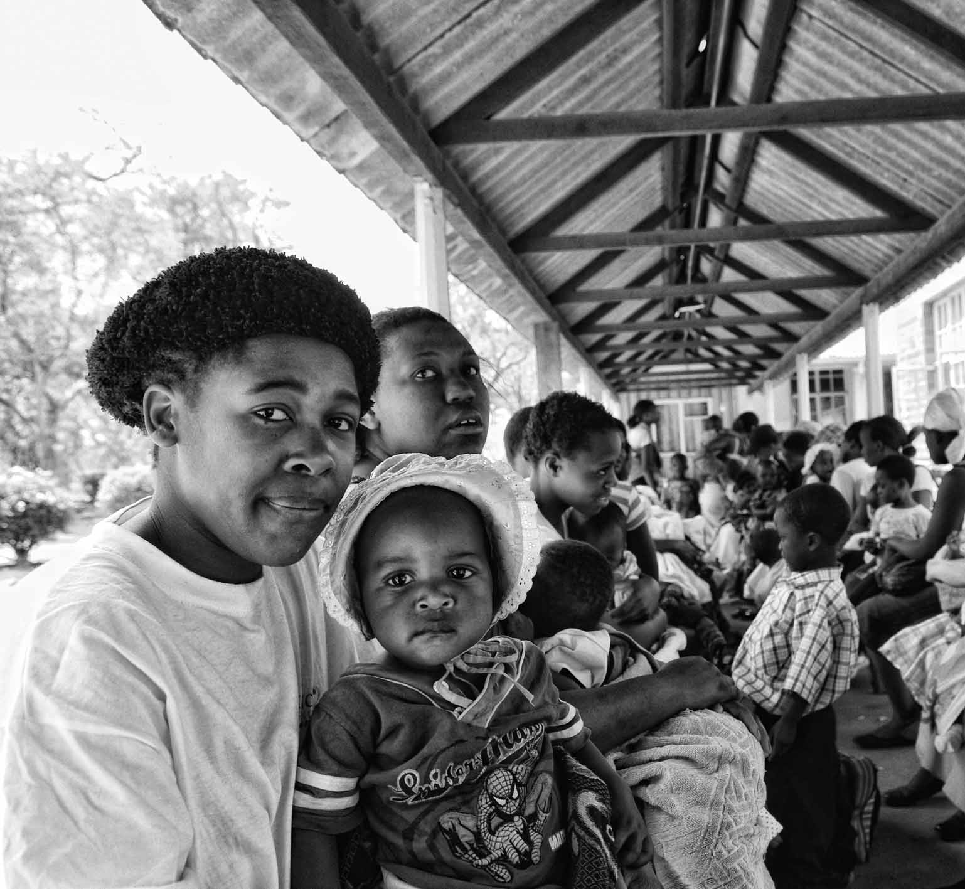
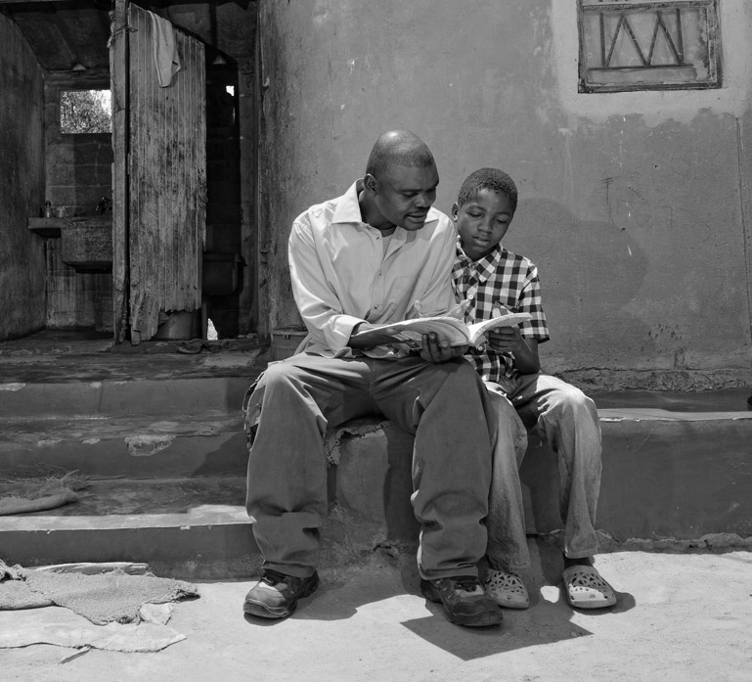
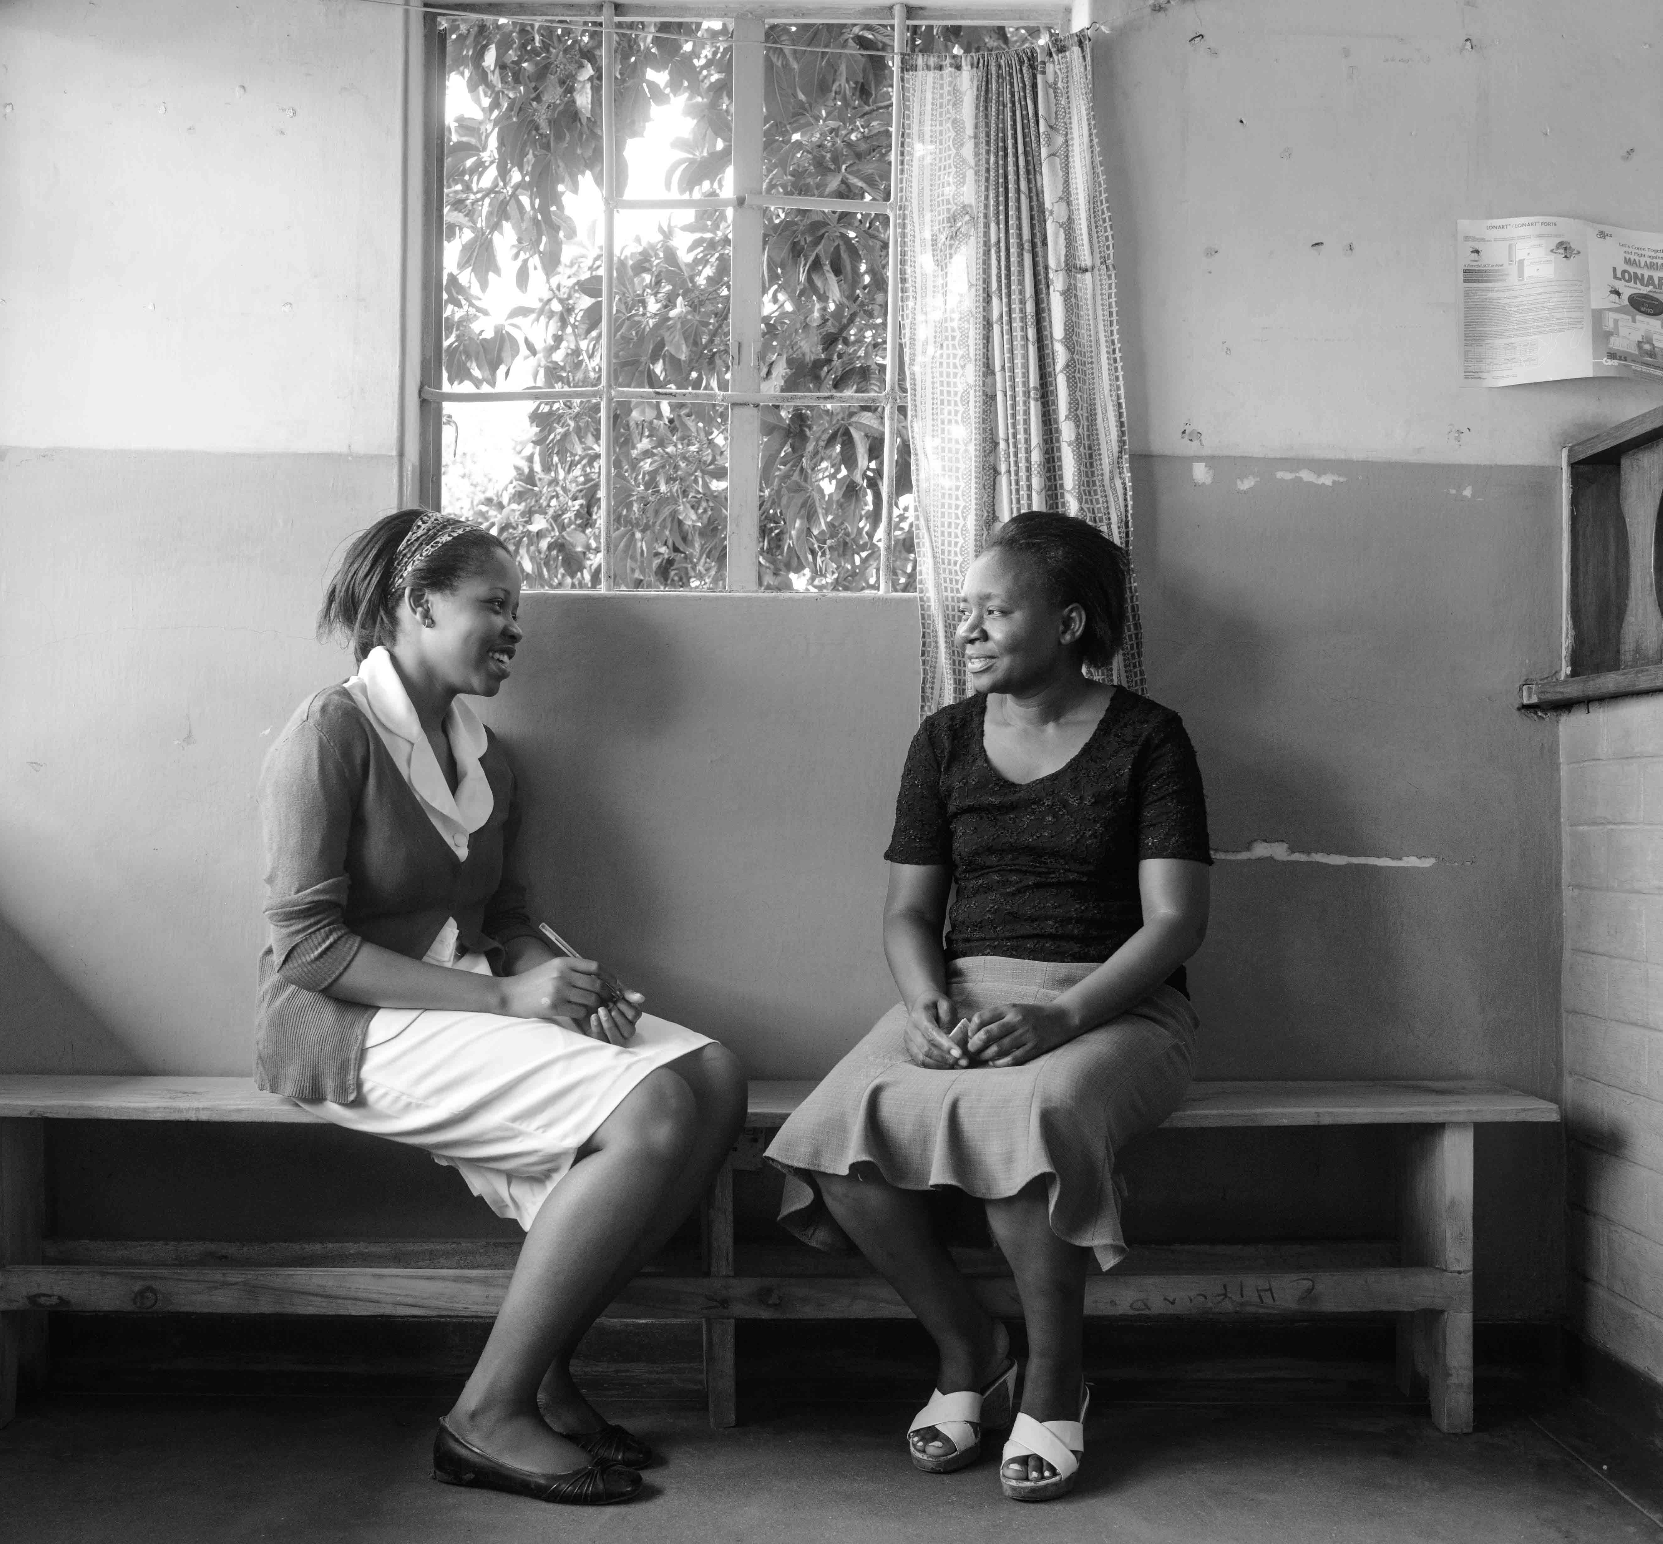
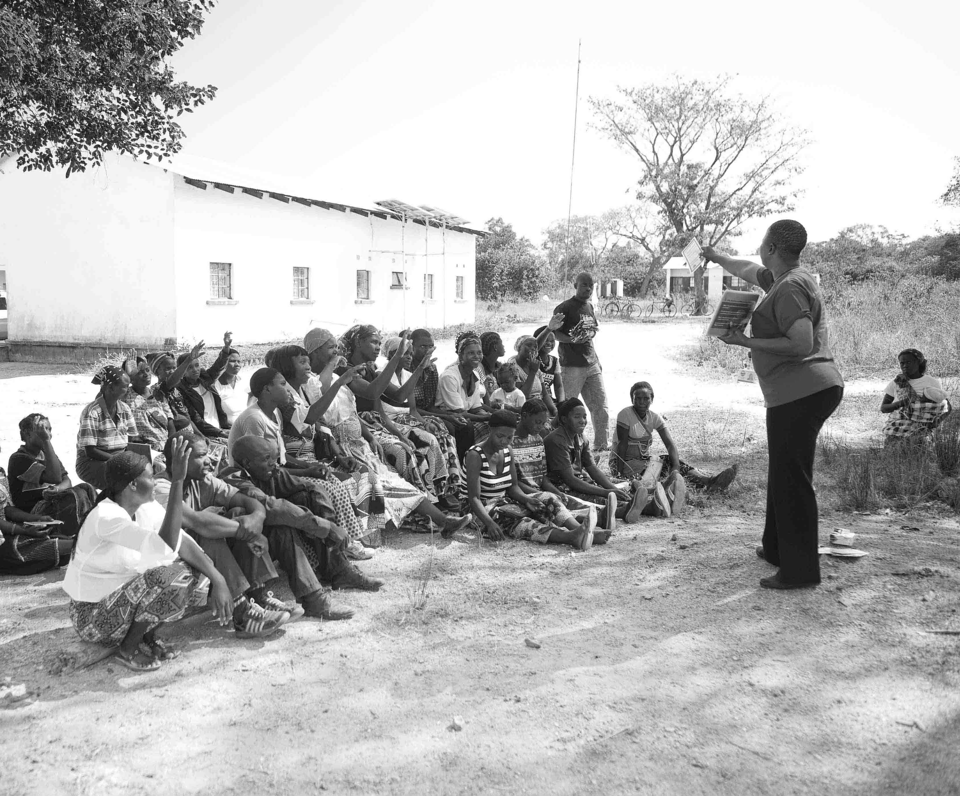


UNITAID PSI
HIV SELF-TESTING AFRICA
Costs and cost-effectiveness of HIV self-testing: findings from STAR
H Maheswaran, V Cambiano, T Sumner & F Terris-Prestholt

Slide 2
Presentation Overview
Cost-effectiveness of HIVST distribution models
Costs of HIV testing and HIVST
SPECTRUM: Human and financial resource planning for programme managers
Cost-effectiveness of introducing HIVST

Slide 3
Costs of HIV testing and HIVST
Costs of different HIV testing and HIVST models
Terris-Prestholt et al

Slide 4
Costing methods
Facility HIV testing & Community-based HIVST
  Malawi, Zambia, & Zimbabwe
Micro-costing/ingredients based costing
  Quantify all inputs to deliver HIV testing
  Assign appropriate monetary value to those inputs
  Financial & economic costs (incurred & donated)
  Includes capital and recurrent costs
Capital costs includes training, buildings, equipment & vehicles
Recurrent costs includes personnel, supplies & vehicle maintenance
Costs based on prevailing local market prices
2016 US Dollars
HIV testing service outputs
  PSI M&E database
  Facility HTS registers

Slide 5
HIV testing at health facilities
Mean cost per individual tested
Malawi: US$4.79
Zambia: US$4.24
Zimbabwe: US$8.79
Mean cost per HIV-positive individual identified
Malawi: US$77.25
Zambia: US$73.63
Zimbabwe: US$178.92.
Mwenge (2017), under review
Mwenge (2017), IAS MOPED1078

Slide 6
HIV self-testing
Mean cost per individual tested
Malawi: US$8.78 (2014 US$)
Zimbabwe: US$6.87-$9.24
Mean cost per HIV-positive individual identified
Malawi: US$97.50 (2014 US$)
Confidentiality of HIVST result
 | Zimbabwe 1 | Zimbabwe 2 | Zimbabwe 3 | Malawi 1
HIVST kits distributed | 12,026 | 16,347 | 12,588 | 15190
HIV-ST kit distribution - Males | 5,174 (43%) | 7,376 (45%) | 5,427 (43%) | 6,653 (44%)
Total HIVST intervention costs (economic) | $82,641 | $113,940 | $116,297 | $133,300
Cost per individual HIVST | $6.87 | $6.97 | $9.24 | $8.78
Mangenah (2017), IAS TUPED1242
Maheswaran (2016), BMC Medicine

Slide 7
Cost-effectiveness of community-based HIVST in Malawi
Cost-effectiveness analysis of HIVST delivery models
Maheswaran et al

Slide 8
Cost-effectiveness analysis
Cluster Randomised study of HIVST
  Trained lay volunteers
  Urban Blantyre (high HIV prevalence; sub-optimal HIV testing/ART coverage)
  (HIVST + Facility HTC) v (Facility HTC)
2010 (initiate at CD4<350 cells/μl) and 2015 (initiate all) WHO ART guidelines
Individual simulation model
  HIV transmission not modelled
  1 month cycle
  20 year Time Horizon
Incremental cost per QALY gained
2014 US and INT Dollars
3% Discount rate
MacPherson (2014), JAMA Choko (2015), PLOS Med
Maheswaran (2016), BMC Medicine Maheswaran (2017), JAIDS
Notes:
The model was a individuals sampling model
--With one month time cycles --- and a 20 year time horizon
I ran probabilistic sensitivity analysis to incorporate the uncertainty in the parameters used in the model.
And it underwent the common validation checks

Slide 9
Cost-effectiveness acceptability frontier
HIVST suited to an early HIV diagnosis and treatment strategy
Notes:
We can also show this on a Cost-effectiveness Acceptability frontier
This allows us to inform policy makers of whether the intervention is cost-effective at increasing values of willingness to pay for a gain in QALY.

Slide 10
Cost-effectiveness HIVST in Zimbabwe
Population level impact and cost-effectiveness of introducing HIVST
Cambiano et al

Slide 11
Cost-Effectiveness of HIVST in Zimbabwe
Aim: assess impact and cost-effectiveness of introducing HIVST considering different delivery models for distribution of HIVST and different target populations
  (HIVST + Facility HTS) v (Facility HTS)
  2ry distribution to partners of pregnant women (% self-testing in each year 40%);
  Pharmacy-based distribution (PBD) to people who had condomless sex (CLS) since last test (% of those eligible self-testing in each year 5%);
  Community-based distribution (CBD) to young people (Y, % of young people self-testing in each year 65%)
  CBD to female sex workers (FSW; % of FSW self-testing in each year ~40%),
  CBD to 25-49 adult men (AM; % of adult men self testing in each year 55%).
Setting: Zimbabwe
Model: including transmission, progression and effect of ART (HIV Synthesis) over 20 years
Factors taken into account: diagnostic accuracy of test kits; increase in % of population tested due to HIVST; reduction in the proportion of people resistant to testing; linkage to care following diagnosis; changes in sexual behaviour resulting from diagnosis

Slide 12
Findings
In settings with high levels of HIV status awareness
  Current levels of testing may not allow first UN 90 to be reached
  Additional strategies such as HIVST needed
  Interventions involving additional HIV tests (at the current costs) are unlikely to be cost-effective in Zimbabwe when using a Cost Effectiveness Threshold of $500/DALY averted.
  Higher levels of linkage into care does not substantially improve cost-effectiveness
  Low proportion of undiagnosed HIV key driver
Other testing approaches face similar challenges with meeting cost effectiveness
Scenarios likely to increase the cost-effectiveness of HIVST
  Introduction into settings with lower testing coverage
  more effective linkage of HIV-negative individuals to prevention (e.g. pre-exposure prophylaxis and VMMC)
  Lower cost of HIVST distribution

Slide 13
Spectrum model
Use-friendly tool for program managers
Sumner et al

Slide 14
Spectrum Modelling
AIM
    To incorporate HIV self-testing (HIVST) into the GOALS model
BACKGROUND
    GOALS is part of the Spectrum suite of tools produced by Avenir Health
    Used for national planning of HIV and TB response
    Make projections of the impact and resource use of a range of interventions
METHODS
    Simplified model of HIV testing (including HIVST)
    Integrated into GOALS structure
    Allow users to project impact of scale up of ST to different target groups
    Estimate infections and deaths averted
    Estimate test volumes and overall costs

Slide 15

Current GOALS inputs
ART coverage or number of ART initiations
Coverage of interventions (PrEP, community mobilization, condom provision etc)
Not sexually active
Sex workers and clients (high risk)
Multiple partners (medium risk)
Injecting drug users (IDU)
Stable couples (low risk)
MSM (can be split into 1-4 levels of risk)
Outputs
Future HIV incidence, prevalence and deaths
Infections and deaths averted
ART need and ART coverage
Volumes of PrEP, HIV tests etc
Costs by intervention
Costs by infection/death averted
Age stratified (15-49)
Gender stratified (M/F)
GOALS populations
Proposed testing module
User specifies:
Coverage and frequency of different testing modes (including HIVST)
Target groups for each testing mode
Linkage to confirmatory testing and care
Other interventions as before
HIV uninfected
CD4>500
CD4>500
GOALS HIV model
CD4 350-500
CD4 350-500
CD4<50
CD4<50
HIV-
HIV+
ART
SPECTRUM
Notes:
Current structure of GOALS allows users to specify ART initiations or coverage as direct input – based on country data, not a function of testing
Click
Red box illustrates where testing module could fit into GOALS structure
Would allow users to specify characteristics of testing (including HIVST) and would project number of tests and linkage to ART/other interventions

Slide 16
Summary
HIVST can be delivered at comparable costs to facility-based HIV testing services
Community-based HIVST may be cost-effective
  Low HIV testing and ART coverage
  Early diagnosis and treatment strategy
Cost-effectiveness at country-level uncertain
May need lower cost HIVST models
HIVST negative clients need to be linked to HIV prevention

