Slide 1
Differentiated service delivery:
Youth perspectives
Prosper Ndlovu
Wits Reproductive Health & HIV Institute (Wits RHI)
Johannesburg, South Africa
Differentiated Care Youth Champion
Notes:
I am here to tell you about the youth perspectives on differentiated ART delivery.

Slide 2
Conflict of Interest
“No conflicts of interest to declare”.

Slide 3
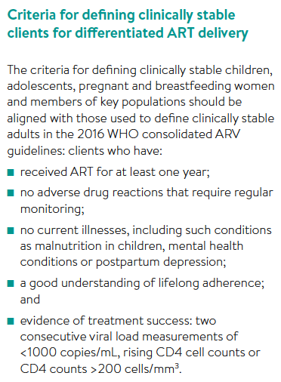


Adolescents now included!
Reference: WHO, CDC, PEPFAR, USAID, IAS. Key considerations for differentiated antiretroviral therapy delivery for specific populations: children, adolescents, pregnant and breastfeeding women and key populations. Geneva: World Health Organization; 2017
Notes:
We as the youth are very happy to hear that adolescents are now included in the definition of a stable client and can access differentiated ART delivery!
Differentiated care is essential for this group of stable adolescents if we wish to maintain their stable status and retain them in care, as in line with the 3rd 90.

Slide 4
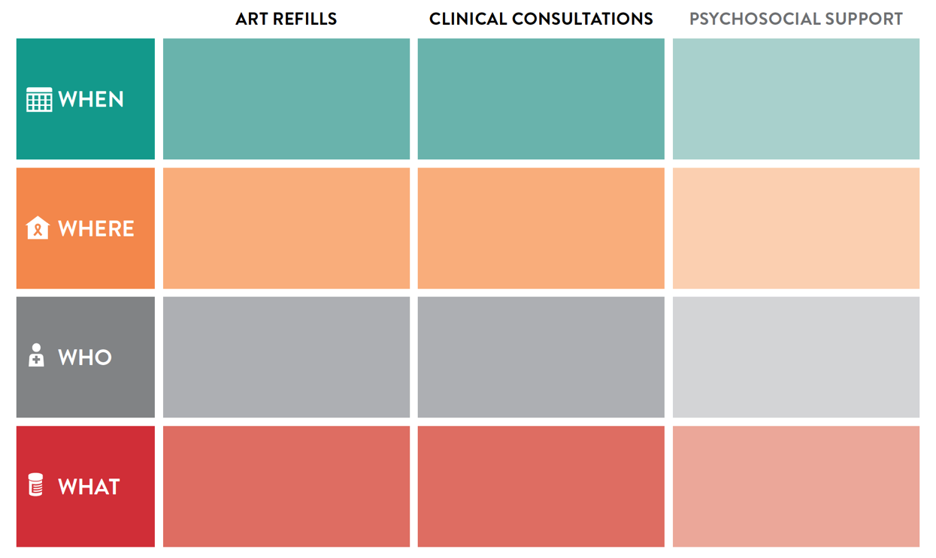
Building blocks for adolescents
3-6 monthly
3-6 monthly
Every 1-6 months
Primary health care,
out of facility
Primary health care,
Outreach
Primary health care,
out of facility, virtual
Nurse, midwife, clinical officer, doctor
Lay providers
Lay providers, peers
ART refill, referral check, adherence check
Adolescent clinical consultation, mental health assessment, lab tests, rescript
Peer group environment, referral check, onward disclosure support
Notes:
You have heard that WHO has set out its recommended building blocks for differentiated ART delivery models for stable adolescents.

Slide 5


Differentiated Care Youth Champions
Notes:
I am here to tell you what we the youth want – what building blocks look like from our perspective. We are 5 youth champions and we held 32 focus group discussions in 5 countries with 393 young people from diverse groups – not just our friends – we made sure that we spoke to different youth wit different circumstances.
They can also get a copy of the policy brief

Slide 6
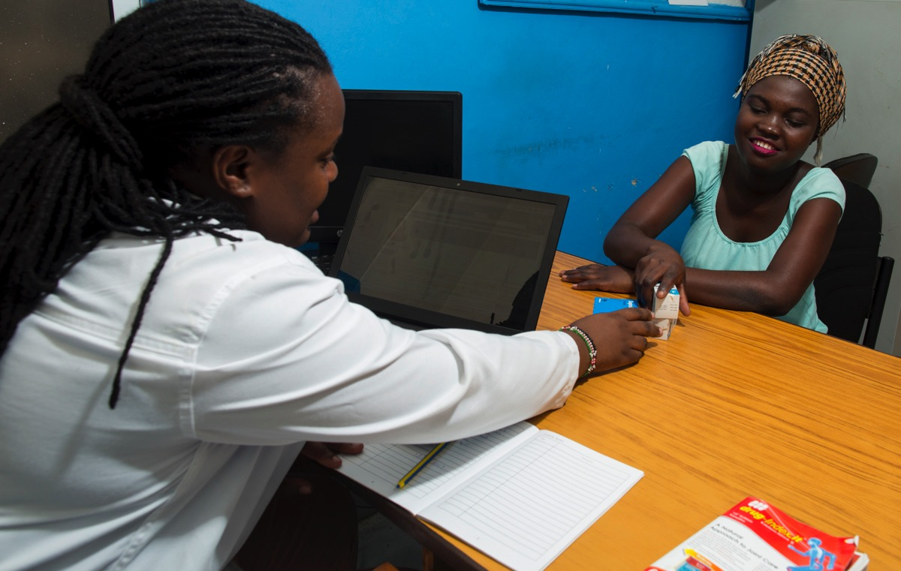
What WE want:
Clinical Consultation
Adolescent friendly services!
© Sydelle Willow Smith
Notes:
Well structured, young people want fewer clinic visits
Even if they only access the clinic 2x a year, based on FGD youth want the following:
Friendly nurses
Youth-friendly clinic environment
Shorter queues
Youth-only queues (don’t want to mix with adults)
Same colour clinical files or appointment cards as other patients (no differences based on illness) Youth don’t necessarily want to access care outside of the clinic due to fears of stigma, they just want a youth-friendly clinic.

Slide 7

What WE want:
ART refills
Aligned with school holidays, extended hours
© Sydelle Willow Smith
Notes:
3-6months in between refills may present a LTFU challenge in that adolescents who interrupt treatment or silent transfer will only be picked up after 3-6 months
Aligining ART refill dates with school terms and extending clinic hours will accommodate adolescents and better support adherence
3-6months in between refills may present a LTFU challenge
Also makes tracing more challenging
Rather consider quick, short, friendly 2 monthly ART refill visits

Slide 8

What WE want:
Psychosocial Support
Young people value peer support
© Sydelle Willow Smith
Notes:
Young people need time to trust and build bonds with healthcare providers and eachother, this can only happen if they meet frequently at fisrts, then consider every 2 or 3 months meeting
Psychosocial support must be integrated with clinical consultation and ART refill dates - To avoid frequent clinic visits, transport costs, time away from school etc.
Peer group psychosocial support is a must, no mixing with adults
Virtual support groups should be offered in between psychosocial support visits
mHealth messaging should also be considered to provide psychosocial support in between visits
Peer support is fundamental to psychosocial support of adolescents to expand social support network
6 monthly psychosocial support visits wont be as effective as 1-2 monthly

Slide 9


Looking ahead:
Realizing differentiated care for adolescents and young people
  Youth Friendly models exist
  Differentiated care approach should be used to support all adolescents and young people:
    Newly initiated on ART <6months and
    Not-virally suppressed
Notes:
YCCs – Prosper to elaborate
HCs – Prosper to elaborate
mHealth – Prosper to elaborate

Slide 10

Southern African HIV Clinician Guidelines:
Adherence to ART in adolescents and young adults
Launched at this conference!

Slide 11
Southern African HIV Clinician Guidelines:
Adherence to ART in adolescents and young adults
Inclusive of adolescents and young people (10-24 years of age)
Building blocks for who/what/where/when for clinically stable and unstable, as well as newly initiated
Guidelines also for pregnant and/or breastfeeding adolescents and young adults, key populations and adolescents and young adults with disability
Chapter on transition to adult care

Slide 12
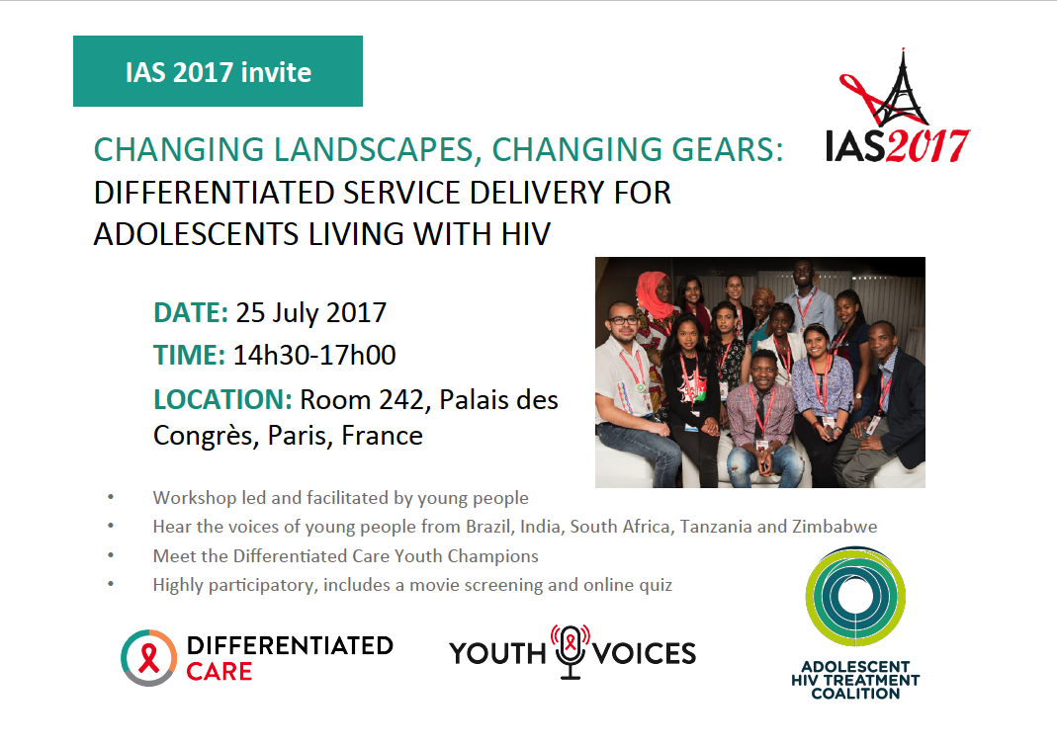

Slide 13
Thank you!

