Slide 1
Differentiated service delivery for key populations: key considerations from a policy perspective
Virginia Macdonald,
HIV Department
World Health Organization

Slide 2
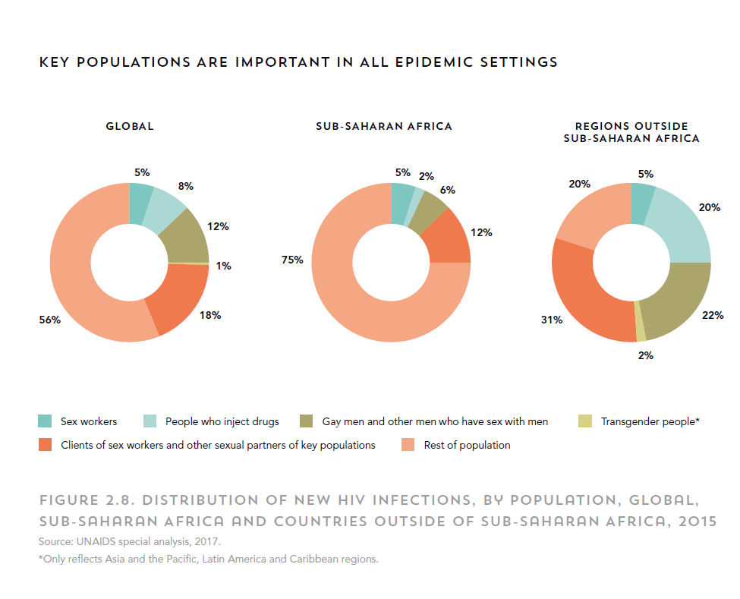
Notes:
Describe definition of KP
We include prisoners too

Slide 3
Structural determinants influence HIV risk
“When you go to visit the hospital, they will not attend to you. In fact I hate going to such hospitals. I do self-treatment from home and I usually use tablets. You know I feel ashamed. I will visit the hospital and everybody will despise me. It is the way female health workers treat me, they make me feel angry and resentful to seek treatment. That makes me feel ashamed. Everybody looks at you. You feel you are not part of the society”
(Transgender woman, HIV-positive)*.
Criminalisation of behaviours
Punitive, restrictive policies
Stigma
Violence
Human rights abuses
Reduced access to prevention, testing and treatment services
Inconsistent condom or needle/syringe use
Increased risk of HIV infection
Poor health outcomes
*
Adapted from Shannon K, Strathdee SA, Goldenberg SM, et al. Global epidemiology of HIV among female sex workers: influence of structural determinants. Lancet 2014; 385: 55-71
Notes:
One in five men who have sex with men in South Africa, Botswana, Malawi and Namibia report that they are afraid to seek health services, almost half had experienced human rights abuses [6]. A survey of almost 2000 female sex workers in Cameroon found that most had experienced violence and this was associated with fear of health services and mistreatment in a health centre, as well as inconsistent condom use [7].
Talk about additional stigma associated with being a KP – and being more than one KP
Barriers to meeting initiation and adherence to ART include stigma and discrimination, criminalisation, violence and makes it difficult for KP to meet criteria for ”stable patients” even though they would benefit from the type of DSD recommended for stable patients
King R, Barker J, Nakayiwa S, Katuntu D, Lubwama G, Bagenda D, et al. (2013) Men at Risk; a Qualitative Study on HIV Risk, Gender Identity and Violence among Men Who Have Sex with Men Who Report High Risk Behavior in Kampala, Uganda. PLoS ONE 8(12): e82937. doi:10.1371/journal.pone.0082937

Slide 4
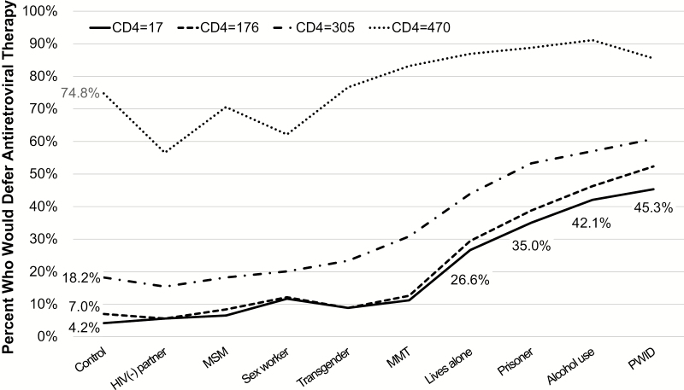
Despite supportive policy, key populations excluded from treatment
Ferro, Culbert et al Physician Decisions to Defer Antiretroviral Therapy in Key Populations: Implications for Reducing Human Immunodeficiency Virus Incidence and Mortality in Malaysia Open Forum Infect Dis 2017 Jan25;4(1)
Notes:
Say something about sensitisation and stigma reduction / can improve expertise and attitude, this can also address barriers to accessing facility based services

Slide 5
UNAIDS 2016 Global estimates: % of PLHIV diagnosed
Adapted from: Risher K et al HIV treatment cascade in MSM, people who inject drugs, and sex workers. Curr Opin HIV AIDS. 2015 Nov;10(6):420-9; Shaw et al Achieving 90-90-90 in the WHO Eastern Mediterranean region: key issues for people who inject drugs (2017) Presented at IAS Conference, Paris; UNAIDS, Global AIDS update 2017

Slide 6
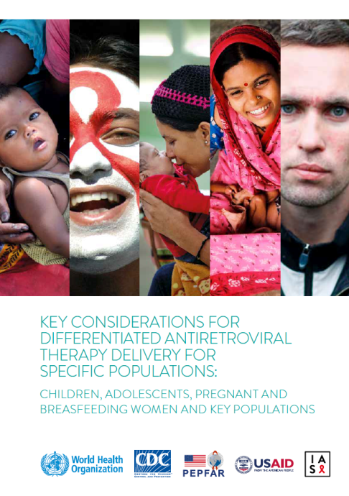
Key considerations for differentiated ART delivery

Slide 7
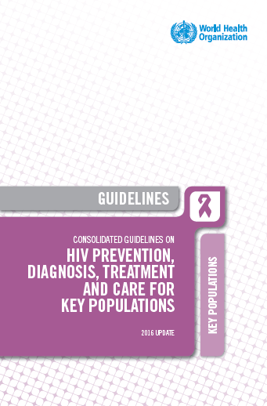
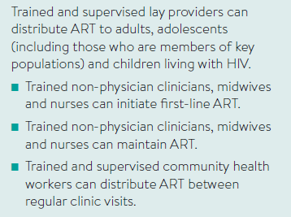
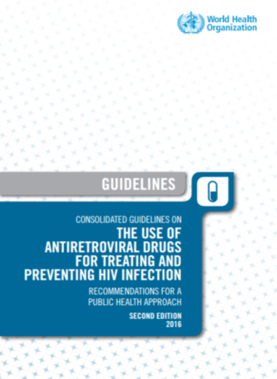
Task shifting for ART delivery

Slide 8
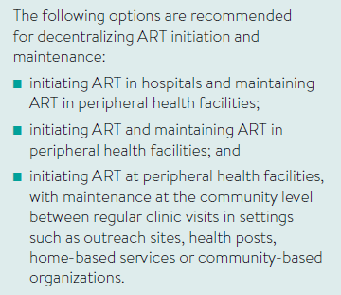
Decentralising ART delivery
In settings where opioid substitution therapy is provided, ART should be initiated and maintained in people who are eligible for ART

Slide 9
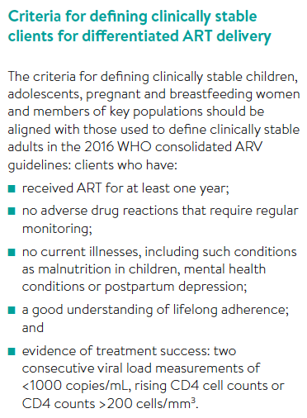
Clinically stable key population members are no different from other clinically stable adults and adolescents
Specific considerations for people who use drugs
Everyone living with HIV who uses drugs should be offered HIV treatment and active drug use should not exclude enrolment ART
Some people may require additional support
As with all other adults and adolescents receiving ART, the decision to reduce clinic visits should be made on a case-by-case basis
ART should be offered at OST clinics – strong evidence base

Slide 10
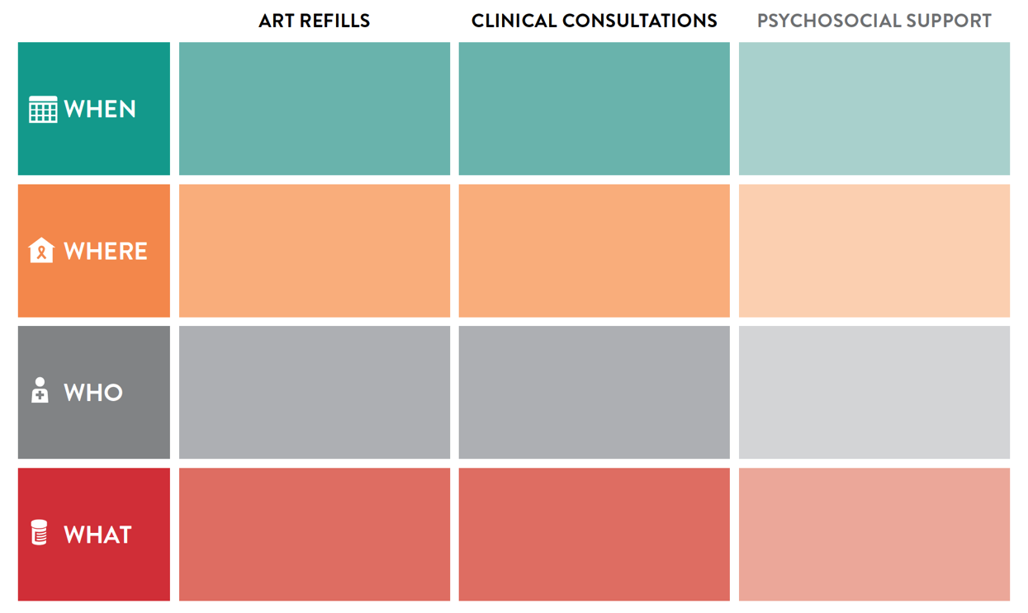


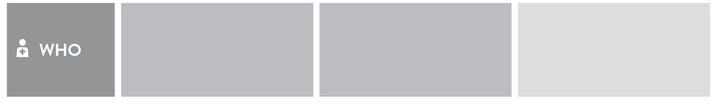

3-6 monthly
3-6 monthly
Every 1-6 months
Primary health care
Community-based organizations,
OST clinics
Prison or other closed setting
Primary health care
Community-based organizations
OST clinics
Prison or other closed setting
Primary health care
OST clinics
Community based organizations
Prison or other closed setting
Phone hotlines
Lay providers
Peers
Peers navigators
Outreach workers
Nurses
Clinical officer
Doctor
(can be seconded to CBOs or through scheduled visits)
Social workers
Lay providers
Peers
Peer navigators
Outreach workers
ART refill
Referral check
Adherence check
Comprehensive services Prevention, including harm reduction
Clinical consultation
Lab tests, rescript
Comprehensive services
Prevention, including harm reduction
Support after release from prison
Peer support
Legal support
Responding to violence
Support after release from prisons
Social interventions
Psychological interventions
Notes:
Say something about sensitisation and stigma reduction / can improve expertise and attitude, this can also address barriers to accessing facility based serviced

Slide 11
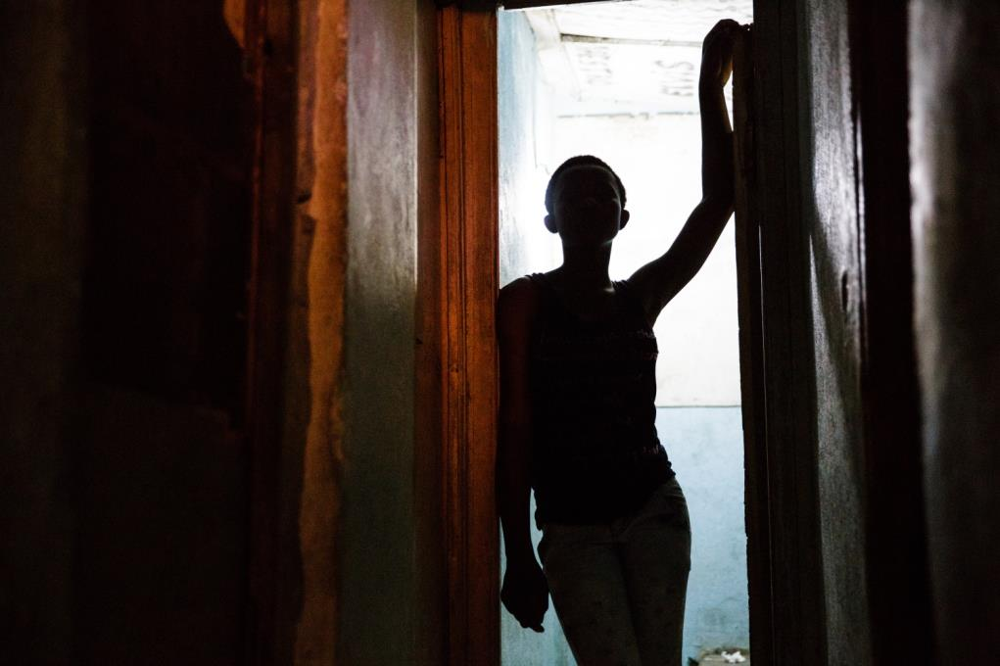
Differentiated service delivery: for inclusion not exclusion
Notes:
How can DSD address structural and other issues, improve retention and uptake etc.
Focus for ke
Differentiated care can address inequities in key population access to HIV treatment services through the development of new ART delivery models that meet the specific needs of key populations, and potentially reach marginalised, criminalised and stigmatised populations.
Differentiated ART delivery can also allow greater involvement of key population communities in HIV treatment and care.
y pops shouldn’t just be on prevention – they also may need a differentiated approach to ART delivery

Slide 12

Looking ahead
Implementation with evaluation
More consideration of “non-stable” clients
Develop of frameworks for:
  Differentiated service delivery for key populations
  Differentiated HIV testing services

