Slide 1
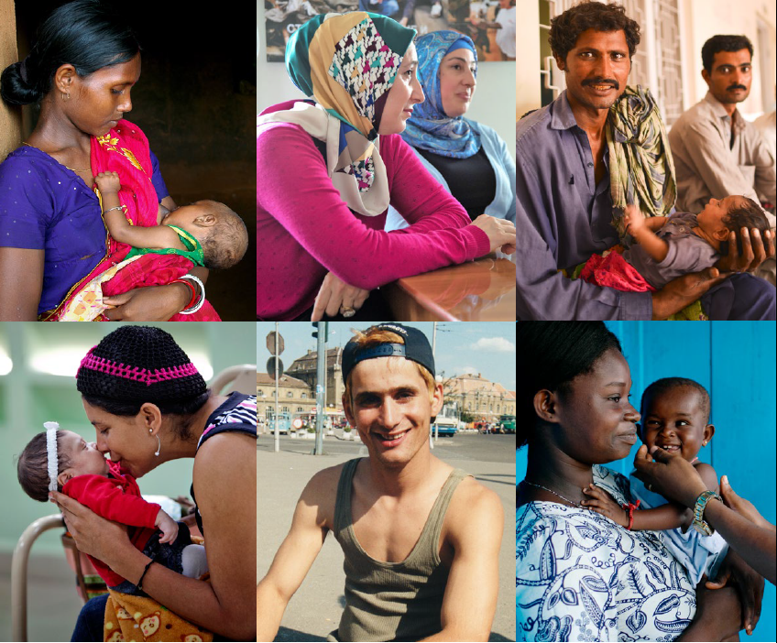
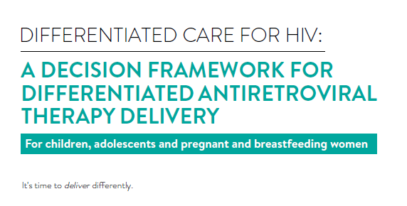

Lynne Wilkinson
IAS

Slide 2

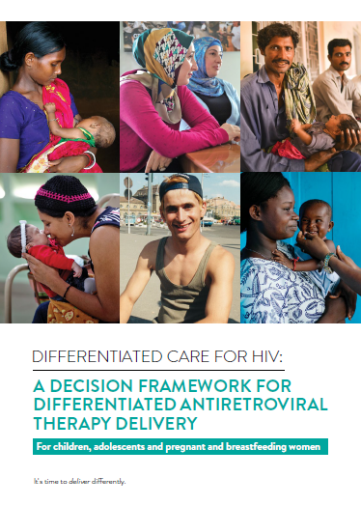
Global Guidance & Evidence
But how do you implement?
Scaled country implementation
Global guidance & evidence

Slide 3
Objective
Principles of differentiated care & ART delivery for these specific populations
Guidance on how to adapt or build for ART delivery models for children, adolescents & pregnant or breastfeeding women and their infants (PBFW)
Children/adolescent/PBFW case studies

Slide 4
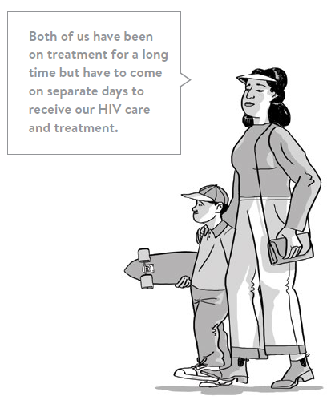
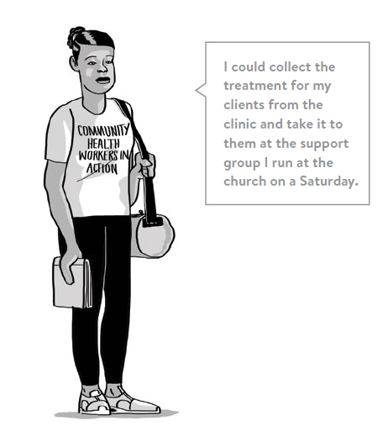
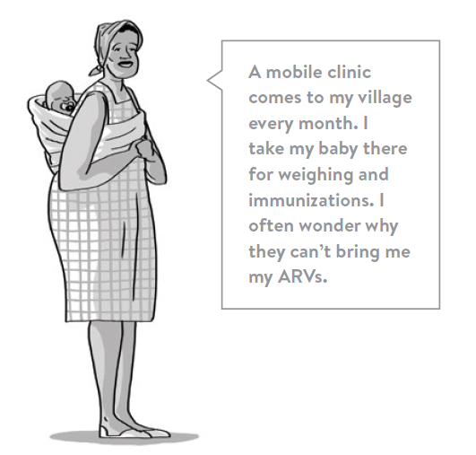
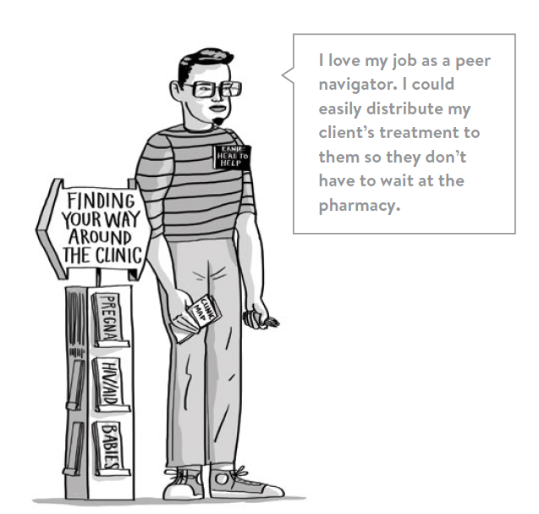
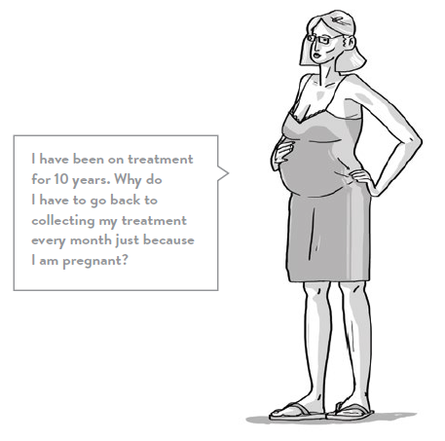
Principles
Client centred care
Health system efficiency
A family centred approach
Integration of services
Leveraging and encouraging psychosocial support

Slide 5
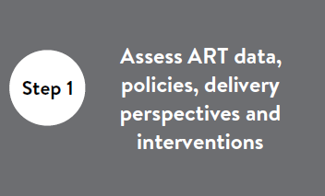
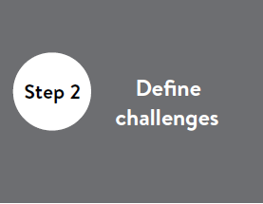
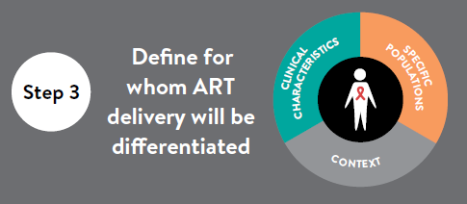
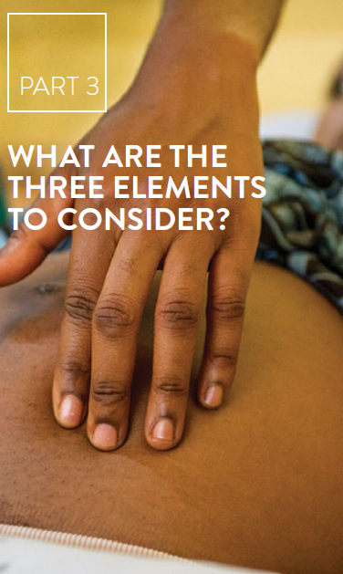

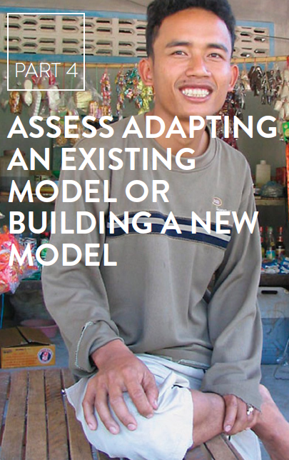
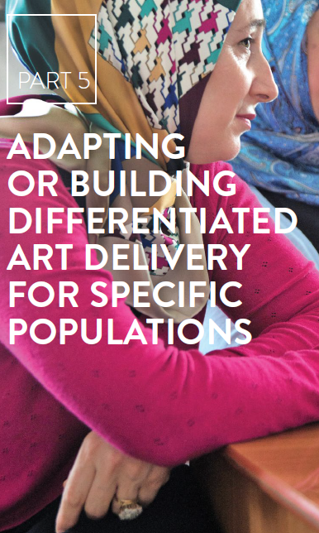
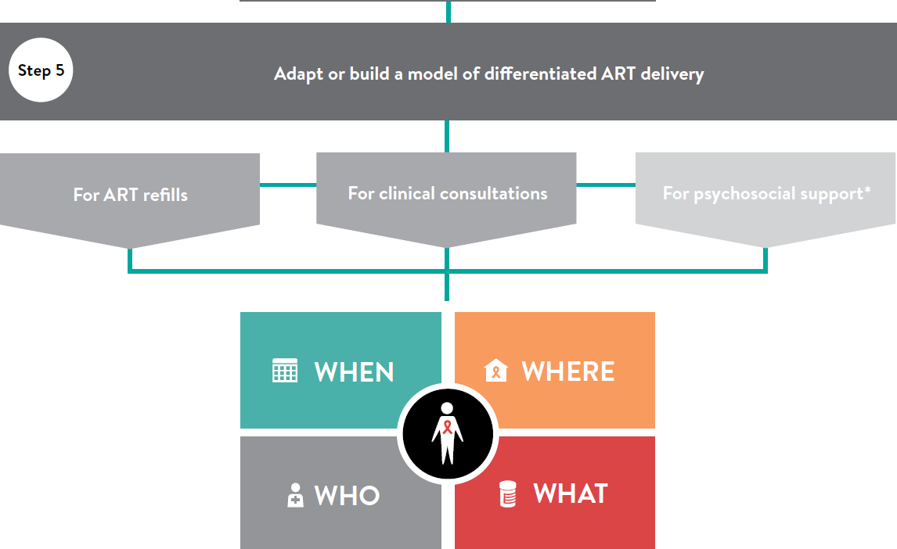
5-step approach

Slide 6
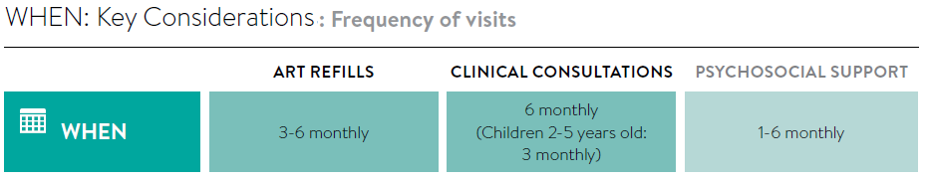




Example: When building block
2017 WHO Key Considerations:
2. What to plan:

Slide 7
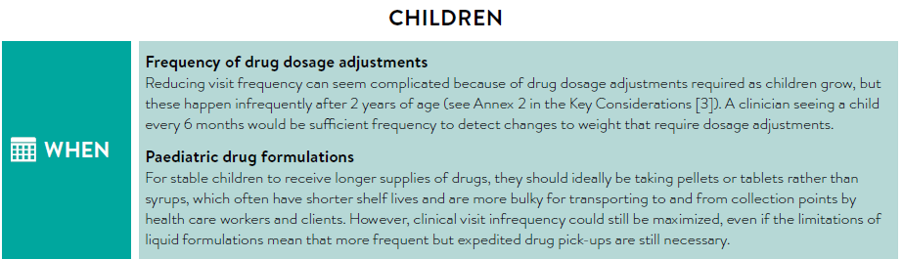
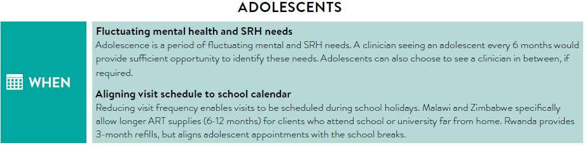
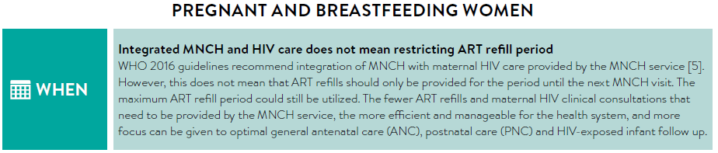
3. Specific considerations for each population

Slide 8
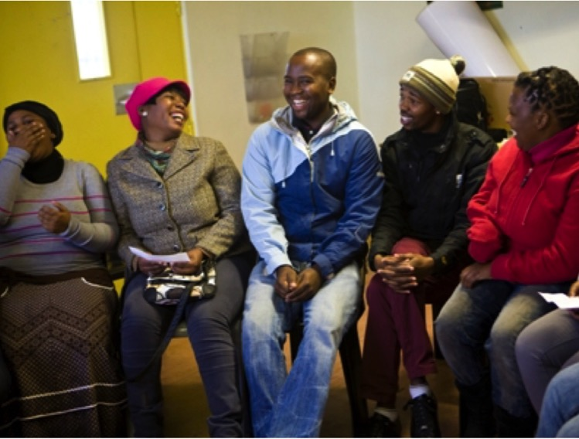
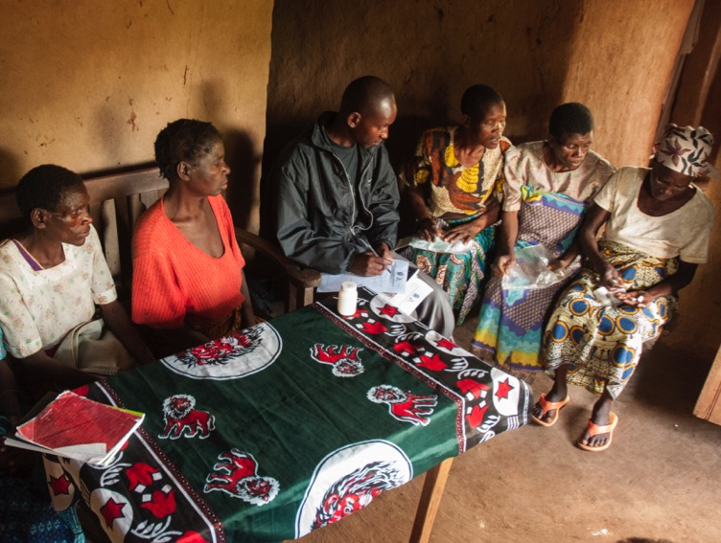
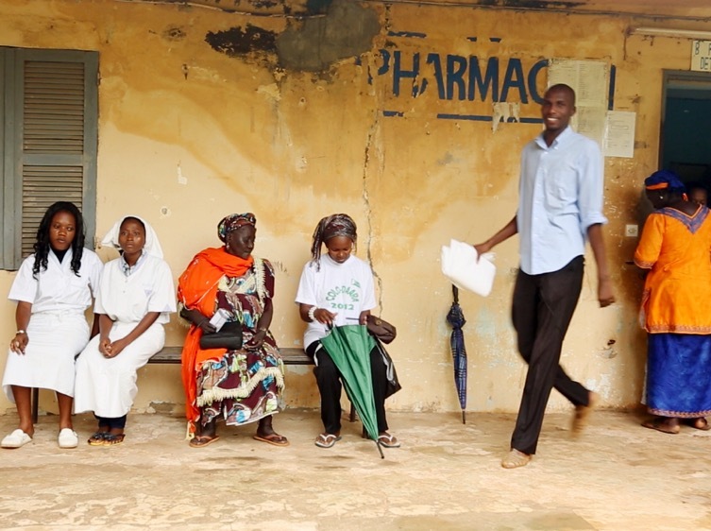
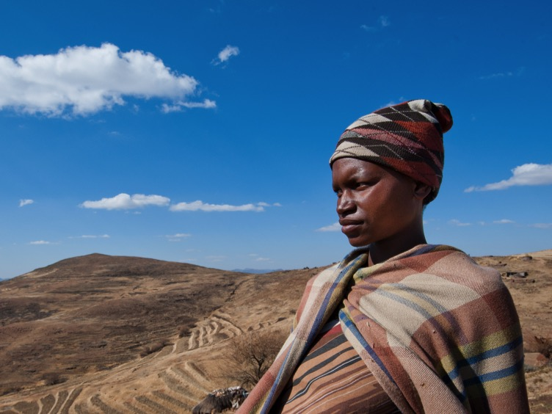
Case studies
Family, youth & post-natal clubs
Family ART refills &
adolescents integrated into adult CAGS
Health care worker-managed group
Client-managed group
Fast track ART refill collection at facility
Out of hours specific family population ART service
Outreach
Fixed community ART refill distribution
Home ART delivery
Facility-based individual
Out-of-facility individual

Slide 9
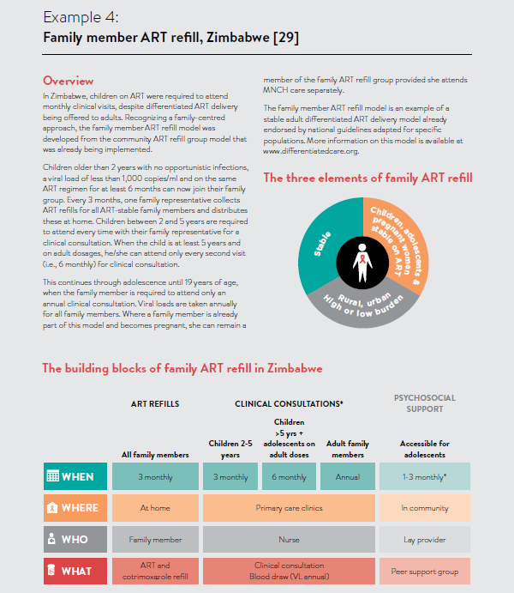
Description
Elements
Building blocks

Slide 10
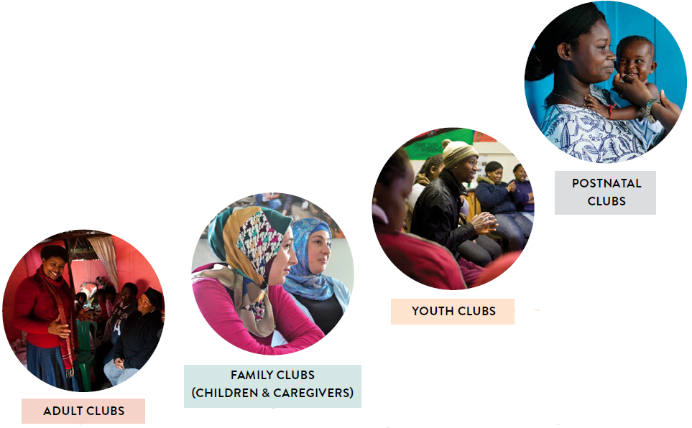
Adaption case studies:
South Africa adult adherence club model

Slide 11
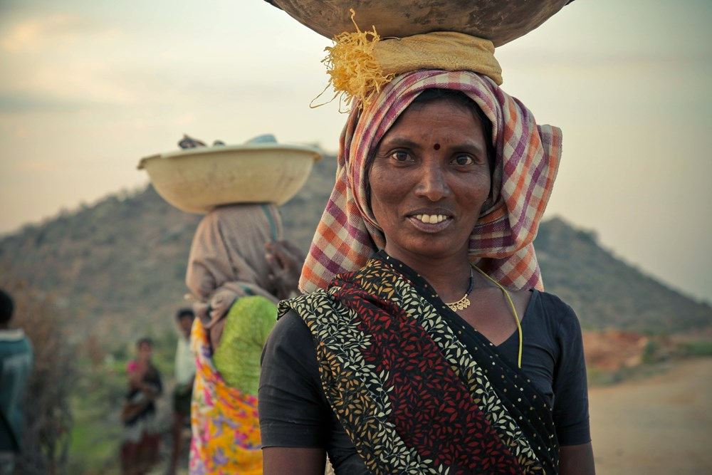

Online knowledge repository
www.differentiatedcare.org
Global and country guidance
ART delivery model examples & tools
Published evidence & resources

