Slide 1

Closing comments
Peter Ehrenkranz
Bill & Melinda Gates Foundation

Slide 2
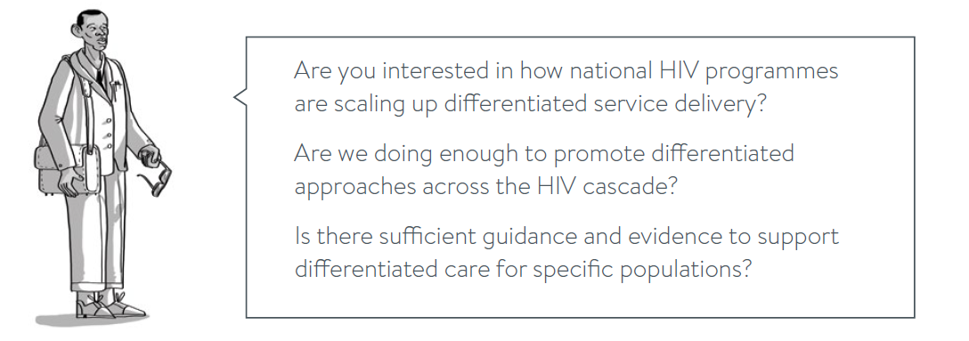
Our initial questions…

Slide 3
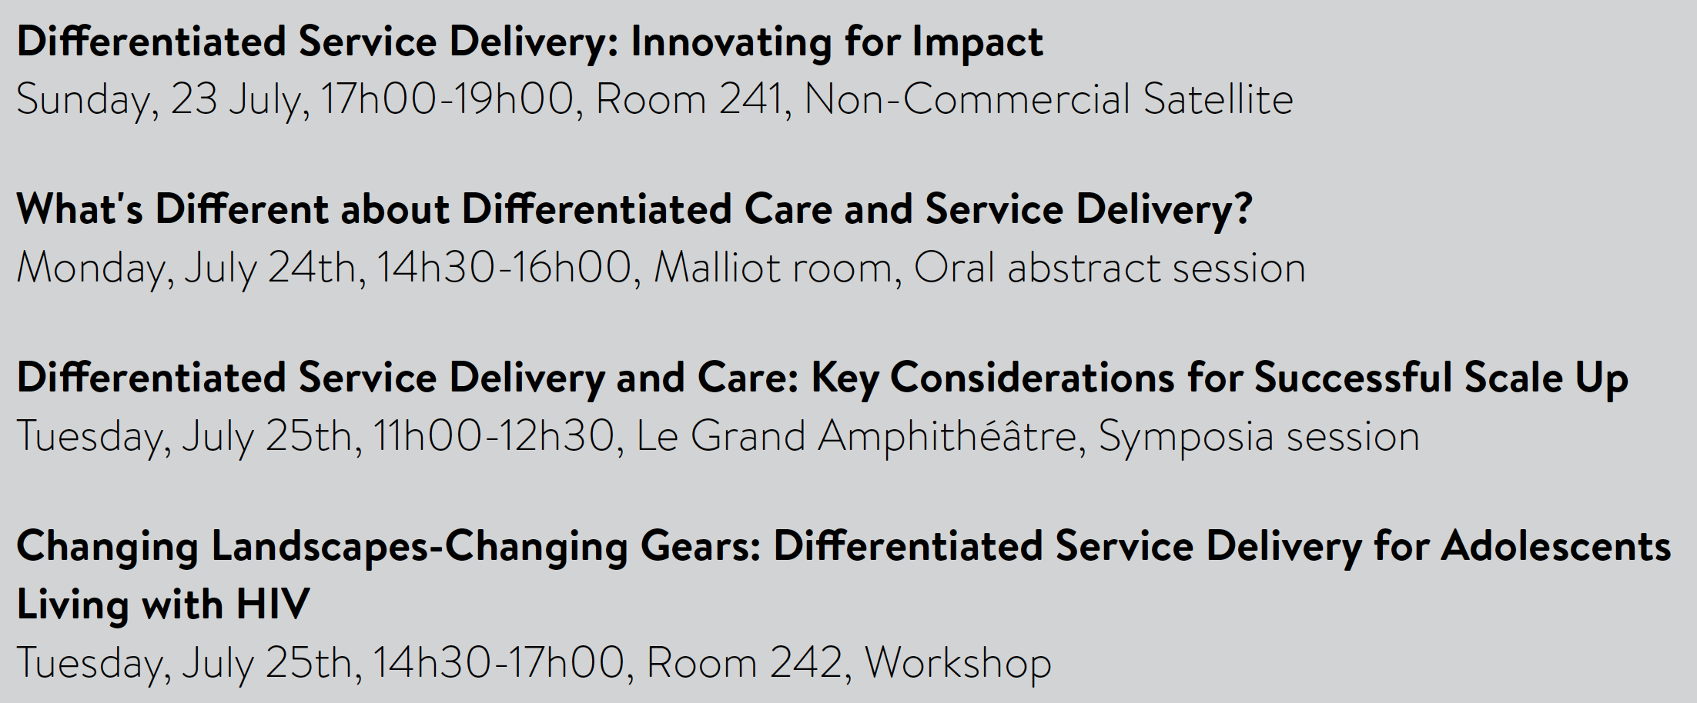
Upcoming Differentiated Care Events at IAS 2017
Check the Differentiated Service Delivery “roadmap” on the IAS 2017 mobile app

Slide 4


Slide 5


Visit www.differentiatedcare.org
for tools, resources and more.

Slide 6

JIAS supplement,
Differentiated care & HIV
Available now -
www.jiasociety.org
12 articles, including:
  9 research articles, 1 review, 1 commentary and an editorial

Slide 7

Differentiated care flash drives
Differentiated care resources released at IAS 2017
  Key Considerations
  Families Decision Framework
  JIAS supplement
Implementation support resources
Resources from www.differentiatedcare.org
Resources from and for people living with HIV
Notes:
Differentiated care resources released at IAS 2017
Key Considerations
Families Decision Framework
JIAS supplement
Implementation support resources
Resources from www.differentiatedcare.org
Resources from and for people living with HIV

