Slide 1

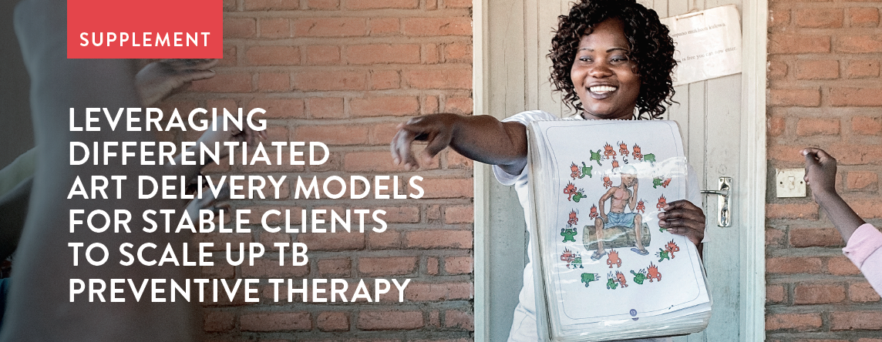
Leveraging differentiated ART delivery models to facilitate contraceptive care and TPT completion
ICASA 2019 satellite
Helen Bygrave, IAS
4 December 2019

Slide 2

Why is this important?
1. Push to increase TPT uptake
2. Scale-up of differentiated ART delivery models
4x
Target: TPT courses completed (FY19) compared with past achievement
Clients in differentiated ART delivery models have less frequent clinical visits and may be excluded for accessing TPT
DSD models for clinically stable clients may provide an opportunity to make sure clients have initiated and completed TPT successfully
22 PEPFAR-Supported Countries
Source: Adapted from Tomlinson, IAS 2019

Slide 3
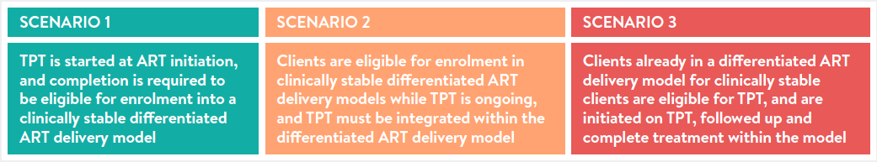
Three scenarios for integration of TPT in DSD models
Briefer gives example for each of these scenarios

Slide 4
Key questions when considering TPT and differentiated ART delivery models
Should TPT completion be part of eligibility criteria for stability to access differentiated ART delivery for clinically stable clients?
Can the duration of TPT refill be adapted to align with the ART refill and facilitate integration within differentiated ART delivery for clinically stable clients?
Can the TPT refill duration be aligned for all members on TPT in a group differentiated ART delivery model for clinically stable clients?

Slide 5
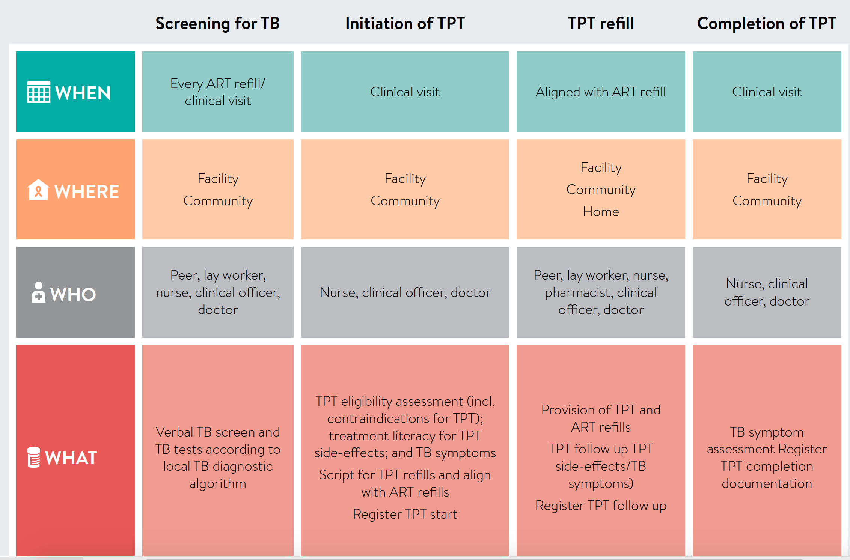
The building blocks of TPT integration in DSD

Slide 6


In group models, alignment of group members to receive TPT together may support adherence and completion through peer support
TPT refill = ART refill
Wherever possible, the duration of TPT refills should be aligned with the duration of ART refills

Slide 7
Are there policy barrier to decentralising the components of TPT to primary care or the community
Are there policy barriers to task share the components of TPT

Slide 8
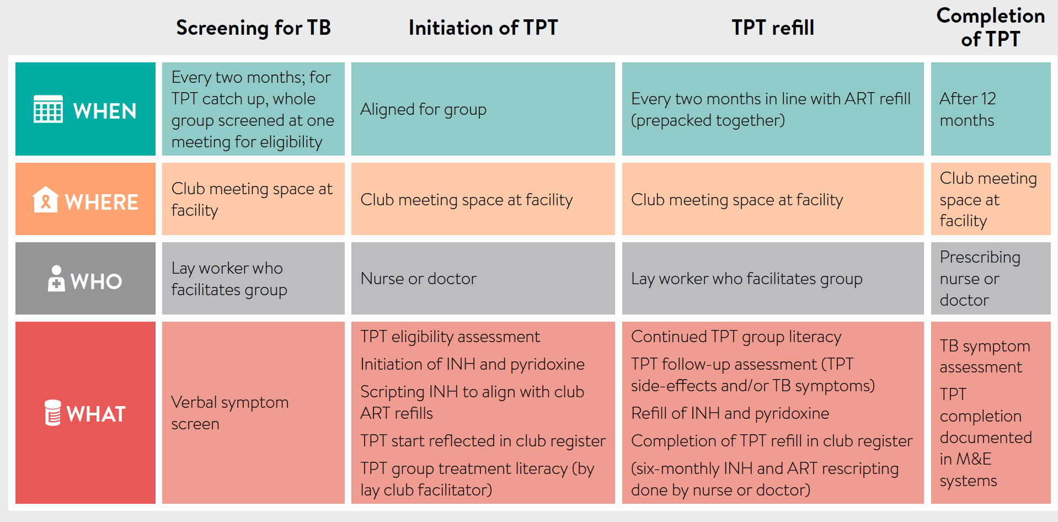
Example 1:
TPT in adherence clubs

Slide 9
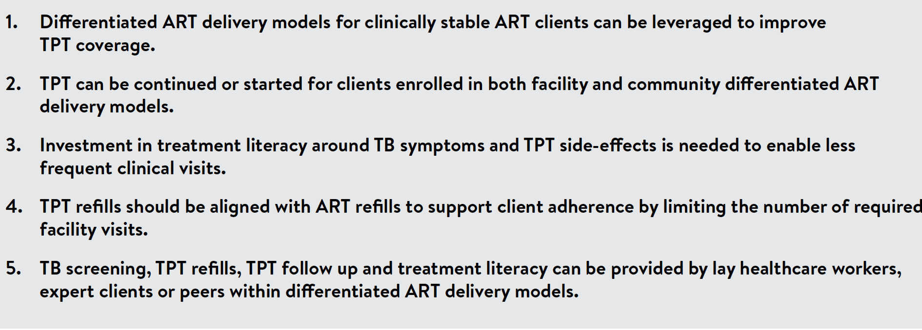
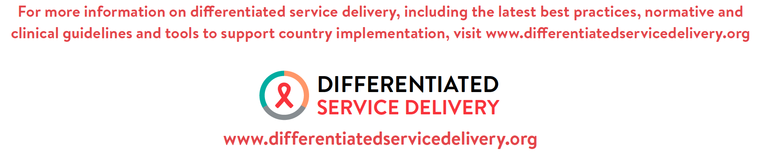
Key takeaways for the integration of TPT in differentiated ART delivery models for clinically stable clients

