Slide 1
Community-led monitoring of programs and policies related to HIV, tuberculosis and malaria
A guide to support inclusion of community-led monitoring (CLM)
in funding requests to the Global Fund
The full guide can be found online at https://bit.ly/clm_guide
Notes:
The full Guide can be found online at https://www.differentiatedservicedelivery.org/Resources/Resource-Library/CLM-guide-GF-funding-requests

Slide 2
Contents
About this guide
About Global Fund funding in 2023–2025
How to use this guide
Describing CLM within the Global Fund’s Modular Framework
Making the case for CLM as a priority
Describing CLM costs and budgets
Summarizing CLM in the Global Fund Funding Request form
Annexes

Slide 3
Abbreviations
CCM Country Coordinating Mechanism
CLM Community-led monitoring
CRG Community Rights and Gender (Global Fund)
CSS Community systems strengthening
GAC Grant Approvals Committee
RCM Regional Coordinating Mechanism
RSSH Resilient and sustainable systems for health
TB Tuberculosis
TRP Technical Review Panel (Global Fund)

Slide 4
About this guide
This guide is intended to support the inclusion of community-led monitoring (CLM) in funding requests to the Global Fund to Fight AIDS, Tuberculosis and Malaria and related country and regional consultations, dialogues and strategy documents.
    Intended audiences
    • Community-led and community-based organizations who want to propose CLM concepts, plans and budgets to Country Coordinating Mechanisms (CCMs) and Regional Coordinating Mechanisms (RCMs) for Global Fund funding
    • Funding request writing teams of CCMs and RCMs who want to understand how to include CLM in funding requests
    • Other stakeholders working to support CLM, including government managers, technical partners, international funders and advocates
The full guide can be found online at https://bit.ly/clm_guide

Slide 5
Rationale
Country programs focused on HIV, tuberculosis and malaria face continuing challenges of service quality, commodity supply and distribution, and human rights barriers for key and vulnerable populations.
The Global Fund 2023-2028 Strategy describes CLM as a priority evidence-based intervention to improve programs and policies in efforts against HIV, tuberculosis and malaria. The Global Fund has also posted updated guidance, templates and application materials to encourage country and regional partners to include CLM in funding requests.
In accordance with its Modular Framework, the Global Fund invites countries and regions to include CLM in all funding requests, including those focused on HIV, tuberculosis, malaria or resilient and sustainable systems for health (RSSH) or a combination of these.

Slide 6
About Global Fund funding in 2023–2025
In 2022, the Global Fund launched its 2023-2025 funding cycle.
Starting in July 2022, the Global Fund posted key application materials, information notes and technical briefs to support partners in developing funding requests.
In December 2022, the Global Fund will inform CCMs and RCMs of available allocations and proposed splits by disease component for each country and/or region. The Global Fund will also inform CCMs and RCMs about windows for submitting funding requests and eligibility for catalytic investment (matching funds, strategic initiatives and multi-country approaches).
During 2023 and 2024, CCMs and RCMs will develop and then submit funding requests to the Global Fund for review by the Global Fund Technical Review Panel (TRP) and subsequent approvals by the Grant Approvals Committee (GAC) prior to grant making and starting implementation.

Slide 7
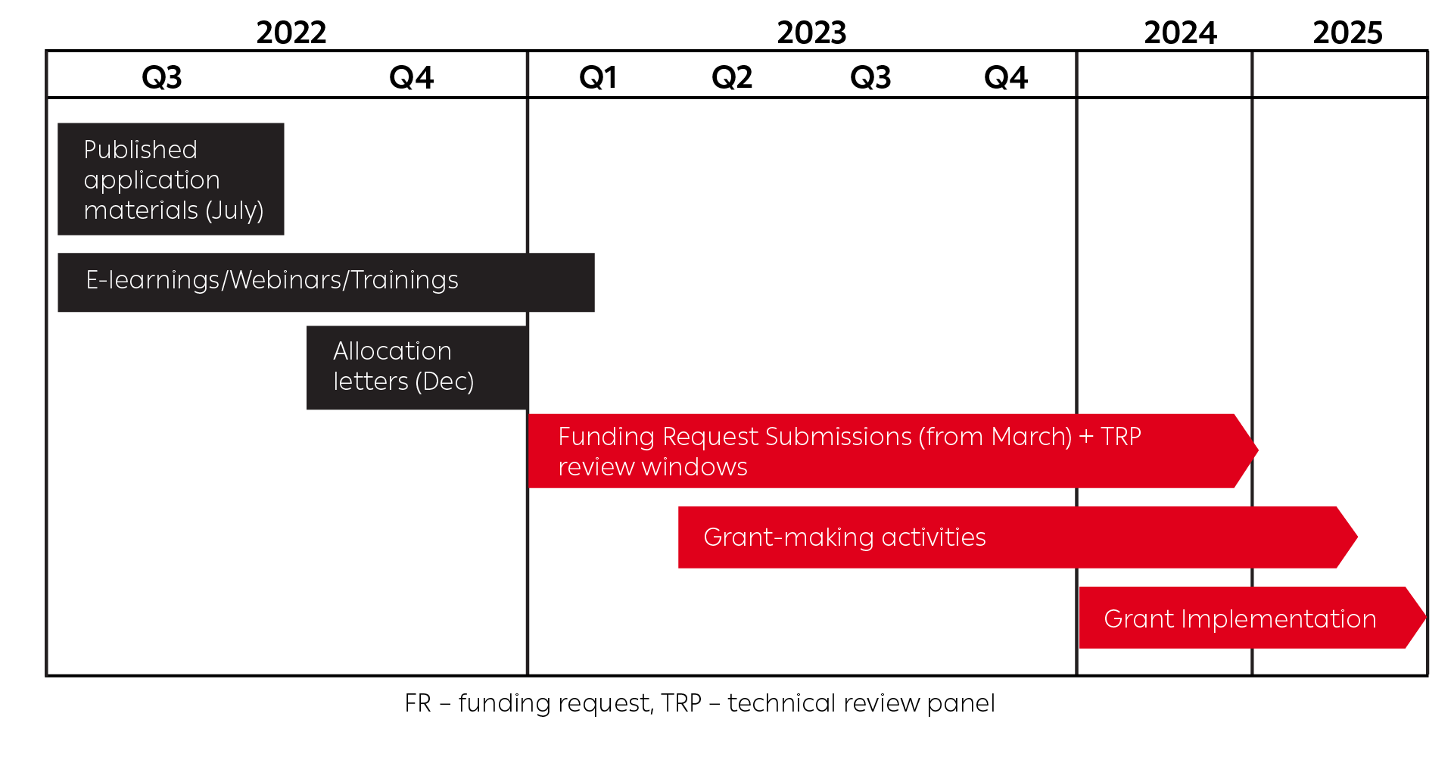
Timeline of Global Fund funding

Slide 8
How to use this guide
CLM implementers and other country and regional stakeholders have several opportunities during the Global Fund 2023-2025 funding process to ensure that their priorities and needs are reflected and included in funding requests and associated budgets:
Before developing a funding request, CCMs and RCMs will organize consultations and dialogues to identify funding priorities. Additional dialogues and reviews can also be organized about the design, implementation, evaluation and funding of community-based and community-led interventions. CLM can be raised as a priority in these dialogues.
During 2023-2025, writing teams will be appointed by CCMs and RCMs and tasked with the development of funding requests. As they write, they may need detailed information about proposed CLM approaches, CLM costs and intended outcomes. CLM implementers can seek to establish contact with these writing teams to provide information when and as needed.
The full guide can be found online at https://bit.ly/clm_guide

Slide 9
How to use this guide
CLM implementers and other stakeholders working to support CLM can use this guide to: | Members of CCMs and RCMs and assigned funding request writing teams can use this information to:
Make the case for CLM as a priority in consultations and dialogues organized by CCMs and RCMs and in reviews of program gaps and priorities. | Document evidence of CLM as a priority in the “Country Dialogue Narrative”, “RSSH Gaps and Priorities Annex” and the “Funding Priorities of Civil Society and Communities Annex”.
Describe CLM costs and budgets. | Include CLM costs in summary funding request budgets and subsequent detailed budgets developed during the grant-making process.
Describe CLM for inclusion in funding requests using the Global Fund’s Modular Framework and application materials. | Describe CLM in funding requests so that investments in CLM can contribute to progress toward country goals and program targets.

Slide 10
Problems to avoid: Past critiques of proposed CLM in Global Fund funding requests
Problems to avoid | Relevant content in this guide
Communities were not consulted. | See discussion of country dialogues in Sections 3 and 7.
The rationale & CLM value was insufficiently described. | See discussion of CLM prioritization in Sections 3 and 5. See discussion of the CLM rationale and value for money in Sections 6 and 7.
What is proposed is not CLM. | See definitions and key principles of CLM in Annexes 1 and 2. Show how clients and communities are meaningfully involved in leading CLM. Show how the CLM and resulting data are truly independent from the programs and providers being monitored.
Proposed CLM was inadequately costed and budgeted. | See discussion of CLM costing and budgeting in Sections 6 and 7. Include sufficient budgets to contract community organizations to conduct data collection, data management and data reporting.
CLM was inadequately planned. | See discussions of CLM activities in Sections 4 and 7. Note: It is understood that detailed planning happens after funding requests are endorsed and the grant-making process begins.

Slide 11
Describing CLM within the Global Fund’s Modular Framework
CLM can be funded through Global Fund grants that are focused on Resilient and Sustainable Systems for Health (RSSH) and can also be funded within RSSH components of disease-specific grants focused on HIV, tuberculosis or malaria.
Within RSSH, CLM activities are funded as a part of community systems strengthening (CSS). In its 2023-2025 funding cycle, the Global Fund emphasizes CLM as one of four aspects of community systems strengthening, alongside community-led research and advocacy, community capacity-building and leadership development, and community engagement, linkages and coordination.
Government and health provider costs for facilitating use of CLM data can be funded as part of strengthening country monitoring and evaluation (M&E) data quality.

Slide 12
Making the case for CLM as a priority
      CLM is an intervention through which communities and service users collect data – regular localized, actionable evidence – that helps managers and providers improve services and programs.
      CLM combines the power of digital technology (phones, tablets, data management) with community engagement to suggest improvements to local services and programs.
      CLM provides unique evidence from the holistic perspective of people who should be benefitting from services and programs. By offering these insights, CLM helps country health systems advance toward integrated person-centred approaches to provision of quality health and social services.
      By involving clients in collection of data about services, programs and policies, CLM can empower key and vulnerable populations to engage in dialogue with providers about intended health outcomes and rights- and gender-related barriers. CLM is a social and structural intervention to empower communities in ensuring accountability of service providers, program managers and policy makers.

Slide 13
Describing CLM costs and budgets
The Global Fund encourages countries to allocate adequate financing to programs implemented by civil society, including monitoring by community-led organizations.
In the context of Global Fund funding requests and grant making, CLM implementers should provide proposed CLM budgets to their CCM or RCM. The CCM or RCM might seek only a summary budget for the initial funding request. However, a more detailed budget will eventually be required after any country funding request is recommended for a Global Fund grant.
Key Global Fund budget categories (see Global Fund guidelines for grant budgeting for more detail)
Human resources
External professional resources
Travel and meeting costs
Equipment (primarily non-health equipment)
Communication material and other supplies
Indirect and overhead costs

Slide 14
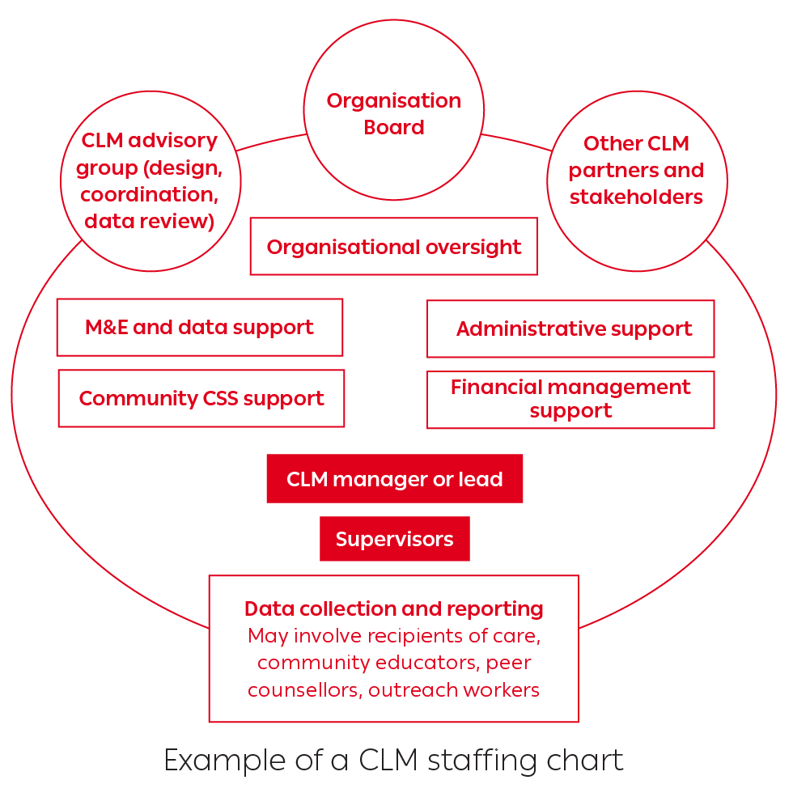
Budgeting for human resources in CLM
Examples of human resource categories
Front-line data collection
Supervisors to support data collection (training, data quality, data verification)
Data management (data software, data entry, storage, cleaning, analysis, security)
Community engagement (training, communications, organizing, advocacy)
CLM program manager
Technical support – program (CLM design, training, tools development, data analysis)

Slide 15
Additional tasks for CLM budgeting
      Consider core and variable costs, differentiating between what is core (required regardless of activity, extent, intensity) and what is variable (costs that expand based on the extent or intensity of CLM work).
      Consider the multiyear budget for 2023-2025, describing how implementation and spending might grow gradually based on iterative deliverables and results and how spending might change as the CLM program is first conceptualized, approved, designed, piloted, then started with trainings, then implemented and scaled up and then scaled down and evaluated.
      Scan the budget for common line-item concerns, such as appropriateness of costs in relation to local prevailing rates and sufficient explanations of key costs, such as for equipment, per diems and organizational overheads.
      Build budget scenarios to consider the likely range and options of the available funding for CLM.

Slide 16
Describe value for money of the CLM budget
      Global Fund funding requests are asked to describe the “value for money” of proposed investments. This means that applicants should describe how each amount of proposed funding will yield “maximum, sustained, equitable, and quality health outputs, outcomes and impact”.
A USD 150,000 investment in CLM to monitor services at 10 hospitals and clinics will (could) yield: | Significant durable (e.g., >5%) improvements in rates of screening, diagnoses, treatment retention and delivery of prevention supplies through (illustrative general examples below): Improving procurement and supply management and preventing stockouts of key commodities and medication Improving clinic conditions to ensure privacy and confidentiality of people living with HIV Reducing wait times and adjusting opening hours to accommodate key and vulnerable populations Addressing facility staff lateness and absenteeism Identifying specific needs for staff competency training Improving community trust, literacy, empowerment and engagement with health providers Attracting a cohort of clients who otherwise would avoid services

Slide 17
Summarizing CLM content in the Global Fund Funding Request form
The Funding Request form is the central document of a full Global Fund funding request.
Most Funding Request forms have three sections:
Section 1. Request
Section 2. Maximizing Impact
Section 3. Implementation

Slide 18
Section 1 of the Funding Request form
      The following content will be needed for the first section of the Funding Request form:
      The rationale and why CLM is a priority
      The focus populations and geographies for CLM
      The barriers that CLM will address
      The key CLM activities to be funded
      The total funding amount requested for CLM
      The expected outcomes of an investment in CLM
Notes:
Note: The full Guide has illustrative examples of content that could be included as responses to each of these content items.
Presenters and trainers may want to simply use this slide for participant discussion about potential responses to each of these content items but can also consult the guide to build out slides adapted to country and regional contexts.

Slide 19
The following is sample language that CLM implementers can discuss with partners in their CCM or RCM:
The rationale and why CLM is a priority
CLM is an evidence-informed intervention through which communities and service users generate data to help program managers and providers improve services, programs and policies.
This CLM proposes focusing on the following documented service and health system gaps [insert detail].
By involving and empowering clients in collection of data about services, programs and policies, this CLM will engage key and vulnerable populations and seek to improve attention to equitable outcomes and rights- and gender-related barriers [insert strategic information on quality and accessibility of services at the moment].
CLM was prioritized in consultations and dialogues (see Community priorities annex) and in program reviews and evaluations [insert who and where] (see RSSH priorities annex).
Notes:
Note: This is one illustrative examples of content that outlines potential responses to the questions in the Funding Request form.
Presenters and trainers may want to consult the full Guide to build out slides for each question in the Funding Request form and then adapt the material to country and regional contexts.

Slide 20
Section 2 of the Funding Request form
      Section 2 of the Funding Request form seeks to understand how requested funding will be used for achieving maximum progress toward control and elimination of the three diseases. Applicants are asked to describe the following:
      How Global Fund support will advance the primary goal of ending AIDS, TB and malaria
      How investments will strengthen overall health and community systems
      How investments will maximize engagement and leadership of most affected communities
      How investments will reduce human rights- and gender-related barriers to services
      How investments will build capacities to prevent, detect and respond to infectious disease outbreaks
Notes:
Note: The full Guide has illustrative examples of content that could be included as responses to each of these content items.
Presenters and trainers may want to simply use this slide for participant discussion about potential responses to each of these content items but can also consult the guide to build out slides adapted to country and regional contexts.

Slide 21
Section 3 of the Funding Request form
      Section 3 of the Funding Request form seeks to understand the following about the proposed program implementation:
      If Global Fund funding is awarded, how will program implementation change?
      Will effectiveness, efficiency or equity be improved?
      Will past programmatic gaps be addressed?
      Will connections between programs or sectors be improved?
      What actions will be taken to strengthen the roles of community-led and community-based organizations, civil society organizations and non-governmental implementers?
      What actions will be taken to minimize risks, including risks due to adequate procurement and supply management, inadequate data quality and data security, and/or inadequate financial management?
      How investments will build capacities to prevent, detect and respond to infectious disease outbreaks?
Notes:
Note: The full Guide has illustrative examples of content that could be included as responses to each of these content items.
Presenters and trainers may want to simply use this slide for participant discussion about potential responses to each of these content items but can also consult the guide to build out slides adapted to country and regional contexts.

Slide 22
Annexes

Slide 23
Annex 1: Basic definitions of CLM
Community-led monitoring (CLM) is relatively new as a term, but the underlying principles and concepts of CLM have been well established as a priority in program quality and accountability for more than 40 years.
CLM builds from the fundamental ideas of community engagement and meaningful involvement of people who are recipients of services and others who are living with or vulnerable to prevalent health issues.
CLM includes terms and concepts such as treatment observatories, community scorecards, consumer feedback mechanisms, community advisory groups and participatory governance.
CLM emphasizes systematic and routine data collection and reporting that is owned and led by community organizations and then shared with service providers, program managers and policy makers to co-create solutions.

Slide 24
Stages of CLM
CLM is implemented through several different approaches, but typically includes the following four cyclical phases:
Educational and planning: Communities identify priority concerns with services, programs and policies and the specific focus for monitoring.
Collection of evidence: Individuals systematically monitor and report on how services, programs and policies are implemented and experienced at the level of communities and recipients of care.
Development of finding and recommendations: Community organizations compile and analyse the resulting data to identify opportunities for improvement.
Communication, development of solutions, and advocacy: Community leaders and recipients of care review evidence with service providers, program managers and policy makers to jointly develop solutions to identified problems.

Slide 25
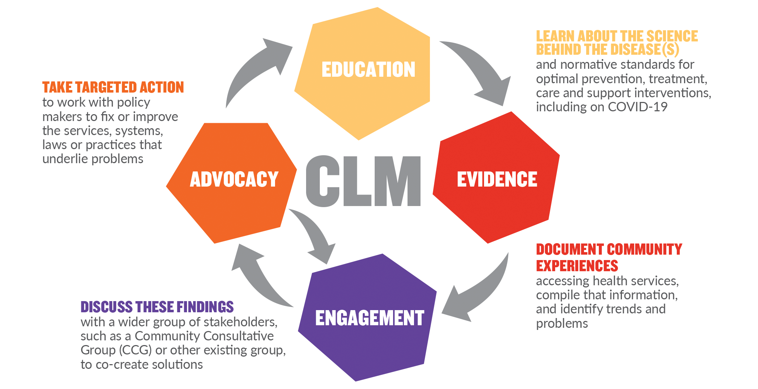
Stages of CLM
The graphic below is produced by the International Treatment Preparedness Coalition (ITPC) to show these four stages.

Slide 26
Annex 2: Essential elements of CLM
Community leadership and community articulation of priorities: As a community-led program, CLM is centred on people who have important perspectives and insights as clients or intended beneficiaries of programs, policies and services.
Collaborative governance and partner engagement: A range of institutions and individuals are important potential partners in CLM because of their roles in using CLM-generated evidence and recommendations for improving health programs and services and protecting and promoting human rights.
CLM indicators, tools and locations: The power of CLM is in its ability to first continuously track and report on a defined set of issues and measures over time and then compile that information in ways that can be disaggregated, compared with government data, analysed over time and used for improvements in programs, policies and services.
Planning and sufficient funding for CLM implementation

Slide 27
For more information
Acknowledgements
This guide was developed by IAS – the International AIDS Society – with advice and support from the Global Fund Community Rights and Gender (CRG) Department and the HIV Team at the Bill & Melinda Gates Foundation and with reviews and input from many others.
For more information
Country stakeholders seeking technical assistance related to inclusion of CLM and other Community Systems Strengthening (CSS) interventions in Global Fund funding requests are welcome to contact the Global Fund through its Community Rights and Gender Regional Platforms. Other inquiries about this content should be directed to Anna Grimsrud, Senior Technical Advisor, IAS, at anna.grimsrud@iasociety.org.

Slide 28
Recommended citation
IAS – the International AIDS Society. A guide to support inclusion of CLM in funding requests to the Global Fund. 2022. https://www.differentiatedservicedelivery.org/Resources/Resource-Library/CLM-guide-GF-funding-requests
Notes:
The full Guide can be found online at https://www.differentiatedservicedelivery.org/Resources/Resource-Library/CLM-guide-GF-funding-requests

Slide 29
Download the full guide in English, French, Portuguese and Spanish https://bit.ly/clm_guide

Slide 30
Thank you

