Slide 1
Global DSD Research collaborative
28 Sept 2026
dsd@iasociety.org
Notes:
AG

Slide 2

Agenda
Welcome & intros
Rapid fire from AIDS 2026
Next steps/AOB
Notes:
Welcome everyone and thank you for making the time.
The purpose of today’s meeting is to reconnect the global DSD research community and take stock of where the evidence is moving.
We’ll cover three main things:
A brief background and framing
New evidence and remaining research gaps, particularly around eligibility for less-intensive DSD models
What people are currently working on, so we can strengthen collaboration.
The spirit of this meeting is informal and collaborative — sharing work in progress and identifying where coordination can help accelerate learning.

Slide 3
1. Welcome and overview
Who's in the room today?
Please drop a quick introduction in the chat:
  👤 Name
  🏢 Organization
  🌍 Country you're joining from (with a flag)
  😀 One emoji to describe your Monday mood (with an emoji)
Anna Grimsrud, IAS, South Africa 🇿🇦, 😌

Slide 4

2. Rapid fire from AIDS 2026
Thanks to those of us who joined us in Rio – and were able to join us for dinner on Sunday, 26 July.
We were too deep in conversation to take a good group shot!

Slide 5

2. Rapid fire from AIDS 2026
Thanks also to those who joined for Run Club!

Slide 6

2. Rapid fire from AIDS 2026
1. Optimizing HIV service delivery through multi-month dispensing of antiretroviral therapy beyond 6 months and biennial viral load monitoring: evidence from the national electronic medical record system in Zambia, 2020–2025 – Suilanji Sivile, MOH, Zambia
2. Early viral load monitoring and enrollment into multi-month dispensing models following South Africa’s 2023 revision of HIV treatment guidelines - Elizabeth Kachingwe, HE²RO, South Africa
3. Providers prefer frequent contact over flexibility to reduce risk of early disengagement from HIV care in South Africa - Allison Morgan, Boston University, USA
4. Predictors and self-reported causes of treatment interruption among clients on antiretroviral therapy in Malawi: a nested case-control study – Colbert Lemani, PIH, Malawi

Slide 7
2. Rapid fire from AIDS 2026
5. Home-based counseling and ART initiation increase viral suppression among men out of care in Malawi: randomized trial – Kate Dovel, UCLA / PIH, US / Malawi*
6. Co-developing mobility-responsive interventions to reduce interruption in HIV treatment in Malawi – Eric Lungu, PIH, Malawi
7. Community-based tracking and re-engagement in HIV treatment among people experiencing treatment interruptions: programmatic outcomes from a multi-district initiative in Eswatini, Sandile Ginindza, Young Heroes, Eswatini
8. Assessing implementation and expansion of advanced HIV disease in Malawi – John Fly Phiri, MOH, Malawi*

Slide 8
2. Rapid fire from AIDS 2026
9. National geospatial mapping of advanced HIV disease (AHD) in South Africa: identifying hotspots for prioritised intervention - Liliwe Shuping, NICD, South Africa
10. Tuberculosis amidst the high tide of antiretroviral therapy interruptions: a retrospective cohort study in South Africa - Haroon Moolla, UCT, South Africa*
11. Addressing the postnatal “last mile” of vertical HIV transmission through integrated postnatal care in South Africa- Jeannette Wessels, University of Pretoria, South Africa
12. Integrating pre-exposure prophylaxis into postnatal care: service delivery, risk perception, and uptake among breastfeeding women in South Africa- Jeannette Wessels, University of Pretoria, South Africa

Slide 9

Sit back, listen, and use the chat to ask questions

Slide 10
Optimizing HIV service delivery antiretroviral therapy dispensing >6 months and
24 monthly viral load monitoring: Evidence from Zambia's national electronic medical record system, 2020–2025
Dr. Suilanji Sivile · Ministry of Health, Zambia
on behalf of CDC Zambia, IHM Southern Africa and MOH co-authors

Slide 11
Background - Can stable clients go longer between refills and VL tests?
Programmes face shrinking resources and need models that save visits without losing outcomes.
3- and 6-month MMD is already recommended for clinically stable PLHIV.
Little is known about dispensing beyond 6 months or 24-monthly (biennial) VL monitoring.
Illustrative 24-month schedule for stable recipients of care
Current practice 6-month refills · annual VL
Evaluated here >6-month refills · biennial VL
0 mo
6 mo
12 mo
18 mo
24 mo
ART refill
VL test

Slide 12
Study question & methods
Funding: President's Emergency Plan for AIDS Relief (PEPFAR), through CDC cooperative agreement 0900f3eb82625dd8.
Study question - do virologically stable adults on dolutegravir (DTG)-based ART maintain clinical outcomes (viral load suppression and retention in care) with extended MMD and biennial VL monitoring?
Design
  Five-year retrospective cohort using SmartCare, Zambia’s EMR (2020-2025)
ELIGIBLE POPULATION
EXTENDED MMD COHORT (dispensation>6mo)
EXTENDED VL COHORT (VL tests after 24 mo)
239,027
4,910
17,001
Adults ≥18 years on a DTG-based regimen for ≥12 months, with complete VL and ART dispensation documentation.
Clients with suppressed VL before an ART dispensation episode of more than 6 months.
Clients with a VL test 24–48 months after two consecutive suppressed VL results.
ANALYSIS Kaplan–Meier survival models with 95% confidence intervals were used to estimate time to first virologic rebound (VL ≥1,000 copies/mL) in both extended-dispensing and extended-monitoring cohorts.

Slide 13
Cohort characteristics and observed outcomes
Characteristic / Outcome | All eligible DTG-stable adults N = 239,027 | Extended MMD cohort N = 4,910 | Extended VL monitoring cohort N = 17,001
Age, median (IQR), years | 43 (35–50) | 43 (35–50) | 44 (37–51)
Age ≥45 years, n (%) | 102,755 (43.0%) | 2,187 (44.5%) | 8,308 (48.9%)
Female, n (%) | 134,690 (56.3%) | 2,988 (60.9%) | 8,576 (50.4%)
Time on ART, median (IQR), yrs | 4.7 (2.5–8.7) | 5.1 (2.9–8.9) | 5.8 (3.1–9.5)
On ART >5 years, n (%) | 114,538 (47.9%) | 2,513 (51.2%) | 9,621 (56.6%)
VL records per patient, median | 5 (4–8) | 6 (5–8) | 5 (4–6)
Retained in care | — | 99.9% | 91.9%
Virally suppressed at 1st follow-up VL | — | 98.6% | 97.2%
2-yr probability, no virologic rebound (95% CI) | — | 95.4% (94.6–96.1) | 98.4% (97.9–98.4)

Slide 14
Extended MMD (>6MMD) maintained viral load suppression
Observed extended dispensing interval
99.9%
retained in care
4,905 / 4,910 clients
98.6%
virally suppressed
at first post-episode VL test
Kaplan–Meier: Time to first virologic rebound
95.4%
2-year rebound-free survival
95% CI: 94.6–96.1
Curve shape illustrative; endpoints reflect reported 95.4% (95% CI 94.6–96.1) survival at 2 years.
06

Slide 15
24 monthly VL testing maintained viral load suppression
91.9%
Observed extended VL monitoring interval
retained in care
15,306 / 16,651 with overlapping refill record
97.2%
virally suppressed
on first VL after longest gap
Kaplan–Meier: Time to first virologic rebound
98.4%
2-year rebound-free survival
95% CI: 97.9–98.4
Curve shape illustrative; endpoints reflect reported 98.4% (95% CI 97.9–98.4) survival at 2 years.
07

Slide 16
Conclusions
Virologically stable people living with HIV on a DTG-based regimen receiving extended MMD and less frequent VL monitoring did not have compromised programmatic outcomes
Consider prospective evaluations, assessing eligibility, safety, equity, feasibility, supply-chain, laboratory implications, resource savings and cost-effectiveness before national scale-up

Slide 17
Acknowledgements
Thank you
This research has been supported by the President's Emergency Plan for AIDS Relief (PEPFAR) through CDC under the terms of cooperative agreement 0900f3eb82625dd8.
The findings and conclusions in this report are those of the authors and do not necessarily represent the official position of the U.S. Centers for Disease Control and Prevention.
AFFILIATIONS
1
U.S. Centers for Disease Control and Prevention, Lusaka, Zambia
2
Institute for Health Measurement Southern Africa, Lusaka, Zambia
3
Zambia Ministry of Health, Lusaka, Zambia
CONTACT
Hanna B. Demeke
hdemeke@cdc.gov
U.S. Centers for Disease Control and Prevention · Lusaka, Zambia

Slide 18




Uptake and outcomes of earlier viral load testing and assignment to longer visit intervals following South Africa's 2023 ART guidelines revision
A retrospective cohort analysis across 18 primary healthcare facilities
Kachingwe E, Benade M, Morgan A, Scott N, Maskew M, Ntjikelane V, Sande L, Mutanda N, Manganye M, Malala L, Rosen S

Slide 19
Background
Disengagement is highest in the first year of care
Despite very high ART coverage across sub-Saharan Africa, disengagement from care remains a major challenge - particularly in the "early treatment period," the first six months after initiation.
South Africa revised its ART guidelines in 2023 to improve outcomes in the early treatment period, decongest facilities, and reduce healthcare-worker workload.
1 in 6
Almost 1 in 4
Only 40%
clients disengaged from care within 6 months of ART initiation
clients disengaged by 12 months after initiation
remained continuously in care through 12 months, with no interruption >28 days
Source: Maskew et al., South African EMR cohort, 2024
Kachingwe et al.
2023 ART Guidelines Uptake - RETAIN6

Slide 20
Methods
Objective: to assess fidelity to the core early-treatment changes in South Africa’s 2023 ART guidelines, and their association with viral suppression.
18 primary healthcare clinics
3 districts: Ehlanzeni, King Cetshwayo, West Rand
16,338 adults starting or restarting ART,
Jan 2022–Mar 2025
Routine TIER.Net data
Guideline change | What we measured | Definition
First VL moved from month 6 to month 3 | Uptake of VL testing at month 3 | VL result 56–<112 days after ART initiation
6-monthly clinic visit eligibility moved from month 7 to 4 | Assignment to ≥6-month clinic visit intervals | Next appointment ≥168 days after a suppressed VL at month 3
Second VL moved from month 12 to month 10 | Uptake and timing of the second VL | VL at month 10 (252–<308 days) or month 12 (308–<392 days)
# of visits in the first year reduced from 11 to 6 | # of clinic visits in the first year | Number of clinic visits in the first 12 months, among clients retained in care
Outcome | Viral suppression at first and second VL | <50 copies/mL at the month 3 or 6 and month 10 or 12 tests
Analysis: Interrupted time-series analysis of uptake, plus modified Poisson regression for outcomes
Kachingwe et al.
2023 ART Guidelines Uptake - RETAIN6

Slide 21
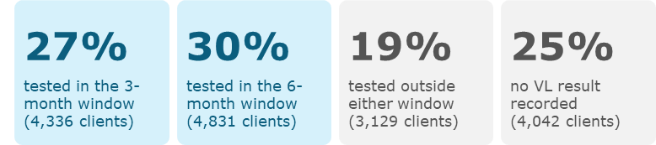
Results
Who was in the cohort?
Timing of first VL (n=16,338)
Characteristic | Ehlanzeni | King Cetshwayo | West Rand | Total
N (row %) | 7,606 (47%) | 4,325 (26%) | 4,407 (27%) | 16,338
Female | 62% | 61% | 64% | 62%
Aged 25–44 years | 68% | 68% | 66% | 67%
Baseline CD4 <200 cells/mm³ | 21% | 25% | 23% | 23%
WHO stage 1/2 at initiation | 94% | 90% | 91% | 92%
Among clients with a documented VL in the respective window, viral suppression (<50 copies/mL) was:
72.2% (3,130/4,336) among those tested at month 3
71.7% (3,466/4,831) among those tested at 6 months.
No difference in VL suppression among those with a 3- vs. 6-month VL
Kachingwe et al.
2023 ART Guidelines Uptake - RETAIN6

Slide 22
Uptake of 3-month VL testing and assignment to ≥6-month visit intervals after suppressed VL
Uptake of month 3 VL testing rose sharply after guideline change
Coverage by mid-2025: West Rand 85%, King Cetshwayo 72%, Ehlanzeni 75%
Among 3,130 clients virally suppressed at month 3 VL:
  48% (1,495) were assigned ≥6-month intervals
  48% (1,498) stayed on shorter intervals
  4% (137) had no visit after the VL result
By end of study, uptake of ≥6-month clinic intervals: Ehlanzeni 48%, King Cetshwayo 71% and West Rand 57%
Kachingwe et al.
2023 ART Guidelines Uptake - RETAIN6

Slide 23
By the second VL assessment (10/12 months)
Status of the full cohort (N = 16,338)
43.4%
19.4%
37.2%
In care, no second VL
Had a documented second VL
N=7,094
No longer in care at original site
N=3,163
N=6,081
7.5% (n=1,226) at 10 months
35.9% (n=5,868) at 12 months
2.1% (n=338) never had a VL test
12.1% (n=1,980) had a first VL, but no second VL
5.2% (n=845) tested outside scheduled windows only
0.4% (n=63) died
2.8% (n=461) transferred out
7.7% (n=1,257) lost to follow-up (recorded)
26.3% (n=4,300) disengaged
Includes 5,682 of the 9,167 clients with a first VL in the 3- or 6-month window (62%)
Kachingwe et al.
2023 ART Guidelines Uptake - RETAIN6

Slide 24
Most clients with first VL at month 3 still had their second VL at month 12
Guidelines recommend the second VL at month 10 after a first VL at month 3, and at month 12 after a first VL at month 6
Had a documented second VL
First VL at month 3
N = 4,336
12.2%
44.5%
26.2%
17.1%
56.7%
n = 2,459
First VL at month 6
N = 4,831
6.4%
60.3%
17.4%
15.8%
66.7%
n = 3,223
Second VL at 10 months
Second VL at 12 months
In care, no second VL
No longer in care
78%
of those with first VL at month 3 who had a second VL, this was done at month 12 instead of month 10
Kachingwe et al.
2023 ART Guidelines Uptake - RETAIN6

Slide 25
The number of clinic visits in the first year on ART fell each year
High suppression at second VL
Viral suppression (<50 copies/mL) at the second scheduled VL, by visit interval assigned after a suppressed VL at month 3
Median visits (IQR)
≥6-month vs <6-month
91%
89%
2022
8 visits (6–9)
aRR 1.02
95% CI 0.99–1.06
2023
7 visits (6–8)
suppressed
≥6-month visit interval
suppressed
<6-month visit interval
Unadjusted RR 1.03 (1.00–1.06)
2024
6 visits (5–8)
Longer visit intervals were not associated with poorer viral suppression. Suppression at the second VL was high in both groups, and the small difference was not significant after adjustment.
By 2024, the median matched the guideline target of 6 visits (down from 11 under the previous guidelines).
Kachingwe et al.
2023 ART Guidelines Uptake - RETAIN6

Slide 26
Conclusions
Guidelines were taken up quickly, but not fully
There was no difference in VL suppression between those tested at month 3 vs. month 6
Earlier assignment to ≥6-monthly clinic visit intervals was not associated with poorer viral suppression
Rapid uptake of VL testing at month 3, earlier longer visit intervals and fewer first-year visits
Variable uptake between districts
Low uptake of month 10 viral load.
Looking ahead, on-schedule VL testing, recording results, and DMOC enrolment should be strengthened. Longer-term retention outcomes should be evaluated.
Kachingwe et al.
2023 ART Guidelines Uptake - RETAIN6

Slide 27
Acknowledgements
Clients and staff of the 18 participating clinics in Ehlanzeni, King Cetshwayo, and West Rand districts
National Department of Health
RETAIN6 study team
Funded by the Gates Foundation
Kachingwe et al.
2023 ART Guidelines Uptake - RETAIN6

Slide 28
Providers prefer frequent contact over flexibility to reduce risk of early disengagement from HIV care in South Africa
Qualitative findings from healthcare providers
Morgan A, Maskew M, Benade M, Kachingwe E, Scott N, Marri A, Sande L, Malala L, Manganye M, Rosen S

Slide 29
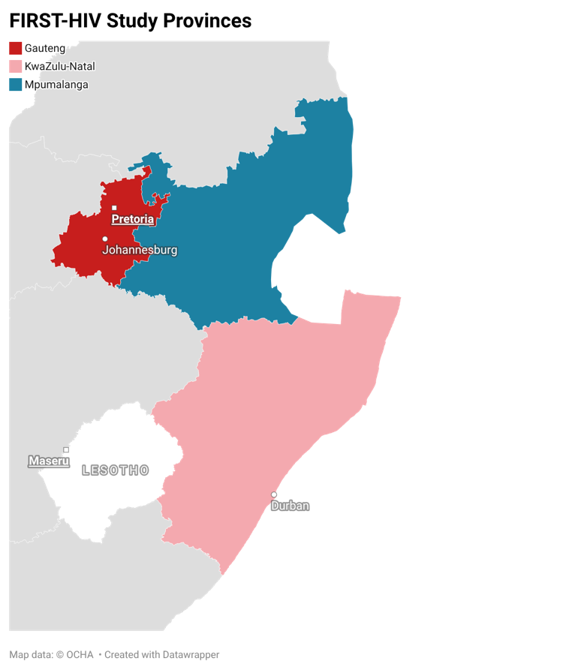
Background
High disengagement in first year on ART.
DMOC/DSD models are typically:
  Reserved for clients stable on treatment,
  Not accessible to clients in the early treatment period or deemed at risk of disengagement.
The FIRST-HIV study aimed to explore how providers identify risk of disengagement and select supportive interventions in Gauteng, KwaZulu Natal, Mpumalanga provinces in South Africa.
18 facilities across three provinces

Slide 30
Methods
18 group interviews with providers at public primary care facilities
Interviews followed a semi-structured interview guide
  How do providers identify risk?
  How do providers make decisions about offering supportive interventions?
Inductive-deductive coding approach and content analysis using NVivo
Additionally, conducted concurrent quantitative facility assessment to understand which services are offered in study facilities and to provide context to group interview findings.
More additive and collaborative than FGDs or individual IDIs
Data
Capturer
Admin
Personnel
Prof.
Nurse
Doctor
Counsellor

Slide 31
Results
N=140 providers interviewed
88% female
Median 11 years in position (IQR 6, 17)
Concurrent quantitative facility assessment found that most sites offer a variety of supportive interventions:
  All health facilities offer
    One-stop appointments
    Flexible appointment scheduling
    Multi-month dispensing (MMD) models
    Enhanced adherence counseling
  Most facilities offer
    Fast-track queues
    Disclosure support
    Case management

Slide 32
Results: How providers reported identifying disengagement risk
The most reported signals were those that confirmed disengagement rather than predicting risk.
Information from client files
  Evidence of previous missed or late visits; elevated viral load
“... [If a client is late] he is likely to stop the treatment because he's not honoring the appointment dates... If the patient keeps on defaulting, that patient needs more support.”
Conversations during clinical consultations
  Lack of social support and status disclosure
  Lifestyle factors, i.e., substance use, travel, food insecurity
  Disposition and acceptance/denial of diagnosis
      “If ever patient lives with people in a household that are not aware and he is not even willing to make them aware of his status... Non-disclosure makes a person not be compliant.”
      “Some patients work...cross border. He says that he will go for three months, out of the country or out of the province... you know that no, he won’t adhere to treatment.”

Slide 33
Results: Intervention mapping
Providers reports different interventions that were suitable or unsuitable for those at risk of disengagement
Suitable for clients at risk | Discouraged for clients at risk
Counseling, referral to social workers Social support Home visits, community-based medication delivery Nutrition support | Multi-month dispensing
"[Clients] interrupt because of lack of knowledge… with intensive counseling, they might come to understand the benefits of treatment."
“For a patient who's gonna interrupt? It's very hard for us to give more medication... he still needs to be here to be monitored. Maybe he still needs counseling... So for those clients, it's very hard for us to just let go and [offer MMD]... If we neglect the signs that we see, then we are failing.”

Slide 34
Conclusions
There may be tension between providers’ desire for frequent contact and the potential benefit to clients offered by DMOCs.
Providers favor interventions involving frequent contact and intensified social support for clients deemed at risk of disengagement.
Despite acknowledging structural barriers and clients’ care seeking experiences, providers are hesitant to recommend MMD.
Not evidence that more frequent clinical visits improves engagement (Mutasa-Apollo, 2017)
Interventions that providers would like to offer, such as additional counseling, generally require additional time and/or resources.
Additional guidance and support may be needed to ensure provider perceptions do not unnecessarily limit access to differentiated service delivery models.

Slide 35
Acknowledgements
Staff of the 18 participating clinics in KZN, Mpumalanga and Gauteng provinces
National Department of Health
RETAIN6 study team
The Gates Foundation

Slide 36




Predictors and self-reported causes of treatment interruption among clients on antiretroviral therapy in Malawi: A nested case-control study
Colbert Lemani, Kelvin Balakasi, Khumbo Nyirenda, Isabella Robinson, Eric Lungu, Joep J. van Oosterhout, Sam Phiri, Steve Shoptaw, Risa M Hoffman, Kathryn Dovel, Marguerite Thorp

Slide 37
Background
Interruptions in HIV treatment (IIT) challenge antiretroviral therapy (ART) programs in sub-Saharan Africa.
IIT associated with viral non-suppression, disease progression, transmission and mortality.
Despite increased access to ART, IIT remains a challenge in Malawi
Improving retention in care requires understanding:
  predictors of IIT
  client-reported reasons for interruption.

Slide 38
Objectives & study methods
Objectives
  Identify factors associated with IIT
  Understand clients’ self-reported reasons for IIT.
Design
  IRTI- Prospective cohort of clients newly initiating/ re-initiating ART
Eligibility criteria
  Initiate or re-initiate ART after ≥28 days late; ≥ 15 years of age
    Sub-study eligibility: Cases (IIT) able to match to controls (no IIT) by facility, age, and sex
Data collection
  Baseline enrolment survey
  Medical chart review 7 months after enrollment
  Endline survey — IIT at 6 months, mobility, alcohol use, depression, reasons for IIT
Analysis
  Descriptive statistics of matched case-controls; conditional logistic regression
  Unadjusted and adjusted odds ratios (aOR) with 95% CIs

Slide 39
Study population
896
participants in parent study
252
in nested case-controls* analysis
*Cases experienced IIT in study period; controls did not
Participant characteristics
Variable | N (%)
Type of client Re-initiators | 182 (72)
Gender Females | 145 (58)
Age 25-44 years | 149 (59)
Education Primary education all above | 162 (64)

Slide 40
Factors associated with IIT
Variable | OR [95% CI] | Adjusted OR [95% CI]
High risk mobility | 1.91 [1.15–3.17] * | 2.04 [1.21–3.45] *
Depression, positive screen (>8) | 0.94 [0.57–1.54] | 0.76 [0.44–1.32]
Suicidal ideation | 1.80 [0.60–5.37] | 2.33 [0.71–7.59]
Drunk alcohol in past 12 months | 1.00 [0.54–1.86] | 0.91 [0.47–1.73]
Marital status Married Widowed Divorced/separated Steady relationship Not in a relationship | REF 7.51 [0.90-62.9] 1.15 [0.59-2.34] 1.56 [0.50-4.85] 1.83 [0.64-5.21]
Educational attainment None Primary education Secondary education Higher education | REF 6.63 [0.78-56.42] 5.59 [0.67-47.01] 3.73 [0.29-48.20]
Number of children | 1.25 [0.91–1.71]
Those with high-risk mobility were twice as likely to have a treatment interruption that those without high-risk mobility.
*High risk mobility defined as: “Travel ≥ 30 nights or any trip longer than expected”

Slide 41
Client-reported reasons for IIT
The main reasons for ITT were travel / migration (32%) unavoidable life events (caring for sick relatives, attending funerals) (18%)
Mobility & competing life demands = major contributors to IIT

Slide 42
Key findings
Treatment interruptions were associated with high-risk mobility
Programmatic implications
DSD approaches that accommodate high-risk mobility are needed (e.g., multi-month dispensing, flexibility refill options
Travel/migration and unavoidable life events were the primary self-reported reasons for treatment interruption
Other factors (depression, suicidal ideation, drinking, marital status, number of children) were not associated with treatment interruptions
Client-reported reasons for treatment interruption should inform retention and re-engagement strategies.

Slide 43
Acknowledgements and references
We acknowledge:
Partners in Hope & participating health facilities in Malawi.
Study participants & research staff supporting data collection and follow-up.
Malawi’s National Health Sciences Research Committee and UCLA IRB.
FUNDERS
UCLA CFAR program
Thank you
References:
1. Matoga MM, Rosenberg NE, Stanley CC, LaCourse S, Munthali CK, Nsona DP, et al. Inpatient mortality rates during an era of increased access to HIV testing and ART: A prospective observational study in Lilongwe, Malawi. Pett SL, editor. PLOS ONE. 2018 Feb 7;13(2):e0191944. doi:10.1371/journal.pone.0191944
2. Kaplan SR, Oosthuizen C, Stinson K, Little F, Euvrard J, Schomaker M, et al. Contemporary disengagement from antiretroviral therapy in Khayelitsha, South Africa: A cohort study. Newell ML, editor. PLOS Med. 2017 Nov 7;14(11):e1002407. doi:10.1371/journal.pmed.1002407
3. Kay ES, Batey DS, Westfall AO, Christopoulos K, Cole SR, Geng EH, et al. Compound Retention in Care and All-Cause Mortality Among Persons Living With Human Immunodeficiency Virus. Open Forum Infect Dis. 2019 Apr 1;6(4). doi:10.1093/ofid/ofz120

Slide 44

Identifying efficient linkage strategies for men after HIV treatment disengagement (IDEaL): Retention and cost results from a randomized clinical trial in Malawi
Kathryn L. Dovel, Kelvin T. Balakasi, Isabella Robson, Khumbo Phiri, Bruce A. Larson, Samuel Phiri, Santhi Hariprasad, Stanley Ngoma, Khumbo Namachapa, Julie Hubbard, Chi-Hong Tseng, Morna Cornell, Thomas J. Coates, Augustine T. Choko

Slide 45

Treatment interruption and person centered care
Convenient
Convenient
Friendly
Responsive
Interruption in treatment (IIT) remains a major concern, particularly men*
Scalable person centered care (PCC) strategies are needed
Current relevance
Need low-cost PCC that is sustainable and effective for everyone, including men
Examples of PCC (low → high touch)
Strategy | Example
Welcoming environment | Friendly, respectful facility experience
Tailored counselling | Kind, individualized counseling by trained lay cadre
Home-based services | ART initiation/refill brought to the client

Slide 46
Pragmatic, comparative effectiveness trial
Goal: Test if lowest cost PCC (male-specific counseling) performs as well as more expensive PCC models

Slide 47

Study overview
Design | Individually randomized, non-blinded, pragmatic comparative effectiveness trial (NCT05137210)
Rationale for no SOC arm | Evidence: ~50% of clients out of care will still be out of care at 6 months under SOC
Randomization | 1:1:1, individually block randomized by biostatistician (R)
Primary outcome | Six-month ART retention (composite): initiated ART <90 days after enrollment + <28 days late for 6-month ART appointment
Secondary outcomes | Scale decisions: Cost, cost-effectiveness Implementation: Fidelity and quality; acceptability Medical: Days with ART coverage; adverse events,
Eligibility | ART naïve after HIV diagnosis (“never initiated”), or >14 days late for first ART refill visit (“false initiate”), or On ART ≥2 visits but >28 days late for most recent appointment (“treatment interruption”)
Dovel K, Balakasi K, … Choko A. BMJ Open. 2023 Jul 1;13(7):e070896.

Slide 48




Three PCC interventions
MALE-SENSITIVE COUNSELING
(Low Intensity)
CHOICE OF HOME ART
(High Intensity)
STEPPED INTERVENTIONS
(Varying Intensity)
Tailored counseling (1-2 visits) (kind, tailored, strategic planning)
Facility navigation for initiation
Lay counselor
Tailored counseling (1-2 visits) (kind, tailored, strategic planning)
Home ART initiation
Facility navigation for refill
Nurse
Changing services and cadre until ART (re)initiation achieved
Combination
Mphande M, Robson I … Dovel K. Available on preprint on VeriXiv.com.

Slide 49
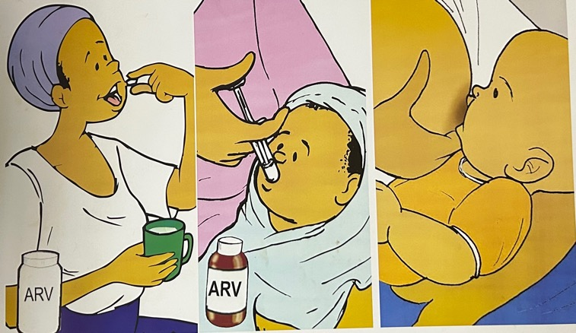


Adapted men’s counselling
Treatment as Prevention
SOC Ministry
IDEaL

Slide 50



New topics added to MoH counselling
Income generation
Financial provision
Alcohol use

Slide 51
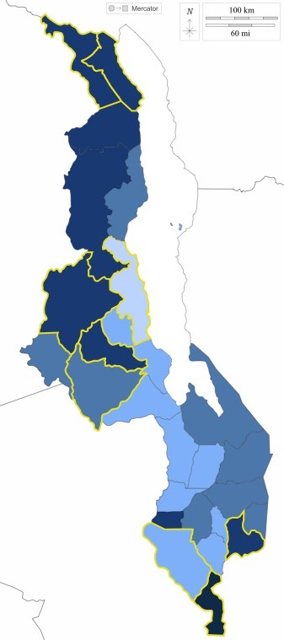
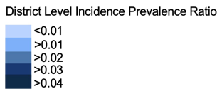
Enrollment and data collection
Recruitment strategy: Medical chart review + tracing
Sites: 13 facilities, 6 districts
Data collection for primary outcome
  9-month Medical chart review
    + Tracing for clients who appeared out of care in medical charts
Analysis
  Intention to Treat
Cost Analysis
  Incremental cost from the provider’s perspective (hybrid micro- and activity-based approach)
IDEaL Study Site
PIH Supported District
Notes:
Stepped vs Counseling; Stepped vs Home ART
(Ad Hoc) Counseling vs Home ART

Slide 52
Results

Slide 53
Trial flow chart
Enrollment Sept 2021 - 31 July 2022
1,684 men assessed for eligibility
Excluded
522 (31%) not found
574 (49%) ineligible:
242 on ART
209 moved outside catchment
53 died
70 other
19 (2%) refused
569 men randomized (1:1:1)
Counseling
n=195
Home ART
n=190
Stepped
n=184
N=569

Slide 54
Participant characteristics (n=569)
Respondent Characteristic | Total | Counseling (n=195) | Home ART (n=190) | Stepped (n=184)
N, (%) | 569 (100) | 195 (34.3) | 190 (33.4) | 184 (32.3)
Median age, years (IQR) | 38 (31–45) | 38 (30–46) | 39 (32–45) | 38 (31–45)
>1 sexual partner <12 months, n(%) | 289 (51) | 97 (50) | 102 (54) | 90 (51)
Ever started ART n(%) | 520 (91) | 179 (92) | 171 (90) | 170 (92)
Median months since ART initiation (IQR) | 12 (3.6–36) | 12 (3.6–48) | 12 (3.6–48) | 12 (2.4–24)
Median duration out of care, months (IQR) | 2 (1–4) | 2 (1–4) | 2 (1–5) | 2 (1–6)
Believed (re-)initiation would lead to unwanted disclosure n(%) | 243 (43) | 87 (45) | 85 (45) | 71 (39)
No significant differences observed between arms at baseline.

Slide 55
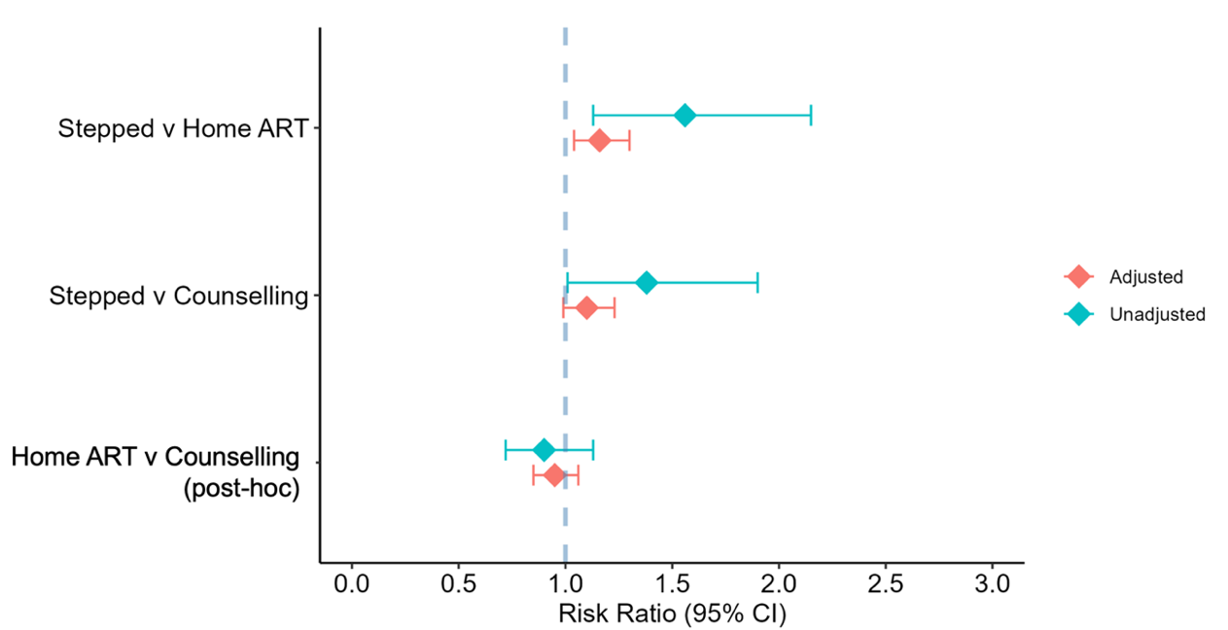
Primary outcome
(Composite retention at 6mo)
Very little difference by arm.
Only significant difference was between Stepped and Home arms.

Slide 56
Primary outcome and composite variables
Outcome | Counseling (N=195) | Home ART (N=190) | Stepped (N=184) | Stepped vs Counseling | Stepped vs Home ART | Counseling vs Home ART
Retention at 6mo (composite; Intention to Treat) | 152 (78%) | 135 (71%) | 154 (84%) | aRR 1.10 (0.99–1.18) p=0.081 | aRR 1.19 (1.07–1.28) p=0.004 | aRR 1.08 (0.94–1.19) p=0.235
Initiated <90 days after enrollment | 175 (90%) | 171 (90%) | 174 (95%) | aRR 1.05 (0.99–1.09) p=0.088 | aRR 1.05 (0.98–1.08) p=0.125 | aRR 0.99 (0.90–1.05) p=0.852
Retained at 6mo (among those who initiated) | 152/175 (87%) | 135/171 (79%) | 154/174 (89%) | aRR 1.04 (0.97–1.08) p=0.229 | aRR 1.12 (1.03–1.17) p=0.009 | aRR 1.07 (0.98–1.14) p=0.139
Adjusted for age, marital status, client type, facility
Blue = statistically significant (p<0.05). Cost outcomes shown separately (Cost Analysis slide); other secondary outcomes on next slide.

Slide 57
Secondary outcome acceptability
Measure | Counseling (N=195) | Home ART* (N=190) | Stepped (N=184) | Total (N=569)
How HCW treated you — outside-facility visits | 186 (95%) | 177 (93%) | 174 (95%) | 537 (94%)
How HCW treated you — facility ART visits | 173 (89%) | 150 (79%) | 165 (90%) | 488 (86%)
*satisfaction drops most for Home ART once clients transition to facility-based care.

Slide 58


Key intervention component:
Kind interactions*
More important
Compelling, relevant messaging
Less important
Positive healthcare worker interactions
Outside-facility dispensing
Positive interactions
with HCWs
Kind and interactive
Private
Ongoing relationships
Community
ART dispensing
Compelling messaging
ART contributes to goals
Tailored solutions
*Findings from 60 in-depth interviews with men (mid and endline)

Slide 59
Cost analysis
 | Counseling (N=185) | Home ART (N=184) | Stepped (N=180) | Home vs Counseling Mean Diff (95% CI) | Stepped vs Counseling Mean Diff (95% CI)
Total Cost (mean) | $31.55 | $62.04 | $40.87 | 30.50 (23.88, 37.11) | 9.33 (3.61, 15.05)
Achieved Outcome | $28.46 | $55.77 | $37.18 | 27.31 (21.33, 33.28) | 8.72 (3.94, 13.5)
Did NOT Achieve Outcome | $42.06 | $77.15 | $60.93 | 35.09 (17.39, 52.8) | 18.75 (−3.99, 41.48)
What drives the cost?
 | Counseling | Home ART | Stepped
Counsellor time (hrs) | 7.68 | 5.83 | 6.18
Nurse time (hrs) | — | 2.52 | 0.20
Psychosocial Counselor time (hrs) | — | — | 1.32
Mean HCW time per client

Slide 60



What happened to clients out of care?
Traced individuals who “failed” primary outcome at endline (128 attempted to trace)
67 successfully traced and completed retention survey
Client identified reasons for >28 days out of care (n=67)
Reason | % (n)
Traveling for work | 45% (30)
Traveling for social event | 10% (7)
Local work | 6% (4)
Fear of disclosure | 16% (10)
Forgot appointment(s) | 3% (2)
Did not want to (fatigue) | 16% (11)
Negative experiences with HCWs | 24% (16)
58% of individuals attribute interruptions to travel

Slide 61
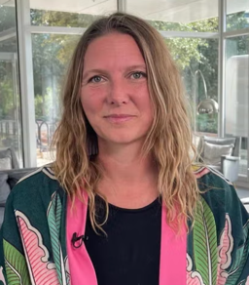











Acknowledgements
Funders:
Gates Foundation
(INV-001423).
Acknowledge:
Facility staff
Community and client participants
PI: Kathryn Dovel, PhD
PI: Augustine Choko, PhD
Kelvin Balakasi, PhD student
Isabella Robson, MSc
Misheck Mphande,
PhD student
Sam Phiri, MSc, PhD
Morna Cornell, PhD
Bruce Larson, PhD
MacDaphton Bellos
Khumbo Phiri, MSc
The content is solely the responsibility of the authors and does not necessarily represent the official views of the Gates Foundation
Marguerite Thorp, MD
Rose Nyirenda

Slide 62
Co-developing mobility-responsive interventions to reduce interruption in HIV treatment in Malawi
Eric Lungu, Isabella Robson, Kelvin Phiri, Misheck Mphande, Thomas J. Coates, Sam Phiri, Risa Hoffman, Carol S. Camlin, Kathryn Dovel, Marguerite Thorp

Slide 63
Background
Interruption in HIV treatment (IIT) (≥28 days late for ART refill) is common
  Increases risk of viremia
  Onward HIV transmission
In Malawi, high-risk mobility (travel >30 nights or unplanned trips) is key driver for IIT
  Often unavoidable (income generation, caregiving responsibilities and social obligations)
Current ART service delivery models inadequately serve mobile clients, resulting in:
  Missed refills
  IIT
  Delayed re-engagement in care

Slide 64

Objective & study design
Objective: Co-develop community and stakeholder-driven interventions to reduce mobility-associated IIT
Study design: Two-phase (intervention design and pilot) pilot trial
  NIMH K01 (Dr Thorp)

Slide 65
Methods: Two-step qualitative approach
Step 1: Data collection
In-depth interviews (IDIs)*
  N=60 mobile men with recent IIT, from 14 health facilities
Focus group discussions (FGDs)
  N=6 FDGs with 58 HCWs providing HIV care from 3 health facilities
Step 2: Co-development of intervention
Findings from the IDIs and FGDs were reviewed:
Community workshops (N=3)
  60 clients, HCWs and community members
National workshop (N=1)
  34 Ministry of Health (MOH) representatives and implementing partners
Output: A co-developed intervention package aligned with MOH guidelines
*A subset enrolled in the IDEAL and ENGAGE trials

Slide 66

Step 1 Results
IDI results
(n=60, median 39 years)
Common mobility patterns
  >14 nights away from home in past year
  Unplanned, unpredictable travel= missed doses and refill appointments
Coping strategies for ART and travel
  Guardian refills, emergency refills/transfers, pre-travel refills
Limits of coping strategies
  Limited by cross-border access, fear of HCW reprimand when re-engaging in care
FGD results
(n=3, 58 participants, median 7 years experience)
System-level barriers for mobile clients
  Perceived Multi-Month Dispensing (MMD) restriction linked to viral load monitoring
  Inconsistent documentation of emergency refills/transfers
  Weak facility-to-facility coordination
Opportunities
  Toll-free hotline
    Support clients with rapid mobility-specific counselling
    Support inter-facility coordination around emergency refills and transfers

Slide 67






Step 2 results
Three-component intervention package
Component
Target Audience
Key Components
1
New and re-initiating ART clients
Proactively prepare clients for travel and support them in developing a personalized travel plan
Mobility-Specific Counseling
2
Mobile ART clients and Healthcare Workers (HCWs)
Support clients before, during, or after travel
Supports HCWs to coordinate and document continuity of care for mobile clients across health facilities
Toll-Free Mobility Hotline
3
ART providers
Improve ART providers knowledge on provision of guideline-aligned use of MMD for mobile clients
HCW Training on MMD

Slide 68
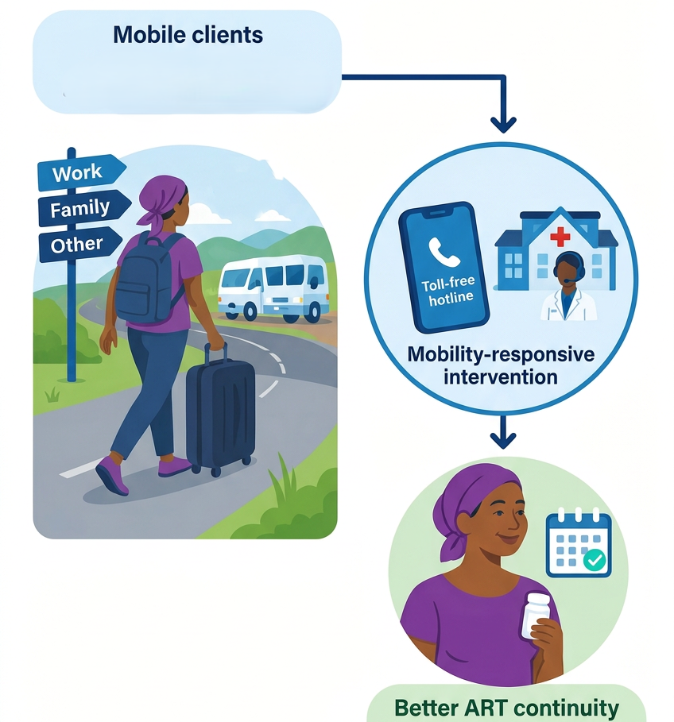
Conclusions
Stakeholders co-developed a mobility-responsive intervention tailored to Malawi
The intervention addresses key client and health system barriers to ART continuity among mobile clients
Evaluation of the intervention package is ongoing to inform refinement and scale-up

Slide 69
Acknowledgements
Participants
ART clients & HCWs participating in IDIs & FGDs
Workshop participants
REMIT partners
Partners in Hope, UCLA, Malawi MOH
Funders
National institute for Mental Health (NIMH) (K01)

Slide 70

AIDS 2026 debrief
Finding the missing 1 in 5
Community-based tracking and re-engagement in HIV treatment among people experiencing treatment interruptions: programmatic outcomes from a multi-district initiative in Eswatini
Notes:
Thanks for having me. I'm Sandile Ginindza, from Young Heroes in Eswatini where I serve as the Technical Director responsible for the design and delivery of programs across four pillars – Health, Education, Protection and Livelihoods.
Today I want to share findings from our AIDS 2026 abstract on community-based tracking and re-engagement in HIV treatment among people experiencing treatment interruptions: programmatic outcomes from a multi-district initiative in Eswatini.

Slide 71
Treatment Interruption Challenges in Eswatini
~1 in 5
people on HIV treatment in Eswatini will experience a treatment interruption
~1 in 6 young adults (18-35) or 17.4% experience a break in their care - Sibandze (2024)
~1 in 4 adults (16+ yrs) or 25% experience unstructured treatment interruption - Kerschberger et al. (2020)
Treatment Interruptions are driven by predictable barriers:
Mobility, stigma, and cost push people out of care
Food insecurity also fuels known disengagements in care
Health Facilities actively flag a missed clinic visit. However, rarely go looking beyond a phone call or SMSs reminder.
Notes:
Recent published studies put the Eswatini scale of attrition in care at roughly 20%. The ratio is higher among older adults at 25% compared to younger adults at 17%.
Our disengagement in care is driven by known barriers including 1) employment driven mobility; social stigma; travel costs and localized food insecurity.
While HFs have invested systems to flag client at risk of treatment interruption actively, few are able to do community tracking for return to treatment beyond phone calls and SMS reminders.
This is where our model kicks in.

Slide 72
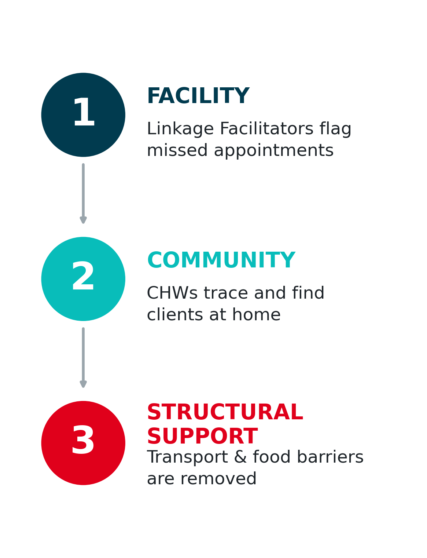
The model: Three moves, one system
Retrospective evaluation of 921 individuals with documented treatment interruptions.
Across 46 healthcare facilities between Aug and Dec 2025.
Multi-cadre response model: Facility Linkage Facilitators systematically identify missed appointments to trigger immediate action & Community Health Workers (CHWs/HVs) conduct targeted household visits to physically locate and re-engage clients.
DSD PACKAGE: deployed resources to directly eliminate structural barriers, e.g. providing transportation subsidies or food assistance - to secure a sustainable return to continuous care.
Notes:
We developed a model that integrated active barrier removal to the stepped-up adherence counselling recommended for those returning to care.
Our model included a coordinated multi-cadre response flow from facility to community and back to facility where:
At facility level – Facility Linkage Facilitators systematically identify missed appointments to trigger immediate action.
At community-level - Community Health Workers (CHWs/HVs) conduct targeted household visits to physically locate and re-engage clients.
Direct Intervention: resources are deployed to directly eliminate structural barriers—such as providing transportation subsidies or food assistance—to secure a sustainable return to continuous care.

Slide 73
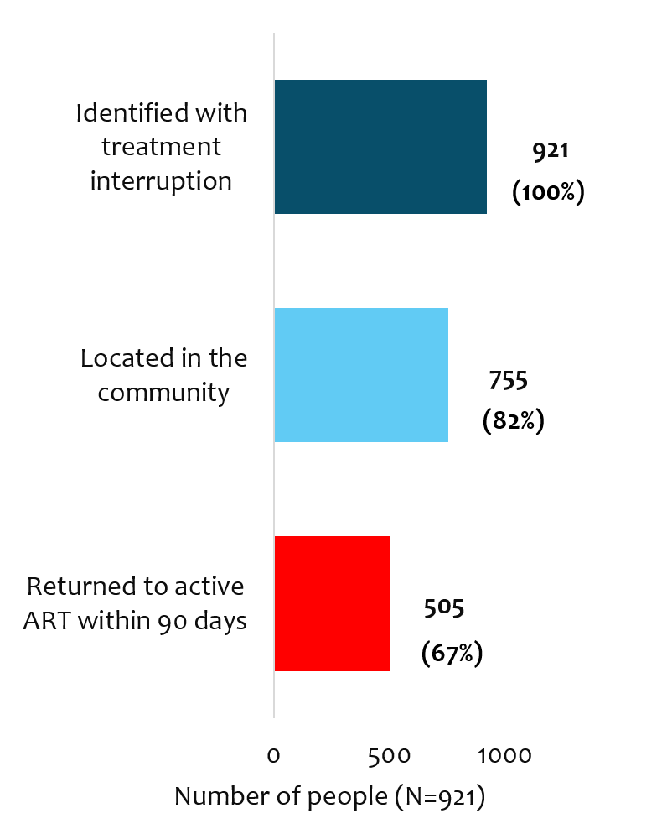
What happened when we looked
7-day median time to return once someone was found
82% (755/921) were located in the community by a CHW.
Of those located, 67% (n=505) were back on ART within 90 days, most within a single week of being found.
Notes:
Of 921 individuals identified, 755 (82%) were located in the community by CHWs. Among those located, 505 (67%) returned to active ART within 90 days — 55% of the total cohort. Median time from identification to return to care was 7 days (IQR 0–34).
Structural support (transport/food vouchers) was independently associated with return to care (aOR 1.96, 95% CI 1.34–2.86). Three-month repeat interruption was significantly lower among clients receiving full structural support than those without it (9% vs. 21%, p<0.001).
All re-engaged clients were confirmed active on treatment in facility records.

Slide 74
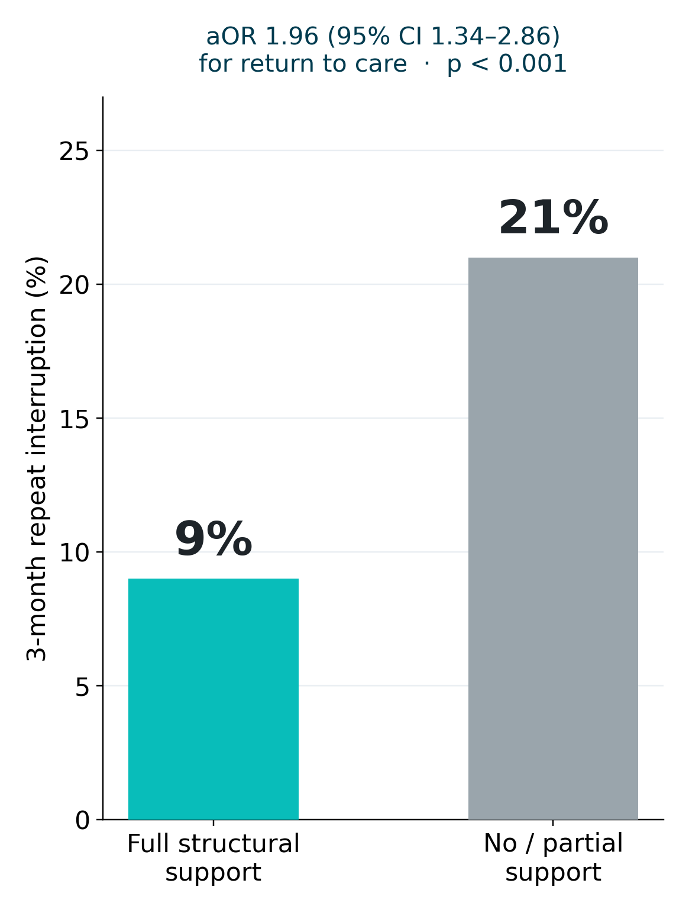
The DSD insight: It wasn’t counselling
People who received transport and food support were nearly twice as likely to return to care (aOR 1.96, 95% CI 1.34–2.86) compared to those who received no or partial support.
Among those who received support, their odds of interrupting again within three months fell from 21% to 9% compared to those who received no/partial support.

Slide 75
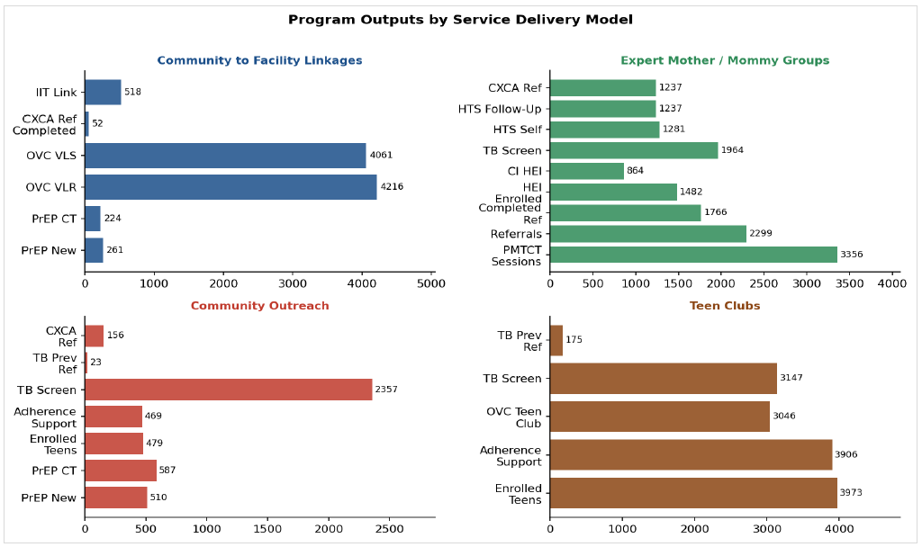
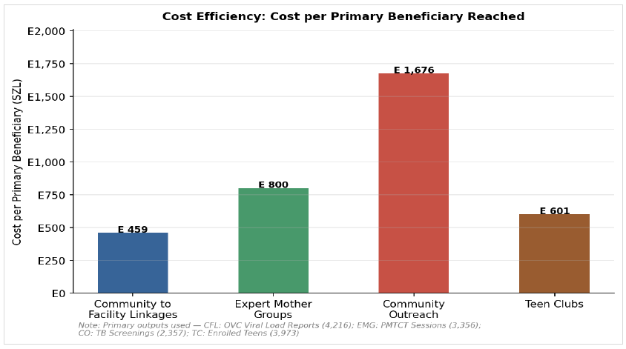
Model Costs: Most cost-efficient of 4 models used in YH programs
A cost analysis assessment done nearly around the same time for all 4 models used in YH implementation showed the Community-to-Facility Linkages model to be cost-efficient.
IIT tracking is one of the interventions delivered under the CFL model and it was found to cost only E459 (28USD) per beneficiary returned to treatment.

Slide 76
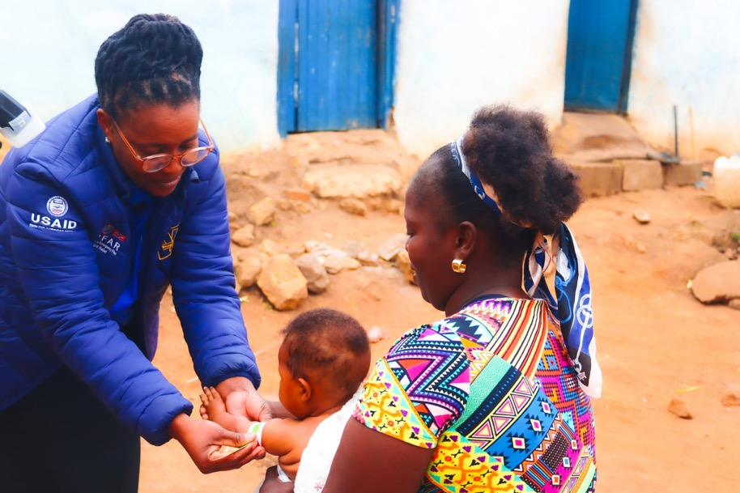
What this means for DSD
CHW-led tracing plus structural support is a low-tech, low-cost DSD component that could plug into almost any high-mobility ART programme.
To maintain the 98-97-98 achievements, Eswatini needs to rethink where else in the cascade a small structural fix beyond counselling could be the real differentiator.
Lessons can very well be transferred to ART adherence support programming for adolescents transitioning to young adulthood.

Slide 77


“Tracing finds people. A transport voucher and a food parcel keep them found.”
  S. Ginindza · Young Heroes, Eswatini

Slide 78
Assessing implementation and expansion of advanced HIV disease services in Malawi
J. Fly Phiri, T. Chimpandule, A. Jahn, R. Malunga, G. Gomani, F. Kalonga, L. Chewere, B.A. Tippett Barr, S. Macheso

Slide 79
Background
Remarkable ART scale-up in Malawi (~ 90% ART coverage).
However, in 2023, about 60,000 people had AHD (2025 Spectrum estimates)
The Ministry of Health and Sanitation aimed to decentralize AHD services and introduced dedicated AHD services in 2024 for all new and re-initiating ART clients.
  Hub and spoke Model
Malawi adopted and adapted the WHO guidance on AHD screening with all:
  Children <5 years not virally suppressed automatically considered to have AHD
  Adults and children ≥5 years with CD4<200
    If CD4 <200, Urine LAM, Serum CrAg, and TB testing
  Clients who are seriously ill or stage 3 or 4l at the time of screening.
We therefore assessed implementation and evaluated gaps in diagnostics and treatment.

Slide 80
Methodology
Analyzed Malawi national AHD program data (July 2024 - September 2025) to evaluate AHD screening and results.
  Screening coverage
  Demographic characteristics
  Proportion with serious illness or WHO stage 3-4
  Coverage of key diagnostics (CD4, CrAg, LAM, Gene Xpert, CXR)
Used National HIV estimates (2025) to compare the proportion meeting AHD criteria to the national AHD data

Slide 81
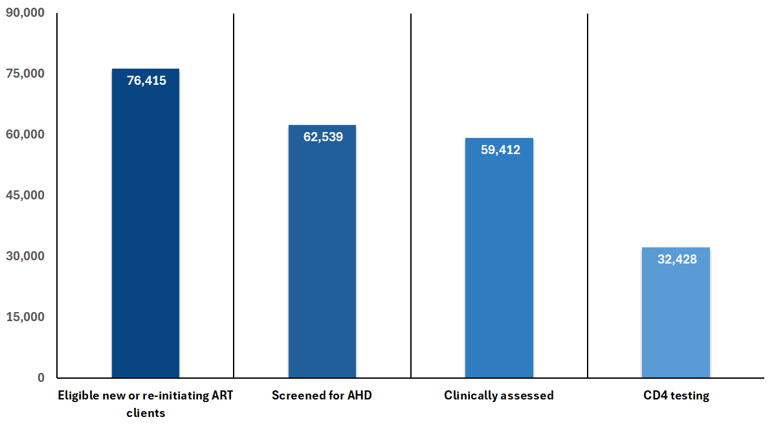
Results: AHD screening
July 2024-Sept 2025
Key messages
Clinical assessments were nearly universally provided.
Only half (52%) of the clients screened for AHD received a lab-based CD4 count
Nearly one-third (29.4%, N=18,405) of clients screened for AHD were diagnosed with AHD based on age, clinical staging, and/or CD4 count
  Representing 39% of the modelled national estimates of 47,000 people with AHD and on ART
82% (n=62,539) were screened for AHD
59% were females
5% were children <15
13% are treatment interrupters
42% are treatment naïve
95% of Clients screened for AHD were clinically assessed (n=59,412)
21% were in Stage 3 or 4 (n=12,517)
~10,287 seriously ill
52% of Clients screened for AHD had a CD4 test (n=32,428)
  29% of whom CD4 <200 cells/mm3 (n=9,486)
  6% of CD4 results missing

Slide 82
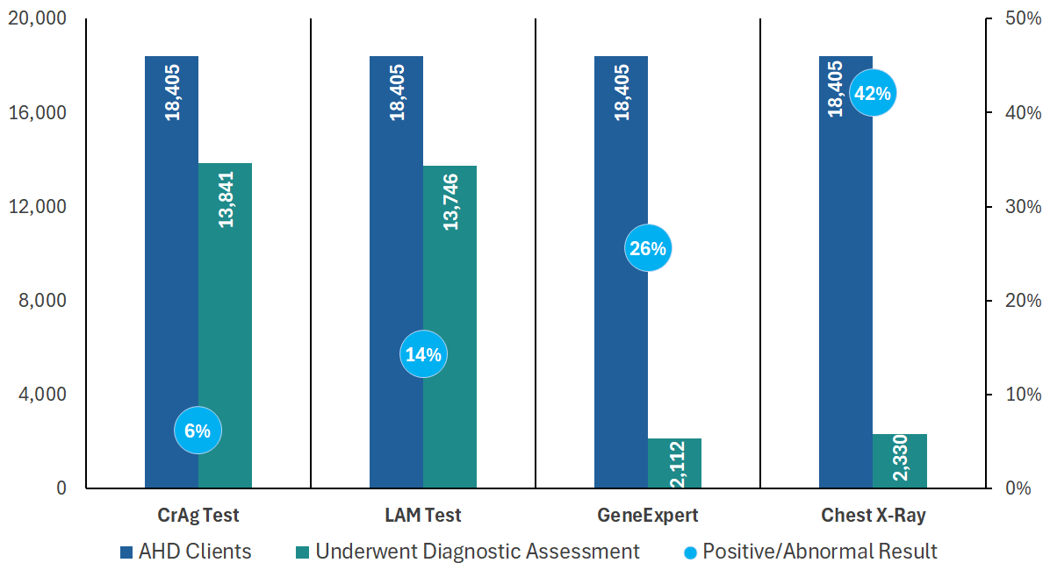
Diagnostics of clients with AHD
July 2024-Sept 2025, n=18,405
Key messages
Very few received the full range of diagnostic tests recommended in the period under review.
Further decentralization of diagnostics is underway in the national HIV program, with semi-quantitative rapid tests being distributed across the facilities, coupled with training for the providers
CrAg: ~75.2% tested
TB-LAM: ~74.7% tested
GeneXpert: ~11.5% tested
Chest X-ray: ~12.7% performed

Slide 83
Conclusions
A structured, routine approach to screening is effective in identifying clients with AHD
We identified 39% of the modelled AHD cases among people on ART
Program data reveal gaps that can be closed:
  CD4 count screening
  Consistent availability of diagnostics for opportunistic microbes or pathogens
Ministry of Health will continue addressing these systemic challenges together with our partners.

Slide 84

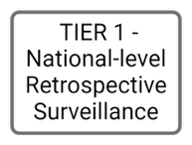



National geospatial mapping of advanced HIV disease (AHD) in South Africa: identifying hotspots for prioritised interventions
Shuping L, Greene G, Mafumo N, Maribe P, Quan V, Mpembe R, Chibabhai V, Maluleka C, Prendergast E, Govender NP, Wake R
Global DSD Research Collaborative Meeting
28 September 2026

Slide 85
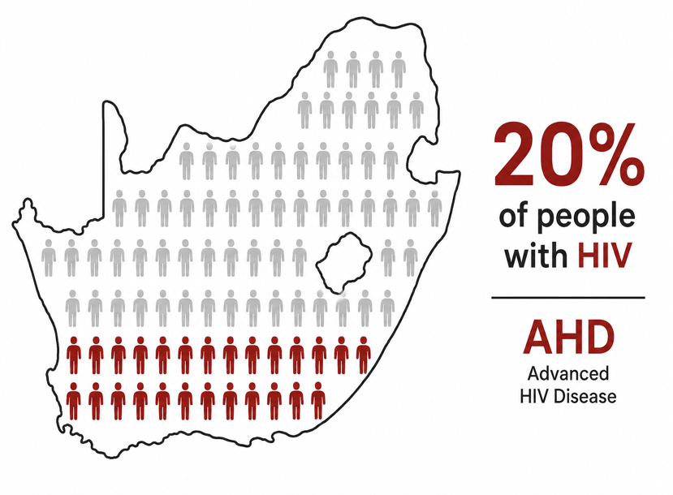
AHD is a heavy burden on healthcare in South Africa
Around 20% of adults living with HIV have AHD
Full CD4 cohort
n (adults) = 7 268 738 million
n (CD4) = 10 874 586
AHD (CD4 <200)
Adults: 1 637 188 (23%)
CD4: 2 116 131 (20%)
Buffer (CD4 ≥200-350)
Adults: 1 389 972 (19%)
CD4: 1 958 502 (18%)
Non-AHD (CD4 >350)
Adults: 4 241 578 (58%)
CD4: 6 799 953 (62%)

Slide 86
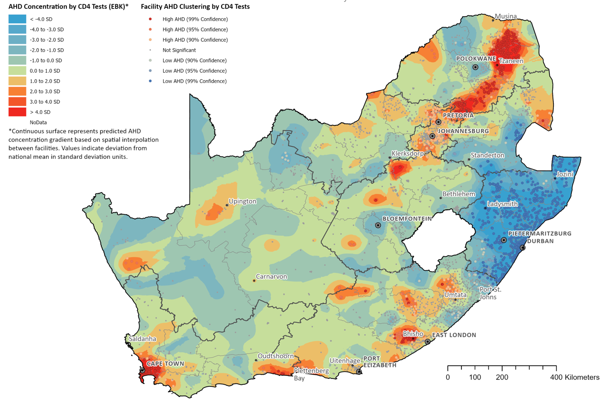

AHD hotspots (by CD4 testing) concentrated in urban areas and in proximity to higher-tier referral hospitals
Reflects referral and testing patterns among
people with AHD

Slide 87
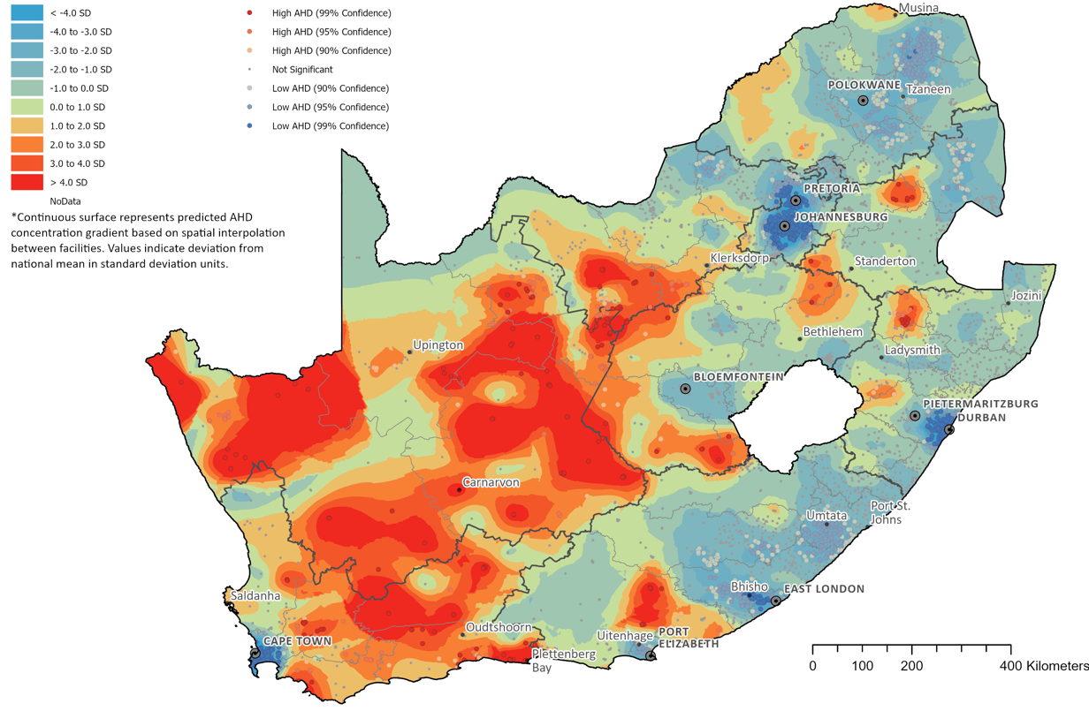
AHD hotspots (by PLHIV) identified a high burden in non-metropolitan areas and sparsely populated regions
Suggests delayed diagnosis, barriers to care,
and ART continuity challenges

Slide 88
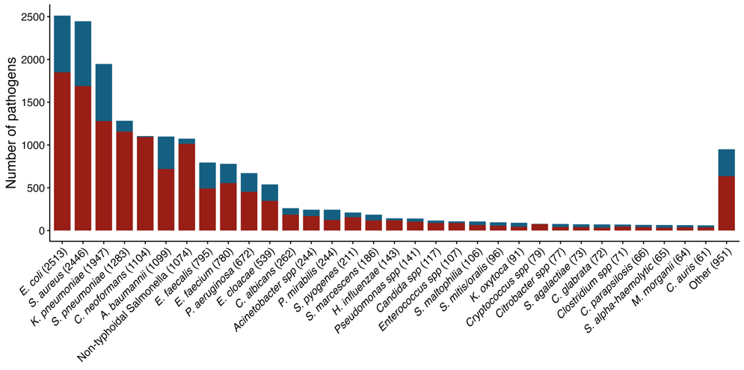

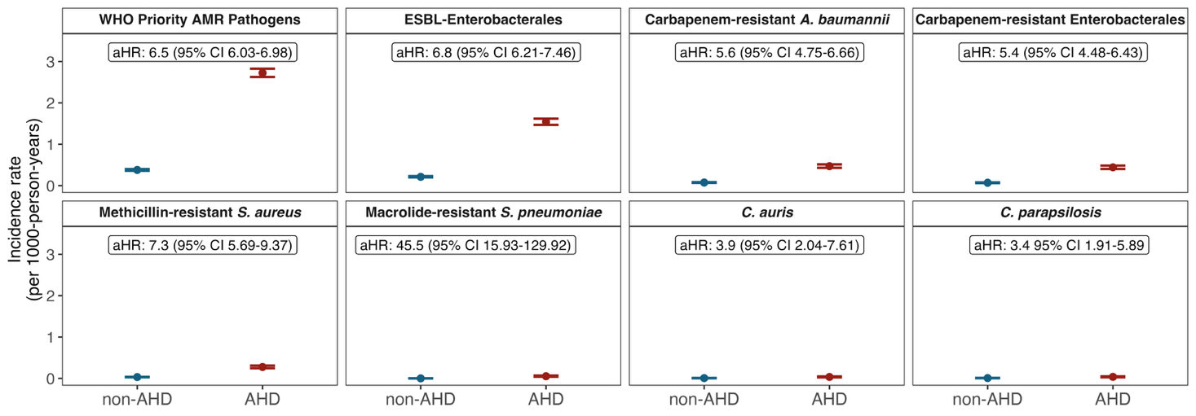



AHD is associated with increased risk of bloodstream and antimicrobial-resistant (AMR) infections
AHD was associated with a >8-fold risk of BSI* during hospitalisation (aHR 8.5 95% CI 8.12 – 8.79)
*BSI: bloodstream infections
AHD associated with >6-fold risk of AMR bloodstream infections with WHO priority pathogens (aHR 6.5, 6.0 – 6.9)

Slide 89

  AHD disproportionately burdens non-metropolitan South African communities and drives high rates of bloodstream infections and AMR.
  Prioritizing early HIV diagnosis and sustained ART retention are critical to preventing AHD progression and associated severe infections

Slide 90





ADVANCE GERMS-SA
Funders:

Slide 91



TB amidst the high tide of ART interruptions: a retrospective cohort study in South Africa
Haroon Moolla, University of Cape Town
September 2026

Slide 92

Background
TB is the leading cause of mortality among PLHIV
ART reduces TB incidence by 60-70%
ART coverage in South Africa: 79%, ~10% have interrupted ART
ART interruption and TB are common – how does cycling into and out of ART affect TB risk?
Haroon Moolla (University of Cape Town)
TB and ART Interruptions

Slide 93
Methods: study population
Retrospective cohort study in the Western Cape, South Africa
Inclusion: Adults
  Started ART 2017-2024
Exclusions: No baseline CD4 count
  TB developing within 90 days of ART start
Follow-up: Starts at ART initiation
  Until last recorded ART prescription, death, or first TB
Haroon Moolla (University of Cape Town)
TB and ART Interruptions

Slide 94
Methods: key variables
“Care status” categories:
ART interruption: no medication “in hand” for 28+ days
Viral suppression: threshold of 1000 copies/ml
First-time ART
Virally suppressed
Not suppressed
Unmeasured
During ART
interruption
Baseline CD4 < 200
Baseline CD4 > 200
Resumed ART
Virally suppressed
Not suppressed
Unmeasured
Haroon Moolla (University of Cape Town)
TB and ART Interruptions

Slide 95
Methods: analysis
Cox proportional hazards model
Outcome: first TB episode after starting ART
Time-updated covariates: age, viral load, comorbidities, calendar year
Inverse probability weighting: for ART status and for censoring

Slide 96
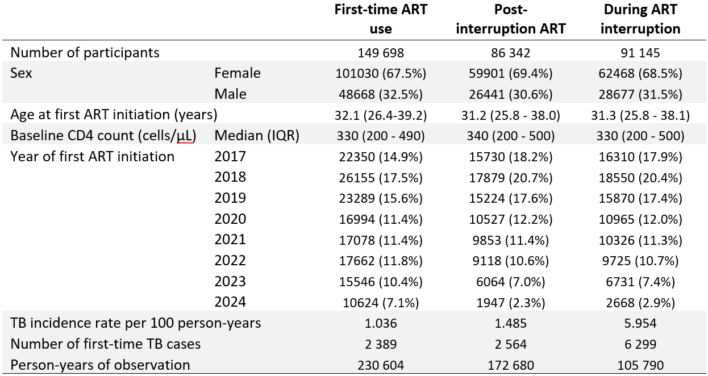
Results
Haroon Moolla (University of Cape Town)
TB and ART Interruptions

Slide 97
Results
Haroon Moolla (University of Cape Town)
TB and ART Interruptions

Slide 98
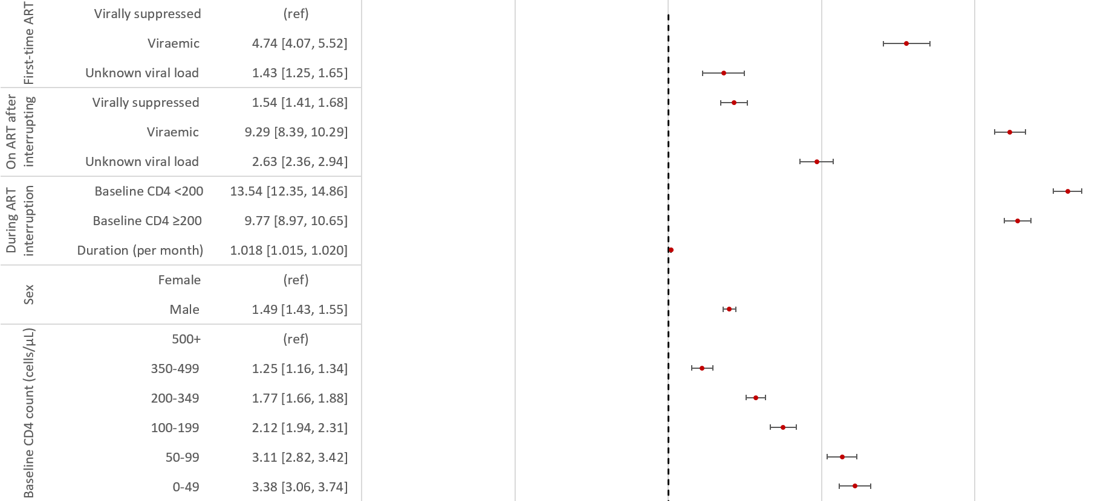
Results: TB incidence
Haroon Moolla (University of Cape Town)
TB and ART Interruptions

Slide 99
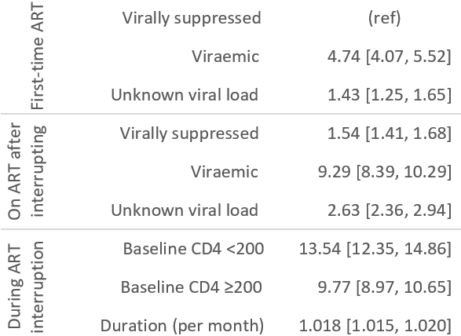
Results: TB incidence
Haroon Moolla (University of Cape Town)
TB and ART Interruptions

Slide 100
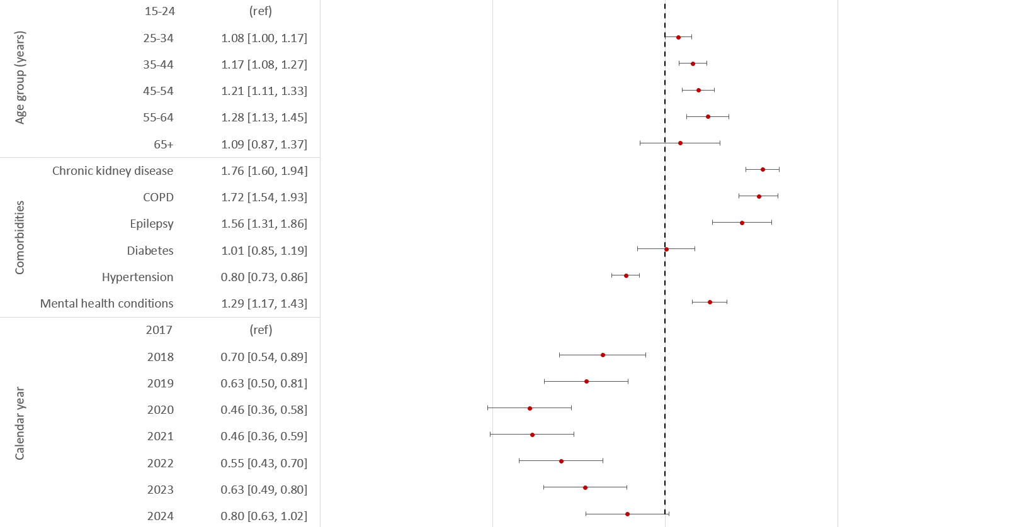
Results: TB incidence
Haroon Moolla (University of Cape Town)
TB and ART Interruptions

Slide 101

Results: TB incidence
Haroon Moolla (University of Cape Town)
TB and ART Interruptions

Slide 102

Limitations
TB screening may be more frequently and diligently done when people re-engage ART
→ higher effect sizes for ART interruptions
Confounding by unmeasured variables: SES, alcohol use, smoking
Generalisability limited by lack of private sector data, and may differ in low TB-burden contexts
Haroon Moolla (University of Cape Town)
TB and ART Interruptions

Slide 103

Key messages
ART interruption is common: 60% by study-end
TB is an additional disease burden related to ART interruptions, distinct from HIV progression
TB vigilance not only at the point of re-engagement, but continued during subsequent care
Haroon Moolla (University of Cape Town)
TB and ART Interruptions

Slide 104
Acknowledgments
Study participants in the Western Cape, South Africa
Data managers at the Western Cape Provincial Health Data Centre
Funding
      Fogarty International Center of the National Institutes of Health and the Eunice Kennedy Shriver National Institute of Child Health & Human Development (NICHD) under Award Number D43 TW010559. The content is solely the responsibility of the authors and does not necessarily represent the official views of the National Institutes of Health.
      The U.S. National Institutes of Health’s National Institute of Allergy and Infectious Diseases, the Eunice Kennedy Shriver National Institute of Child Health and Human Development, the National Cancer Institute, the National Institute of Mental Health, the National Institute on Drug Abuse, the National Heart, Lung, and Blood Institute, the National Institute on Alcohol Abuse and Alcoholism, the National Institute of Diabetes and Digestive and Kidney Diseases and the Fogarty International Center under Award Number U01AI069924. The content is solely the responsibility of the authors and does not necessarily represent the official views of the National Institutes of Health.
Haroon Moolla (University of Cape Town)
TB and ART Interruptions

Slide 105

Dr Jeannette Wessels,
University of Pretoria on behalf of the Sihamba Kunye team

Slide 106

A story we’ve heard before
A breastfeeding mother
An unplanned pregnancy
An HIV negative test during pregnancy
Her baby presents sick at around 7 months of age.
Baby tests HIV positive.
Mother tests HIV positive

Slide 107

~ 70%
of remaining vertical
transmissions occur
during breastfeeding

Slide 108







Background
International and national goals, policies and plans
The problem
THE FIRST
1000 DAYS
11 visits
in the 1st 6 months after birth
resulting in missed opportunities and disengagement from care
Postnatal care for mom is fragmented
Clinical Guidelines
Significant missed opportunities
The “What”
The “How”
Notes:
Background slide: goals/policies, the problem statement (75% vertical HIV transmission during breastfeeding; fragmented postnatal care), and the Integrated Postnatal Care Model as the proposed solution with its expected benefits.

Slide 109





From fragmentation to integration
Part of the Solution
An Integrated Postnatal Care Model
as a "one-stop shop" for all moms and babies,
using a life-course approach
Improve
operational efficiencies
Improved
Clinical
Outcomes
Increased convenience and reduced cost for mother
Sustainable,
using existing
resources
Notes:
Background slide: goals/policies, the problem statement (75% vertical HIV transmission during breastfeeding; fragmented postnatal care), and the Integrated Postnatal Care Model as the proposed solution with its expected benefits.

Slide 110






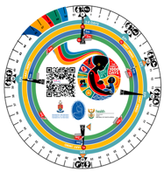

Methods: To figure out the "how" of IPNC
Sihamba Kunye Side-by-Side
A 2-year funded Implementation Science Project (July 2024 to June 2026)
Proof of Concept
8 Facilities
Small, med, large
Urban rural
Tshwane Health District
Gauteng province
Aim: To implement a structured and integrated postnatal care package ('First 1000-day Roadmap') for the mother after delivery, located
at the same service delivery point as care for her infant
Reoriented Clinical Decision Support Tools
Time and Motion Studies
Structured Interviews
Descriptive statistics
1618
Cycle times
> 10800
Maternal Interviews
CFIR:
Enablers and barriers
Roadmap & Integration wheel
Client journeys:
Process flows & bottlenecks
Notes:
Methods slide: Sihamba Kunye Side-by-Side implementation science project design, proof-of-concept scope, four data-collection streams (clinical decision support tools, time-and-motion studies, structured interviews, TripleCare@6), and the two analytic approaches (descriptive analyses, CFIR).

Slide 111
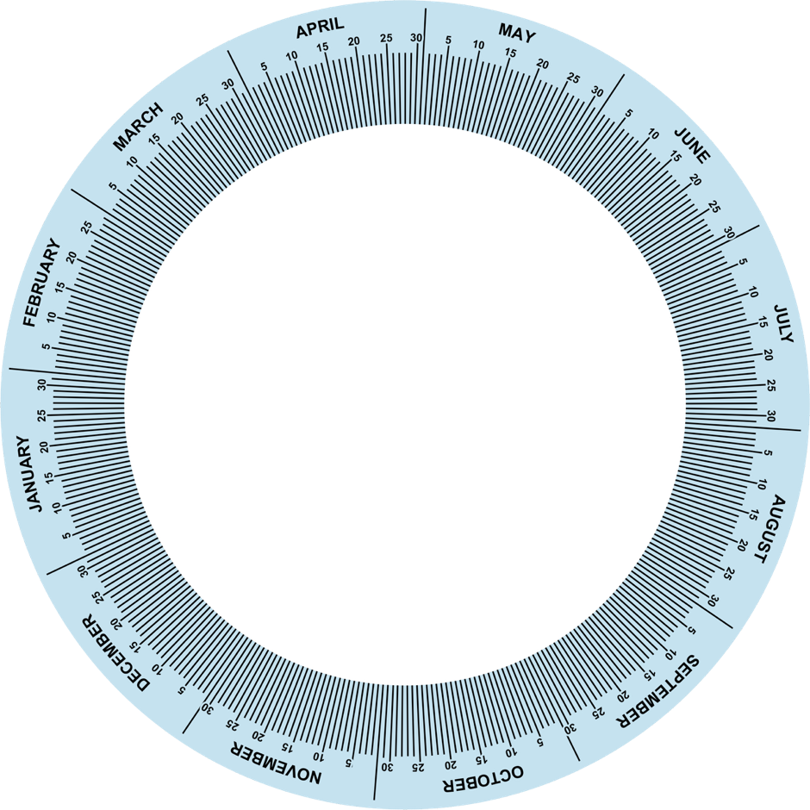
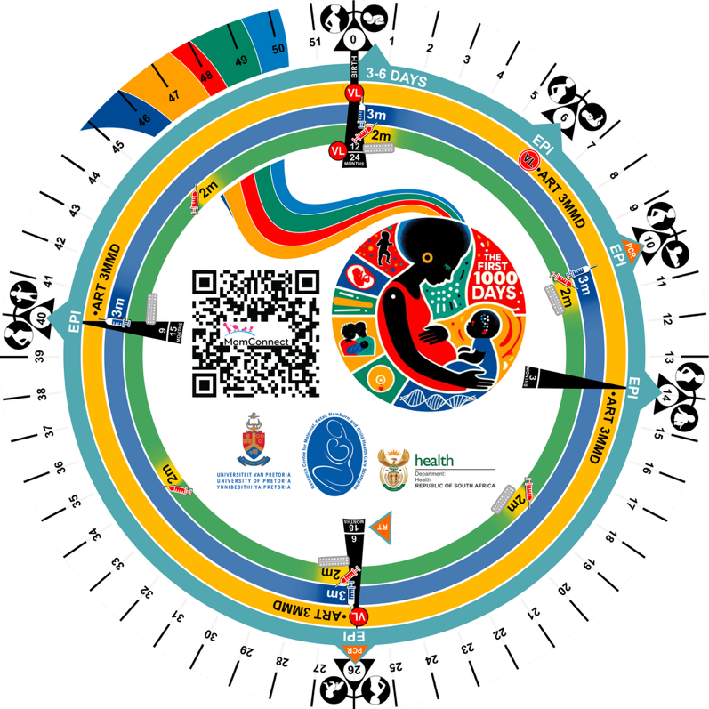
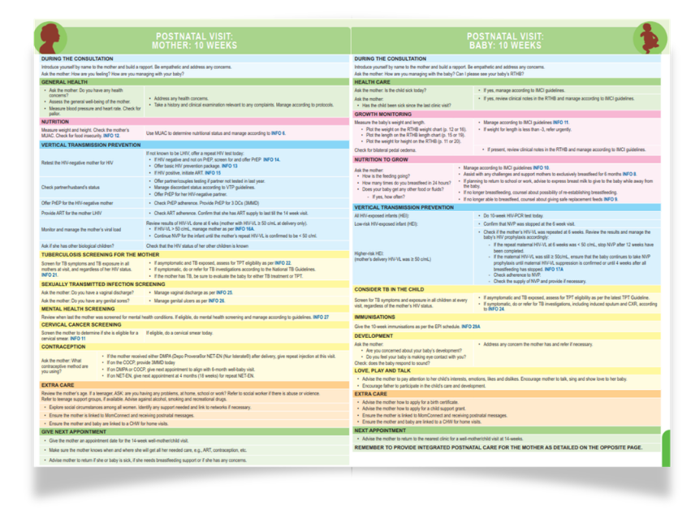
Methods: Clinical Decision Support: Integration Wheel
From a disease-specific orientation
To a patient-centred and visit-focused orientation

Slide 112

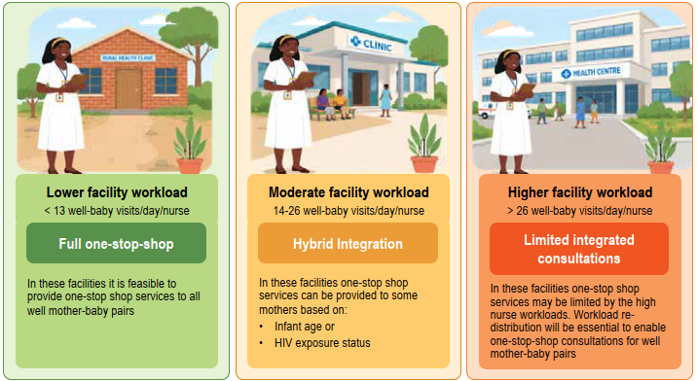
Barriers to integration were primarily operational
1
Consultation time doubles!
Enabled workload calculations
2
Ideal process flows and operational inefficiencies (waste) were identified
Notes:
Operational waste: Any activity or process that consumes resources but does not add value
Types of operational Waste identified: waiting, extra processing, unnecessary motion, defects (e.g. incorrect prescriptions/lab MDOs)

Slide 113

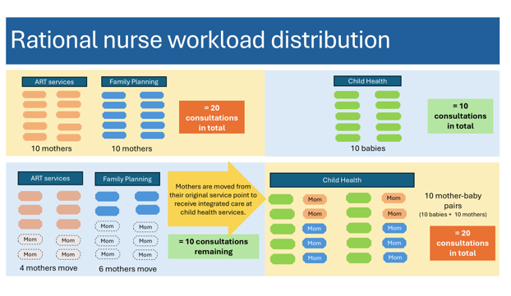
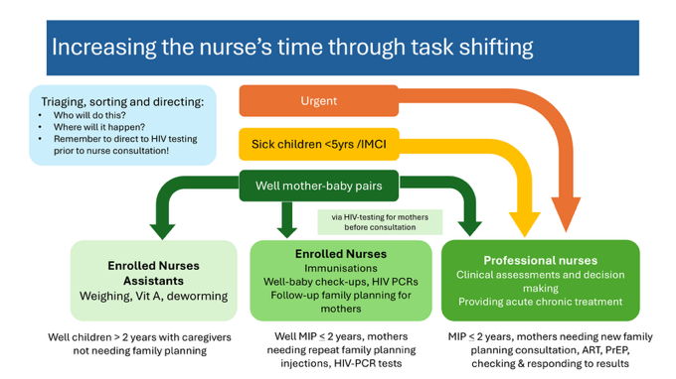
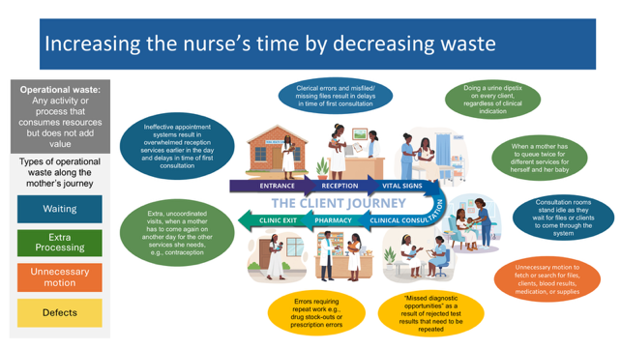
Essential steps for providing integrated postnatal care
Results: Time and Motion Studies (2)
Key facilitator:
Ensuring sufficient nurse consultation time to manage increased per-visit workload
15
The following mechanisms can be used to increase available nurse consultation time without employing more nurses:
Nurse workload redistribution based
on < 5 yr headcount
Task shifting
Decrease process waste
A
B
c
Notes:
A key facilitator of integrated postnatal care was ensuring sufficient nurse consultation time to manage increased per-visit workload when seeing mother–infant pairs at child health service points. Time-and-motion studies identified modifiable process inefficiencies reducing effective consultation time and established average consultation durations of 13m00s for well-baby visits (n=552), 26m00s for well-mother–baby visits (n=252), and 21m30s for sick-baby visits (n=249). Workload optimisation through waste reduction, task shifting, and aligning nurse capacity with under-five headcount enabled efficient one-stop care. Missed opportunities for six-month infant HIV PCR testing at measles immunisation visits declined from 81% (995/1236) at baseline to 37% (299/814) in April–December 2025 (p<0.001).
You can provide additional results during the presentation. But the results as per abstract all need to be covered systematically.
Think around how best to “tell the story” of the results (bit more complex here than

Slide 114
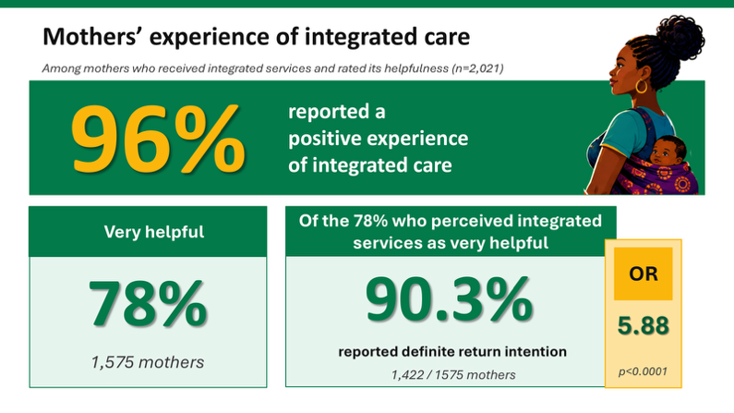
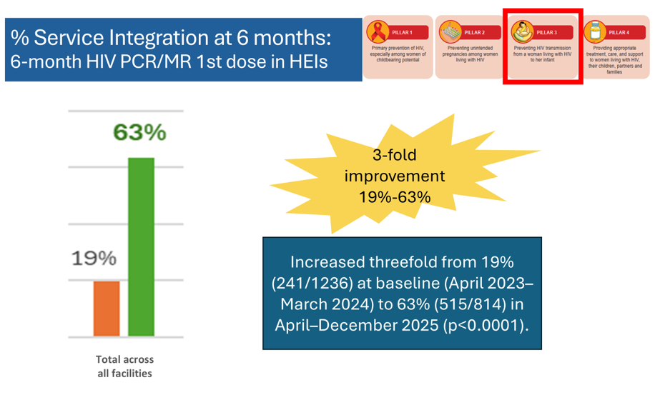
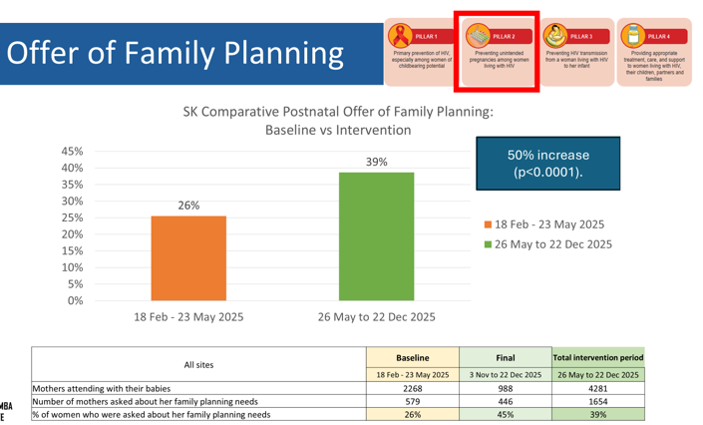
Results
Mothers value Integrated care
FP Offers increased 26% → 39%

Slide 115
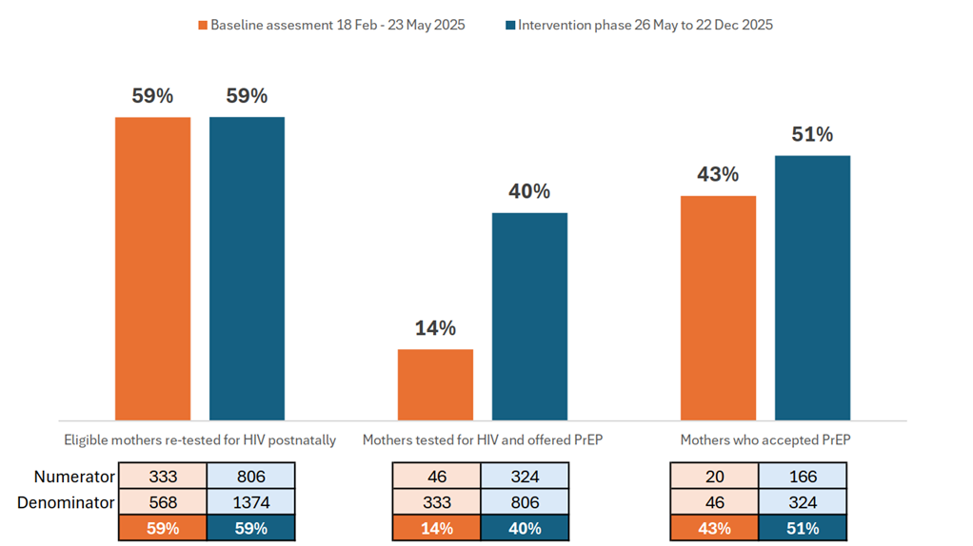
Postnatal PrEP Cascade
2,5-fold improvement 14%-40%
Increased from 14% (46/333) to 40% (333/806), p<0.0001

Slide 116


Slide 117
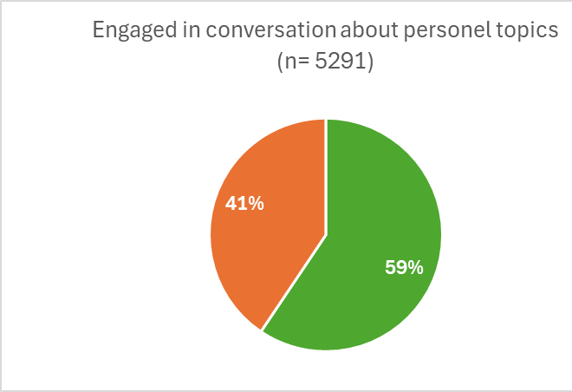
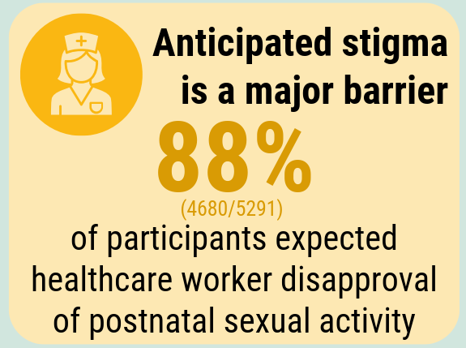
5291
women
41%
DID NOT engage
But, of those who did engage about sex, almost 9 out of 10 did not actually experience stigma
Expected stigma from health care workers around sex is still very prominent barrier to PrEP, even if it may not be accurate

Slide 118
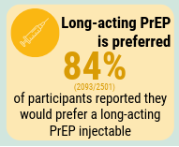
Sub-analysis
2501
HIV negative women

Slide 119
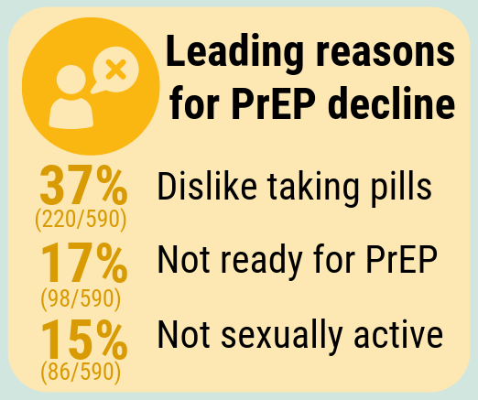
Reasons why women decline PrEP (n=590)
I do not like taking pills
I’m not having sex currently
37%
I’m just not ready yet
15%
17%
My partner is HIV negative
I’m in a monogamous relationship
My partner won’t trust me 4%
I am scared of side effects 6%
12%
9%
Notes:
SK data on reasons people don’t take PrEP

Slide 120


Conclusion
Integrated postnatal care uses a person-centred approach that has the potential to increase access to
HIV prevention and treatment
Contraception
Infant HIV testing, and other care
Integration gaps are operational, rather than primarily clinical
Clinical decision-support tools do change practice
One size does not fit all facilities
Move us closer to VTP elimination targets
Move us closer to SDG survive thrive targets for MIPs
Notes:
Conclusions: Integrated postnatal care provides a person-centered, scalable model that strengthens HIV prevention and treatment during breastfeeding by improving access to PrEP, contraception, ART, maternal VL monitoring, and infant HIV testing, supporting elimination of vertical transmission and the Global
Alliance goal to end AIDS in children.
IPNC is a vehicle to move us closer to the VTP elimination tagrgets and the SDG targets for mothers and babies

Slide 121


Thank you!
Acknowledgements:
Affiliations:
Core Sihamba Kunye research team:
Jeannette Wessels, Ute Feucht, Nthabiseng Serudu-Nageng, Valentina Trivella, Renea Berry, Helen Mulol, Julia Turner
PHC managers:
Mpho Moshime-Shabangu, Melanie Langeveldt
Programme managers and DCST:
Rebecca Makau, Paul Mabasa, Annelet Kruger, Vivian Mfolo, Refilwe Malatji
NDoH Chief Director MNCWH:
Lesley Bamford
Research Centre for Maternal, Fetal, Newborn and Child Health Care Strategies, University of Pretoria
Department of Paediatrics, University of Pretoria
Tshwane District Health Services, Gauteng Department of Health
National Department of Health, Pretoria
City of Tshwane Health Department, Pretoria
Department of Family Medicine, University of Pretoria
University of Pretoria
Research Centre for Maternal, Fetal,
Newborn and Child Healthcare Strategies
ute.feucht@up.ac.za
pj.wessels@up.ac.za
ronald.mosweu@up.ac.za

Slide 122
Discussion

Slide 123
3. Next steps/Any AOB

Slide 124


