Slide 1
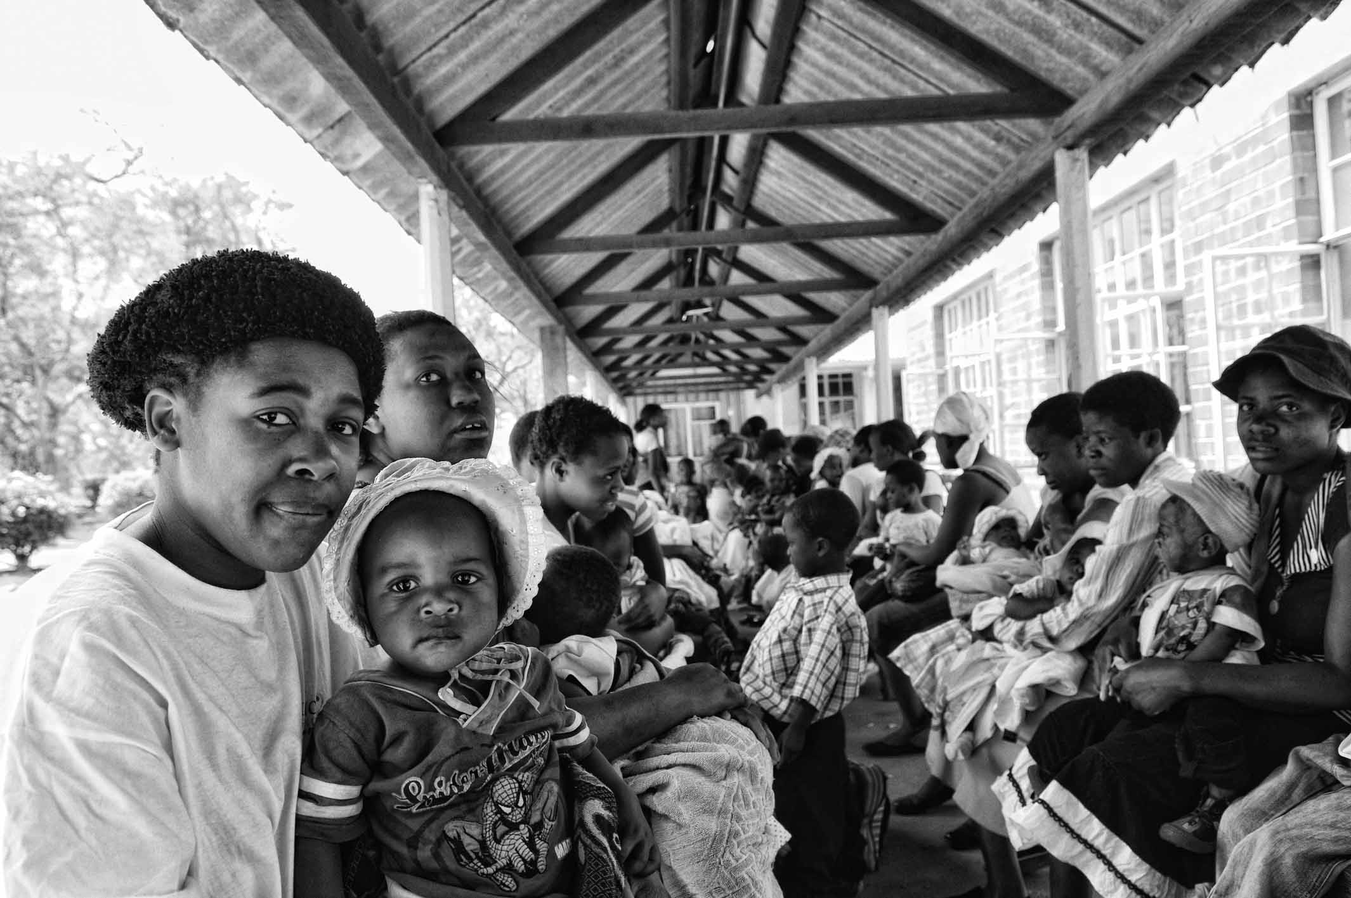
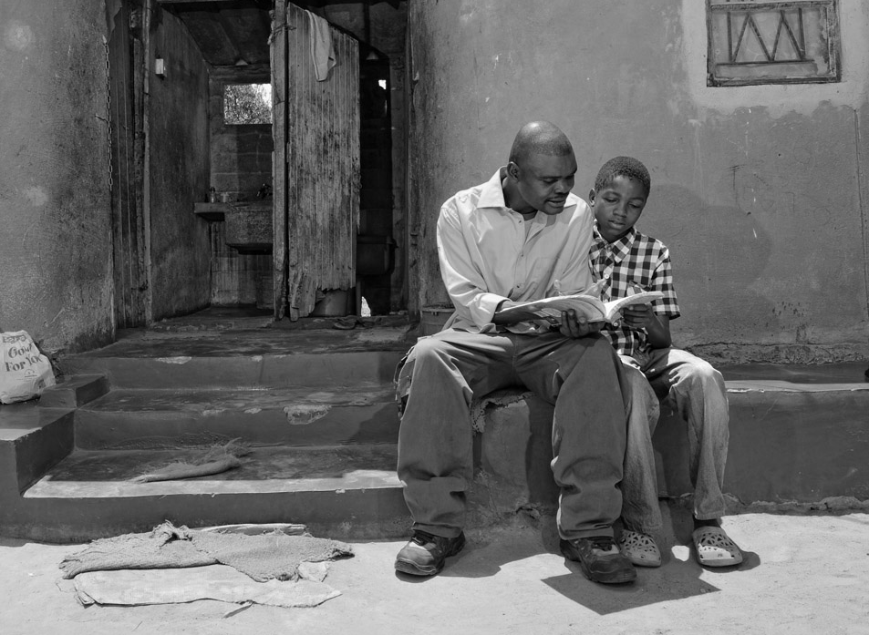
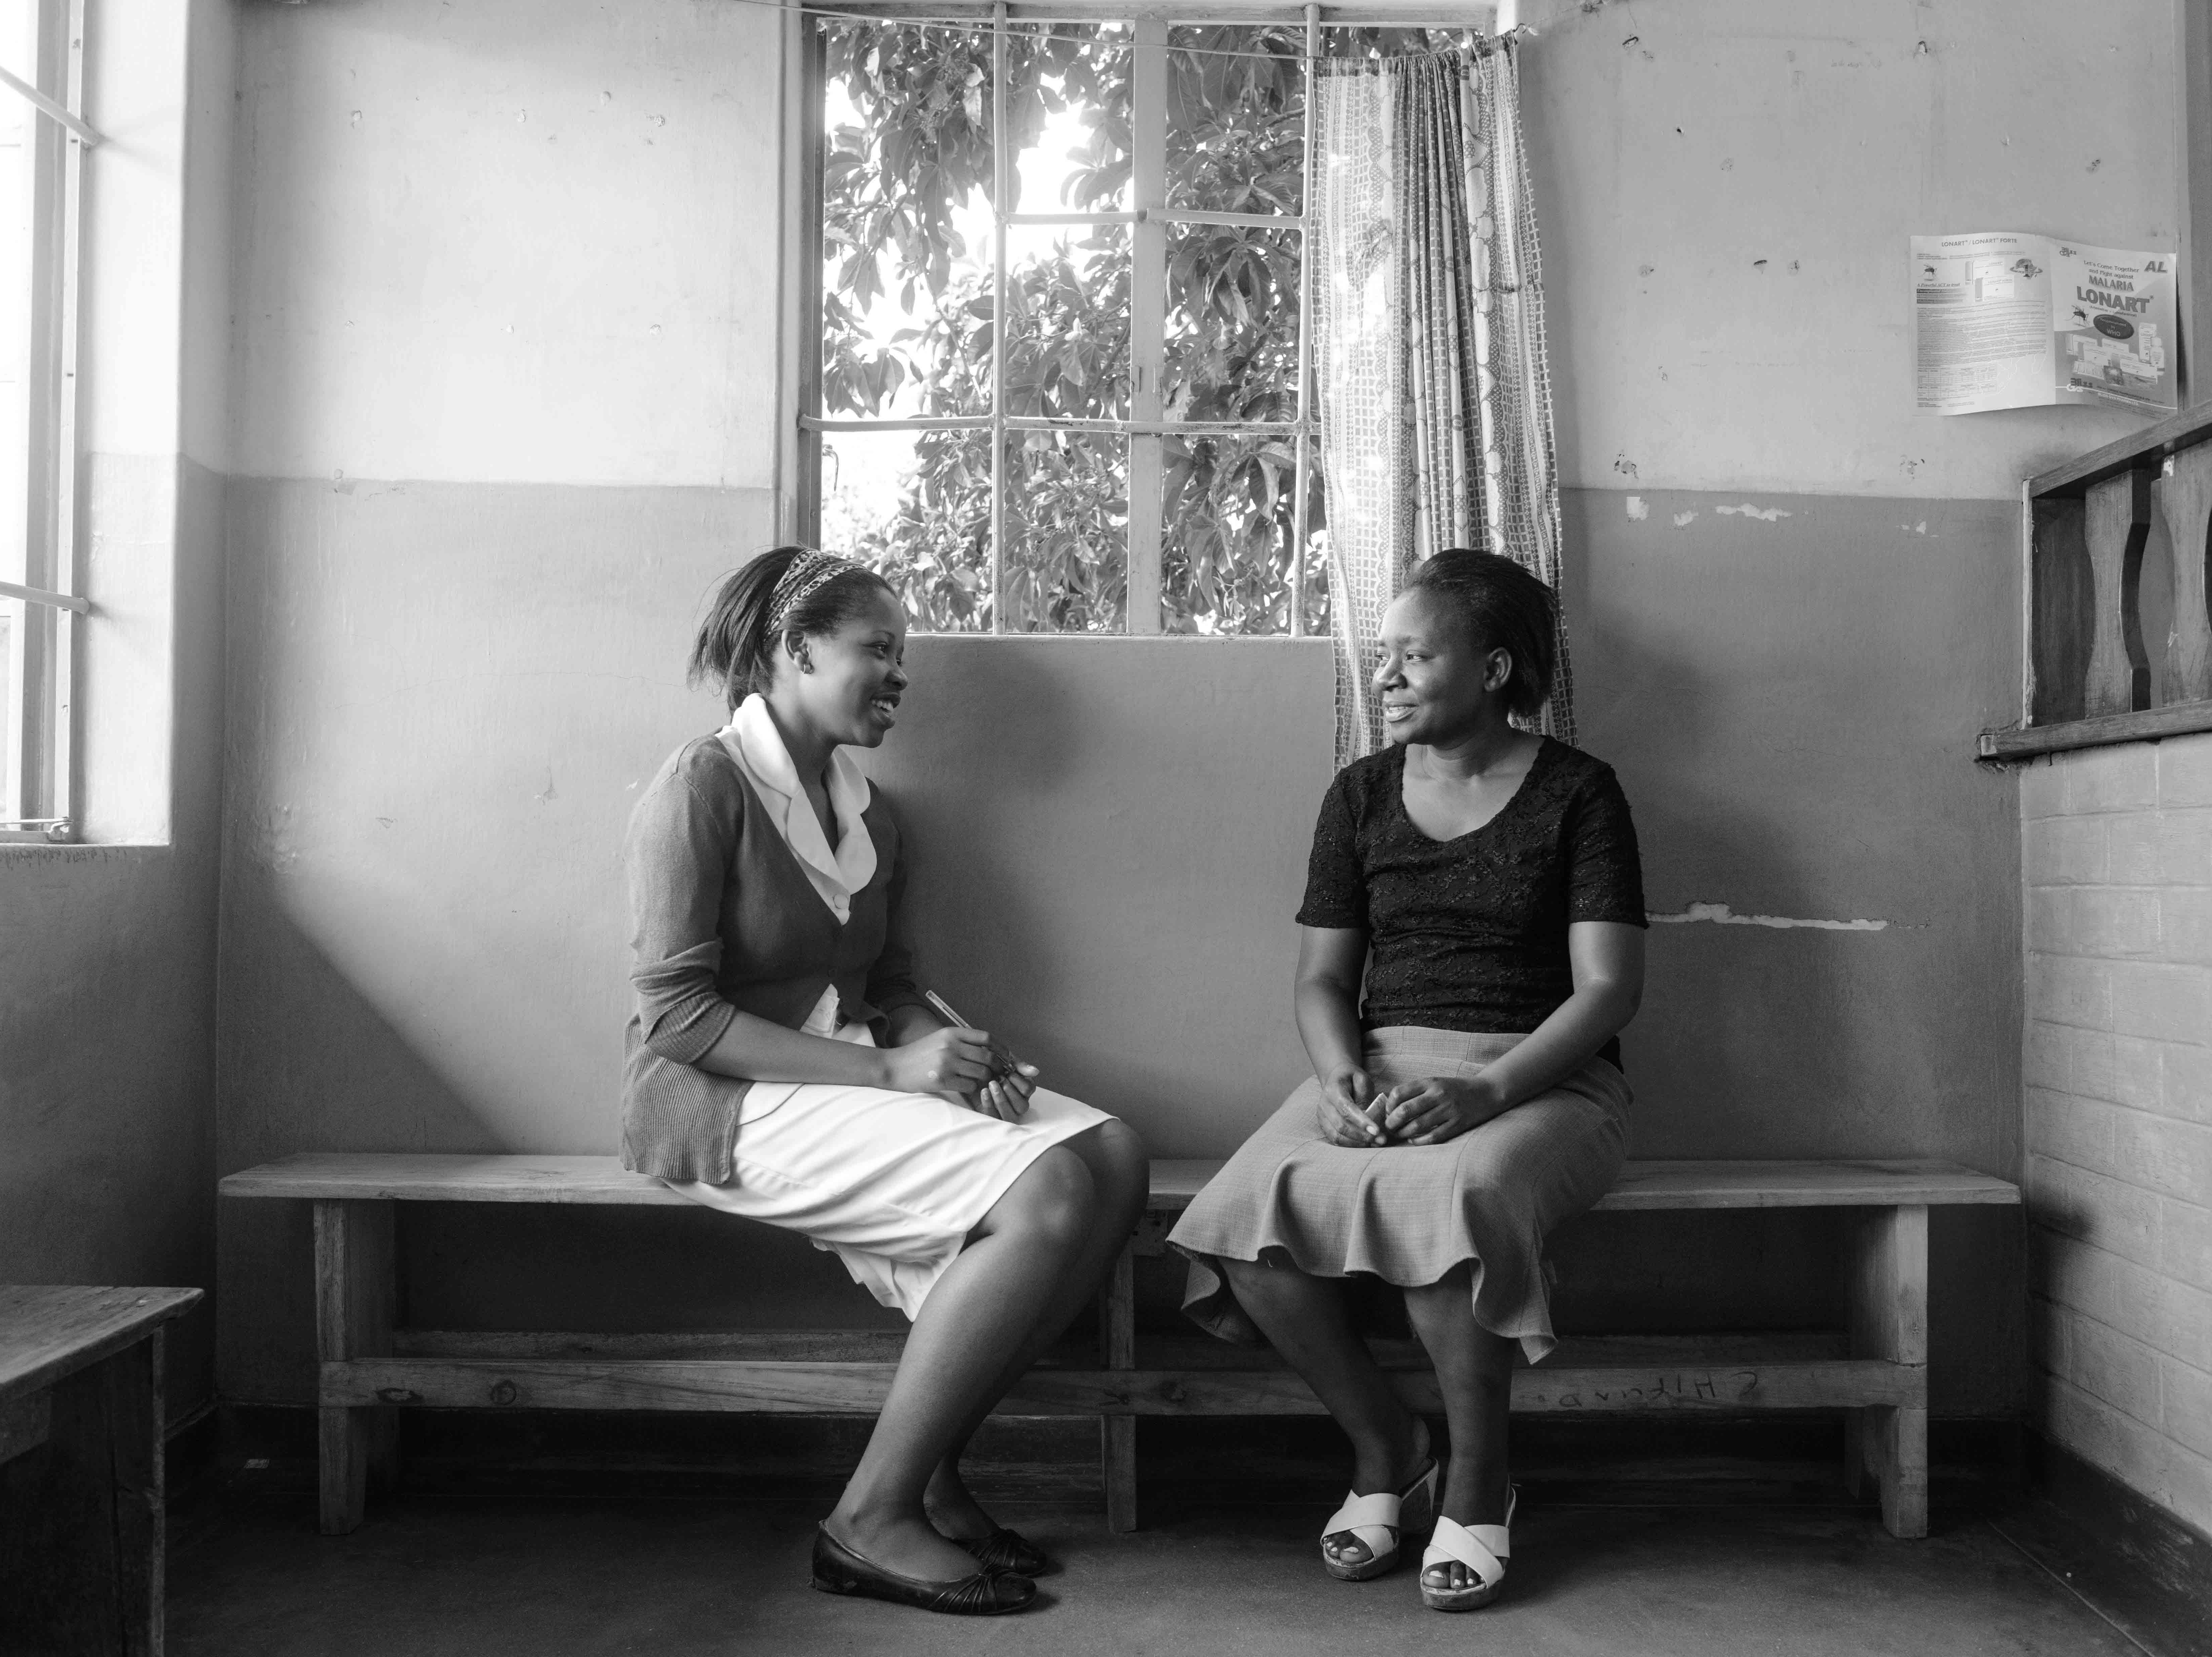
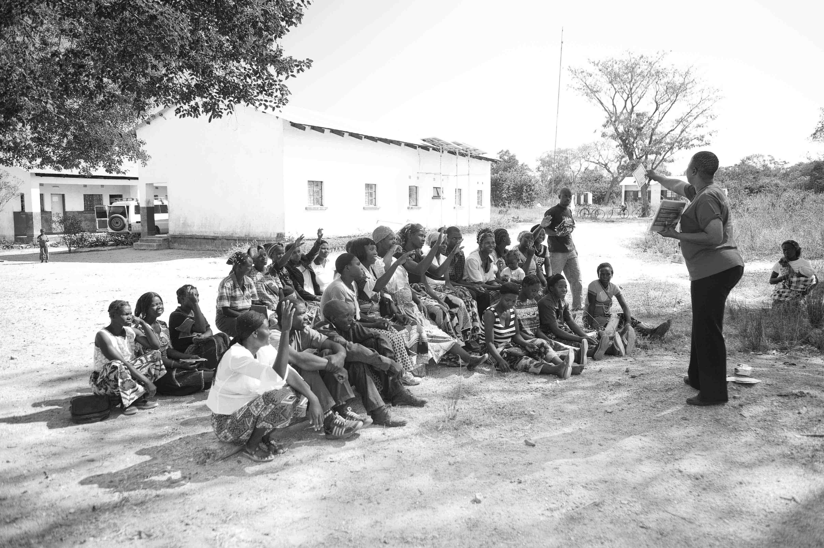


UNITAID PSI
HIV SELF-TESTING AFRICA
Maximising uptake of HIVST Distribution and Linkage: the critical role of user preferences
Fern Terris-Prestholt & Miriam Taegtmeyer
]

Slide 2
Approach
Findings
Next steps

Slide 3
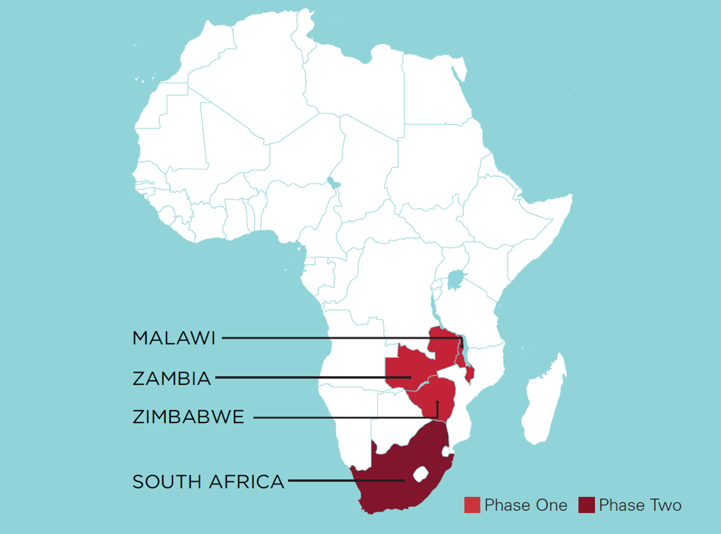
The Research Networks:
QRN & EconNetwork
UK
  LiverpoolSTM
  Lot Nyirenda
  Miriam Taegtmeyer
  LondonSHTM
  Marc D’Elbee
  Fern Terris-Prestholt
Zambia- Zambart
  Musonda Simwinga
  Lawrence Mwenge
Zimbabwe- CeSHHAR
  Nancy Ruhode Claudius Madanhire
  Mary Tumushime
  Euphemia Sibanda Galven Maringwa Collin Mangenah
Malawi-MLW
  Moses Kumwenda
  Nicola Desmond
  Pitchaya Indravudh
  Linda Sande
Notes:
1 minute on importance of face to face and regular skype meetings to bond teams and develop cross country analyses and synergise results

Slide 4
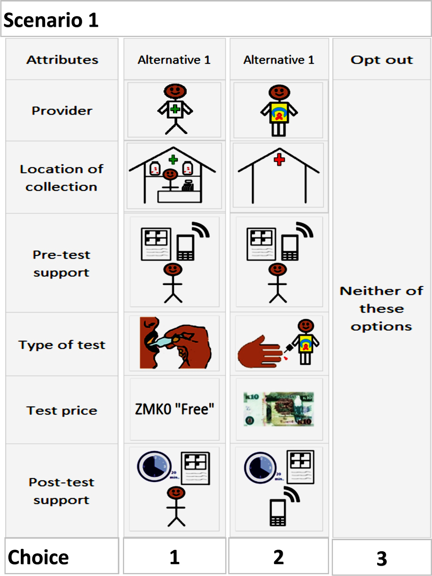
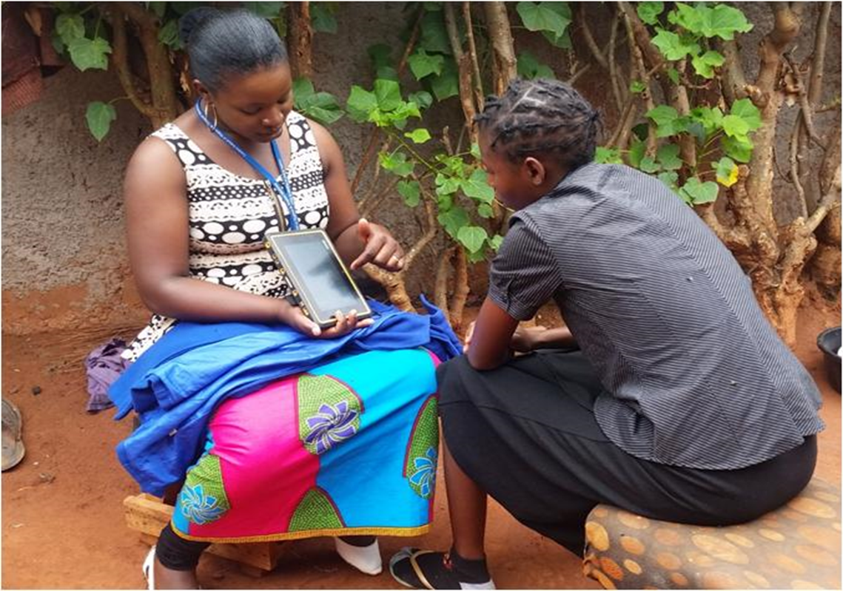
What are DCEs?
A quantitative survey approach to eliciting user preferences
Build on qualitative phase to:
  ensure attributes key in decision-making included, and
  presentation clear
Repeated scenario
responses with
varying characteristics
Force trade offs between attributes allowing quantitative estimation relative values (utilities).
Distrib 1
Distrib 2

Slide 5
Intensity of data collection
Qualitative:
DCE surveys
 | FGDs | IDIs
Malawi | 3 | 33
Zambia | 20 | 44
Zimbabwe | 32 | 25
>150 qualitative interviews
 | Distribution | Linkage
Malawi | 714 | 555
Zambia | 498 | 388
Zimbabwe | 296 | 496
~Almost 3000 DCE interviews
Notes:
In this presentation I aim to demonstrate the wealth of information gained from such an thorough formative research component and most importantly how it contributes to better interventions and higher uptake and linkage to care

Slide 6
Approach
Findings to Date on HIVST preferences
Next Steps

Slide 7
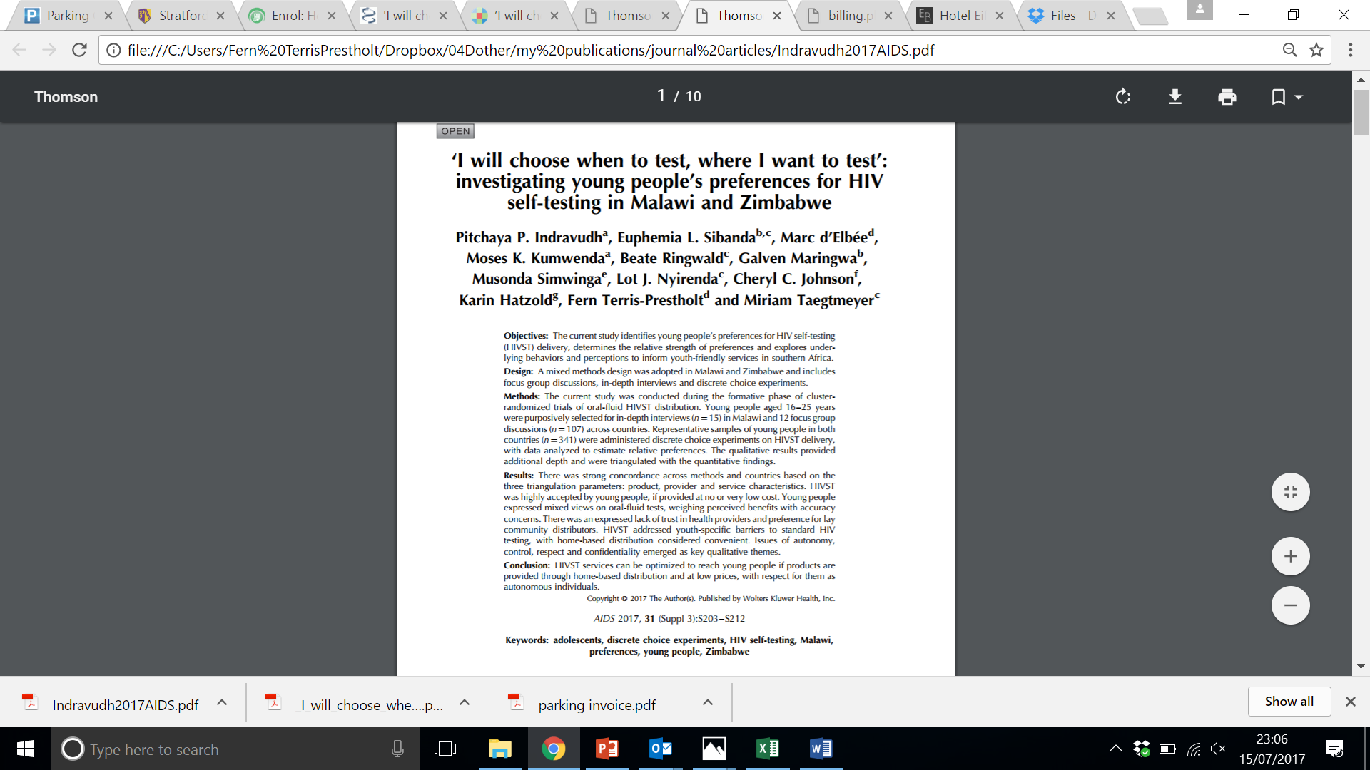
Consider Young People’s preferences for HIVST delivery
Synergise across qualitative and quantitative research on preferences and across countries

Slide 8
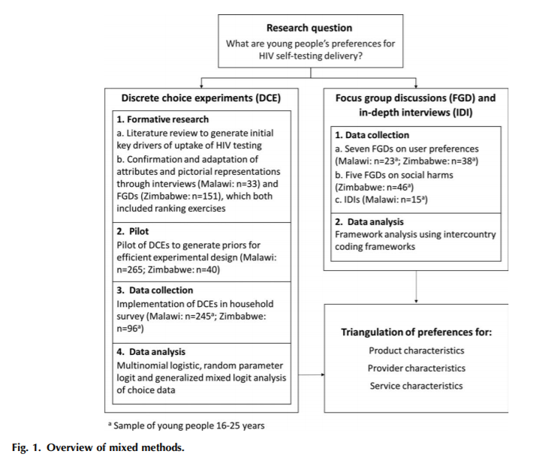
Triangulation
Parallel analysis to triangulate
DCE and Qualitative data to answer core question:
What are young people’s preferences for HIV ST delivery?

Slide 9
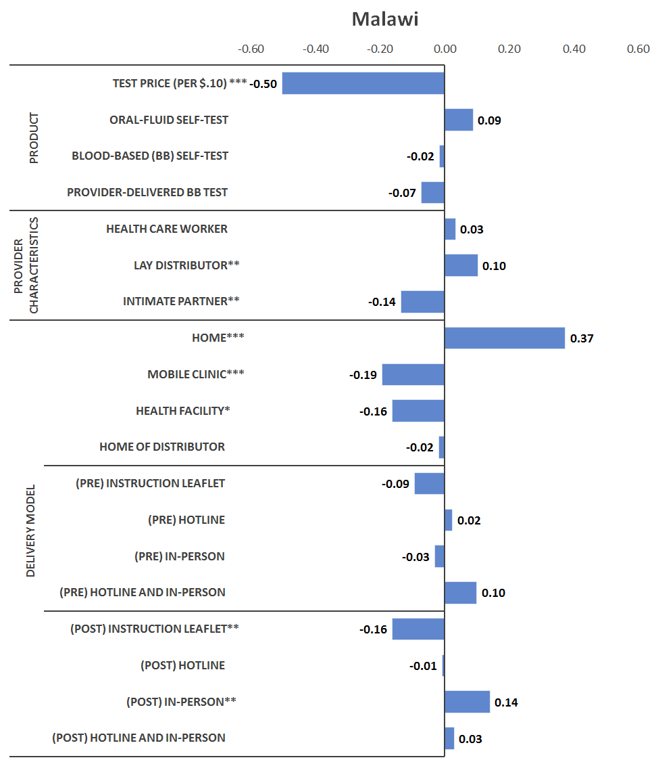
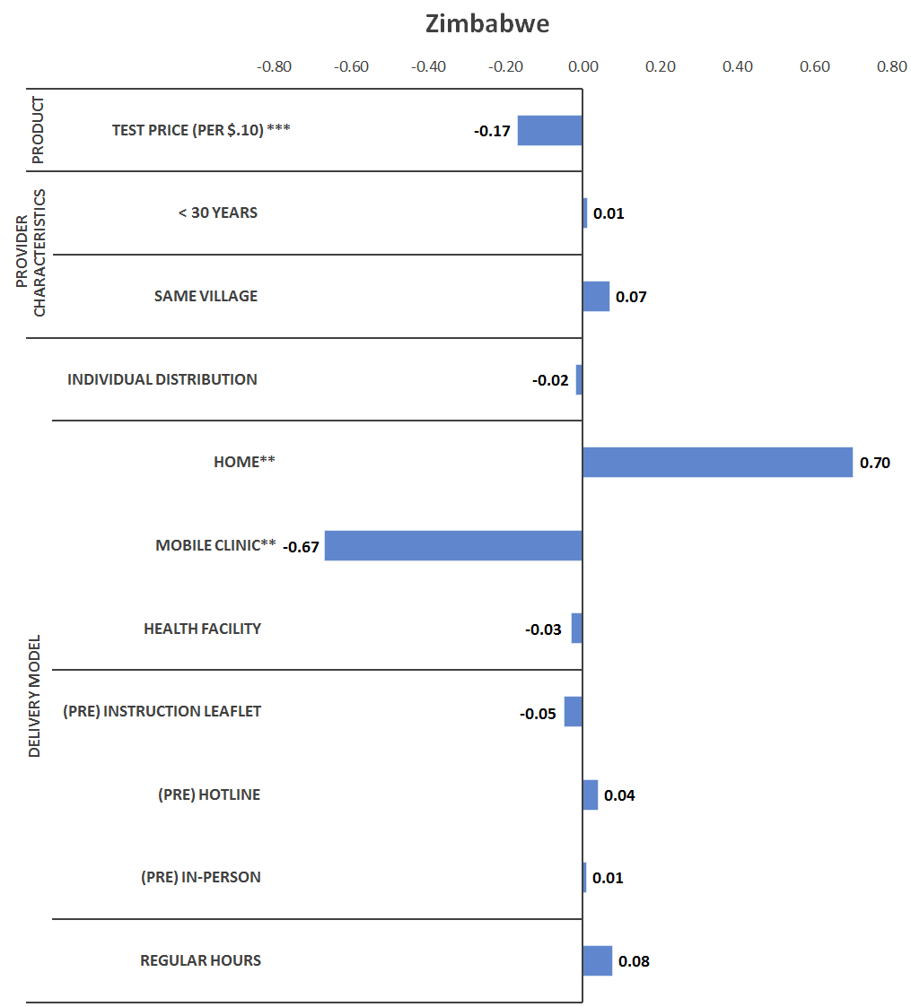
Bars indicate relative strength of preferences

Slide 10
I will choose when to test, where I want to test, and I can determine how private the place of testing is… 19-year-old man, FGD, Zimbabwe

Slide 11
People can’t be going to the hospital for an HIV test... Once I go there today, the news is going to spread everywhere and people will know that so and so is HIV positive. 22-year-old woman, FGD with female youth peer group, Malawi

Slide 12
‘The counselor must be there but not during the entire process’ (22-year-old female, FGD, Malawi).

Slide 13
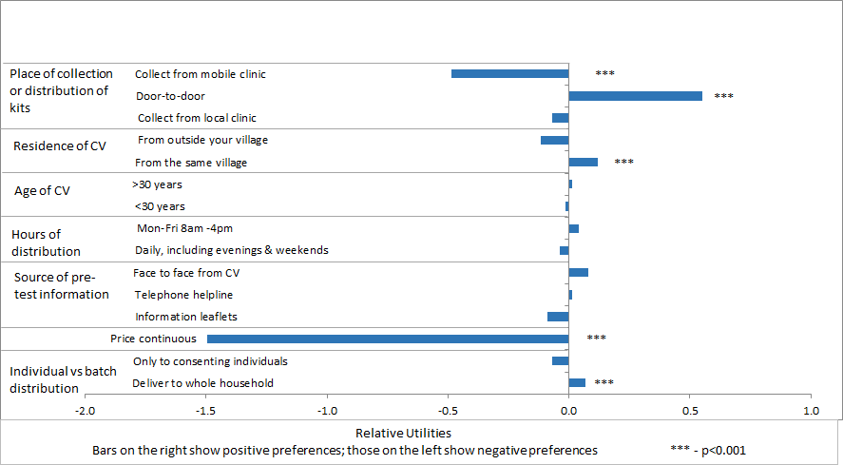
Sibanda, MOPED1114: Preferences for Models of HIV Self-Test Kit Distribution:
Results from a Qualitative Study and Choice Experiment in a Rural Zimbabwean Community
It’s economic in terms of time. Let’s say the hospital is far, you can just test at home
19-year old single woman

Slide 14
Sibanda, MOPED1114: Preferences for Models of HIV Self-Test Kit Distribution:
Results from a Qualitative Study and Choice Experiment in a Rural Zimbabwean Community
It’s economic in terms of time. Let’s say the hospital is far, you can just test at home
19-year old single woman
People will not fork out money to buy a test kit. In my view they would rather go to a clinic where they can be tested for free
22-year old married woman

Slide 15
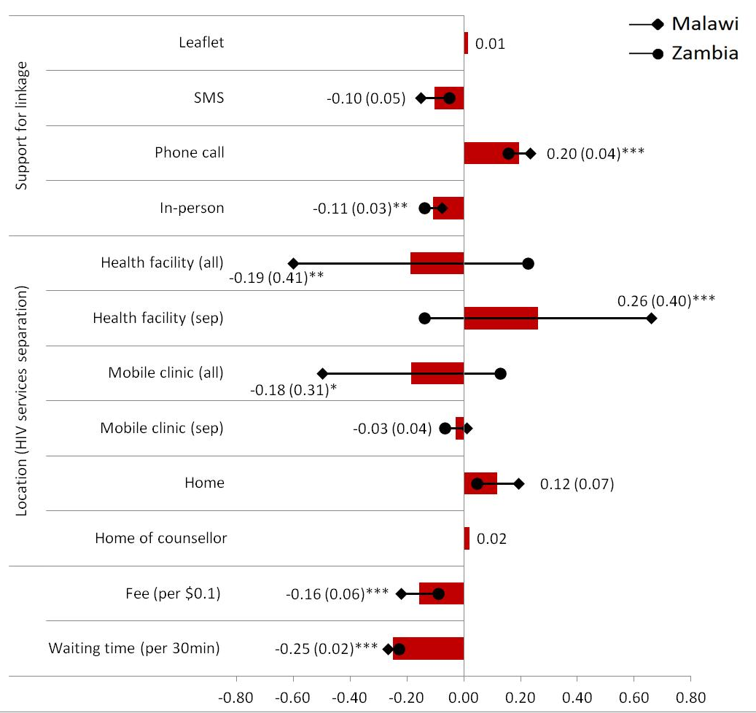
D’Elbée MOPED1095
Supporting Linkage to care after HIVST in Malawi and Zambia
Largely consistent results across countries:
  Phone call preferred post test support
  Paying for confirmatory testing and waiting times strong barrier to link
Notes:
Findings from DCE were consistent across Malawi and Zambia and suggest that optimal linkage programs should prioritize on waiting time and incurred costs for potential users. Community- based approaches are an alternative to overcome these issues. Finally, there
is still a need to address high stigma associated with HIV services.
In Malawi and Zambia, beliefs around ART effectiveness may be affected by traditional views of diseases and cures and could impact on health-seeking behaviours⁴. Future work should explore how these beliefs may affect willingness to seek for care after self-testing for HIV and qualitative studies could help better understand these beliefs and associated behaviours.

Slide 16
D’Elbée MOPED1095
Supporting Linkage to care after HIVST in Malawi and Zambia
Largely consistent results across countries:
  Phone call preferred post test support; in person least desirable
  Paying for confirmatory testing and waiting times strong barrier to link
Malawi strong preference against waiting all together regardless of facility type
Notes:
Findings from DCE were consistent across Malawi and Zambia and suggest that optimal linkage programs should prioritize on waiting time and incurred costs for potential users. Community- based approaches are an alternative to overcome these issues. Finally, there
is still a need to address high stigma associated with HIV services.
In Malawi and Zambia, beliefs around ART effectiveness may be affected by traditional views of diseases and cures and could impact on health-seeking behaviours⁴. Future work should explore how these beliefs may affect willingness to seek for care after self-testing for HIV and qualitative studies could help better understand these beliefs and associated behaviours.

Slide 17
Approach
Findings
Next steps
Further analyses of preferences and valuation

Slide 18
Preference heterogeneity
To better tailor services to those currently failing to test and link:
  Analysis of preferences by:
    Testing status
    Gender
    Age
    Belief in ART
    Religion (in Zimbabwe)

Slide 19
Demand for HIV self-tests in Zimbabwe: A field experiment
CeSSCHAR, UNC, PSI
Door to door offer of HIVOFT voucher (random allocation of prices, range $0-5 for urban, $0-2 for rural)
Questionnaire
Aims
Estimate demand for HIVST at different out of pocket prices
Compare client characteristics for those who buy kits at low vs high prices
Examine whether demand for repeat HIVOFT is contingent on initial prices
  Planned start end Aug/Sep 2017
Allow one month for using voucher (can buy two HIVOFT kits)
Twelve months later
Offer of HIVOFT via SMS at a common price for all
Allow one month for using voucher (can buy two HIVOFT kits)

Slide 20
Key Messages

Slide 21
Cross Country Formative Research Lessons
High quality cross country analyses through investment in research networks, generates robust evidence to support high uptake strategies
  People like HIV self testing but are concerned about:
    price, and anonymity
  Consistent preferences
      favouring home distribution by lay counsellors
      against mobile testing and distribution by partners
  Deferring preferences around:
    Forms of support (pre-and post test & and linkage) ; oral versus blood
Analysis of variation in preferences across populations can strengthen user-centred interventions and targetting, including private sector distribution & WTP

Slide 22
HIV-STAR Preferences at IAS
Views on HIV self-test kit distribution strategies targeting female sex workers: qualitative findings from Zimbabwe,
  Mary Tumushime, CeSHHAR, Zimbabwe (WEPDD0102)
Preferences for models of HIV self-test kit distribution: results from a qualitative study and choice experiment in a rural Zimbabwean community,
  Euphemia Sibanda, CeSHHAR, Zimbabwe (MOPED1114)
Informing targeted HIV self-testing service delivery in Malawi and Zambia: a multi-country discrete choice experiment,
Marc d’Elbée, LSHTM, UK (MOPED1095)

Slide 23

Contact
DR. MIRIAM TAEGTMEYER, PHD
STAR Qualitative lead
Liverpool School of Tropical Medicine
Miriam.Taegtmeyer@lstmed.ac.uk
FERN TERRIS-PRESTHOLT, PHD
STAR Economics Lead
London School of Hygiene and Tropical Medicine
Fern.Terris-Prestholt@lshtm.ac.uk
DR. KARIN HATZOLD
Director UNITAID/PSI HIV Self-Testing Africa (STAR) Project
khatzold@psi.org

