Slide 1

Factors associated with loss to follow up in a primary healthcare clinic practicing test and treat
Authors:
Julius Kiwanuka^{1,2}, Noah Kiwanuka³, Flavia Matovu Kiweewa^{3,4}, Juan Gonzalez Perez⁵, Jonathan Kitonsa^{2,6}
Authors’ Affiliation:
AIDS Healthcare Foundation, Kampala, Uganda
Makerere University School of Public Health, Kampala, Uganda.
Makerere University School of Public Health, Epidemiology and Biostatistics, Kampala, Uganda.
Makerere University John Hopkins Research Collaboration, Kampala, Uganda.
AIDS Healthcare Foundation, Kigali, Rwanda.
Medical Research Council Uganda Virus Research Institute, Masaka, Uganda

Slide 2
Background and rationale
World health organisation (WHO) currently recommends T&T in all, regardless of CD4 cell count or WHO stage.
Current HIV treatment programs especially in sub Saharan Africa are plagued with the challenge of patients‘ loss to follow up.
To date, little information is available on factors associated with LTFU in a T&T setting.
We set out to study factors associated with loss to follow up (LTFU) in a primary healthcare facility practicing T&T.
Notes:
UN 2015 report estimated that out of the 2.1m new infections recorded in 2013, almost half (48%) were in three SSA countries including Uganda.
By 2013, an estimated 35 million people were living with HIV and only 13.6M estimated to be on treatment.
Treatment demonstrates a protective effect against HIV infection in sero-discordant couples and currently WHO recommends wide spread ART coverage to reduce on community viral loads. Therefore,
Its Up on this success of TasP, WHO thru UNAIDS has set ambitious testing and enrolment targets achievable by the year 2020.
Putting the 90-90-90 campaign into perspective, HIV testing and immediate enrolment (Same Day Testing and Same Day Enrolment –SDT/SDE-) can be important in immediately increasing patients’ numbers into HIV programs.
However, how long and well clients tested and enrolled instantly sieve HIV care as part of them, to ultimately stay in care, has not been widely studied.
Experience from PMTCT programs where SDT/SDE has largely been practiced, indicate quite a large number (50%) of mothers (with their new-borne infants) getting lost shortly after delivery.
Understanding time to patients’ attrition is important to mitigate it before it occurs whereas understanding the factors associated with it, provides insights into improvement of the overall HIV care cascade.

Slide 3
Methods
We retrospectively sampled 600 patients from routine patients' data in OpenMRS at Masaka Regional Referral Hospital Uganda Cares clinic.
    Clinic started piloting T&T at the beginning of 2012.
    Included patients tested and initiated on ART from January 2012 to December 2014.
    Defined (T&T as Test date=ART start date; Deferred=Otherwise)
    Analysis date Dec-2014
We defined loss to follow up as;
    Failure of the client to show up at the Masaka clinic for at least 90 days from the date of their last scheduled appointment taking 31st December 2014 as the reference date.
We determined cumulative incidence of loss to follow up at differing time intervals.
    Compared LTFU using competing risk regression
    Used multivariable cox proportional hazards regression model to determine factors associated with time to LTFU (with death as a competing risk).

Slide 4
Ethical Considerations
Ethical review/approval was sought from the Makerere University School of Public Health Institutional Review Board (MUSPH-IRB).
Engaged Clinic’s management where the study was conducted.
Program data routinely collected and entered into an electronic records management system (OpenMRS) was extracted with patients’ identifying information only limited to a database Identification Number (patient ID).
Notes:
This was done to conserve the confidentiality of patients.

Slide 5
Results
Baseline characteristics.
Characteristic (s) | Percent
Started ART instantly | 50%
Females | 64.7%
Median Age (IQR) | 30.4 (23.8-37.1)
Median CD4 at Start of ART (IQR) | 373 (204-570)
Proportion of patients in WHO stage 3&4 | 15.2%
Proportion of Patients with Access to Phone | 43.5%
Proportion with suspected or diagnosed TB | 7.5%

Slide 6
Results..
Compared to the T&T group (12.3%,95% CI=7.9-17.5%), cumulative incidence of LTFU was 5.9% (95% CI=3.6-9.0%) in the deferred group within 12 months of ART initiation
Notes:
Generated with Death as a competing risk
Difference was sign (p=0.023).

Slide 7
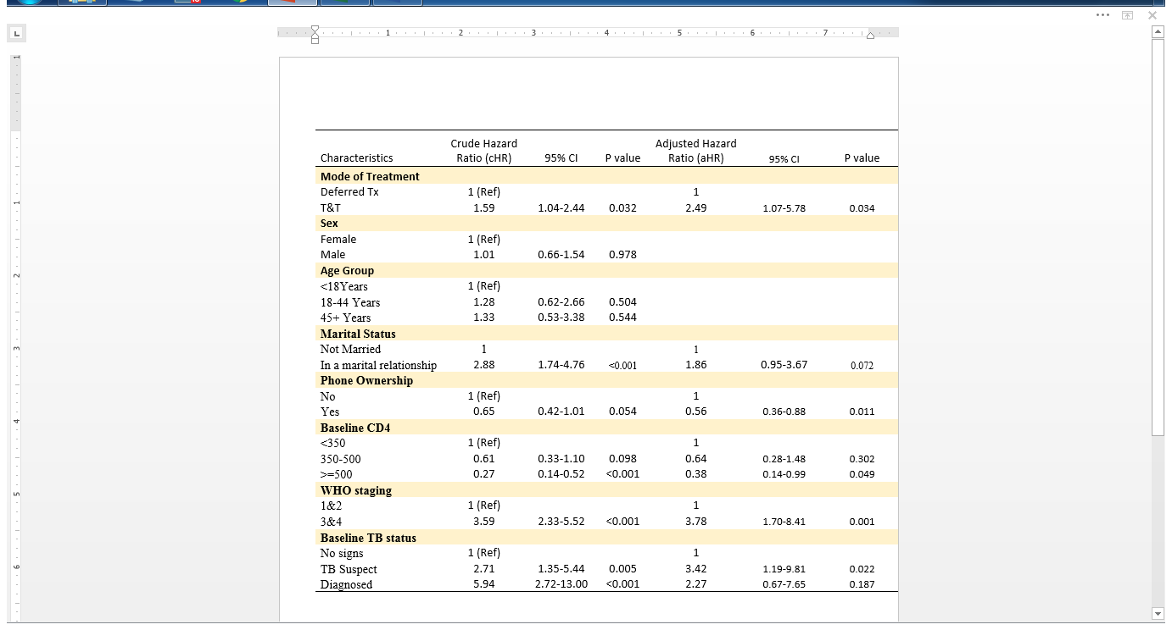
Factors associated with LTFU

Slide 8
Sensitivity Analysis…
Compared to the T&S group (13.3%,95% CI=8.8-18.8%), cumulative incidence of LTFU was 5.3% (95% CI=3.1-8.3%) in the deferred group within 12 months of ART initiation
Notes:
Relaxed the conventional definition from starting Instantly to within 7 days
Generated with Death as a competing risk
Difference was sign (p=0.023).

Slide 9
Summary and conclusions
Summary
  Initiating on ART instantly (T&T) was associated with an elevated risk of LTFU.
  Advance disease (WHO stage 3 or 4) as well as TB suspicion were also associated with a higher risk of LTFU.
  Access to a mobile phone and high baseline CD4 (borderline sign) were protective against LTFU.
Conclusion
  In a bid to achieve the 90-90-90 campaign, steep ART initiation should be backed by intensive pre-initiation and adherence counseling for better long term retention of patients.

Slide 10

Acknowledgement

