Slide 1










The CQUIN Learning Network:
Partnering to Advance Differentiated Care
Differentiated Service Delivery:
Innovating for Impact
Wafaa El-Sadr, MD, MPH
ICAP at Columbia University
IAS Satellite Meeting, July 23, 2017

Slide 2
Global Scale-up of HIV Treatment

Slide 3
HIV Treatment-- Global Targets By 2020
90%
of all PLWH will know their HIV status
90%
of all PLWH will receive sustained antiretroviral therapy
90%
of all PLWH receiving antiretroviral therapy will have durable suppression
UNAIDS 2014

Slide 4
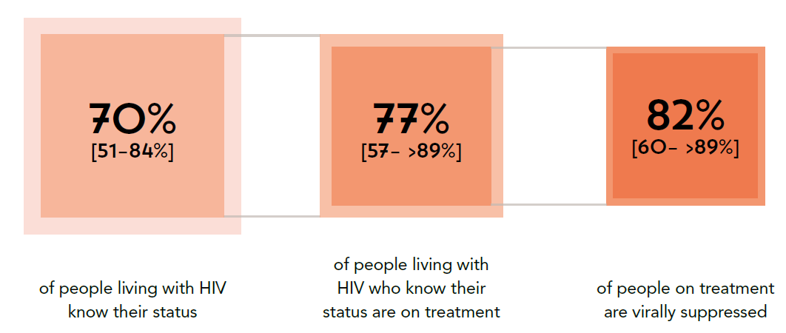
Reaching the 90/90/90 Targets
70%
[51-84%]
77%
[57- >89%]
85%
[60- >89%]
of people living with HIV know their status
of people living with HIV who know their status are on treatment
of people on treatment are virally suppressed
UNAIDS. Ending AIDS. Progress towards the 90-90-90 targets, 2017

Slide 5
Stark Gaps in Continuum among
Key Populations
Gay men and other men who have sex with men (Moscow)
13%
36%
64%
People who inject drugs (India)
41%
52%
83%
Gay men and other men who have sex with men (India)
30%
68%
78%
of PLHIV know their status
of PLHIV who know their status are on treatment
of PLHIV on treatment are virally suppressed
UNAIDS. Ending AIDS. Progress towards the 90-90-90 targets, 2017

Slide 6
Barriers to Epidemic Control
Coverage
  Access (geographic, language, cultural competency)
  Demand (uptake by communities and clients)
Quality
  Technical quality (safety, evidence-based)
  Interpersonal quality (respectful care)
Efficiency
  For health system
  For clients

Slide 7

Putting People at the Center
WHEN?
How often are services provided?
WHICH?
Which clinical,
laboratory and
supportive services
are needed?
WHEN?
How often are services provided?
WHICH?
Which clinical,
laboratory and
supportive services
are needed?
SERVICE
INTENSITY
SERVICE
FREQUENCY
People
Living
With HIV
WHO?
Who is providing services?
WHERE?
Where are services
being provided?
WHO?
Who is providing services?
WHERE?
Where are services
being provided?
SERVICE
LOCATION
SERVICE
PROVIDERS

Slide 8


Program Design “Control Knobs”
Service Frequency
Monthly
Bimonthly
Every 6 months
Every 12 months
90:90:90
Service Intensity
ART initiation and refills
OI prevention and treatment
Clinical monitoring
Laboratory monitoring
Psychosocial support
Quality of Life
Efficiency
Service Location
Hospital (inpatient or outpatient)
HIV clinic
Primary care clinic
Community
Home
Equity
Epidemic Control
Service Provider
Physician Clinical Officer
Nurse CHW
Pharmacist Laboratorian
Peer Family

Slide 9
Differentiated Service Delivery to the Rescue?
In response to concerns about coverage, quality and efficiency, many global and national guidelines now recommend the use of differentiated service delivery:
“A client-centered approach that simplifies and adapts HIV services across the cascade to reflect the preferences and expectations of various groups of people living with HIV while reducing unnecessary burdens on the health system.” – IAS

Slide 10
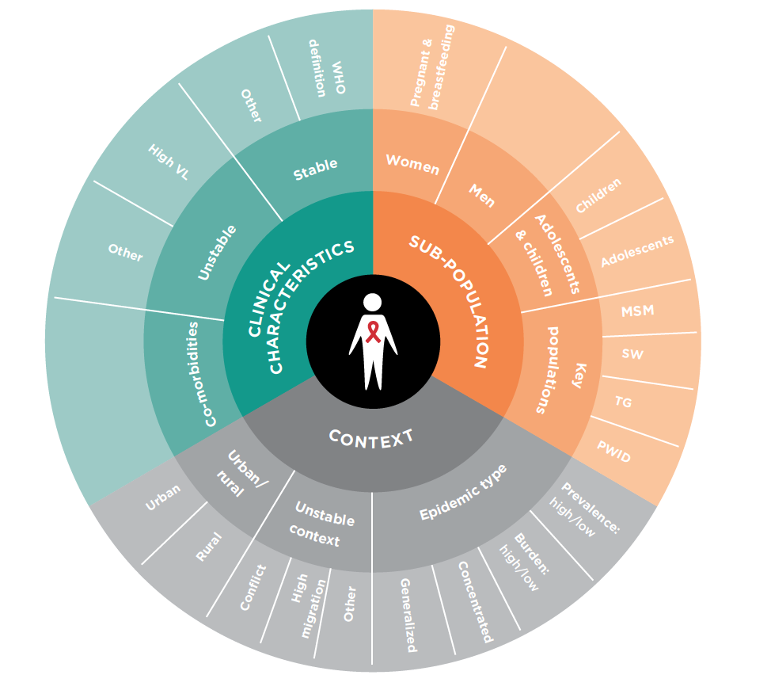
Differentiating Services for
Multiple Groups
IAS 2016

Slide 11
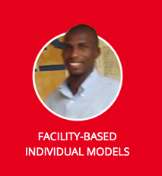

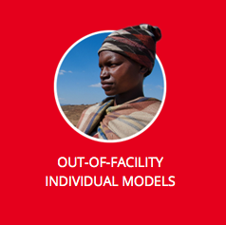
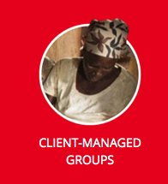
Defining Stable Patients
Receiving ART for at least 1 year AND
No adverse drug reaction AND
No current illnesses or pregnancy AND
Good understanding of lifelong adherence AND
Evidence of treatment success:
  Two consecutive undetectable viral load
  Rising CD4 count or CD4>200 cells/mm³ and adherence measure
www.differentiatedcare.org
Waldrop et al. Trop Med & Intern Health, 2016

Slide 12











Beyond “Stable Patients”
Pregnant/post-partum women
Patients at high risk (advanced disease, unsuppressed viral load)
Men
Children and adolescents
Patients with HIV and co-morbid conditions (TB, NCD)
Migrants/mobile populations
Key populations
Older PLWHIV

Slide 13







Coverage, Quality and Impact Network (CQUIN)
Ethiopia
Kenya
Malawi
Mozambique
South Africa
Swaziland
Uganda
Zambia
Zimbabwe

Slide 14
The CQUIN Learning Network
Focus is on joint learning towards scale-up of differentiated service delivery models (DSDM) in order to improve coverage, quality and efficiency
Knowledge exchange, sharing and learning
Knowledge co-creation, especially where models, tools, resources are new and/or scarce

Slide 15

https://cquin.icap.columbia.edu

Slide 16
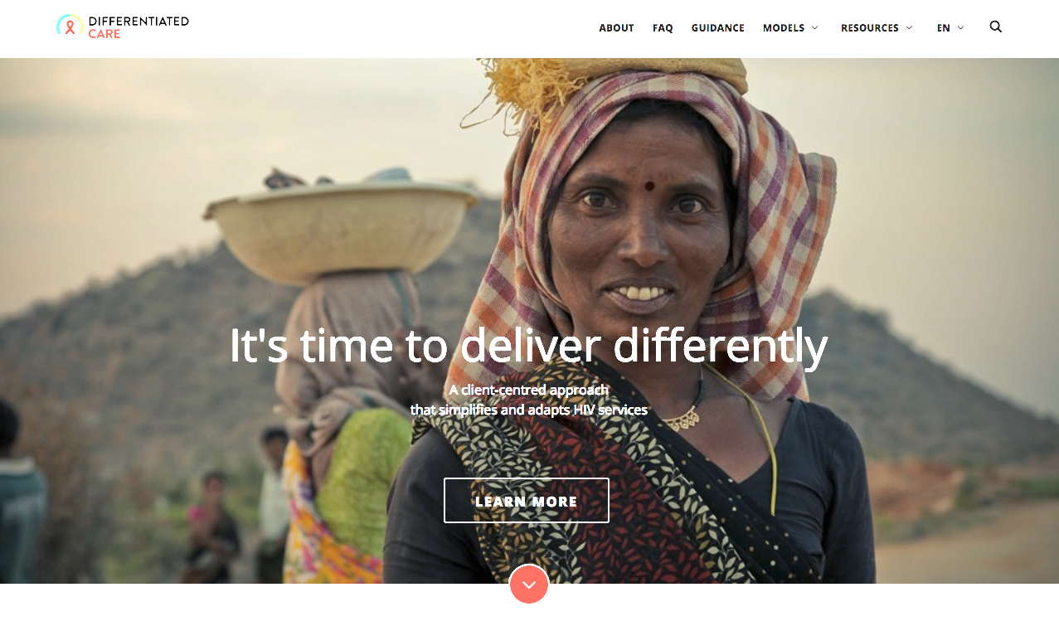
www.differentiatedcare.org

Slide 17
Today’s Agenda
Framing remarks: Drs. Tsitsi Apollo & Bactrin Killingo
Introduction to CQUIN: Dr. Peter Preko
DSD for individuals at high risk of disease progression:
Dr. Maureen Syowai
Differentiated Monitoring & Evaluation: Dr. William Reidy
Mozambique CAG update: Dr. Aleny Couto
DSD for individuals w/HIV and NCDs:
Dr. Nomthandazi Lukhele
The view from civil society: Dr. George Ayala

Slide 18









Thank You

