Slide 1


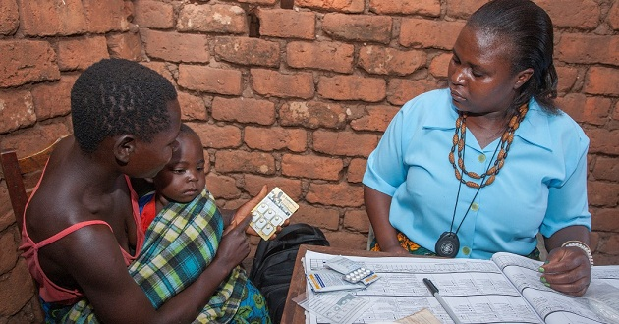

How differentiated care supports “Tx all” and
90-90-90
Dr. Gottfried Hirnschall
Director, WHO HIV Department

Slide 2
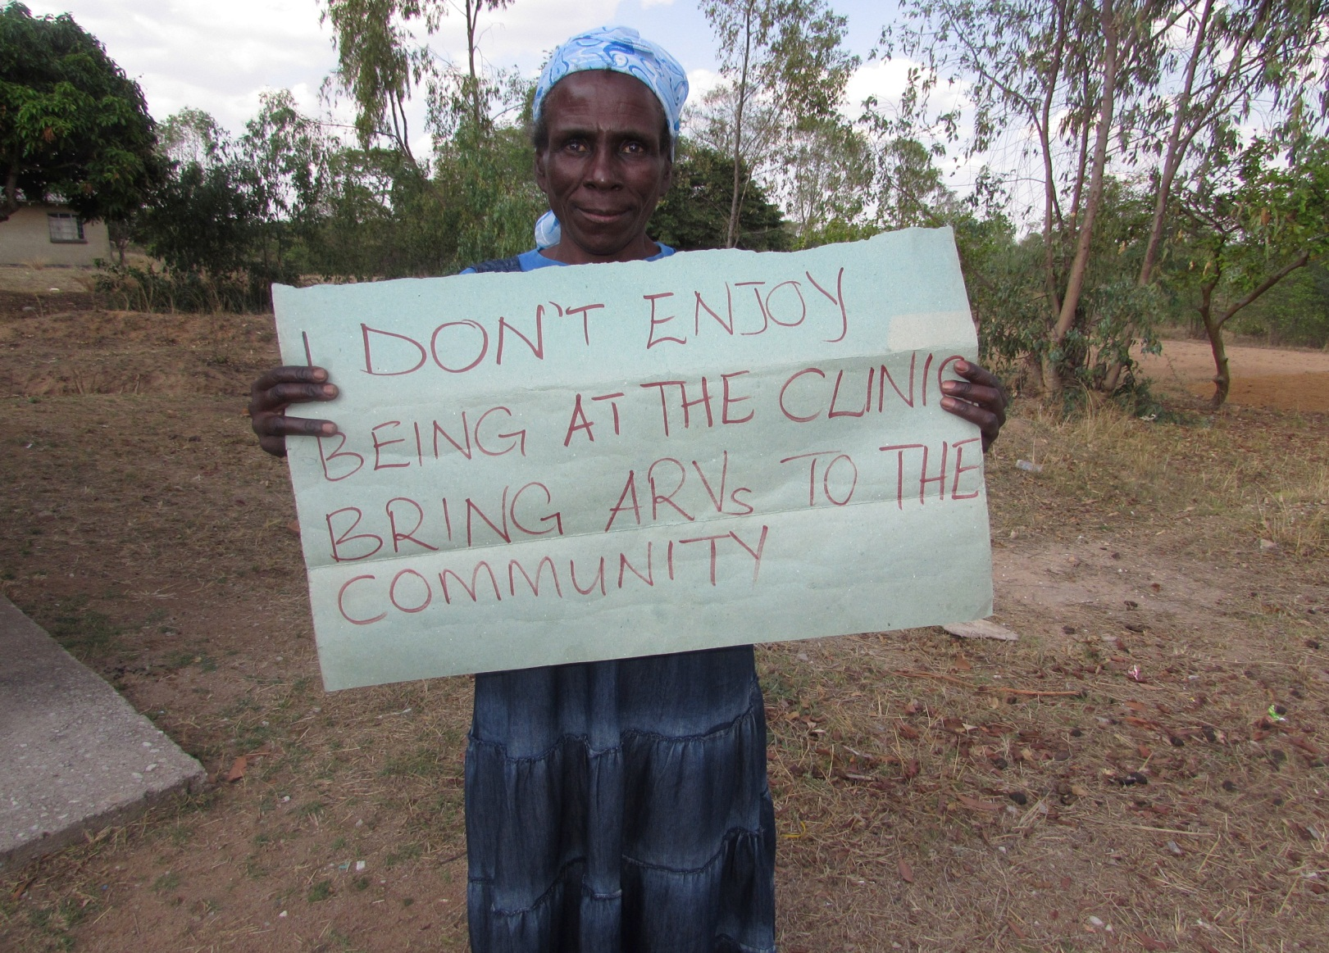
Closer to home: MSF pioneered community ARV models
MSF
Notes:
MSF Photo

Slide 3
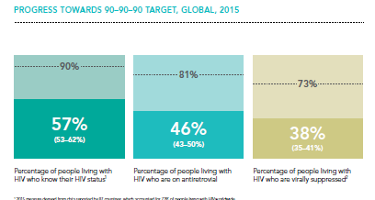
Much to do to achieving the 90 90 90 targets

Slide 4
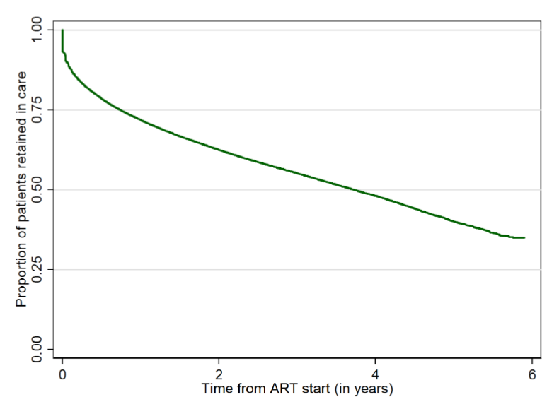
Retention on ART 2009-2014
Data from
6 regions
41 countries
304,000 patients
Retention worse for
Men
Children & adolescents
Retention is a major challenge
Source: IeDEA-WHO 2015

Slide 5

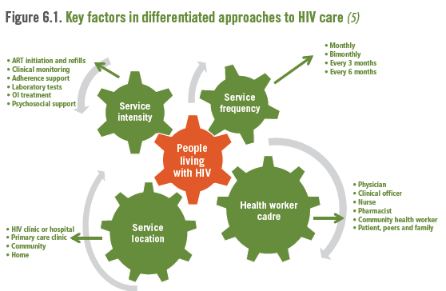
Framework for Differentiated care
WHO recognizes that “one size fits all “will not work as HIV programmes continue to expand
Differentiated services allow for a public health approach that maximizes the benefit for PLHIV and for the health care system
People presenting well
People presenting with advanced HIV infection (CD4<200 cells)
People who are stable on treatment
People on ART with complex problems

Slide 6
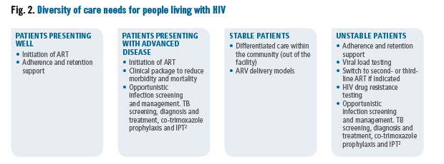
Service Delivery Approaches to Treat All

Slide 7
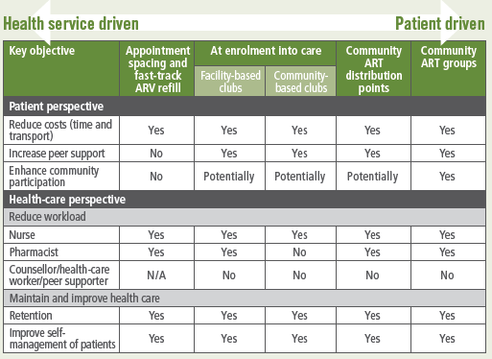
Differentiated care improves outcomes for patients and health services and health care worker
Adapted from MSF
Notes:
These models have improved retention in S Africa and Mozambique; and allowed decanting from over crowded clinics to communities that have established rapport

Slide 8
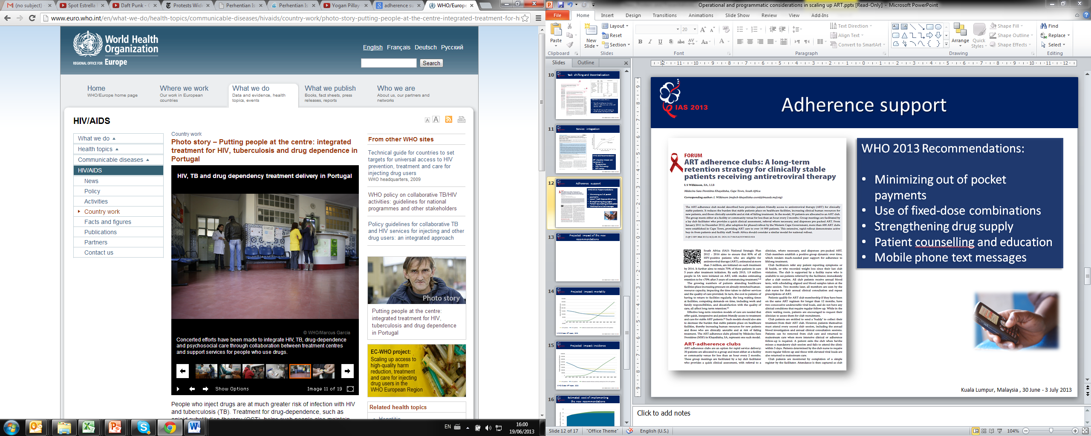


Reducing the frequency of clinic visits and ARV pickup
For patients stable on ART:
Less frequent clinic visits: 3-6 months
Less frequent medication pick up: 3-6 months
Trained and supervised lay providers can distribute ARV in community settings for children, adolescents and adults living with HIV
Notes:
Background Information:
People with advanced disease are defined as those presenting to care with a CD4 count below 200 cells/mm3 or WHO disease stage 3 and 4.
Stable patients are defined as those who have received ART for at least one year and have no adverse drug reactions that require regular monitoring, no current illnesses or pregnancy, are not currently breastfeeding, have good understanding of lifelong adherence and evidence of treatment success (i.e. two consecutive viral load measures below 1000 copies/ml). In the absence of viral load monitoring, rising CD4 counts or CD4 counts above 200 cells/mm3, an objective adherence measure can be used to indicate treatment success. The definition for stable patients does not include pregnant women, as they also need attending maternal health services.

Slide 9

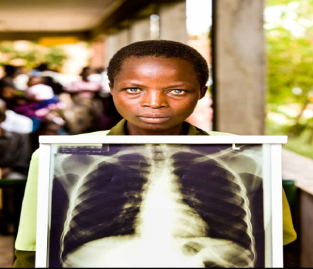


Integrated service delivery
Integration with other services:
  HIV-Associated TB integration
  ART in MNCH care services
  Comprehensive services for people who inject drugs
  STIs and family planning services -

Slide 10

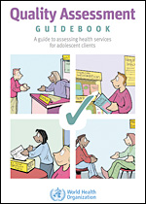
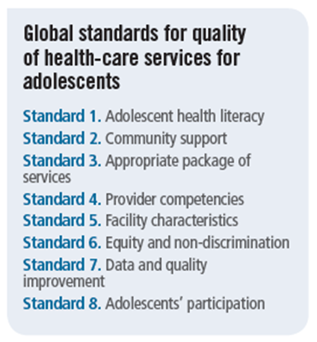
Adolescent Service Delivery
Adolescent friendly health services approaches should be implemented in HIV services to ensure engagement and improved outcomes
*New* Standards

Slide 11
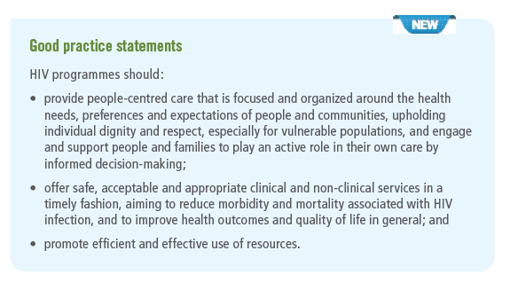
WHO Global strategy of people-centred and integrated health services

Slide 12
Perspectives of people living with HIV
People centred care = easily accessible, good quality, humane, respectful and dignified.
HIV should be normalised and families and communities should be involved in provision of care.
Need to have a partnership between provider and recipient of care.
Barriers and challenges relate to health system access, stigma, discrimination and attitudes.
GNP+ Bushee J, Hows J, de Haas B, Beanland R Survey on the quality of HIV care experienced by people living with and affected by HIV around the world 2015 (in press).

Slide 13
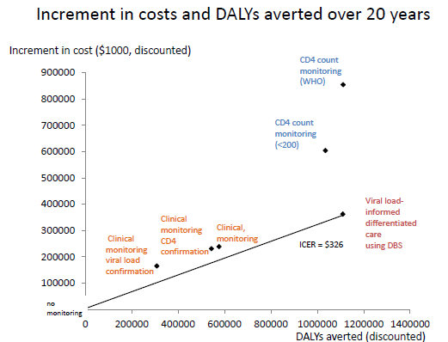
Using viral load to support differentiated care is cost effective
Nature, 2015

Slide 14
Adherence clubs in South Africa more cost effective than standard of care
 | Clubs | Standard care
Cost (patient year) | $300 ✔ | $374 ✔
Retention (12 months) | 98% ✔ | 95% ✔
Viral suppression (12 months) | 99% ✔ | 97% ✔
Bango et al, TMIH 2016

Slide 15
“Differentiated Care” as a key element of the New ARV Guidelines
Adopting the “Treat all” recommendation is central to achieving 90-90-90
WHO guidelines put forward 20 new service delivery recommendations that enable differentiated care
Potential to improve outcomes and service efficiency
One size does not fit all – different approaches to service delivery according to epidemic context
A flexible M&E system from clinic to community is required to ensure quality and safety

Slide 16
Acknowledgements
MSF
Andrew Philipps
Meg Doherty
Nathan Ford
Chery Johnson

