Slide 1


Implementing Differentiated Services Delivery:
Differentiated Monitoring & Evaluation
William Reidy, PhD
ICAP at Columbia University
9th IAS Conference on HIV Science | Paris, France
July 23, 2017

Slide 2
Background/Context
Countries are rapidly adopting diverse differentiated service delivery models (DSDM)
  eligibility criteria and DSD models vary
Monitoring and evaluation systems (tools, reporting, databases) are often not tailored to these new models
  New data elements may be needed
  Some current data no longer applicable at visits
  Data may be collected in the community, by patients
  Flexible DSDM vs. standardized M&E

Slide 3
Outline
The challenges:
Changes in program design associated with DSDM may cause problems for existing M&E systems
Existing M&E systems may not capture the information needed to monitor and evaluate DSDM
The solution: Differentiated M&E?
Harmonizing and streamlining systems
Updating patient and program level data
Performance assessment

Slide 4
Mismatch between Existing Indicators and Some DSD Models
Retention on ART by Month from ART Initiation
24-month retention on ART
(optional)
36-month retention on ART
(optional)
12-month retention on ART
ART Initiation
First eligible for DSD models*
12-month retention on DSD model
24-month retention on DSD model
Retention on DSD Model by Month from ART Initiation
* timing of eligibility differs based on model

Slide 5
Parallel M&E Systems are Proliferating
ART medical record
Standard indicators and reports
Traditional M&E
ART register
DSDM M&E
CAG data
CAG register
CAG reports

Slide 6




Rationale for integrated M&E
As ART models diversify and additional patients move to DSD models, ensure information is accessible to HCW
Clinic-based ART
CAG
Fast-track
Community pick up

Slide 7
Documentation is Insufficiently Streamlined
Standard ART visit:
Weight / height
WHO stage
Pregnancy
OIs
TB status and treatment
IPT
Adherence
Side effects
Lab test & results
ART refill
Next appointment date
Fast-track visit:
TB screening
ART refill
CAG “visit”:
Adherence self-assessment
TB screening self assessment
ART refill

Slide 8
Outline
The challenges:
Changes in program design associated with DSDM may cause problems for existing M&E systems
Existing M&E systems may not capture the information needed to monitor and evaluate DSDM
The solution: Differentiated M&E?
Harmonizing and streamlining systems
Updating patient and rogram level data
Performance assessment

Slide 9


Illustrative DSDM Treatment Indicators
UPTAKE
percentage of newly eligible patients receiving DSDM
COVERAGE
percentage of sites
offering DSDM
percentage of all eligible patients receiving DSDM
QUALITY & OUTCOMES
percentage of patients retained
  percentage maintaining DSDM
percentage receiving VL test
  percentage suppressed

Slide 10
Outline
The challenges:
Changes in program design associated with DSDM may cause problems for existing M&E systems
Existing M&E systems may not capture the information needed to monitor and evaluate DSDM
The solution: Differentiated M&E?
Harmonizing and streamlining systems
Updating patient and program level data
Program assessment

Slide 11
Integrated M&E Systems
Incorporate all information into one record
(paper or electronic)
updated
CAG register
Standard indicators / reports
ART medical record
All indicators / reports
ART medical record
1. Mainstream HIV care & tx M&E
Integrated HIV care & tx M&E
ART register
CAG data
CAG register
CAG reports
2. DSD model M&E

Slide 12
Integrated M&E Systems
Incorporate all information into one record
(paper or electronic)
updated
CAG register
Standard indicators / reports
ART medical record
All indicators / reports
Integrated HIV care & tx M&E
ART patient-level database
CAG data

Slide 13
Patient-Level Tools to Document DSD
Adapted patient ART medical record
Adapted pharmacy tools and systems
New tools to document DSD services

Slide 14
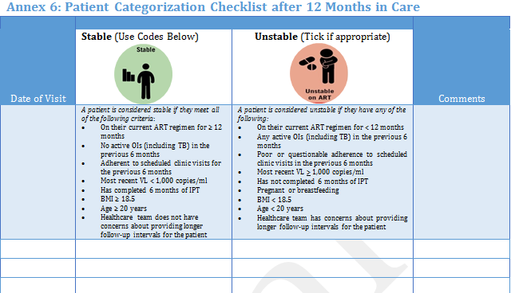
Updating Patient ART Medical Record:
Is the patient eligible for specific DSD models?
□Eligible □Not eligible
□In DSDM □Not in DSDM
DSD Model: _________
Source: Kenya MOH

Slide 15

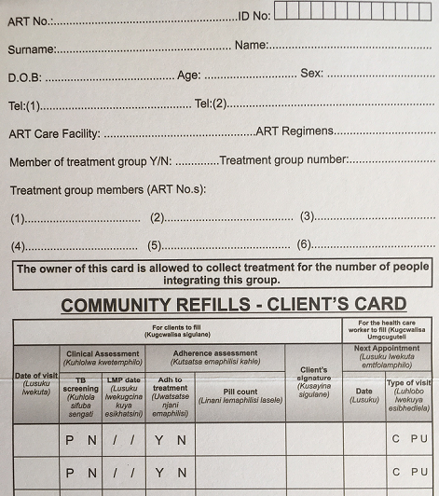
New Tools – Documentation of services in community
Patient self assessments recorded:
TB screening
Last menstrual period
Adherence and pill count
(Source: Swaziland MOH)
ART distributed

Slide 16
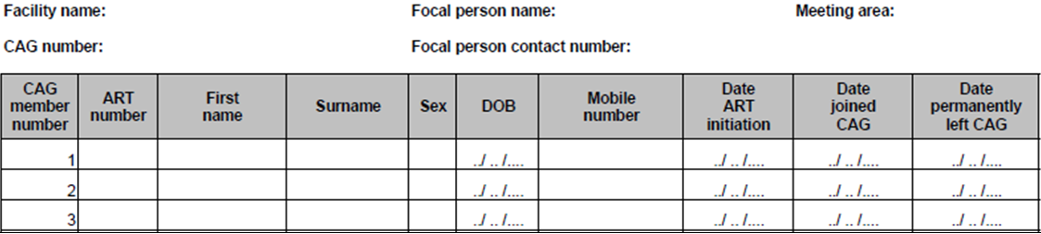
New Tools: Registries of CAG/club patients
Clinic register of patients in CAGs (Source: MSF)

Slide 17
Program-Level Tools to Document DSD
Identify program-level indicators
New systems for aggregation

Slide 18

Illustrative DSD performance indicator cascade
Cohort of patients newly-eligible for DSD
Additional 12 mo. outcomes:
# In care, maintains DSD model classification
# In care, switched to entirely clinic-based ART
# Lost to follow-up or stopped ART
# Dead
# newly classified as eligible for DSD model
# initiating DSD model
# received a VL test at 12 mos.
# virally suppressed at 12 mos.

Slide 19
Tools and Systems to Generate Aggregate Reports for DSD
Standard ART registers cannot calculate DSD indicator cascade
  Eligibility classification, DSD model, and services not documented
  Timeframe oriented around ART initiation
New systems for aggregation of relevant data may be necessary
  Electronic database systems
  Paper-based tools: DSD ART registers, facility reports

Slide 20
Measuring Impact
Measuring Performance of DSDM
Evaluations of impact of DSD model on patient outcomes
  Plan ahead to ensure necessary routine data will be available
Periodic assessments of facility adoption of DSD
Surveys of patient and provider satisfaction
Provider-patient load and productivity
Cost-effectiveness

Slide 21
Summary
DSDM may require changes to M&E systems
  M&E systems should be tailored to context
  Patient-level tools and methods for aggregation may need to be adapted
DSDM may be monitored using a unique cascade of indicators
The ART medical record is the optimal “home” of all patient-related information
Plan ahead; measure performance of DSDM using various approaches

Slide 22

Additional Resources
Learn more about ICAP’s CQUIN learning network for differentiated service delivery at: cquin.icap.columbia.edu
Download the ICAP Approach to DSD at: bit.ly/ICAPDSD

Slide 23
Acknowledgements
Bill & Melinda Gates Foundation
Swaziland Ministry of Health
Kenya Ministry of Health
ICAP colleagues
Other CQUIN members who provided input on our approach

