Slide 1
differentiated care – Innovating for Impact:
Civil Society View
George Ayala, PsyD
Executive Director

Slide 2
Civil society view
Differentiated care models require:
Smart investment, not divestment.
Thorough assessment, screening and diagnostics;
Safe spaces;
Interventions and services that are principled – acceptable, accessible, evidence-informed, and rights-based;
Participatory approaches that center community; and
Particular attention to the specific needs of key populations.

Slide 3
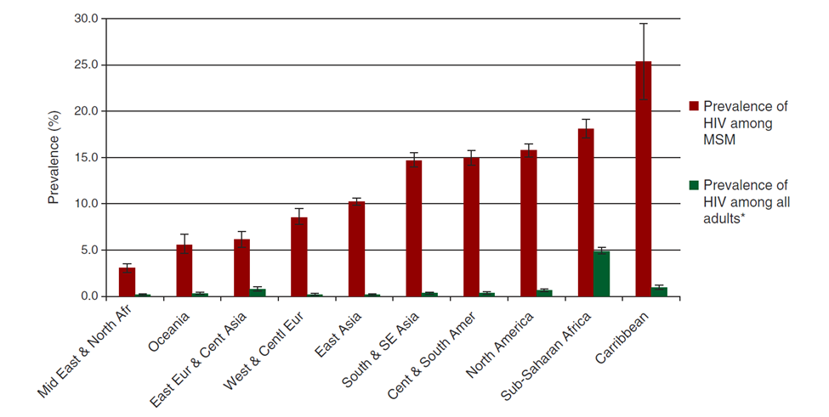
HIV prevalence is disproportionately high
BEYRER, ET AL., LANCET, 2012

Slide 4
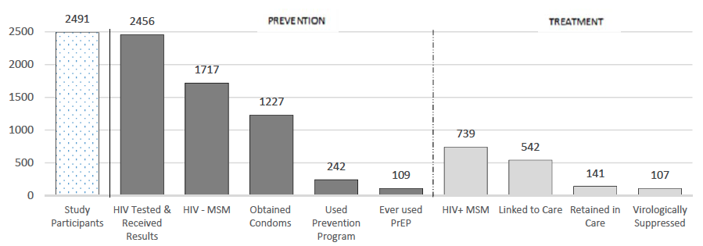
Cascades reveal challenges
AYALA G., SANTOS G-M., JAIS, 2016.
Notes:
Utilization
treatment
25% are pos but not linked
Further 55% not retained retained in care
Leaving only 20% of those surveyed in care
Prevention
70% obtained condoms within past year
14 % participated in prevention program
6% had ever used PrEP

Slide 5
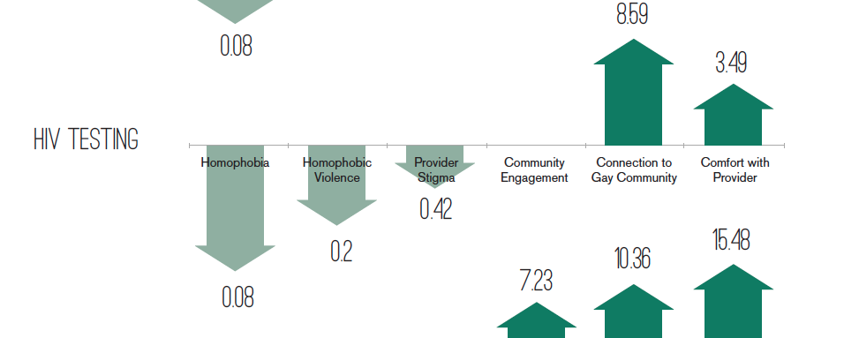
how People are treated Matters
Makofane et al. 2014, MSMGF
Notes:
Call out Service Delivery Location figures in JIAS paper

Slide 6
Funding inequity also matters
$4 billion/year
$254 million
$82 million
    The Global Fund raises and invests to support HIV, TB and Malaria programs
    Investment in key populations programming approved during the NFM (by 31st July 2015)
    Resources committed for programmes for men who have sex with men and transgender people* during the NFM (as of 31st July 2016)
Global Fund, 2016
Notes:
6.3% and 2
6.3% and 2% respectively.
It is important to note that from our quick review the national investment is largely focused on the prevention of HIV amongst sex workers. These programmes vary in terms of focus, scope, approach and the extent to which sex workers are engaged/implemented

Slide 7
Community can play Key roles
Accessing services through an LGBT-led CBO has a dramatically large and positive association with utilization of HIV prevention, testing and treatment.
  Risk reduction programs (OR 76.72; CI 58.18-102.34, p=0.00)
  Condoms (OR 4.81; CI 4.09-5.68; p=0.00)
  Lubricants (OR 5.77 CI 4.83-6.90; p=0.00)
  HIV testing (OR 11.07; CI 8.67-14.23; p=0.00)
  ART(OR 1.92; CI; 1.19-3.10; p=0.00)
  GMHR, 2014
Notes:
Make the point that there are many organizations with a lot of experience and some of it has been condensed into tools like the MSMIT.
We need to figure out how to leverage this experience (the second panel will tackle that issue)
UNAIDS released:

Slide 8
Roles community play
Communities:
Deliver and tailor services;
Provide safe spaces;
Link with friendly healthcare providers;
Drive demand for quality, evidence-informed and rights-based services;
Monitor service implementation and document human rights abuses; and
Mobilize for advocacy.

Slide 9
Differentiated care
Increase in people power, while down-streaming & task-shifting
Primary prevention services
HIV-negative, low risk
Community mobilization, education,
Social marketing, social media, ICT
Prevention counseling, condom & lubricants
PrEP, PEP
Behavioral health, group support/safe
HIV, STI, Hepatitis, HPV screening
Community
Peers
MH workers
Testing staff
HIV negative, high risk
Care and treatment services
HIV-positive, newly diagnosed
Anti-retroviral treatment
Adherence counseling
Viral load testing and other diagnostics
Peer support
Community
Peers
MH workers
Testing staff
Nurses
Doctors
HIV-positive, virally suppressed
HIV-positive, unmanaged viral load
Anti-retroviral treatment
Adherence counseling
Viral load testing and other diagnostics
Peer support
Case management services
Community
Peers
MH workers
Testing staff
Nurses
Doctors
Social workers
HIV-positive, opportunistic infections

Slide 10
THANK YOU!

