Slide 1










The CQUIN Learning Network:
Partnering to Advance Differentiated Care
Differentiated Care for People with HIV & NCDs
Dr. Nomthandazo Lukhele
ART Coordinator, MOH Swaziland
IAS Satellite Meeting, July 23, 2017

Slide 2
Outline
HIV and NCDs: Overlapping Epidemics
Integrating NCD services into HIV Programs in Swaziland: Lessons Learned
Differentiated Service Delivery: Challenges and Opportunities

Slide 3
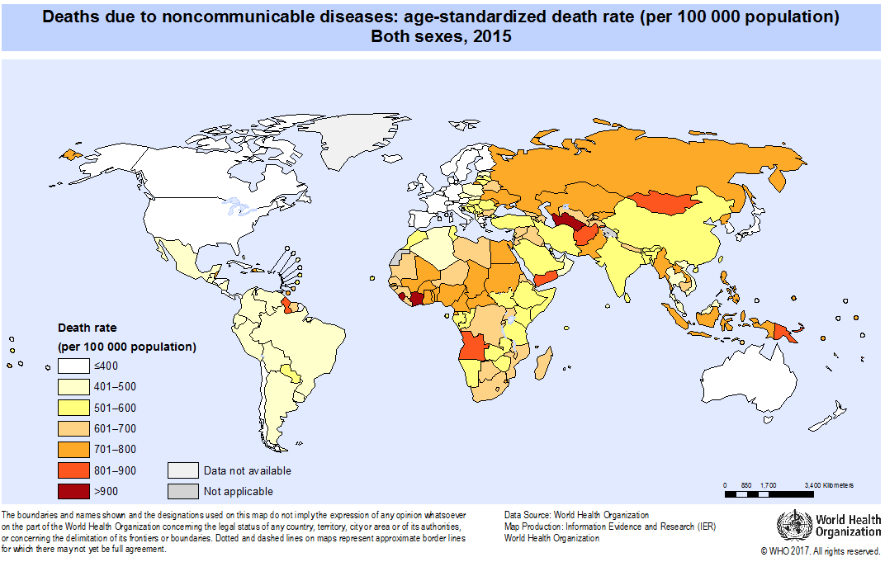
HIV and NCDs: Co-Located Epidemics

Slide 4
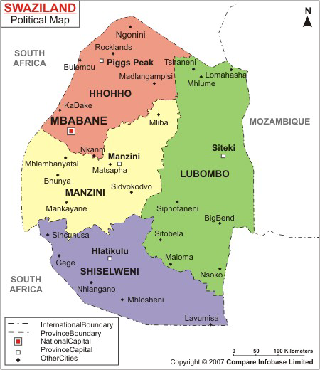
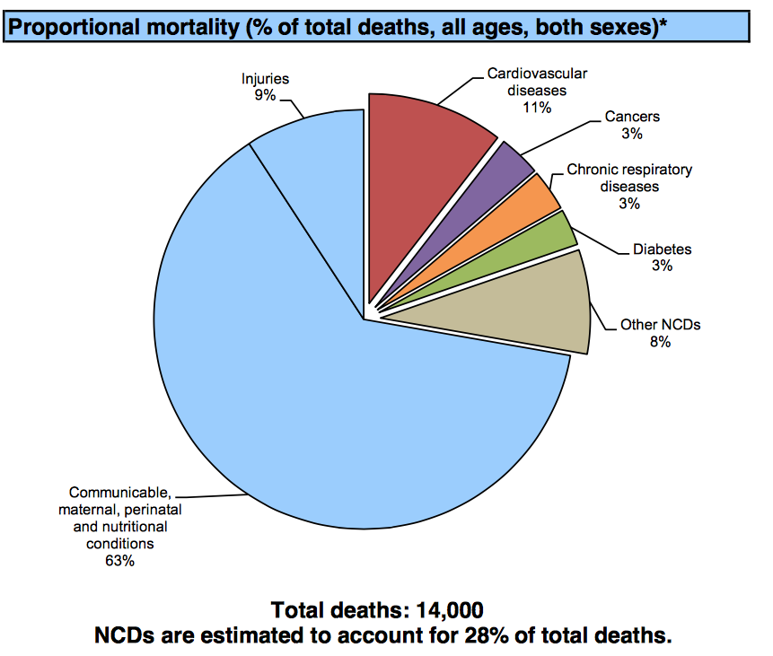
HIV and NCDs in Swaziland
  Population of about 1.2 Million.
WHO Country Profile 2014

Slide 5
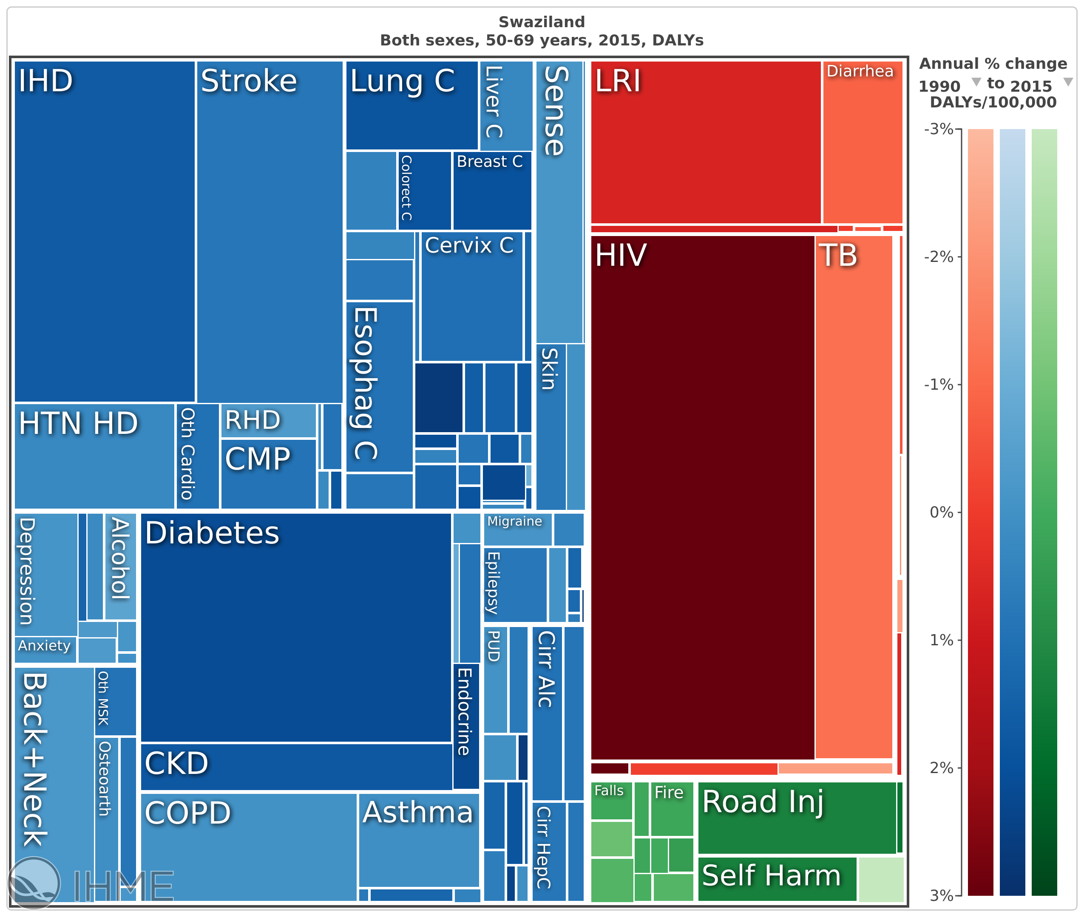
DALYs amongst Swaziland Adults (50-69 years)
www.healthdata.org

Slide 6
Metabolic Complications in HIV
Aging
Genetics
Metabolic complications NCD risk factors
NCD amongst PLWH
Non-AIDS morbidity and mortality
Chronic immune activation and inflammation
Some
ARVs
Lifestyle factors

Slide 7
Outline
HIV and NCDs: Overlapping Epidemics
Integrating NCD services into HIV Programs in Swaziland: Lessons Learned
Differentiated Service Delivery: Challenges and Opportunities

Slide 8
HIV and NCD in Swaziland
Population of 1.2 Million people
HIV prevalence 26%
Incidence : 2.38 (18-49 years, SHIMS 2011)
ART Coverage at 77%
  9% are 50+ year old
    (HMIS, June, 2017).
Good retention and viral suppression rates

Slide 9
The HEART Study
HEART is an ongoing NIH-funded study to explore the feasibility and acceptability of integrating cardiovascular disease risk factor (CVDRF) screening and management into a busy urban HIV clinic in Swaziland
In Phase 1, ART patients > 40 years were screened for hypertension, diabetes, high cholesterol and tobacco use
39% of patients had at least one CVD risk factor

Slide 10

HEART Study Phase One:
CVDRF Screening Results (N=1,826)
Rabkin et al. CROI 2017, abstract #637
 | Total | Age (years) |  |  | Sex
Characteristic |  | 40-49 | 50-59 | 60+ | Male | Female
Total, n (%) | 1,826 (100%) | 1,121 (61%) | 462 (25%) | 238 (13%) | 701 (38%) | 1,125 (62%)
At least 1 CVD risk factor | 39% | 32% | 47% | 55% | 45% | 35%
Hypertension (BP > 140/90 mmHg) | 25% | 19% | 31% | 42% | 21% | 27%
Hypercholesterolemia (non-fasting TC > 6.2 mmol/L, POC) | 8% | 6% | 11% | 11% | 6% | 9%
Diabetes (HbA1c > 6.5%, POC) | 5% | 3% | 8% | 10% | 4% | 5%
Smoking in past year (self-report) | 9% | 9% | 10% | 8% | 22% | 2%

Slide 11
National Pilot Program for HIV/NCD Management
Goal:
To determine prevalence of NCDs in HIV settings and to determine feasibility of integrating NCD clinical management in HIV settings, 2014- 2015
Methods:
Pilot in 6 Hospitals and Health centers
Developed Integrated HIV/NCD management guidelines with algorithms
Trained HIV clinic health workers on;
  NCD diagnosis and management
NCD-related indicators incorporated into the national HIV medical records system,
    electronic and paper system
Developed Facility based SOPs
  Revised Patient flow
  Synchronized ART and NCD refill dates
Analyzed HMIS data

Slide 12
Pilot Screening Results
  Obesity among those > 50 years was at 22%

Slide 13
Outline
HIV and NCDs: Overlapping Epidemics
Integrating NCD services into HIV Programs in Swaziland: Lessons Learned
Differentiated Service Delivery: Challenges and Opportunities

Slide 14
DSD for HIV & NCD Challenges and Opportunities
The high prevalence of NCDs amongst PLHIV in Swaziland poses potential challenges for DSDM;
If HIV care is streamlined but NCD care is not,
  the benefits of DSD both for patients and for the health system will be attenuated
If the presence of NCDs or NCD risk factors is an exclusion criteria for DSDM, scale-up will be limited
Key questions
  How can we “differentiate” care for people with both HIV and NCDs?
  Can we leverage the lessons of HIV to develop systems and strategies to differentiate services for chronic NCDs such as hypertension and diabetes?

Slide 15
DSDM for People with HIV and NCDs
Next steps and way forward:
  NCD/HIV screening and management is standard of care: Chapter in National HIV management guidelines
    HTN, Diabetes, Depression & cervical cancer
    More clients will be diagnosed
  Scale up DSDM for clients with both NCD and HIV : all models applicable
  Treatment clubs and CAGS members encouraged to support each other to do monitoring test e.g. VL, Cervical cancer, TB screening and BP
  Pilot study of home-based BP monitoring supported - CQUIN
  Learning from other countries (MSF Kenya models) - CQUIN

Slide 16









Acknowledgments

