Slide 1
Satellite Session
HIV Self-Testing: Evidence for Action: Key Findings from the HIV Self-Testing Africa (STAR) Project in Malawi, Zambia and Zimbabwe
Prof. Anne-Claude Crémieux
Hôpital Saint-Louis
Université Paris 7

Slide 2
France: concentrated HIV epidemic
Key populations
  MSMs
  Individuals from sub-Saharan Africa
  Metropolitan Paris region: 42% of France’s new HIV diagnoses
  Undiagnosed HIV infections
    16% of people living with HIV unaware of their infections
    Almost exclusively in high-risk populations
    Tested 3 to 5 years before but never retested ++
    Encourage key populations to be retested
(Crémieux, D’Almeida, Lert, Semaille et al, Archives of Internal Med 2012, Plos One 2013, AIDS 2012)

Slide 3

Is self-testing able to reduce the number of undiagnosed infections by encouraging key populations to repeat tests?
2013: French Ministry of Health legalized HIV self-testing
September 2015: whole-blood rapid
self- HIV test was available in pharmacies
140,000 tests have been sold in French pharmacies
2017 joint initiative of the President of Metropolitan Paris Région, Valérie Pecresse, and the Mayor of Paris, Anne Hidalgo, for free or low-cost HIV self-tests.
French Center for Disease Control (“Santé Publique France”): REMIND study (ongoing)

Slide 4
HIV Self-Testing in Africa, the STAR Project
In Southern Africa, the epidemic is generalized and HIV still affects up to 20% of the adult population.
40% of people living with HIV are not aware of their infections.
HIV-screening rate is still insufficient for men.
The epidemic also disproportionally affects adolescent girls and young women, sex-workers, and MSM.

Slide 5
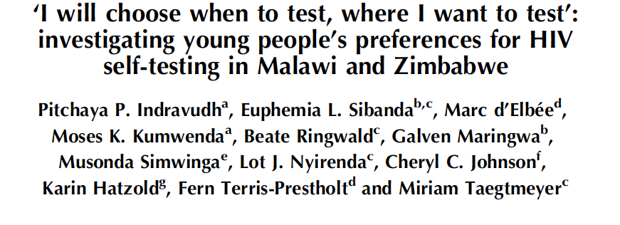

People want to be tested at the moment they are ready

Slide 6
Satellite Session
Results on the public health impact and cost-effectiveness of HIV Self-Testing.
  (London School of Hygiene and Tropical Medicine, University College London, Liverpool School of Tropical Medicine, and Population Services International, Malawi, Liverpool Wellcome Trust, ZAMBART, CESSHAR Zimbabwe)
Discussion with panelists on the remaining research questions that will be addressed during the next phase of the STAR Project, extension to South Africa, Lesotho and Swaziland
Official launch of the next STAR phase with UNITAID, PSI, Society for Family Health and the South African Ministry of Health’s

