Slide 1

Operational successes and challenges of contraceptive provision in DSD models for stable clients
Experience from MSF
Leveraging differentiated ART delivery models to facilitate contraceptive care and TPT completion ICASA 2019 satellite
Arthur Mboya
MSF, Kenya
4 December 2019

Slide 2
Overview of MSF and DSD
MSF has supported implementation of DSD models (fast track, clubs, community ART groups, community distribution points) in projects across East, West and Southern Africa
Family planning has been integrated into three examples of DSD for
    Clinically stable clients
    Adolescents
    Post partum women

Slide 3
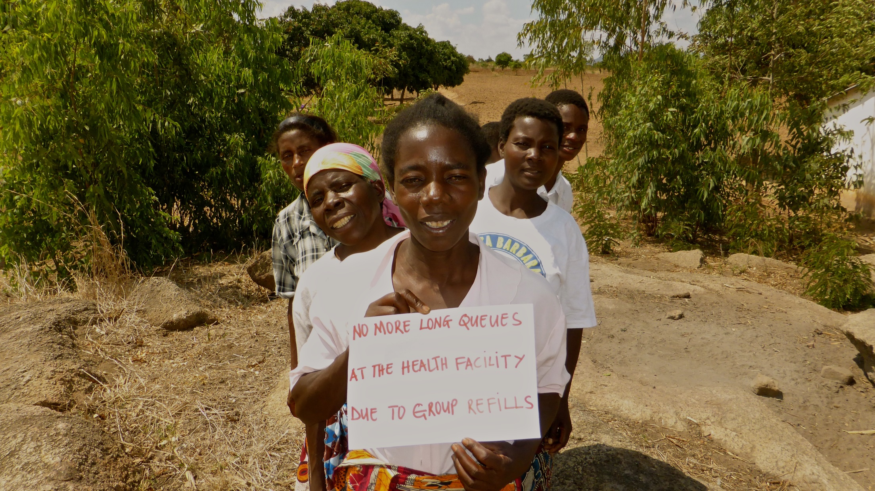
Example 1: Integration of contraceptive care into community adherence groups (CAGs)
Ndhiwa, Kenya

Slide 4
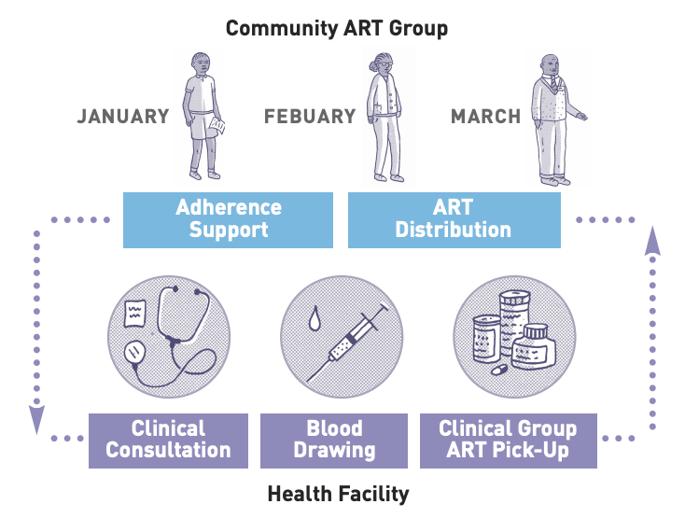
Model Description
Groups of between 4-10 clinically stable clients meet on a 3-monthly basis. The following 3 steps are repeated:
STEP 1: CAG meeting in the community before collection of ART by the group representative
STEP 2: CAG Representative reports to the health facility and receives 3mth ART refills for the group
STEP 3: CAG meeting after ART collection in the community where ART is distributed by representative
In Ndhiwa, 632 clients are part of a CAG (5% of the on ART cohort)

Slide 5
Contraceptive care in CAGs, Ndihwa, Kenya
Female CAG members asked for FP to be integrated into the model
FP options offered include: implants (implanon NXT/jadelle), DMPA (three monthly) and oral contraceptives
CAG members requiring injectable or oral contraception, are selected to attend the clinic to collect the ART for the group as well as their contraception
Where more than one member requires contraception, they attend the clinic together.
Oral contraception has to be personally collected but refill length is aligned with ART refill length
Notes:
Depot injection is the most common method
IUD very rarely used

Slide 6
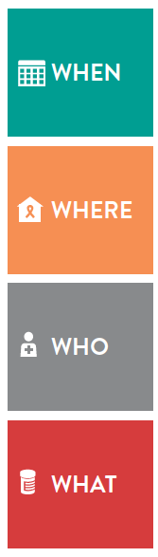

Contraceptive care in CAGs:
The building blocks
IUD
Implant
Oral pills
Injectable
Prior to entry into club or at any time contraception need assessed
Every 3 months
Every 3 months
Not available
Collect ART and FP from clinic as nominated group member to collect ART
Given at Facility; group member in need nominated to collect ART for others
Same facility as ART delivered
Not available
Not available
Doctor, CO, Nurse or midwife provides script
Nurse or midwife
Nurse or midwife
Combined and progestogen only
DMPA
Not available
Jadelle and Implanon NXT

Slide 7
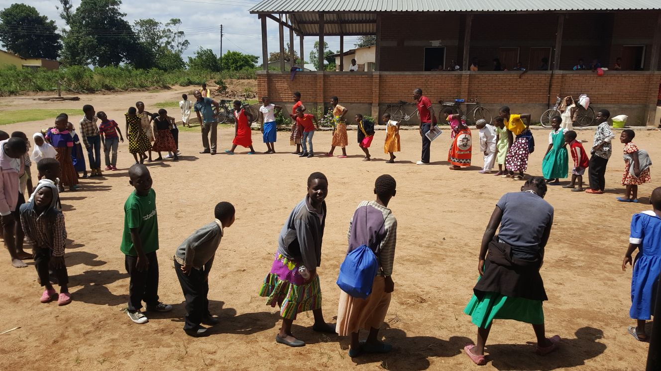
Example 2:
Integration of contraceptive care into teen clubs
Chiradzulu, Malawi

Slide 8
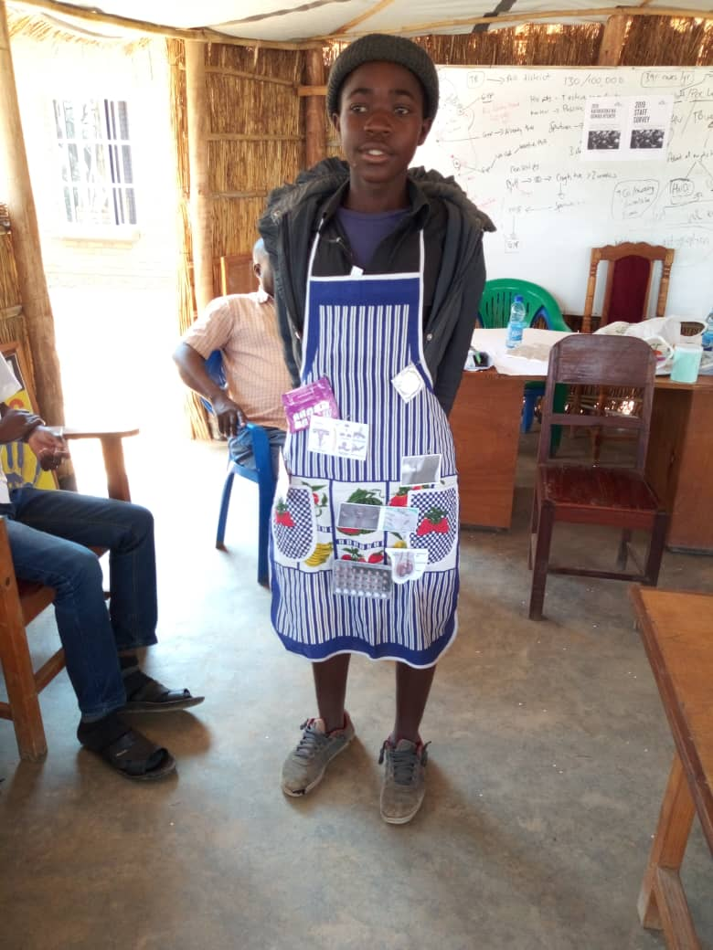
Model Description
Teen clubs are run for clinically stable adolescents
Clinical review is planned to be moved to six monthly
ART refills are two monthly
Prior to entry to the club, family planning needs are discussed.
Options available include oral contraceptives, injectables, implants and IUDs
Injectable or oral contraception is provided as a one stop service during the teen club meeting
Notes:
Of 49 (8%) of adolescent females using contraception 41 (83%) are using depot.

Slide 9
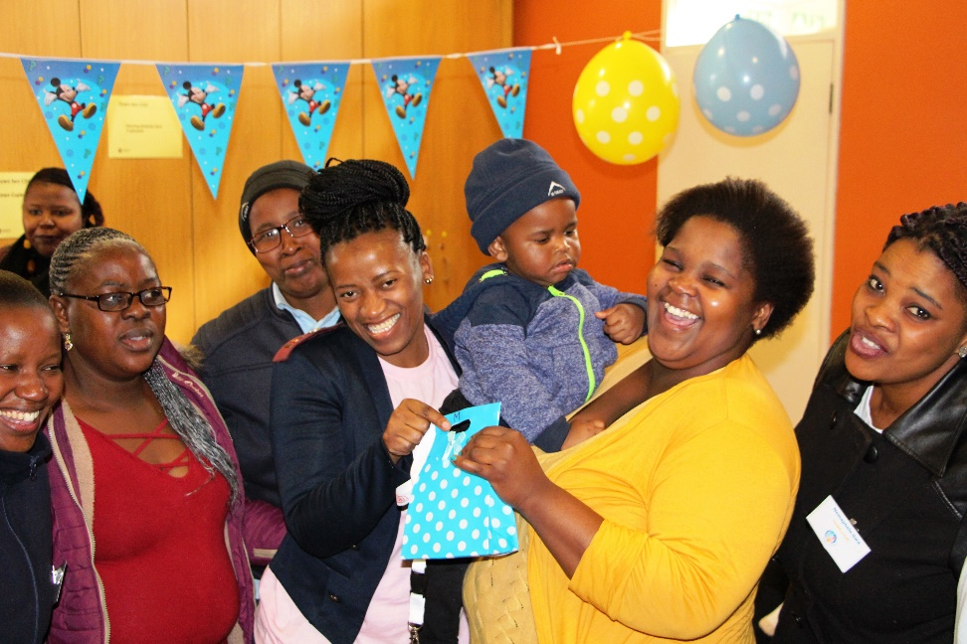
Example 3:
Integration of contraceptive care into postnatal clubs
Khayelitsha, South Africa

Slide 10
Model Description
Groups breastfeeding women and their exposed infants meet at a booked time at the facility (3-6 pairs)
Post delivery they meet every month for six months and then three monthly
At each visit the following is provided
  Clinical follow up
  ART refills
  Follow up of exposed infant including vaccination
  Contraceptive care
Almost all women use injectables
Oral contraception is rarely prescribed but refill duration aligned with ART refill
Implants and IUDs are available but only offered at 18 or 22 week visit

Slide 11
Early lessons
Female members in DSD models for stable clients are asking for integration of contraceptive care
It has been feasible to integrate a question on FP in the screening tool used in community-based models
FP uptake is possible both for stable adults and specific populations
Policies to allow extended refills of oral contraception are essential to support integration of FP and DSD
Injectable duration that aligns with duration of ART refills facilitates integration of FP into DSD models
The way oral contraception is packaged can impact on ease of integration for HCW - packs of 3 or 6 months to align with ARVs

Slide 12
Early challenges
Limited uptake of LARC in all settings
  HCW’s explanation and preferences versus client acceptance
  Lack of commodities
  Lack of training of HCW on how to insert implant and IUD
Lack of acceptance of community delivery of injectable and oral contraceptives

Slide 13
Thank you

