Slide 1
Integrating family planning (FP) into ART DSD
Lynne Wilkinson, IAS DSD
Notes:
Good morning colleagues, in this plenary session I will take you through how to integrate family planning and ART DSD.

Slide 2

What am I talking about?
Integrated less-intensive DSD models for ART and contraception
HIV and FP service integration (HTS, PrEP and ART)
FP DSD
Differentiated service delivery (DSD) is a client-centred approach that simplifies and adapts services in ways that both serve the needs of people living with HIV and reduce unnecessary burdens on the health system.
Notes:
We are often not talking about the same thing, so to be clear – I am not going to be addressing HIV and FP service integration or family planning DSD for people not living with HIV, I am specifically addressing integrated less-intensive differentiated service delivery models for ART and contraception.

Slide 3
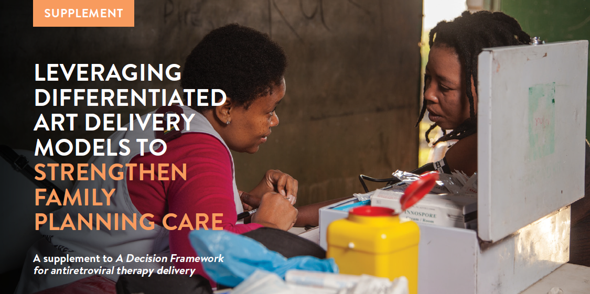
An overview of DSD
An overview of FP
Key principles for FP in the context of DSD
Guidance on how FP could be integrated into DSD models
Case studies and examples
A tool to assess FP policies and model building blocks
Take-home messages for leveraging DSD to strengthen FP care.
How to leverage DSD ART models to strengthen family planning care
Notes:
Many people in this room may know this supplement to the ART DSD decision framework which IAS brought out in 2020 which specifically addresses how to integrate family planning and contraceptive needs and preferences into less intensive DSD models with case studies and examples and a specific tool to assess family planning policies and model building blocks. See the link in red here.

Slide 4


Update will include:
FP DSD (not only integration)
Revised WHO FP and integration guidance
Account for increasing self-care methods - scale up of sub-cut self-injectable access and implementation
Integrating FP and PrEP DSD
How to leverage DSD ART models to strengthen family planning care
Presentation note:
Sub-cut injectable refers to
Depo Provera SC = Sayana Press
Notes:
This supplement is currently under review with a revised version to be expected by AIDS 2024, the revised version will also cover DSD for FP – not specifically for people living with HIV, incorporating latest WHO FP and integration guidance and account for increasing scale up of self-care methods, focusing on sub-cut self-injectable – also known as DMPA-SC/Sayana Press. I will take you through the supplement today accounting for some of these updates.

Slide 5
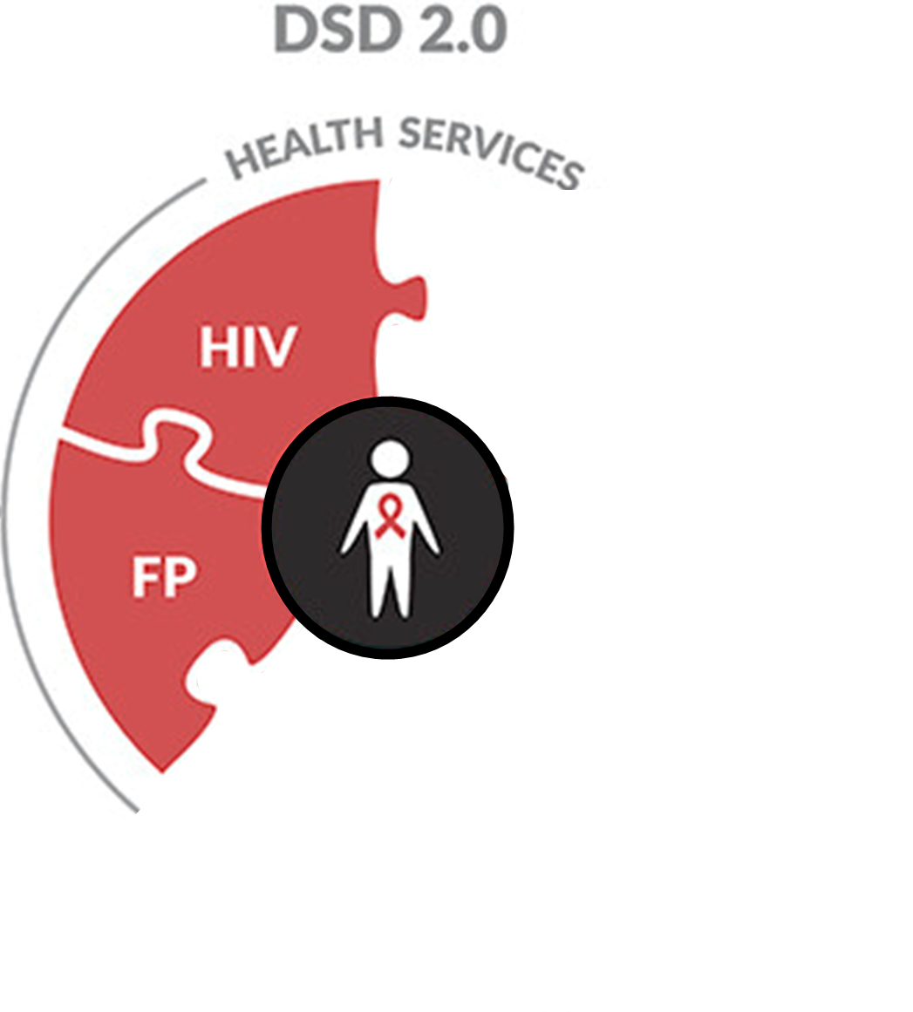
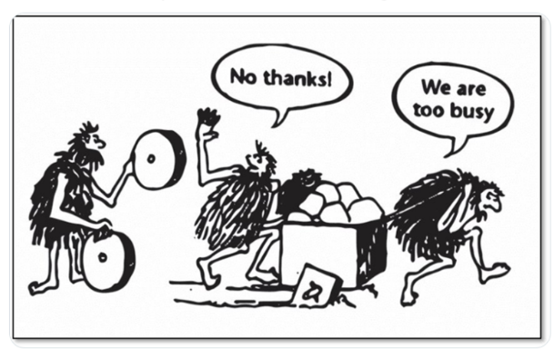
Meeting PLHIV’s FP needs and preferences
Recognise that FP less-intensive DSD already exists and can be leveraged.
Identify opportunities to integrate ART and FP service delivery:
  Adapt existing FP or ART DSD models; and/or
  Build new models
Notes:
If we are to move forward with providing for women living with HIV’s family planning needs within differentiated service delivery models, we need to recognise that in parallel to ART DSD, family planning DSD also exists and has increasingly been scaled. We need to identify opportunities to integrate either by adapting existing FP or ART DSD models to integrate or if necessary, build new integrated DSD models.

Slide 6
Remember the ART DSD evolution…
 | ART maintenance
 | Clinical consultation + ART refill
WHEN Service frequency | Monthly
WHERE Service location | Health facility
WHO Service provider | Doctor/Nurse
WHAT Service package | ART clinical guidance
Notes:
It always helps to remind ourselves where ART DSD started, there was no separation of clinical consultation and treatment refills, commonly with monthly visits to a health facility to see a doctor or nurse for both clinical review and to collect your refill.

Slide 7
Remember the ART DSD evolution…
 | ART maintenance
 | Clinical consultation + ART refill
WHEN Service frequency | Monthly
WHERE Service location | Health facility
WHO Service provider | Doctor/Nurse
WHAT Service package | ART clinical guidance
 | ART maintenance (from 6 months on ART with VL suppression)
 | ART refill only | Clinical consultation
WHEN Service frequency | 3 to 6 monthly (increasingly 6MMD) | 6 to 12 monthly
WHERE Service location | Community pick-up Health facility fast lane | Community outreach Health facility
WHO Service provider | Client, Peers, Lay health providers | Nurse
WHAT Service package | Minimum package commonly only distributing ART | ART clinical guidelines
Notes:
To where we are today, separating clinical consultation visits and ART refill only visits – only requiring clinical reviews when necessary, 6 to 12 monthly providing 6 to 12 month scripts. ART refill collection can then take place separately if shorter refill length at fast collection points or in the community and can be provided by non-clinical staff such as community healthworkers.

Slide 8
Remember the ART DSD for HIV treatment evolution…
 | ART maintenance
 | Clinical consultation + ART refill
WHEN Service frequency | Monthly
WHERE Service location | Health facility
WHO Service provider | Doctor/Nurse
WHAT Service package | ART clinical guidance
 | ART maintenance (from 6 months on ART with VL suppression)
 | ART refill only | Clinical consultation
WHEN Service frequency | 3 to 6 monthly (increasingly 6MMD) | 6 to 12 monthly
WHERE Service location | Community pick-up Health facility fast lane | Community outreach Health facility
WHO Service provider | Client, Peers, Lay health providers | Nurse
WHAT Service package | Minimum package commonly only distributing ART | ART clinical guidelines
Notes:
Over time 4 categories of less-intensive DSD models evolved:
Facility-based individual models, such as fast-track, where individuals collect their ART refills at the health facility without queuing or seeing a clinician.
Out-of-facility individual models, where individuals collect their ART refills from mobile ART services, fixed community distribution points or community pharmacies.
Healthcare worker-managed groups in facilities or communities, such as adherence clubs. Clients booked to collect their ART at the same time as a group. A lay worker or peer facilitates the group with the aim of providing education, support and distributing pre-packed medication.
Client-managed groups, such as community ART groups (CAGs). Smaller groups of clients meet in the community, rotating to collect treatment for all group members.

Slide 9
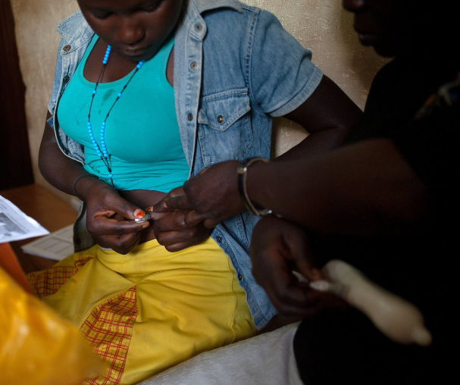
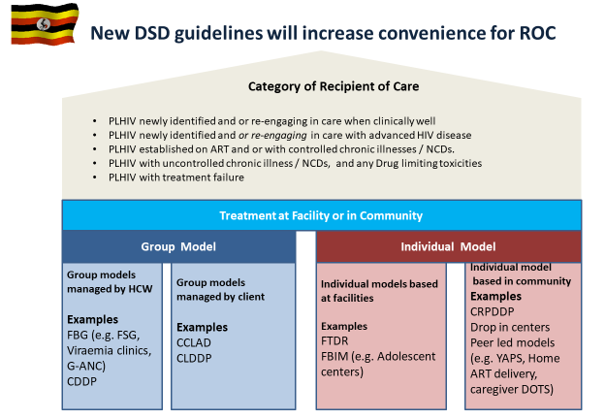
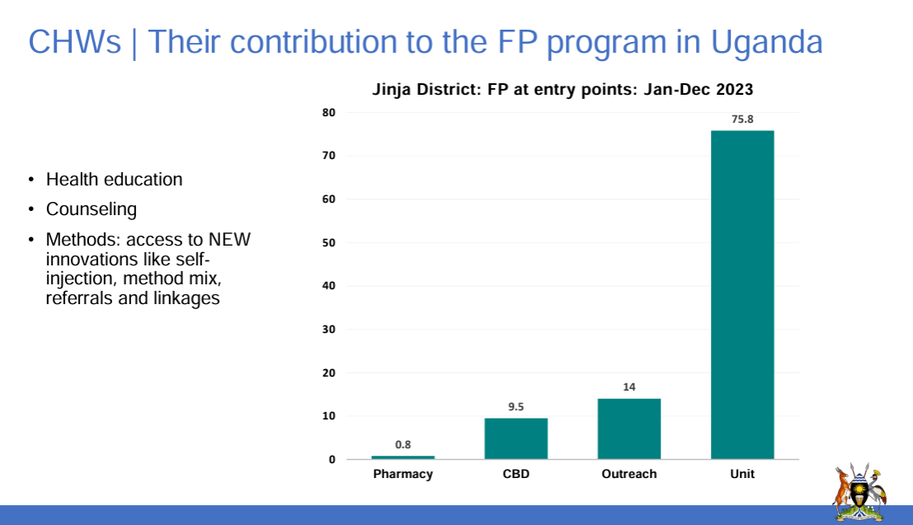
FP and ART DSD might already exist in parallel
In Uganda CHWs distributing 10% of FP commodities in community predominantly self-injectable Depo-Provera SC (Sayana Press) + oral FP
Injectables Access Collaborative Learning and Action Network
Notes:
What we commonly find in countries is that alongside scaled ART DSD models, there are scaled FP DSD models but these often exist in parallel. Here you see Uganda’s ART DSD models on the left from their HIV DSD policy which similarly to other countries does not consider or provide guidance on the integration of contraception methods into these models. On the right, Uganda’s scaled community-based FP service delivery with 10% of all commodities distributed by community health workers at community level, mostly sub-cut injectable for self-injection or community health worker assisted injection if preferred.

Slide 10
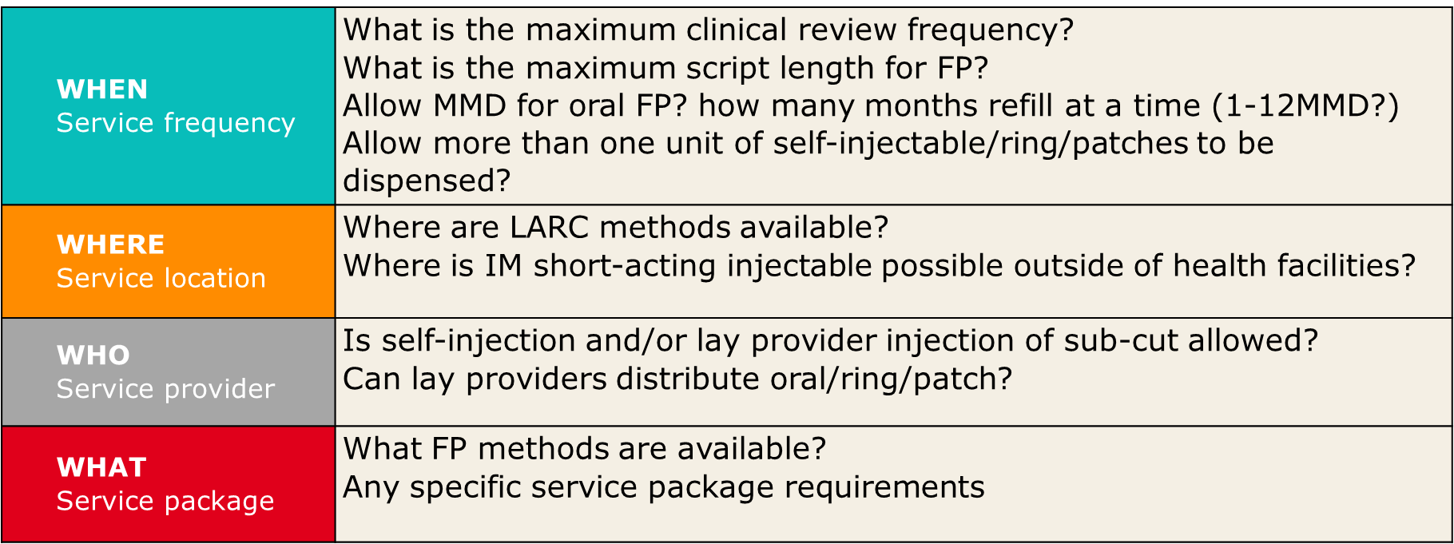
Understand existing FP DSD: Policy and models
Notes:
To be able to integrate FP into ART DSD, we need to understand a countries FP policy enablers and existing models:
Read through
WHEN
WHERE
WHO
WHAT

Slide 11


Remember contraception methods are ahead of HIV treatment
Long-acting formulations – LARC:
  Contraceptive implants (LNG and ETG implants): 3-5 years
  Hormonal intrauterine device (LNG-IUD): 3-5 years
  Copper-bearing intrauterine device (Cu-IUD): 5-10 years
More self-care methods:
  Self-injectable contraception (Sayana Press/DMPA-SC)
    3-monthly
    No cold chain/36 month expiry
    Sub-cut and easy to self-administer
  Patch (weekly)/Ring (monthly)*
Combined oral contraception:
  WHO recommends 12MMS and 12MMD
*not widely available
Notes:
Always remember that contraception methods are ahead of HIV treatment – already using long acting methods, more self-care methods including sub-cut self-injectable, the patch and the ring and WHO already recommends annual scripts with 12MMD

Slide 12
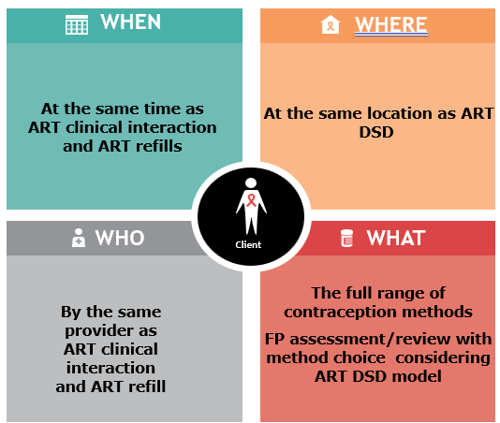
Apply DSD principles to FP to enable integration
Separate (re)initiation/early follow-up and maintenance phases
Is “stability” on specific method required before the maintenance phase?
Maintenance phase – “how to reduce intensity of service delivery burden”
  Separation of clinical consultation and refill collection visits
  Integrate FP/ART DSD building blocks
Notes:
I will now move onto the “how” – applying the 3 DSD principles to family planning to integrate.
Firstly, separate the initiation/early follow-up and the maintenance phases of service delivery.
Secondly, determining whether stability is required to move into the maintenance phase
Thirdly, once reaching the maintenance phase, how to reduce service delivery intensity

Slide 13
1. Separate initiation/re-initiation and maintenance phases
 | Initiation and early follow up phase (more-intensive) | Maintenance phase
ART | (Re) initiation until enrolment in less-intensive DSD (4-12 months) | Less-intensive DSD
FP | (Re) initiation/method change and early follow-up (0-3 months) | Less-intensive DSD
(Re) assess FP needs and preferences at ART (re) initiation; provide method choice information.
Inform on how method choice affects overall service delivery frequency and location.
Initiate/change contraception method:
  The initial phase length varies by method while the ART timeline is more fixed based on first viral load.
  Early follow-up is necessary to check method satisfaction/address concerns
Notes:
When a person living with HIV is initiated on ART, her family planning needs and preferences should be assessed with information provided on contraceptive method choice
Importantly we must explain how method choice affects overall service delivery frequency and location.
The woman should be enabled to start or change her contraceptive method.
ART has a fairly fixed initial phase from treatment initiation to review of the first viral load – usually the first viral load is taken at month 6 (although some countries are following WHO guidance to ensure the result can be reviewed at 6-months – South Africa, Kenya and Rwanda), with the review visit at either M7 or M9. New contraception methods initial phase is shorter, method dependent and focuses on ensuring client satisfaction with the method chosen and started.

Slide 14
1. Separate initiation/re-initiation and maintenance phases
 | Initiation and early follow up phase (more-intensive) | Maintenance phase
ART |  | Less-intensive DSD
FP | (Re) initiation/method change and early follow-up (0-3 months) | Less-intensive DSD
(Re) assess FP needs and preferences at ART (re) initiation; provide method choice information.
Inform on how method choice affects overall service delivery frequency and location.
Initiate/change contraception method:
  The initial phase length varies by method while the ART timeline is more fixed based on first viral load.
  Early follow-up is necessary to check method satisfaction/address concerns
  FP method can be initiated when ART is already in the maintenance phase
Notes:
Remember that ART and contraception are commonly not started together and contraception may be started or changed when ART is already in the maintenance phase

Slide 15
1. Separate initiation/re-initiation and maintenance phases
 | Initiation and early follow up phase (more-intensive) | Maintenance phase
ART | (Re) initiation until enrolment in less-intensive DSD (4-12 months) | Less-intensive DSD
FP |  | Less-intensive DSD
(Re) assess FP needs and preferences at ART (re) initiation; provide method choice information.
Inform on how method choice affects overall service delivery frequency and location.
Initiate/change contraception method:
  The initial phase length varies by method while the ART timeline is more fixed based on first viral load.
  Early follow-up is necessary to check method satisfaction/address concerns
  FP method can be initiated when ART is already in the maintenance phase
Can be no change to FP method at ART (re) initiation:
  Directly into the FP maintenance phase enabling infrequent clinical follow-up.
Notes:
Or a women can already be using contraception and not want to change the method, meaning she is already in the maintenance phase of FP when she starts ART.

Slide 16
Entry into DSD for clients established on ART and family planning
Review family planning needs and method choice
Does a long- acting or a change to short-acting method simplify access and delivery of family planning in clients chosen ART DSD model?
Same script
LARC linkage or aligned refill/administration
ART initiation
Provide family planning assessment
Include FP on script
LARC linkage or aligned refill/ administration
Until established on ART
Review family planning needs and method choice
Same script and aligned refills/ administration
Initiation and early follow-up phase
Maintenance/continuation phase
Notes:
To summarize differently:
If we follow the ART pathway at ART initiation, a woman should be provided with a family planning assessment.
If she wants contraception or is using contraception, she should be offered LARC, which will simplify and reduce her service delivery burden, LARC can be assessed at ART clinical reviews.
If she prefers short-acting, her contraception should be included on her ART script ensuring her contraceptive refill collection or injection administration is provided with her ART refill – same place and same provider. This continues through the ART initiation phase until her DSD enrolment assessment i.e. after her first VL when the result is available for review. At this point, her family planning needs should be re-assessed including offer of LARC. Where she wants to start or continue short-acting methods, it is key to consider which DSD model works best for both ART and contraception method – I will go into this in the slide after the next one.

Slide 17
Considerations for FP integration into ART DSD
 | Initiation phase and early follow-up |  | Maintenance phase
Method choice | ART (re) initiation | Clinical consultations until DSD
LARC | Always offer and facilitate insertion/administration (consider linkage component). Remind client simplifies less-intensive DSD models and can be reversed.
Short-acting: | Review 1-3 months after method initiation
Oral | Align with next required ART clinical consult: Same script and refill length
Injectable SC | Offer, demonstrate, and align with an ART clinical review 3 months later
Injectable IM | Administer and align ART clinical follow-up with next administration 2-3 months later using IM timing flexibilities
Notes:
Here a little more detail by method:
During the initiation phase:
LARC should be actively offered. There is an important linkage component here – facilitating insertion. With implants, this can be done by the ART clinician. Where IUD, the ART clinician needs to know which facilities can insert and the booking system and should make a booking in consultation with the client.
After insertion, a check-in either in person or virtually should be made to check client satisfaction and any concerns that need support/method change.
For short-acting:
Oral – easy, same script and refill length.
Injectable sub-cut – demonstrate, assist self-injection and align script and refills
Injectable IM – administer and then align ART clinical reviews with next administration date.

Slide 18
2. Stability criteria for less intensive FP DSD
Unlike ART/NCDs, for FP there is no need for stability specific criteria:
Establish the client is satisfied/no concerns with their method choice
Assess method choice impact on combined service delivery frequency and locations and support any method change
ART DSD model type | Individual models NOT based at facilities (3MMD) |  | Individual models based at facility |  | Group models (3MMD)
Model name | Community point | Private pharmacy | Fast-track 3MMD | 6MMD | HCW managed group | Client-led group
LARC: Implants/IUD | ☑ | ☑ | ☑ | ☑ | ☑ | ☑
Oral: COC/POP | ☑ | ☑ | ☑ | ☑ | ☑ | ☑
Self-injectable (Sayana press) *also patch/ring | ☑ | ☑ | ☑ | ☑ Provided 2 units can be dispensed | ☑ | ☑
IM injectable | * | * | ☑ |  | ☑ If at facility
Notes:
The second DSD principle is determining when a person moves from the initiation phase to less-intensive DSD within the maintenance phase
Unlike ART/NCDs, for family planning there are no specific stability criteria to move to the maintenance phase, provided the woman is satisfied with her method choice, she can access less-intensive DSD for her contraception.
But which less-intensive DSD model is appropriate?
This depends on her method choice:
For LARC – she can choose any DSD model including those out-of-facility at community points or private pharmacies, or facility-based models – 6MMD or fast-track 3MMD or a group model based at the facility or in the community for her ART.
For oral – she can similarly choose any ART DSD model, provided her oral refill can be given for the same length of time. If not, we have to think about where best for fast collection of more frequent contraception refills
For self-injectable sub-cut – again all ART DSD models. However if 6MMD, it must be possible to provide 2 units of Sayana press, one for immediate administration and the other for self-administration at home 3 months later.
For IM injectable – we are far more limited with ART models. A fast track 3MMD facility-based model works best to ensure the woman doesn’t have additional facility visits for her IM injections.

Slide 19


3. Maintenance phase: Integrate building blocks for differentiated service delivery
WHEN
WHERE
ART refills can also be aligned with contraception refills when simplified e.g., IM injectables
At the same time as ART clinical interaction and ART refills
At the same location
as ART DSD
Repeat DMPA and NET-EN can be given 2 weeks early
Repeat DMPA can be given 4 weeks late
Repeat NET-EN can be given 2 weeks late
WHO
WHAT
Client
By the same provider as ART clinical interaction and ART refill
The full range of contraception methods
FP assessment/review with method choice considering ART DSD model
Notes:
The third DSD principle focuses on the maintenance phase when it becomes possible to offer and support less intensive DSD for stable ART clients.
Here it becomes necessary to think about the building blocks of the integrated DSD model:
WHEN: the frequency and timing of clinical reviews and refill-only visits
WHERE: the location of clinical reviews and refill-only visits
WHO: the service provider for clinical reviews and refill-only visits
WHAT: the service package for clinical reviews and refill-only visits.

Slide 20
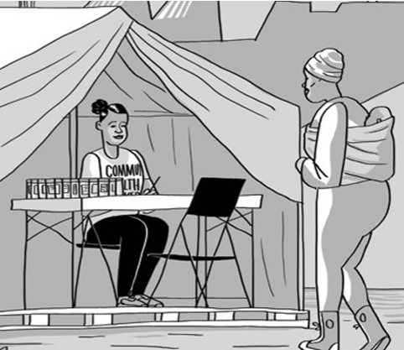
Separate clinical consults and refill-only visits
 | Initiation and early follow up phase (more-intensive) | Maintenance phase
ART/FP | (Re) initiation until enrolment in less-intensive DSD | Less-intensive DSD
 | (Re) initiation/method change and early follow-up
 |  | Refill only building blocks | Clinical consultation building blocks
Separation enables fast lane/community models by lay providers
Notes:
You will have noted that every time I spoke about the building blocks – I spoke about clinical reviews and refill only-visits. The building blocks – the WHEN,WHERE, WHO and WHAT can be different to enable less intensive care.
We should only require clinical reviews when absolutely necessary. For ART management, these are either 6 or 12 monthly depending on the country. Where ART refill length is shorter, it is important to separate out refill-only collections. For example 6-monthly clinical reviews with 3MMD.
Similarly for family planning, where oral contraception refill length permitted by policy only allows 1-3MMD, these can be collected at an easier, quicker location from a lay provider, with the service package limited to checking in and distributing the refill.

Slide 21
Entry into DSD for clients established on ART and family planning
Review family planning needs and method choice
Does a long- acting or a change to short-acting method simplify access and delivery of family planning in clients chosen ART DSD model?
Same script
LARC linkage or aligned refill/administration
At every clinical visit
Assess family planning needs and method choice
Same script
aligned refill/
administration
ART initiation
Provide family planning assessment
Include FP on script
LARC linkage or aligned refill/ administration
Until established on ART
Review family planning needs and method choice
Same script and aligned refills/ administration
At refill only visits (if any)
Aligned refill/ administration
Initiation and early follow-up phase
Maintenance/continuation phase
Notes:
Returning to our client’s ART pathway – once we reach the maintenance phase, clinical reviews require a combined ART and FP management review, scripting for the same period with aligned refill/injection administration dates.
Combined refill/injection only visits within the same DSD model

Slide 22
Important considerations for FP integration into ART DSD
 | Initial phase and early follow-up |  | Maintenance phase
Method choice | ART (re) initiation | Clinical consults | DSD enrolment | Less-intensive DSD clinical consults
Long –acting (LARC) | Always offer and facilitate insertion/administration (consider linkage component). Remind client simplifies less-intensive DSD models and can be reversed.
Short-acting: | Review 1-3 months after method initiation |  | Utilize longest FP scripting period and MMD/number units allowed in FP policy at least same as ART, can be longer. If shorter period than ART refill length allowed, same script length with more frequent FP refill only collection in DSD model
Oral | Align with next required ART clinical consult: Same script and refill length
Injectable SC* | Offer, demonstrate, and align with an ART clinical review 3 months later
Injectable IM | Administer and align ART clinical follow-up with next administration 2-3 months later using IM timing flexibilities |  | Remind method choice will increase intensity of model, offer method change or consider facility-based DSD models if no community-based IM options. Align ART refills with injectable timing.
Notes:
Specific consideration for less-intensive integrated DSD clinical consultations – see the blue text
None for LARC
For short-acting:
For oral and sub-cut injectable: Utilize the longest FP scripting period and MMD/number units allowed in FP policy at least the same as ART.
If shorter period than ART refill length allowed, provide same script length with more frequent refill/unit only collection in DSD model
For IM injectable: Remind the client, method choice will increase intensity of model, offer method change or consider facility-based DSD models if no community-based IM options
Align ART refills with injectable timing

Slide 23
Example 1: Facility-based 6MMD with LARC
Less-intensive DSD maintenance phase: LARC
ART DSD enrolment
M6
ART clinical review
M12
ART clinical review
FP needs and method review
Script ART 6MMS +
ART 6MMD
Actively link and follow-up LARC insertion/ administration
FP check-in
FP needs and method review
Script ART 6MMS +
ART 6MMD
Script ART 6MMS +
ART 6MMD
Notes:
I now want to take you very briefly through 3 examples of combining different contraception methods into DSD models. I will go quickly but you can look at these in more detail by accessing the presentation.
This first model shows combining LARC into facility-based 6MMD with no separation of clinical consults and ART refills as both are required 6-monthly.
You will note in red the important of linking to LARC insertion, the FP check-in at 6-months and the full FP needs and method review annually.

Slide 24
Example 2: Facility-based 6MMD with Sayana Press (DMPA-SC)
Less-intensive DSD maintenance phase: Self-injectable (Sayana Press)
M6
ART clinical review
M12
ART Clinical review
ART DSD enrolment
FP need and method review
FP check-in
FP needs and method review
self-inject at home
Combined script 6MMS
+ ART 6MMD
+ 2 units of Sayana Press
self-inject at home
Combined script 6MMS
+ ART 6MMD
+ 2 units of Sayana Press
Combined script 6MMS
+ ART 6MMD
+ 2 units of Sayana Press
Notes:
This example shows combining sub-cut injectable contraception into a facility-based 6MMD model, now common in CQUIN countries.
Again look at the red text, every 6 months at the clinical review both ART and contraception will be scripted for 6 months with 2 units of Sayana press dispensed. The first for immediate administration and the second for home administration 3 months later.

Slide 25
Example 3: Community-based 3MMD ART and 3MMD oral contraception
Less-intensive DSD maintenance phase: Oral FP refill
M3
Refill only visit
M6
ART clinical review
M9
Refill only visit
M12
ART Clinical review
ART DSD enrolment
FP need and method review
FP needs and method review
FP check-in
Combined script 6MMS
+ ART & FP 3MMD
ART & FP 3MMD
Can be community location
By CHW
Combined script 6MMS
+ ART & FP 3MMD
ART & FP 3MMD
Can be community location
By CHW
Combined script 6MMS
+ ART & FP 3MMD
Notes:
This last example combines oral contraception with community-based 3MMD ART.
Every 6-months at the combined clinical review ART and oral contraception is scripted at the facility, the first 3 months is immediately collected and the remaining 3-month refill can then be collected from a DSD model located in the community from a lay provider.

Slide 26
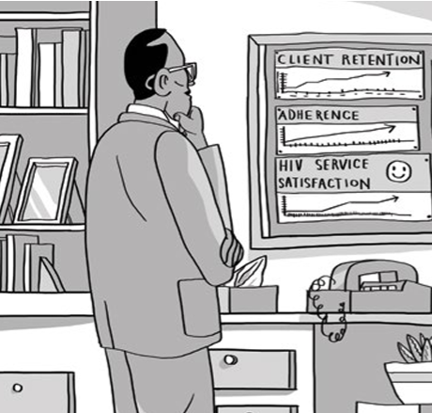
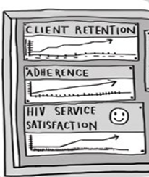
Thank You!
Couple protection rate
+
Unplanned pregnancies
Service delivery
Notes:
So that’s a wrap, thanks for listening. Lets work together, recognise both programmes service delivery evolutions and strengths, to make integrated DSD a reality for women living with HIV. Thank you.

